Slide 1
Why USSR didn’t annex
Finland
Or turn it into satelite state

Slide 2
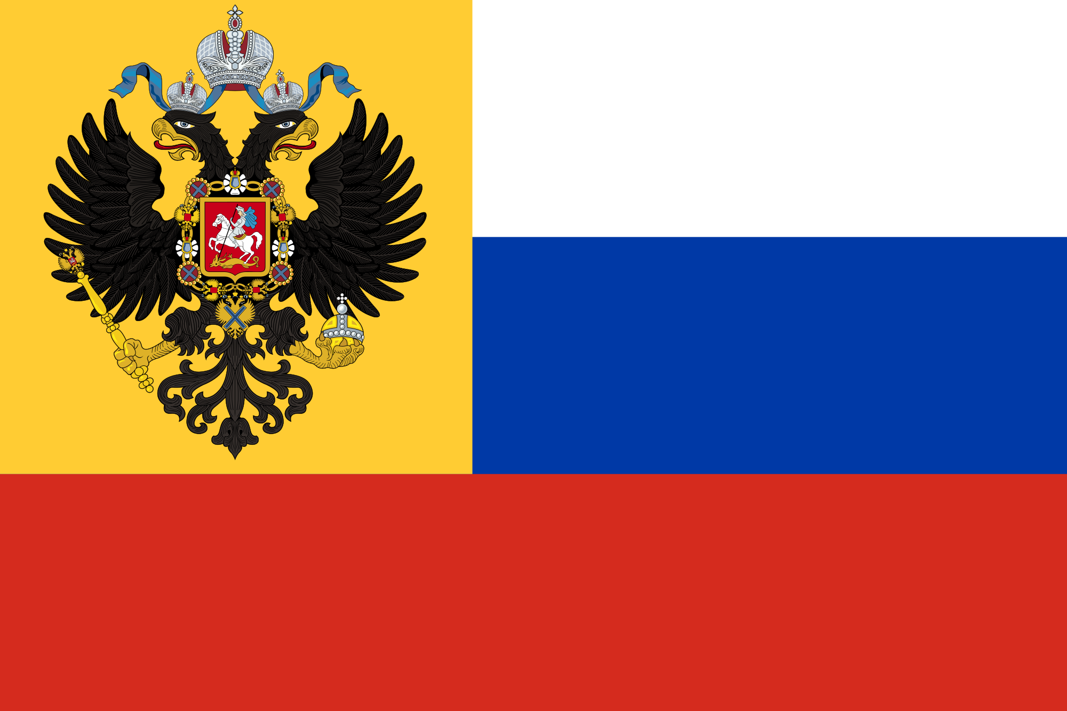
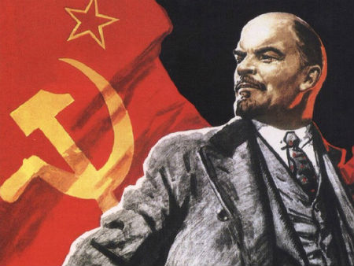

Finnish Independence (1917)
Russian Empire
Bolshevik Revolution

Slide 3
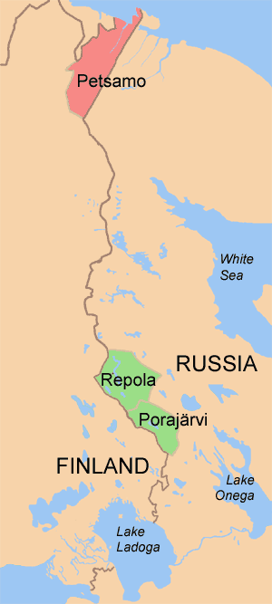
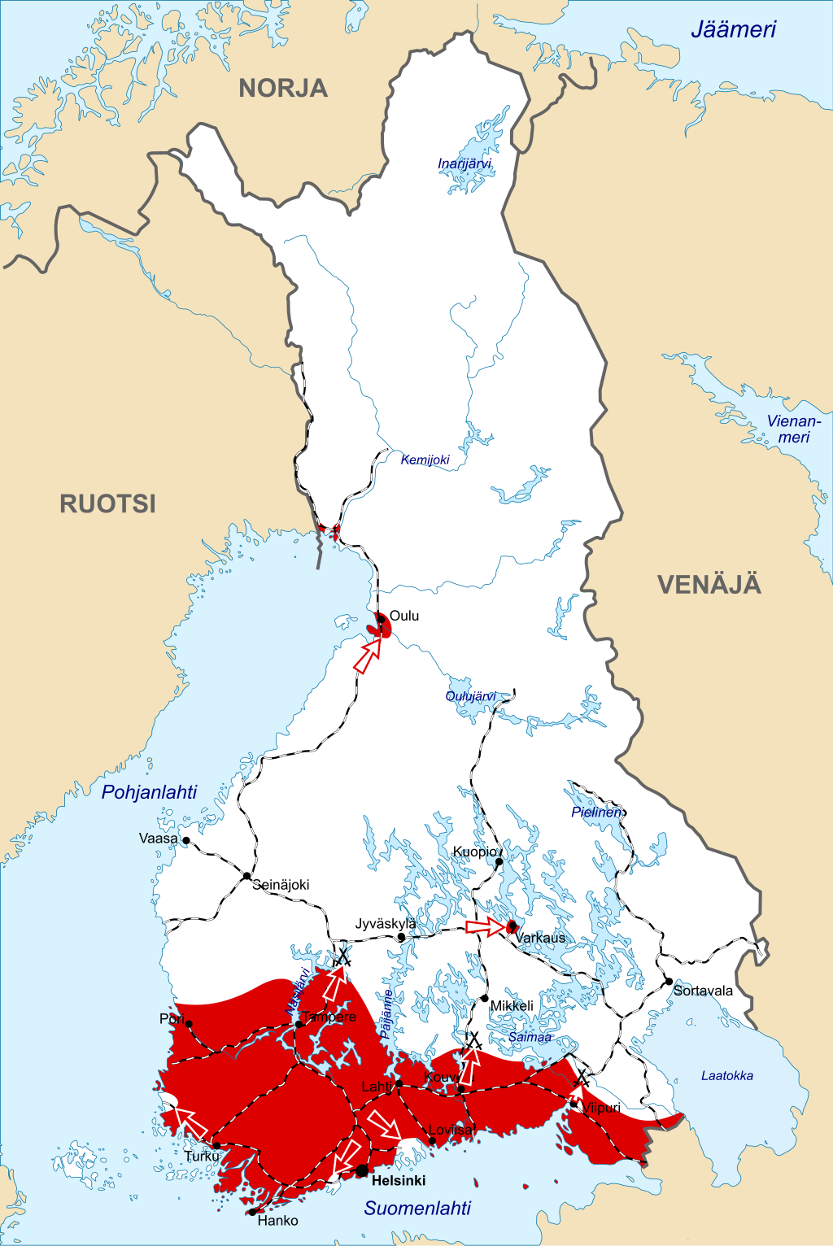
Finnish Civil War (1918)
Whites
Reds
German Support
Finnish Expansion (1920)

Slide 4
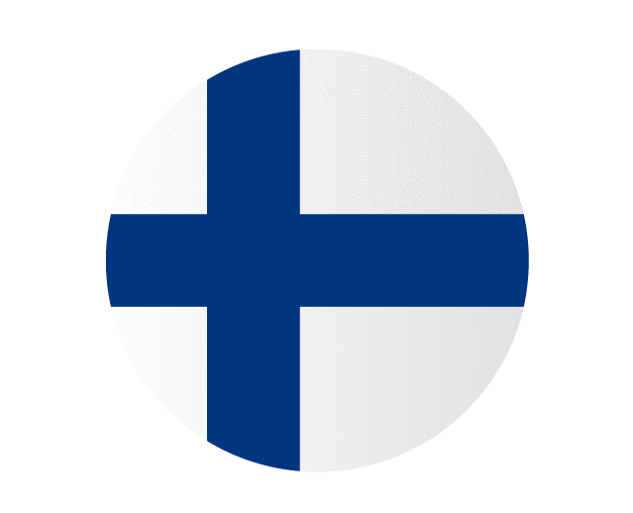
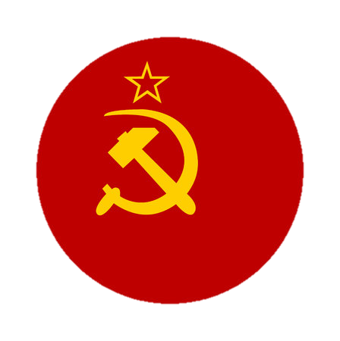
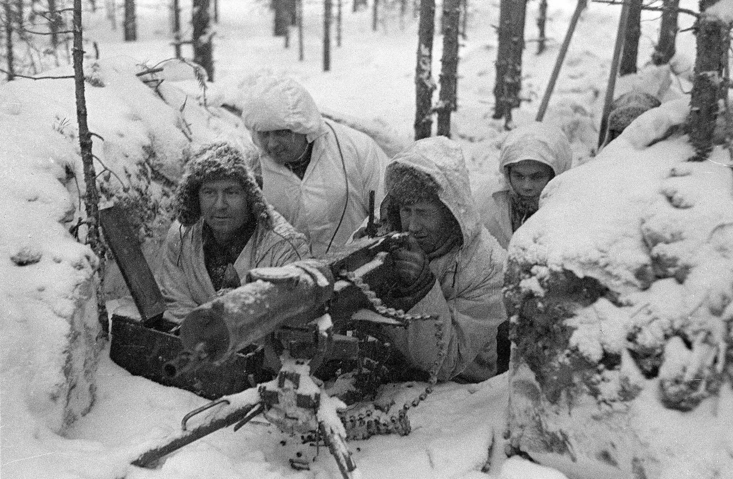
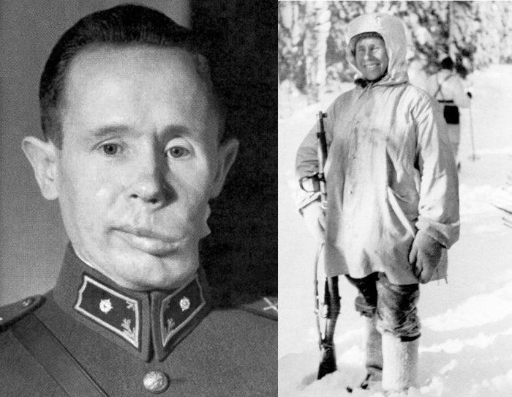
Winter War (1939)
Finland
Soviet Union
vs
Simo Häyhä

Slide 5
Operation Barbarosa
Continuation War

Slide 6
Finland Post War
No Annex?
War not over
Finnish Leaders Trialed
Defeat
Sweden
Unban of Communist party

Slide 7
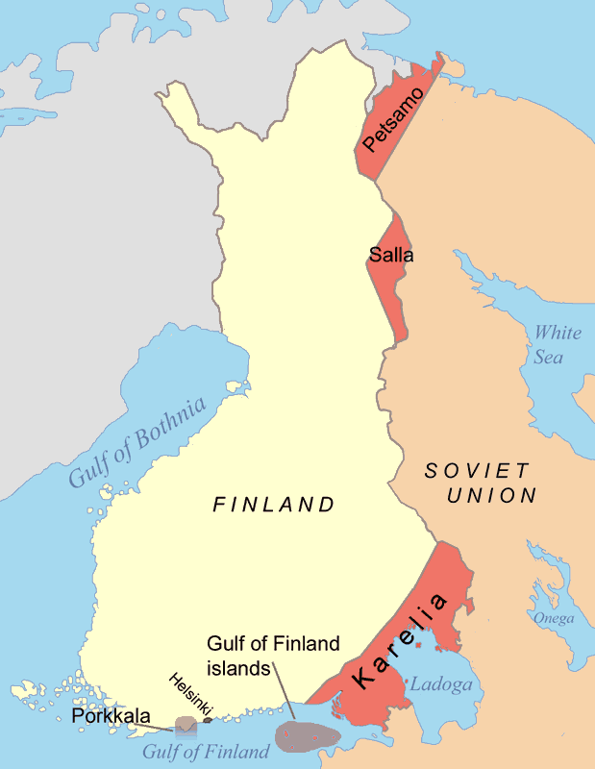

Slide 8



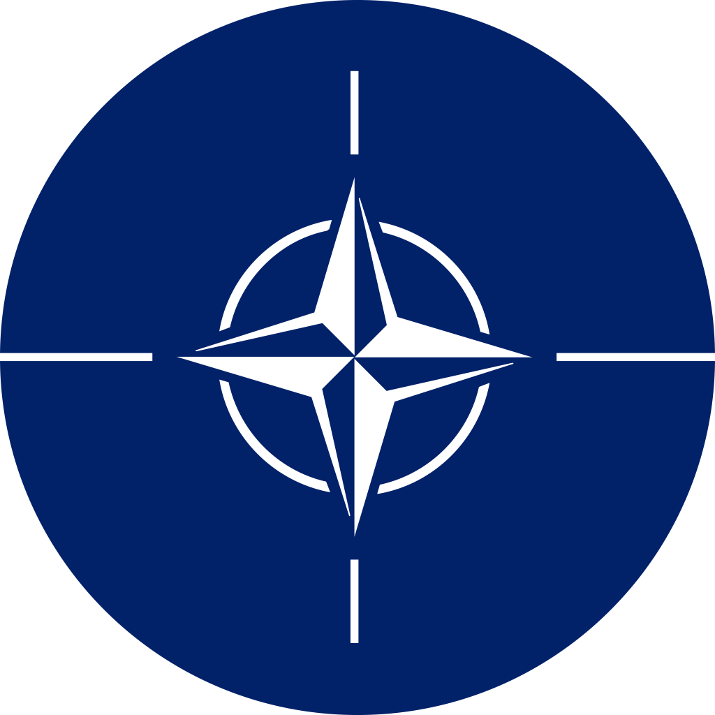
Friendship Treaty (1948)
“Neutrality”
Guarantee of independence
Conditionally
Finlandasation
No NATO
No Warsaw Pact
Jupiter is the biggest planet of them all
Neptune is the farthest planet from the Sun

Slide 9
Thanks!
Do you have any questions?

