Slide 1
Information Visualization How to Guide D3
John Rene Lorelli
Fall 2020

Slide 2

What is D3.js?
D3.js is a Javascript library
It creates interactive data visualizations for web pages (front-end)
It basically takes advantage of HTML, CSS, and SVG to create visuals

Slide 3
Getting Started
Is it hard? How much programming do I need to know?
D3 is not as hard as it looks.
You will need some understanding of HTML and CSS and minimal Javascript.
It's not hard to follow along.
What will I need to follow along or try it?
Text editor: Atom , Notepad ++, Codepen.io
I use Atom

Slide 4
Big Challenge
Figuring out what data you want to visualize, and then figuring out what's the best way to visualize it.

Slide 5
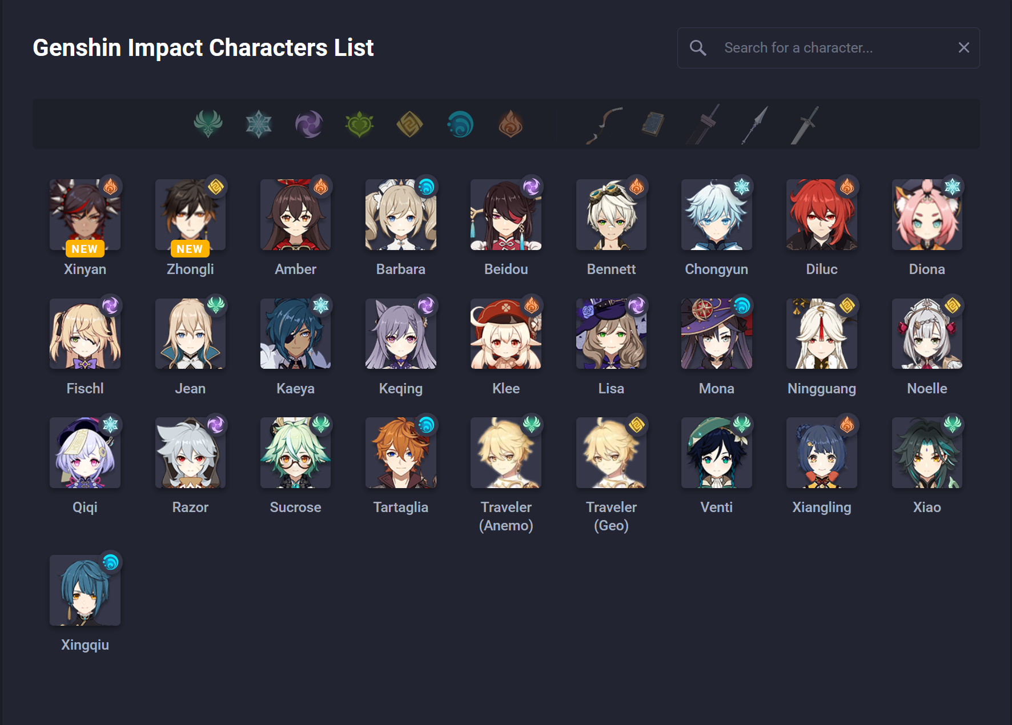
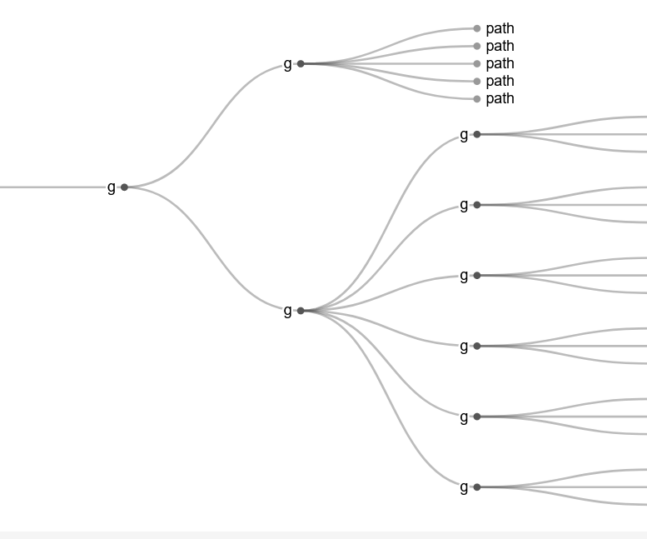
My Data and Visual
My data was going to be on characters and their elements from the video game Genshin Impact
I wanted to visualize them in a animated hierarchy tree.

Slide 6
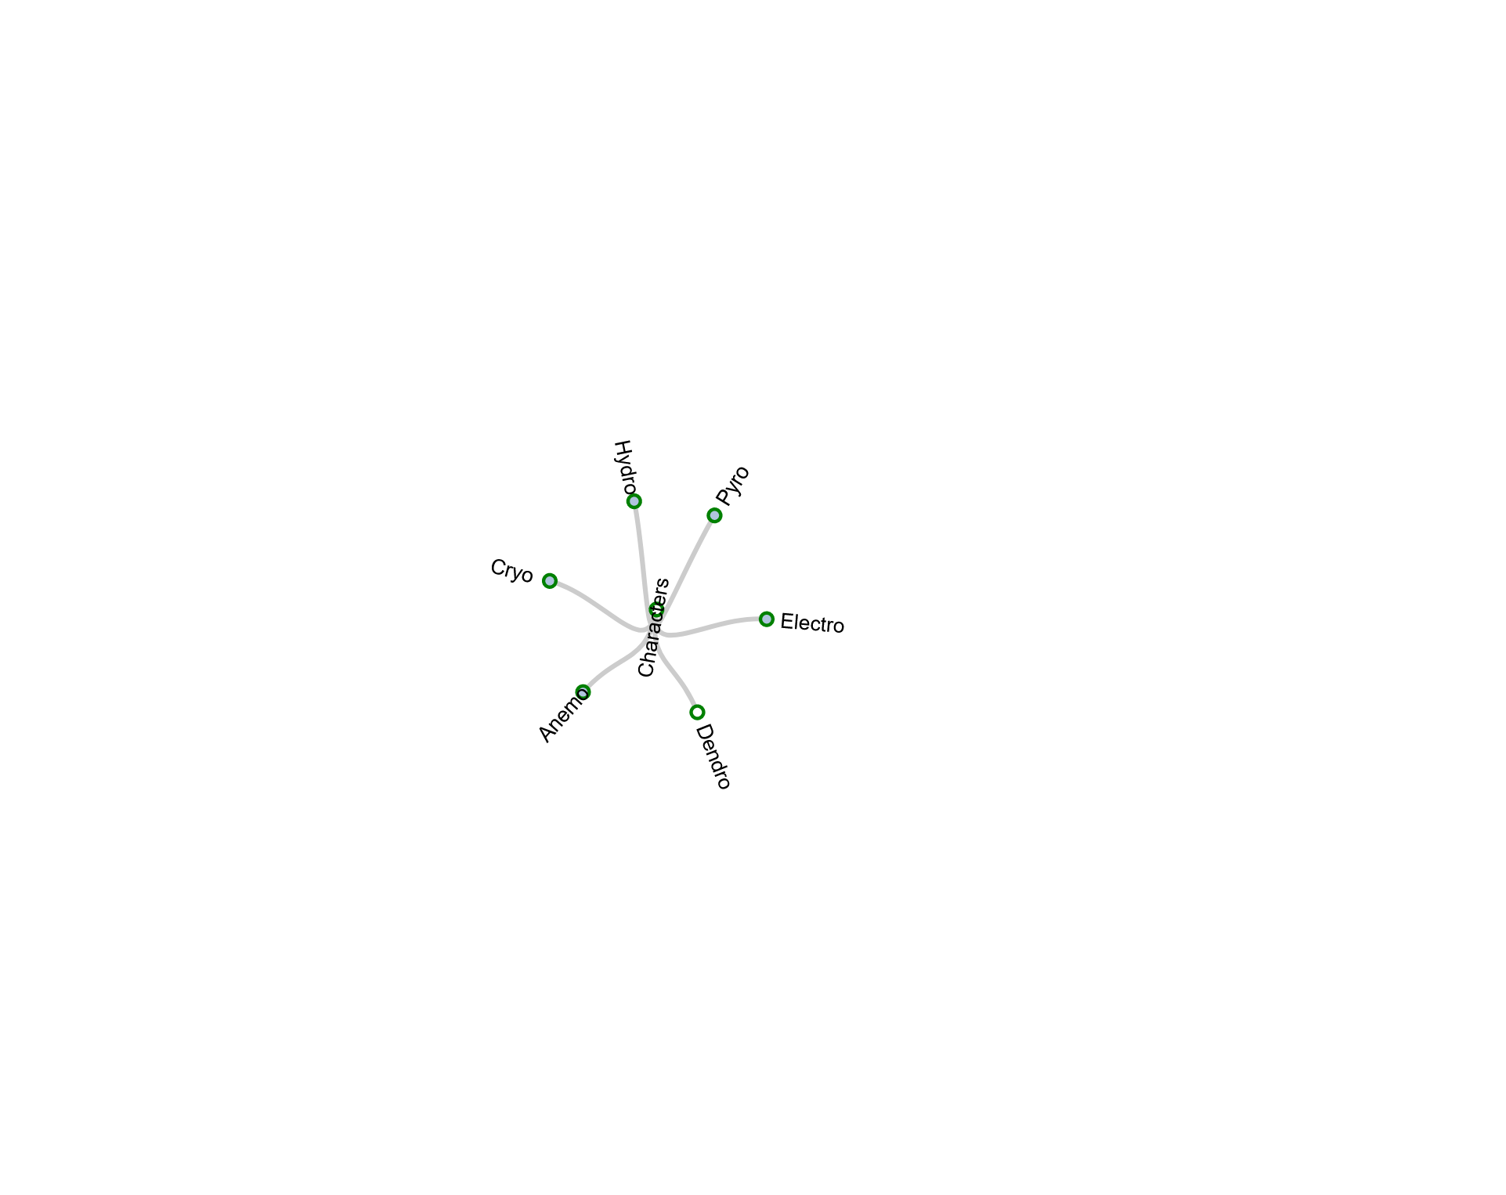
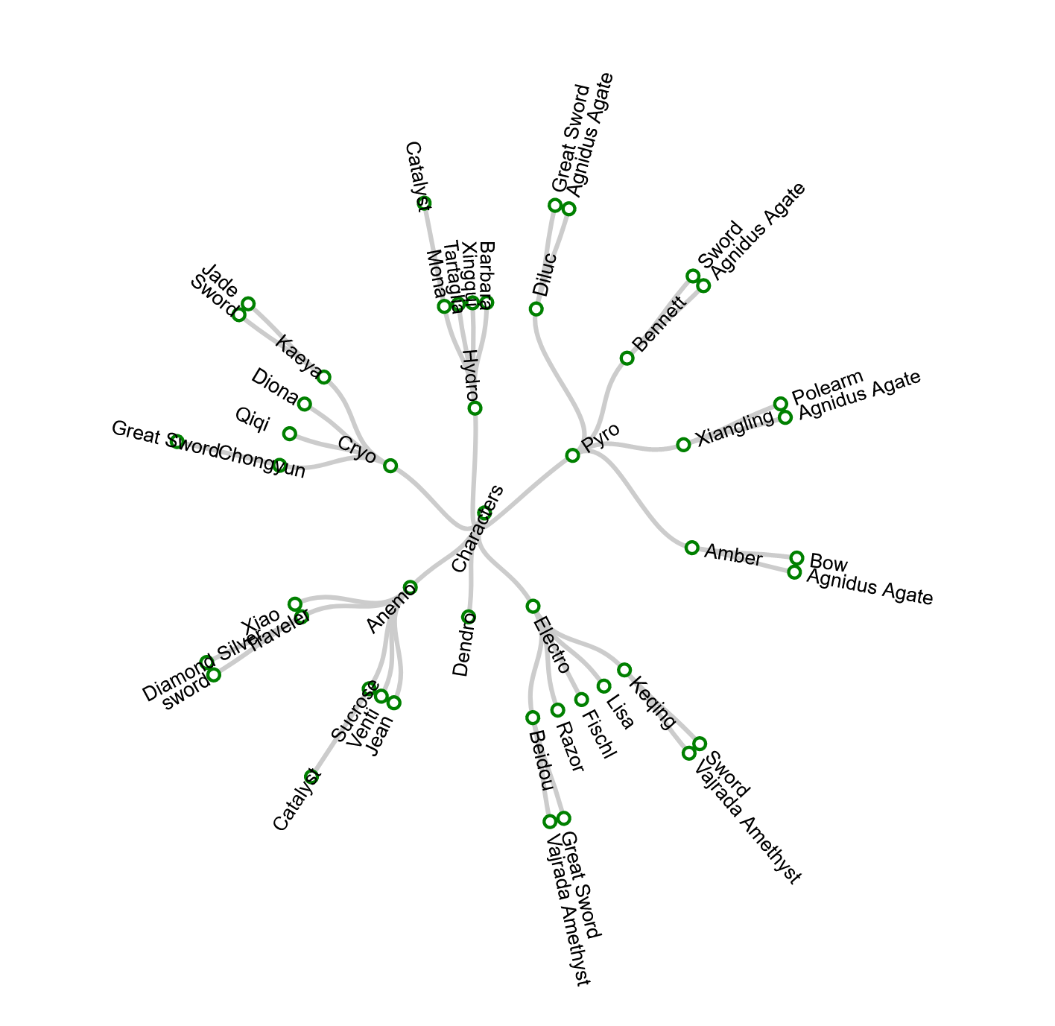
Final Result

Slide 7

Final Result Video

Slide 8
How To Video: D3 Animated Tree
This is a video of how I did it

Slide 9
The Beginning Process
Created: Index page
Stylesheet
Js page
Linked D3 library from d3js.org

Slide 10
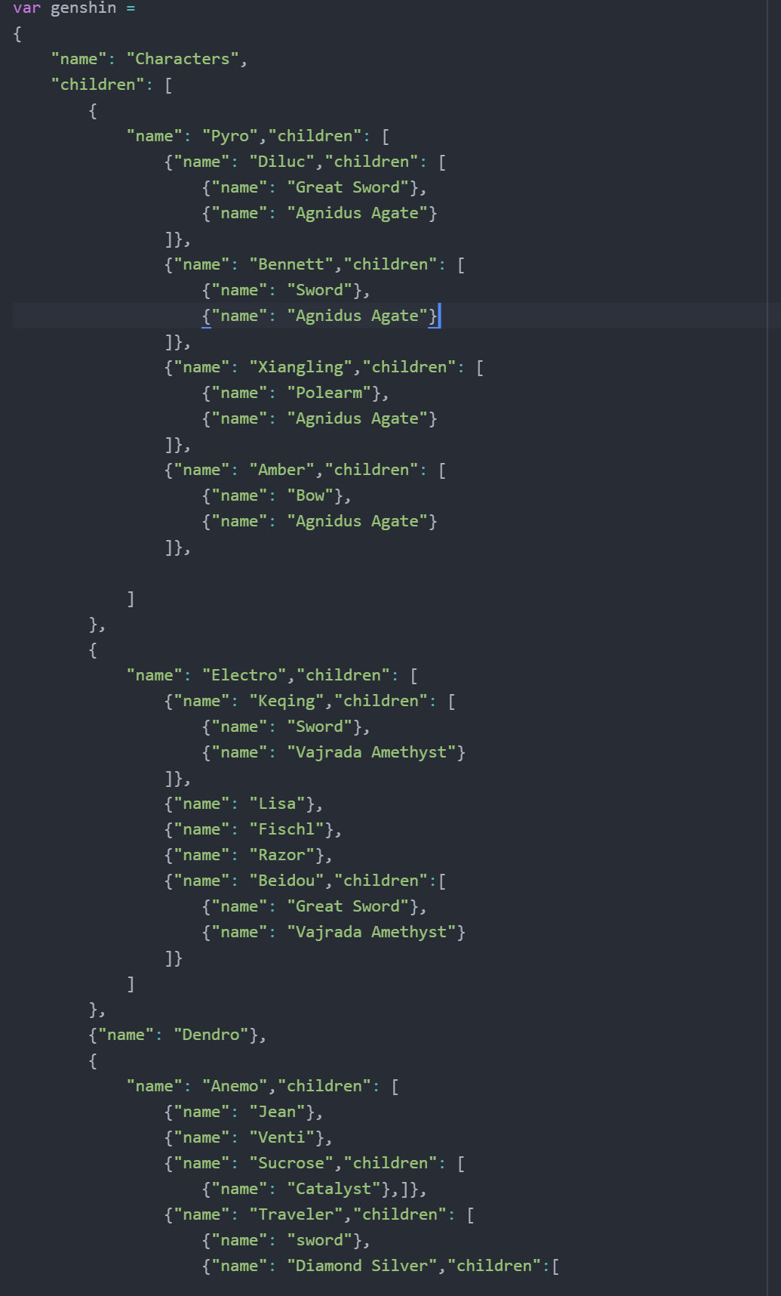
The Data Variable
Stored all my data in a variable
Note: storing the data in a json or csv is recommended.

Slide 11
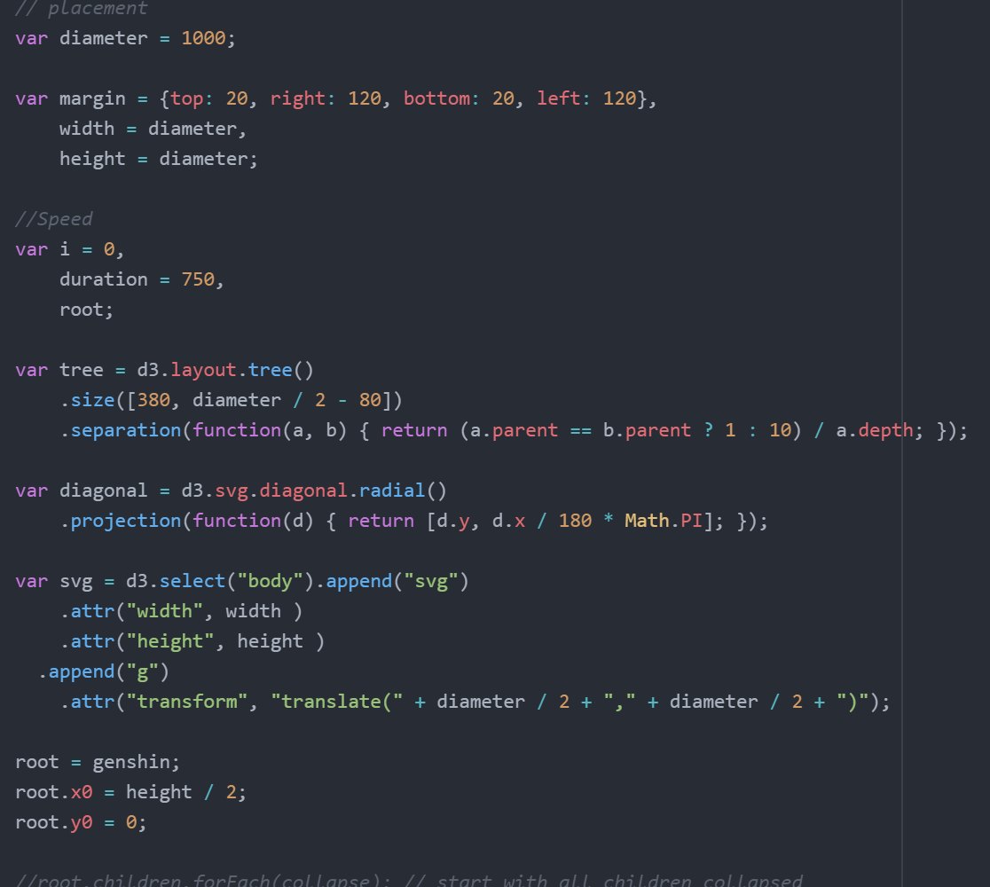
Placing, Speed, D3 library Tree
Here I start laying the foundation
Trying to determine where the tree will go
Speed of movement of tree
Calling the shapes for tree and start how it functions

Slide 12
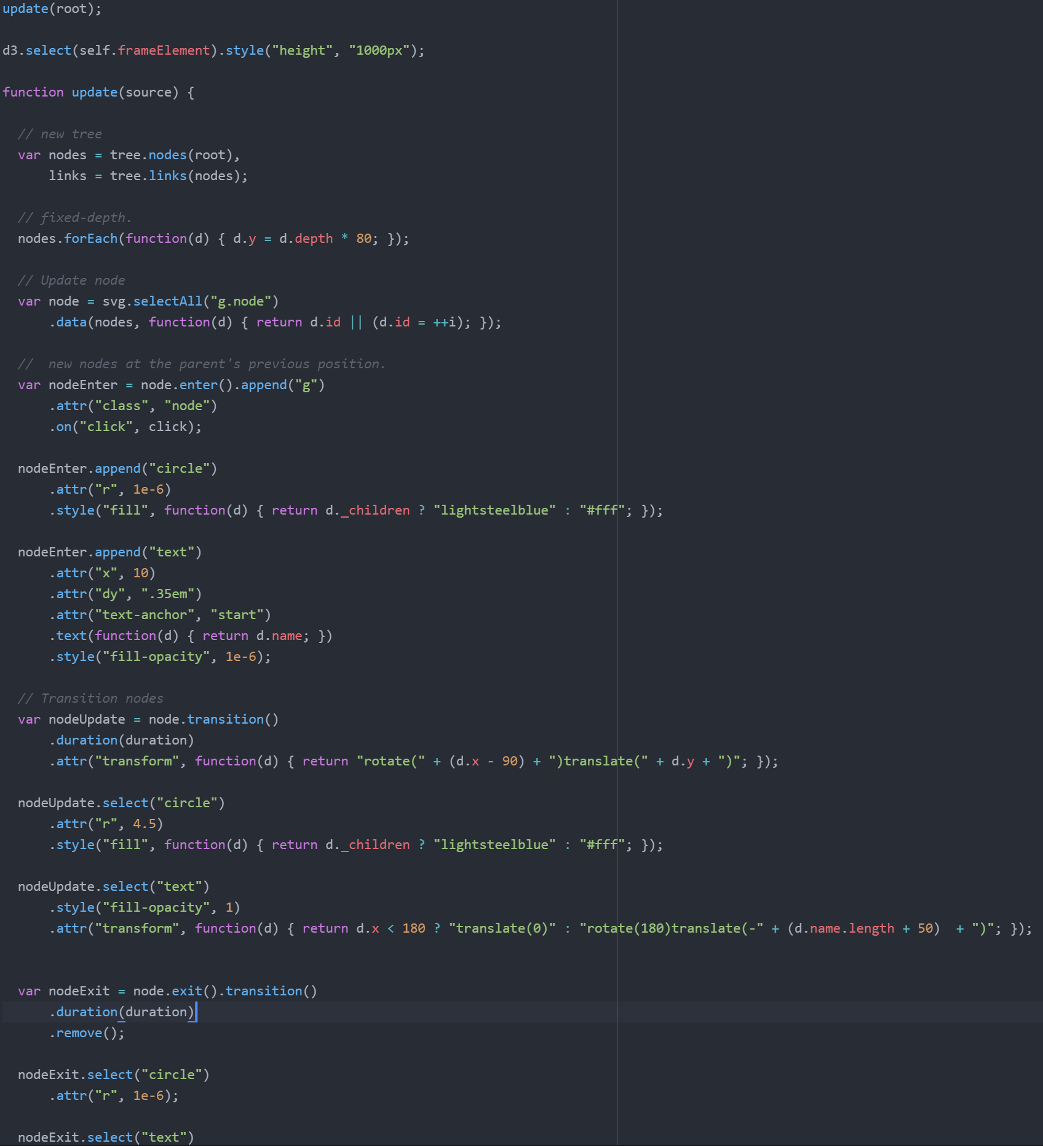
Setting up how node will work
Here I define how the nodes will work
Need define how they will work, update, and transition.

Slide 13
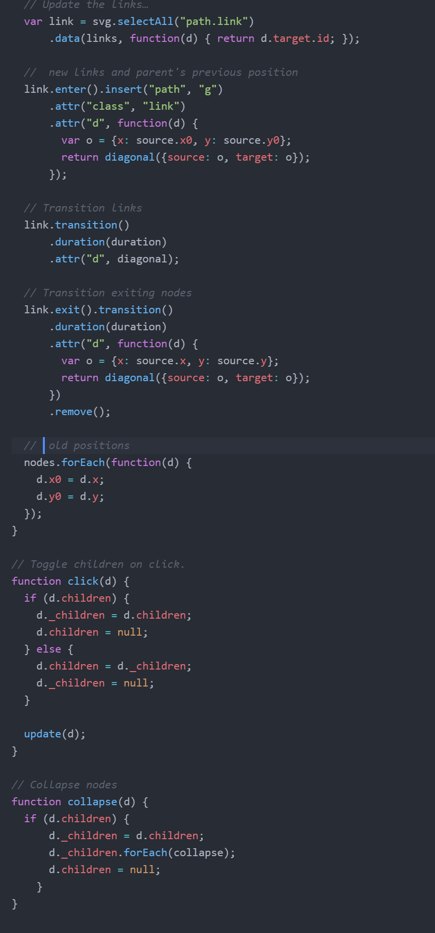
Setting up links and functions
Like nodes I needed to parameters for the links
I needed to focus on the parameters for the transition movement.
This proved difficult to get to work smooth
Finally need function on what happens when clicks and collapsed

Slide 14
Thank you for following along!

