Slide 1
Netflix TV Shows and Movies
John Rene Lorelli
Fall 2020
Problem Solving w/ Data

Slide 2

Final Project
For this final project I used Kaggle.
I became interested in looking at data for streaming services specifically Netflix.
Problem Looking to Solve:
Do I keep Netflixs or cancel my subscription? I currently have too many subs and wish to downgrade on the amount of 5. My main type of of watching entertainment is TV shows, and I am not a big movie person.

Slide 3
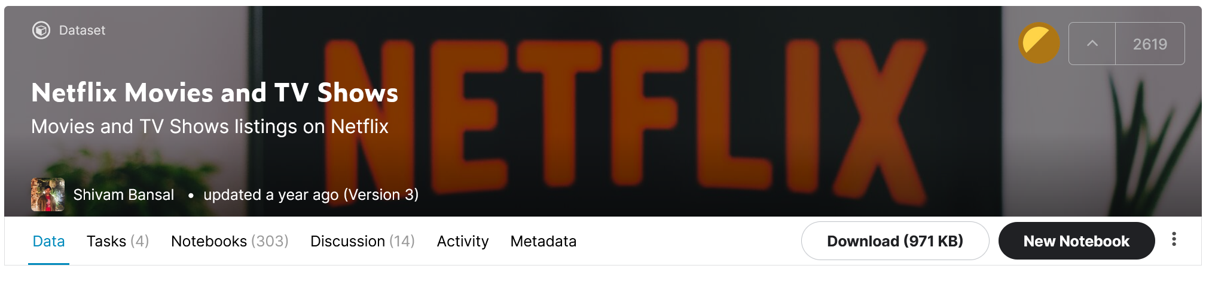
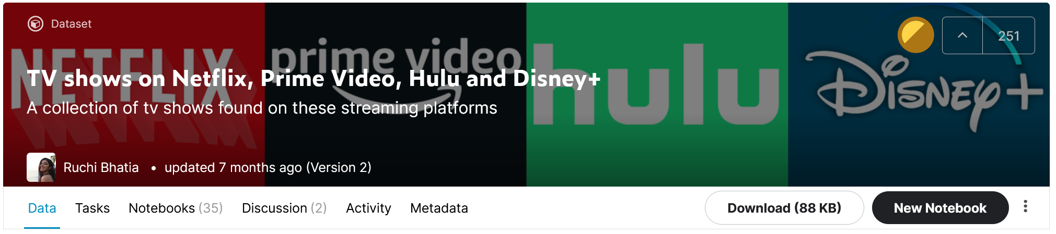
Datasets

Slide 4

NETFLIX
1997 Netflix started as a mail in DVD rentals
1999 The Netflix subscription service debuts. The subscription offered unlimited DVD rentals with no dues, late fees, or limits.
2002 Netflix makes its initial public offering (IPO), at a selling price of $1 a share under the NASDAQ
2016 Netflix expands to 130 new countries
2017 Membership hits 100 million members globally
Image from netflix.com
information source: https://about.netflix.com/en

Slide 5
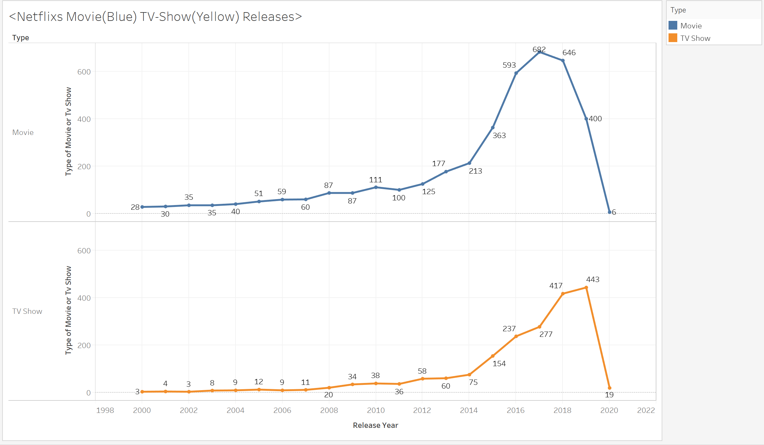
Netflix TV Show and Movie Release Rates

Slide 6
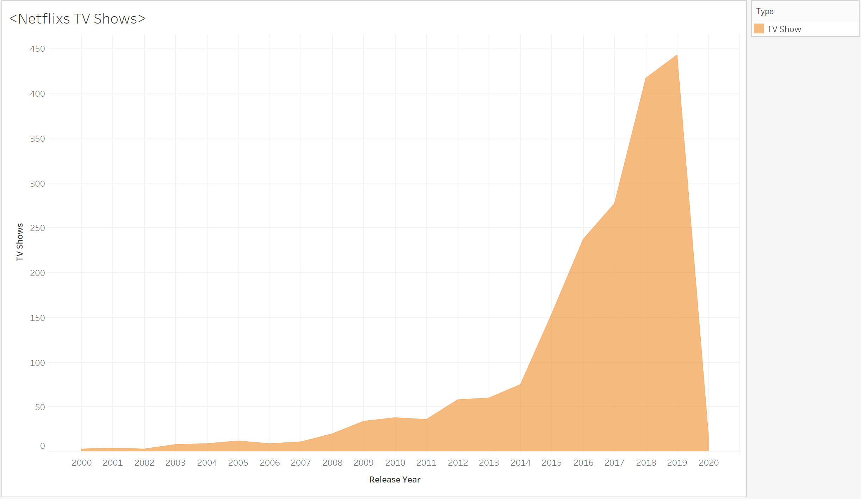
Netflix TV Shows
Before 2019, Netflix was very movie heavy, but that changed in 2019.
Netflix switched gears and focuses on TV shows.
2019 TV shows released 443
Movies released 400
2018 - 2019 Movies went from 646 to 400 compared to TV went from 417 - 443

Slide 7
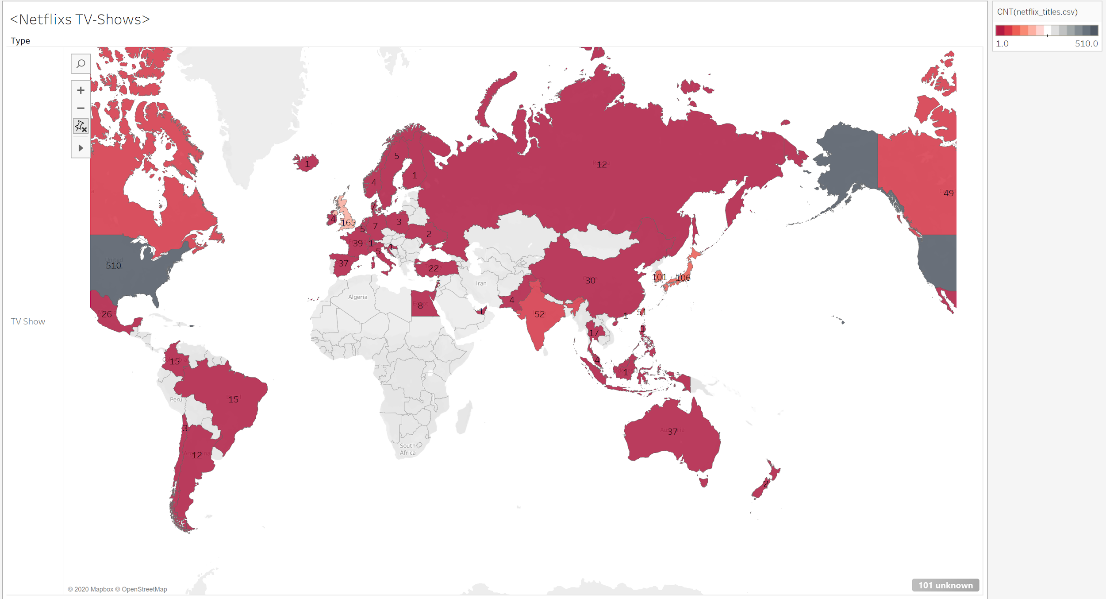
Netflix TV Show Release by Countries

Slide 8
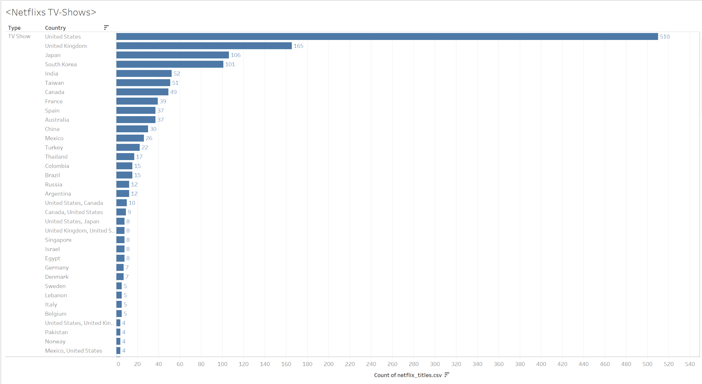
Netflix TV Show Release by Countries
Show Releases by Countries
US
UK
Japan
South Korea
I expected more releases from other countries like Japan and South Korea
The rise of anime and k-dramas in US has been talked about a lot so figured they would buy/license of that content

Slide 9
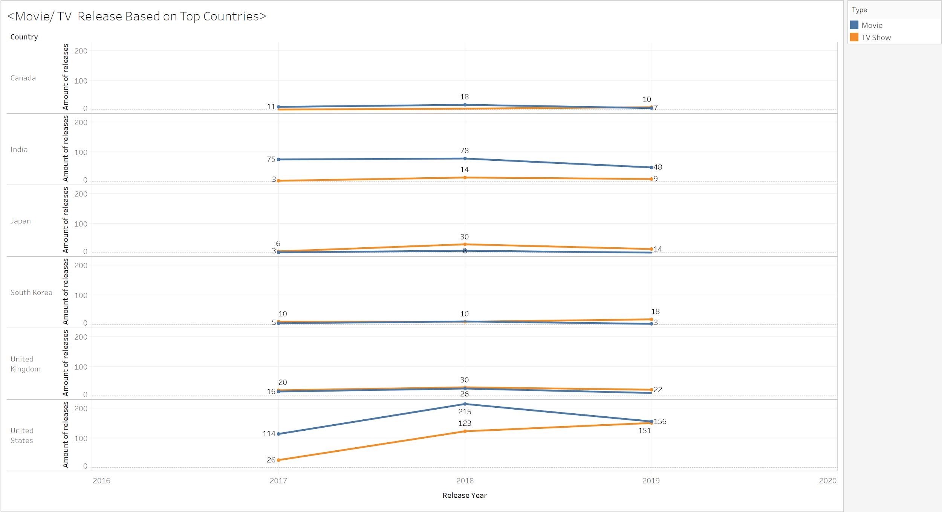
TV / Movie Release Comparison by Top Countries

Slide 10
TV / Movie Release Comparison by Top Countries
From 2017- 2019 the data seems to suggest that Netflix is slowly starting to focuses on release TV shows.
India is the only country where movies seem to be focused on more.
The gap started to close for United States around 2019
Japan’s releases focus on TV shows.
I thought South Korea data would be closer to Japan, but instead for South Korea movies and tv-shows were neck and neck.

Slide 11
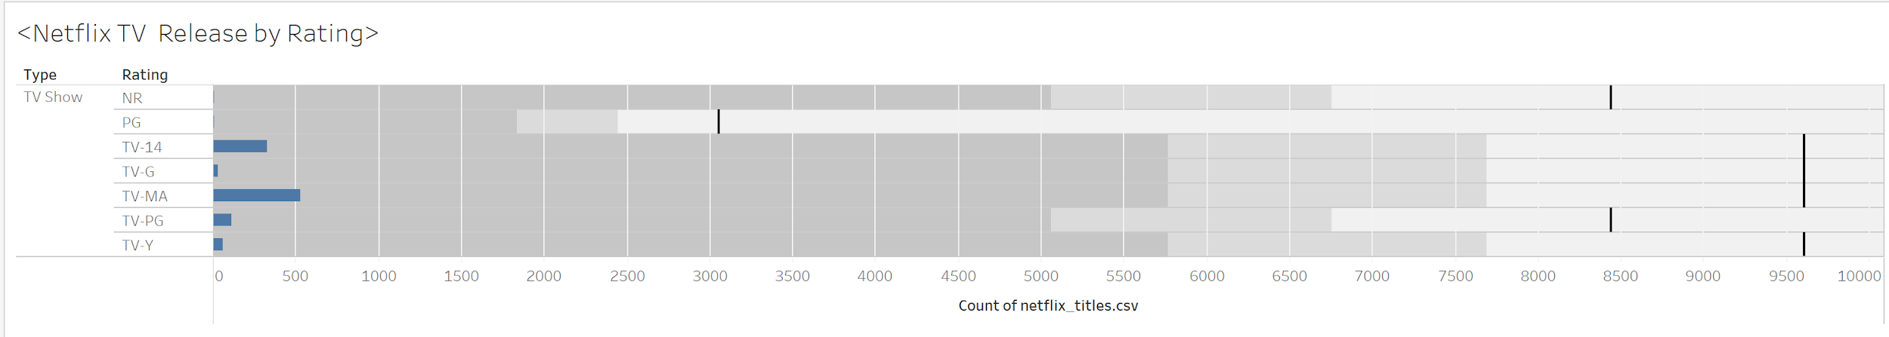
Netflix Release by Rating
2017 - 2020
Most common release ratings for TV shows on Netflix is TV-MA and TV-14
I was surprised at how little PG and G release were. It seems Netflix is not concerned with children/younger tv at the moment or they do not see the value in it.

Slide 12
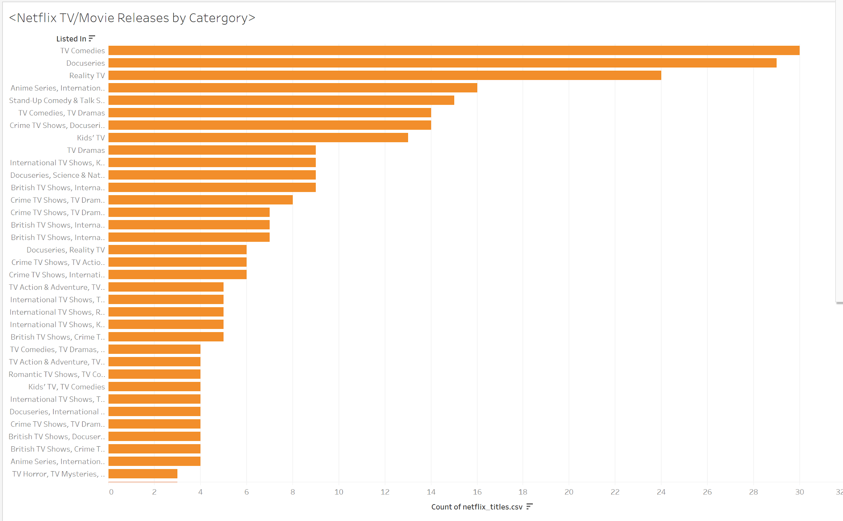
NETFLIX RELEASES BY GENRE
Top Genres
TV Comedies
Docuseries
Reality TV
I really thought crime would be higher on this chart.
I never see reality tv on my netflix, so I assume that's hidden content for me.

Slide 13
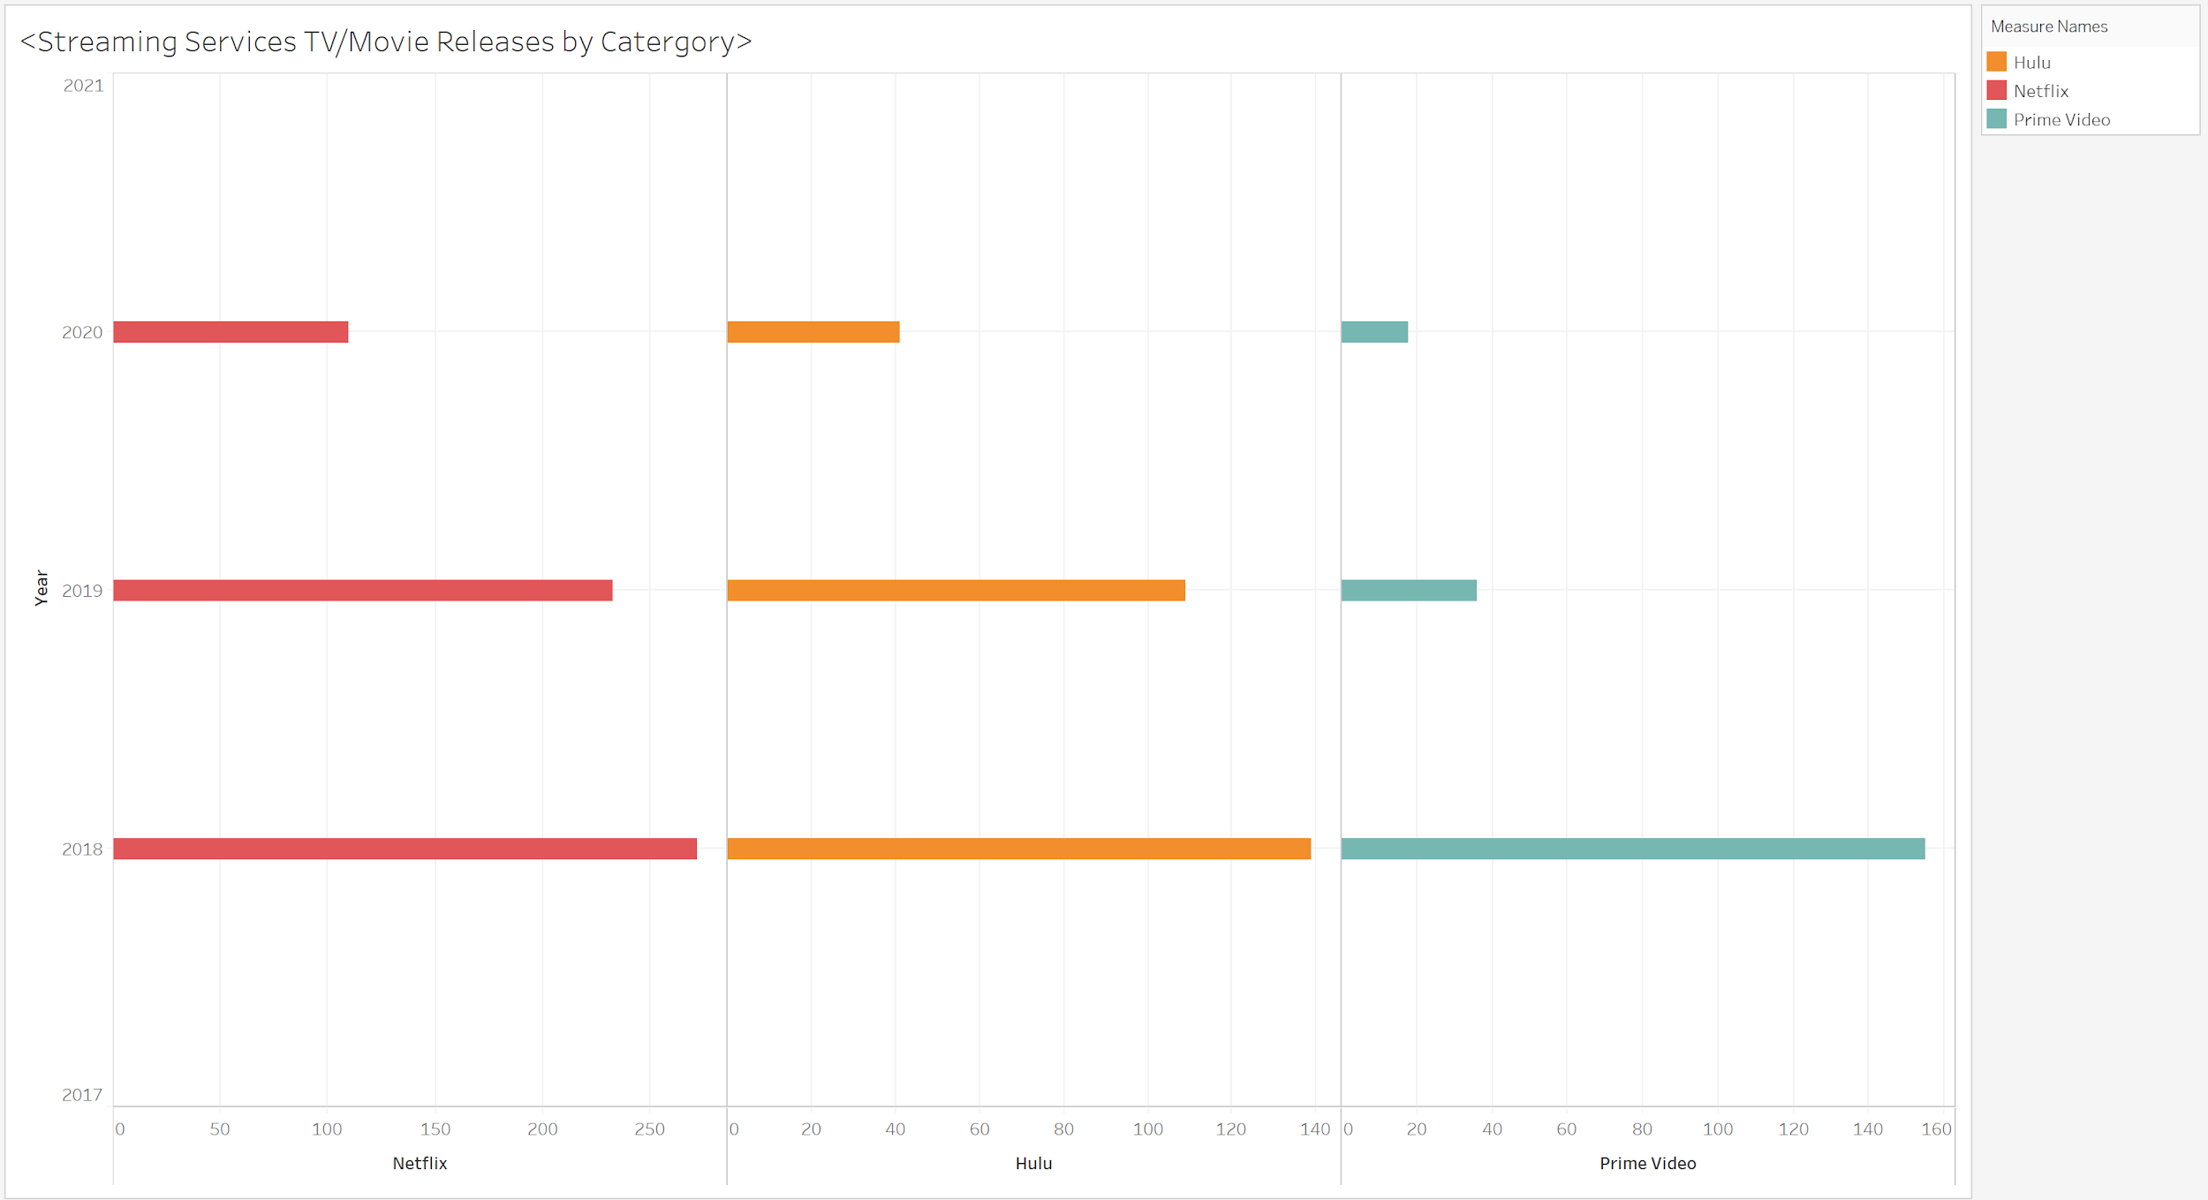
TV Show Releases Compared Streaming Services
Netflix released more TV shows compared to Hulu and Prime
2019 Netflix release 109 more shows than Hulu
2018 Prime beat Hulu for second place but than drastically decreased for 2019

Slide 14
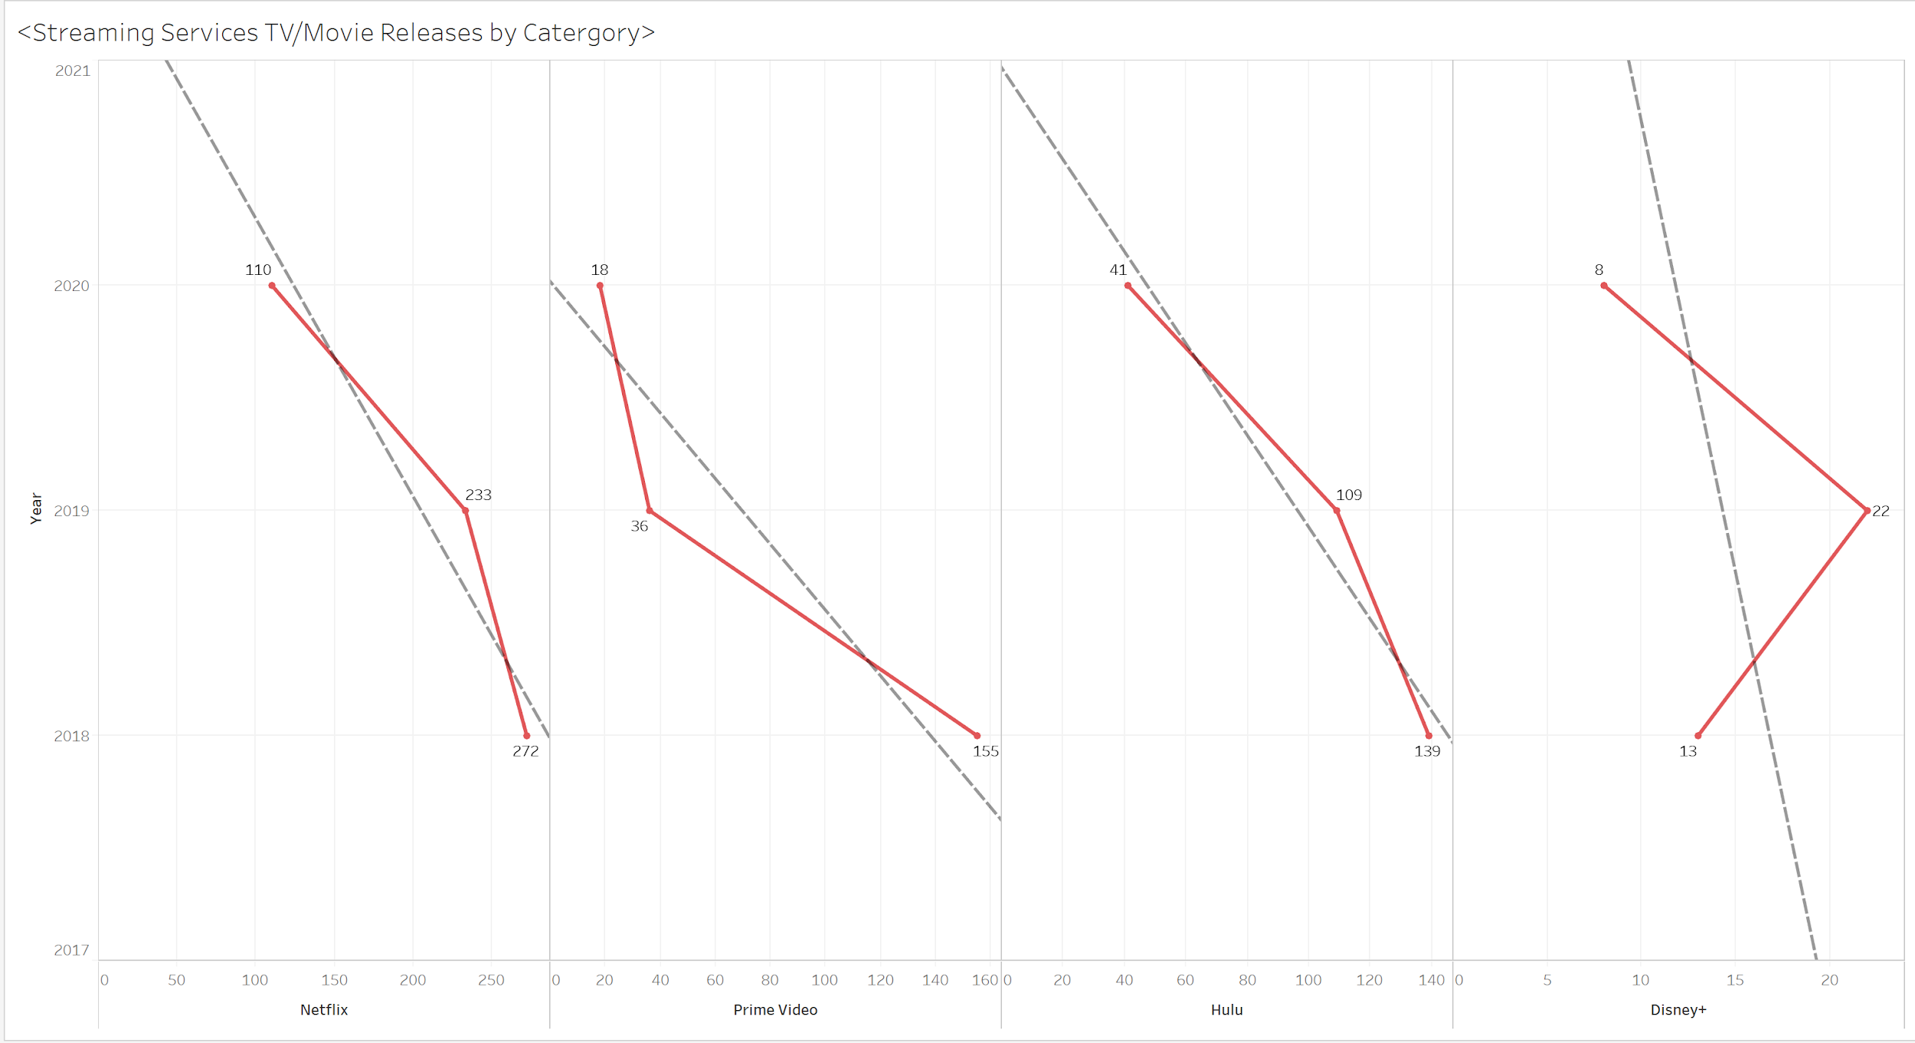
Stream Services Comparisons

Slide 15
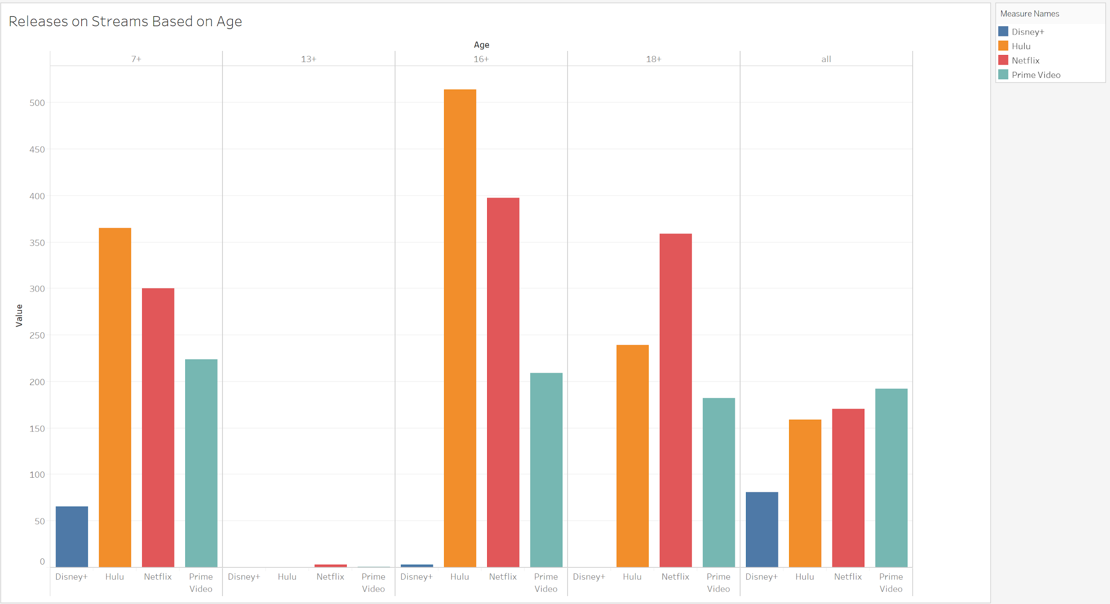
Age Content on Streams
Netflix and Hulu produce the most content for 16+ and 18+
Hulu focuses on more content for 16+
Netflix focuses on 18+ content audiences.

Slide 16
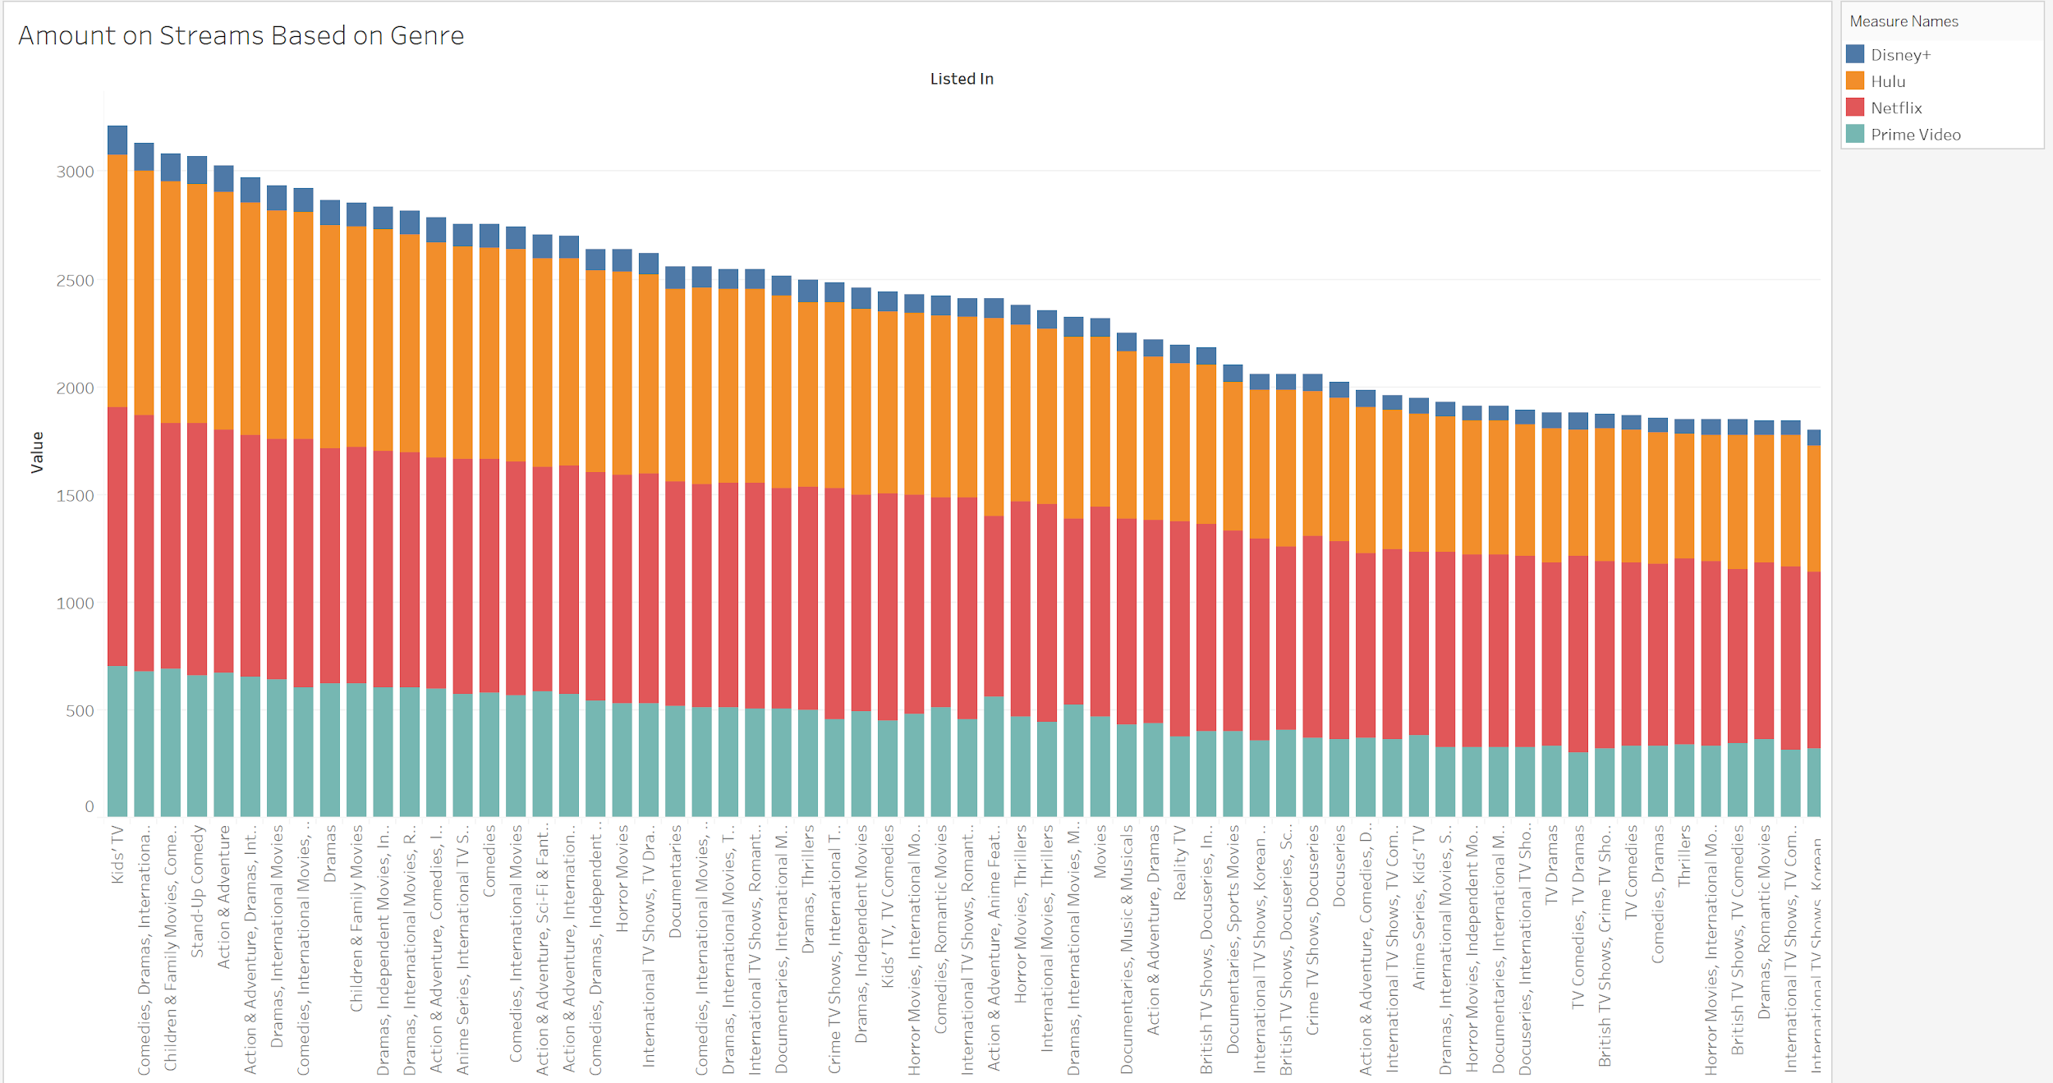
Streams and Genre

Slide 17

Year 2020 Releases
2020 showed the least release results and this was most likely due to COVID-19
Many productions were put on hold over all the world.
For some of the plots I did exclude 2020 for this reason.
Image from fda.gov

Slide 18
Conclusion
After looking at all the data, I decided that Netflix is worth keeping.
Netflix seem to be putting more TV shows up as the years increase.
Hulu holds value and is a solid 2nd in TV show releases.
I am glad Prime shipping comes with Prime Video, because I do not see the value in it.
Disney + needs to release more content or they will become obsolete. (Hopefully more marvel and star wars shows.)
Thank you

