Slide 1
FH OÖ HAGENBERG · CIV4
COMPUTER VISION
THERMAL DETECTION & MULTI-OBJECT TRACKING
BAMBI Wildlife Tracking
Multi-object tracking on aerial thermal drone footage — plus a reproducible YOLO26 + RF-DETR detection stack on the same data.
By Yasin · Ghaderian · Danjuma · Buinitskii
BOXMOT · YOLO26 · RF-DETR · MLFLOW
Notes:
Welcome. Our project benchmarks and improves multi-object tracking for aerial thermal wildlife monitoring on the BAMBI dataset, and builds a reproducible detection-training stack on the same data. Team: Yasin, Ghaderian, Danjuma, Buinitskii.

Slide 2
01
/
THE PITCH
Two parallel problems, one dataset.
01
Tracking
02
Detection
Given boxes, how well can we keep a stable identity on each animal across a thermal video?
Can we produce those boxes automatically with a trained thermal detector?
NOTEBOOKS 06 – 07 · BOXMOT
DETECTION_MODELS/ · MLOPS
BAMBI WILDLIFE MOT
FH OÖ HAGENBERG · CIV4
Notes:
One dataset, two parallel problems. Tracking: given boxes, how well can we keep a stable identity on each animal across a thermal video? Detection: can we produce those boxes automatically with a trained thermal detector? Notebooks 06-07 handle tracking; the detection_models stack handles detection.

Slide 3
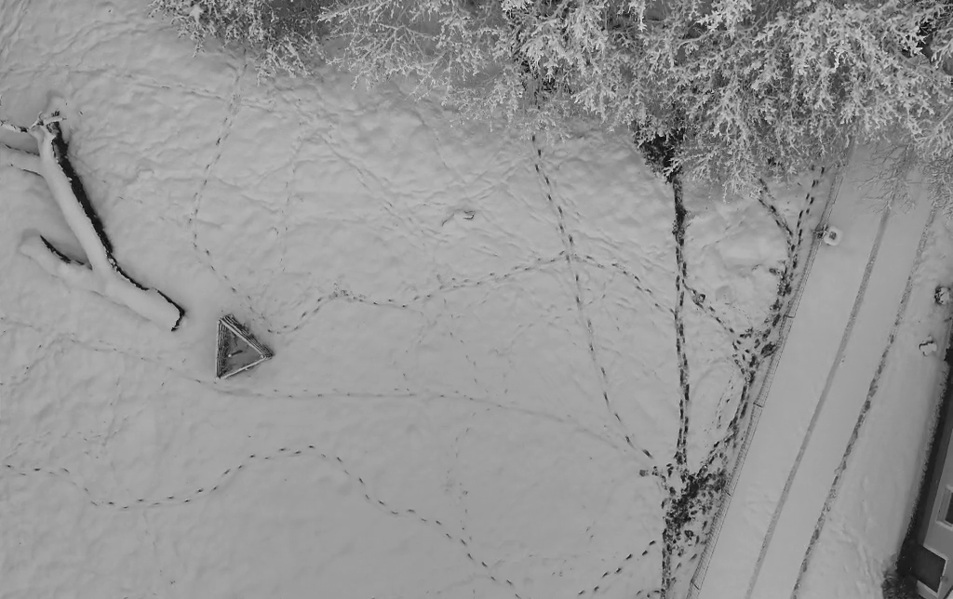
02
/
THE CHALLENGE
Why thermal wildlife tracking is hard
No color, no texture
Color-histogram Re-ID is useless on a grayscale heat blob — association falls back on motion, shape & deep features.
Thermal flicker & camouflage
Heat signatures fluctuate and blend into sun-warmed soil, so detections flicker in and out and tracks die.
Severe class imbalance
Wild Boar dominates; far fewer Roe / Red Deer across different body shapes.
Tiny, top-down targets
Nadir UAV perspective means small, low-detail objects.
A BAMBI thermal frame with a ground-truth box — note the low contrast and the single small target, bottom-center.
BAMBI WILDLIFE MOT
FH OÖ HAGENBERG · CIV4
Notes:
Thermal aerial footage breaks most assumptions RGB trackers rely on. No color or texture, so classic Re-ID color histograms are useless. Thermal flickering and camouflage make detections blink in and out. Severe class imbalance — Wild Boar dominates. And tiny top-down targets with little detail.

Slide 4
03
/
THE DATASET
BAMBI, in numbers
21,509
240
1024²
3
FRAMES TRACKED
VIDEO SEQUENCES
RESOLUTION
CLASSES
across 240 sequences
distinct captures
~16 GB raw on disk
boar · red · roe deer
Detection split · 23,829 images
COCO / BAMBI MOT → YOLO
Train · 17,684
Val · 2,868
Test · 3,277
~91% of sampled training frames contain at least one animal box — the rest are intentional background frames so the detector learns to say “nothing here.”
BAMBI WILDLIFE MOT
FH OÖ HAGENBERG · CIV4
Notes:
BAMBI in numbers. The tracking subset is 21,509 frames across 240 video sequences. The detection split is 17,684 train, 2,868 val, 3,277 test images at 1024 by 1024, three classes. Around 91% of sampled training frames contain at least one animal; the rest are intentional background frames so the detector learns to say nothing here.

Slide 5
04
/
METHODOLOGY
THE DECISION · GROUND-TRUTH ISOLATION
To measure pure tracking , bypass the detector entirely.
The benchmark feeds human-verified ground-truth boxes straight into the trackers. A bad MOTA now reflects the tracker's association logic — Kalman prediction, IoU matching, Re-ID — and not a weak upstream detector.
Ground-truth boxes
→
Tracker (BoxMOT)
→
HOTA · MOTA · IDF1
Isolates the one variable we actually study: association.
BAMBI WILDLIFE MOT
FH OÖ HAGENBERG · CIV4
Notes:
The key methodology decision. To measure pure tracking quality, the benchmark deliberately bypasses the detector and feeds human-verified ground-truth boxes straight into the trackers. This cleanly separates the two error sources: a bad MOTA number now reflects the tracker's association logic — Kalman prediction, IoU matching, Re-ID — and not a weak upstream detector.

Slide 6
05
/
THE TRACKERS
Four configurations, one framework
BASELINE
RECOVERY
MOTION-AWARE
WINNER
SORT
ByteTrack
BoT-SORT
BoT-SORT + ReID
Kalman + IoU only.
Also recovers low-confidence detections.
Camera-motion compensation + better matching.
Adds deep appearance features.
Re-ID — none
Re-ID — none
Re-ID — none
Re-ID — OSNet wrapper
BAMBI WILDLIFE MOT
FH OÖ HAGENBERG · CIV4
Notes:
Four configurations, all run through the BoxMOT framework. SORT is the baseline — Kalman plus IoU only. ByteTrack also recovers low-confidence detections. BoT-SORT adds camera-motion compensation and better matching. And BoT-SORT plus ReID adds deep appearance features via our custom OSNet wrapper.

Slide 7
06
/
HIGHLIGHT A · CUSTOM RE-ID
Making deep Re-ID work on 1-channel thermal
Re-ID libraries assume 3-channel RGB and crash on thermal input. Our OSNetReIDWrapper bridges Torchreid's OSNet into BoxMOT.
→
→
→
→
01
02
03
04
05
Intercept patch
Stack pseudo-RGB
Normalize
FP16 CUDA infer
Flatten to CPU
1-channel grayscale numpy
1 → 3 channels
fixed 256 × 128 crop
OSNet embeddings
Float32 for tracker
The piece that makes “appearance-based” tracking even possible on colorless thermal data.
BAMBI WILDLIFE MOT
FH OÖ HAGENBERG · CIV4
Notes:
Implementation highlight A. Deep Re-ID libraries assume 3-channel RGB and crash on single-channel thermal. We wrote an OSNetReIDWrapper to bridge Torchreid's OSNet into BoxMOT: intercept 1-channel patches, stack to pseudo-RGB, normalize to 256x128, run FP16 CUDA inference, and flatten embeddings back to CPU float32. This is what makes appearance-based tracking possible on colorless thermal data.

Slide 8
07
/
HIGHLIGHT B · THE BOUNDARY BUG
One fix, a 9× longer track lifetime
⚠ THE BUG
All 21,509 frames fed as one video
Kalman states and track IDs bled across different captures , corrupting metrics and killing tracks at every scene cut.
✓ THE FIX
MEAN TRACK LIFETIME · BOT-SORT + REID
Reset trackers at every boundary
Parse the filename prefix (get_sequence_id) to group frames into their 240 real sequences.
AFTER
BEFORE
36.3
4.0
→
frames
frames
A ~9× improvement — the single most impactful change in the pipeline.
BAMBI WILDLIFE MOT
FH OÖ HAGENBERG · CIV4
Notes:
Implementation highlight B — the single most impactful engineering change. The bug: all 21,509 frames were initially fed as one continuous video, so Kalman states and track IDs bled across completely different captures, killing tracks at every scene cut. The fix: parse the filename prefix to group frames into their 240 real sequences and reset the trackers at each boundary. Mean track lifetime went from 4.0 to 36.3 frames — a 9x improvement.

Slide 9
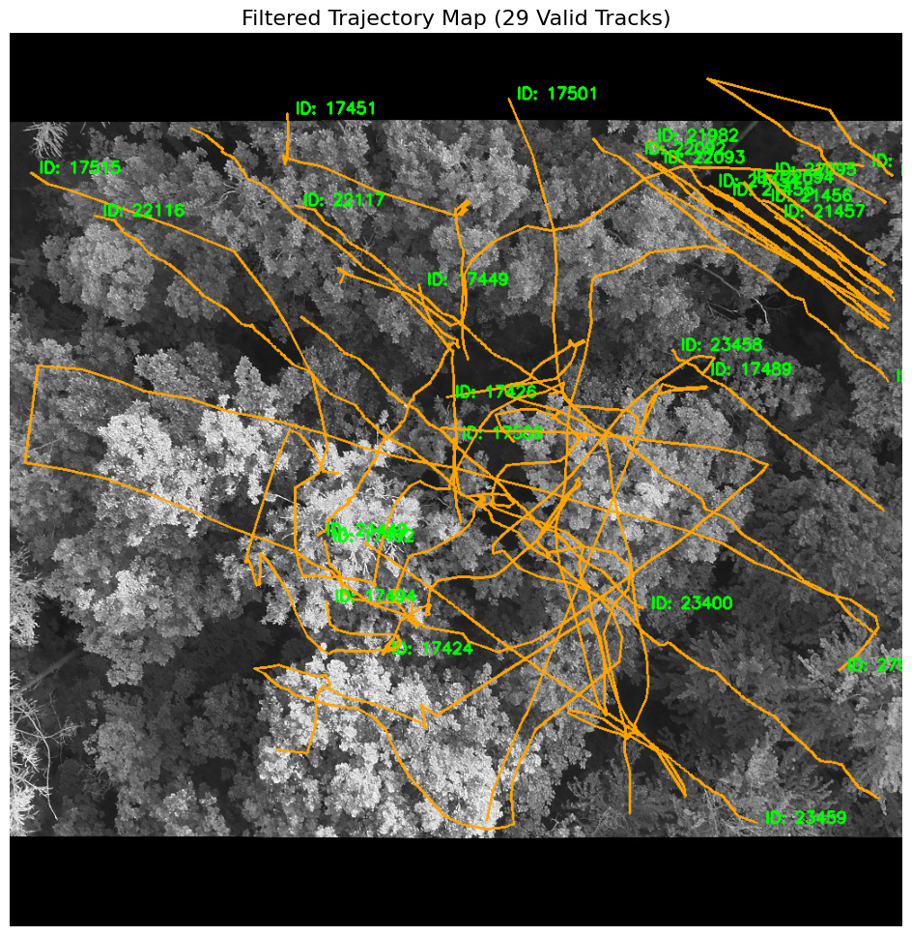
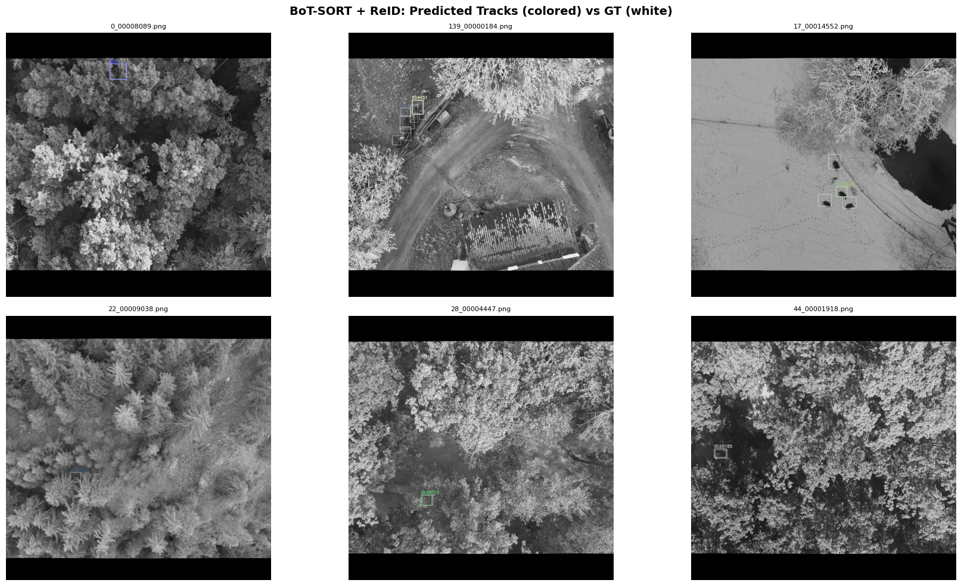
08
/
HIGHLIGHT C · TRAJECTORY MAPPING
From noisy blips to 29 true trajectories
60
29
MIN FRAMES KEPT
LONG-TERM TRACKS
29 filtered long-term trajectories over the master thermal canvas — persistent IDs stamped at each path's end.
Predicted BoT-SORT + ReID boxes (colored by track ID) overlaid on white ground-truth — tight spatial convergence.
BAMBI WILDLIFE MOT
FH OÖ HAGENBERG · CIV4
Notes:
Implementation highlight C. Thermal noise produces blips — micro-tracks from transient hot spots. A diagnostic temporal filter discards any track shorter than 60 consecutive frames, leaving 29 true long-term wildlife trajectories out of hundreds of noisy IDs. These surviving paths are drawn onto a master thermal canvas with OpenCV, and on the right, predicted boxes converge tightly on the white ground-truth boxes.

Slide 10
09
/
TRACKING RESULTS
BoT-SORT + ReID wins on every quality metric
MOTA
IDF1
WINNER
.352
.386
.356
.388
.301
.200
.230
.139
SORT
ByteTrack
BoT-SORT
BoT-SORT + ReID
baseline
Vs. the SORT baseline, the winner more than doubles true positives (11,470 → 29,216) and lifts MOTA ~2.6× (0.139 → 0.356).
Notes:
Tracking results. BoT-SORT + ReID with the sequence fix wins on every quality metric. Compared to the SORT baseline it more than doubles true positives, from 11,470 to 29,216, and lifts MOTA by about 2.6x, from 0.139 to 0.356. The custom bars show MOTA and IDF1 climbing steadily from SORT through ByteTrack and BoT-SORT to the ReID winner.

Slide 11
10
/
READING THE NUMBERS
Lower isn't always better — read carefully
SORT's low ID-switches are deceptive
~4
~32k
FALSE POSITIVES · 21K FRAMES
FALSE NEGATIVES · EVEN THE BEST
It has few switches only because it dropped most tracks entirely . BoT-SORT's higher IDSW is the price of actually maintaining tracks across textureless frames.
BoT-SORT keeps false positives near zero while maximizing true positives — it is precise, not trigger-happy.
The stubborn FN floor across all trackers is the honest signature of thermal flicker. The ceiling is set by detection — which motivates the next layer.
BAMBI WILDLIFE MOT
FH OÖ HAGENBERG · CIV4
Notes:
A key talking point: read the numbers carefully. SORT's low ID-switch count is deceptive — it has few switches only because it dropped most tracks entirely. BoT-SORT's higher IDSW is the price of actually maintaining tracks across thousands of textureless frames. BoT-SORT keeps false positives near zero, about 4 across 21k frames. And the stubbornly high false-negative count across all trackers — about 32k even for the best — is the honest signature of how hard thermal flickering is. The ceiling is set by detection.

Slide 12
11
/
DETECTION · MLOPS
An opinionated, reproducible harness
One uv environment
Persistent MLflow
Zero-copy views
All four models share it, torch pinned to CUDA 12.4 wheels — the GPU build is reproducible.
Dockerized at :5000. Two experiments kept separate — detection vs. bench — surviving restarts.
The ~16 GB image set is never copied — whole-directory & per-file symlinks satisfy each layout.
Two resolutions
OOM is recorded
Fault-tolerant queue
640 (fast) and 1024 (full detail), both ÷32. Every model timed at both to isolate resolution.
Each model runs in its own process; a CUDA OOM is logged as a status, never crashing the run.
train_all.sh reports a failure but keeps the queue running.
BAMBI WILDLIFE MOT
FH OÖ HAGENBERG · CIV4
Notes:
The detection stack is a small but opinionated MLOps setup. One joined uv virtual environment shared by all four models, torch pinned to CUDA 12.4 wheels for reproducibility. Dockerized persistent MLflow with two separate experiments. Zero-copy dataset views via symlinks — the 16 GB image set is never copied. Two resolutions, 640 and 1024, benchmarked and trained. OOM is recorded not fatal, each model in its own process. And train_all is a fault-tolerant queue.

Slide 13
12
/
SPEED BENCHMARK
Plan the compute before the run
RTX 4070 · 1 epoch / 500-img subset → extrapolated
Model
Params
Res
img/s
Peak VRAM
1 epoch
50 epochs
yolo26-s fastest
10.0 M
640
32.67
9.13 GB
9.0 min
7.52 h
yolo26-s
10.0 M
1024
26.09
9.64 GB
11.3 min
9.41 h
yolo26-l
26.3 M
640
27.97
8.87 GB
10.5 min
8.78 h
yolo26-l
26.3 M
1024
14.51
9.74 GB
20.3 min
16.93 h
rf-detr-s
32.1 M
640
16.28
12.17 GB
18.1 min
15.09 h
rf-detr-l
33.9 M
640
15.02
11.29 GB
19.6 min
16.35 h
rf-detr-l slowest
33.9 M
1024
8.17
8.36 GB
36.1 min
30.06 h
▸ YOLO26-s @640 is ~4× faster than RF-DETR-L @1024; going 640 → 1024 roughly doubles the cost for every architecture.
Notes:
Detector speed benchmark on an RTX 4070, one epoch on a 500-image subset, extrapolated to the full epoch. YOLO26-s at 640 is about 4x faster than RF-DETR-L at 1024 and uses the least memory — the obvious choice for fast iteration. Going 640 to 1024 roughly doubles the cost for every architecture. RF-DETR's DINOv2 backbone is memory-hungry, which is why batch sizes are tuned per model to fit the 12 GB card.

Slide 14
13
/
DETECTOR ACCURACY
Each lever adds accuracy on the last
MAP@50 · VALIDATION
YOLO26-s · 640
0.071
+50%
Bigger model
YOLO26 s → l @640 (0.071 → 0.107)
YOLO26-l · 640
0.107
+25%
Higher resolution
YOLO26-l 640 → 1024 (0.107 → 0.134)
YOLO26-l · 1024
0.134
RF-DETR-l · 1024
0.186
+39%
Architecture
RF-DETR-L @1024 — best overall (0.186)
But all scores are low — even the best mAP@50 sits under 0.2. This is the detection bottleneck that sets the ~32k false-negative floor seen in tracking.
Notes:
Detector accuracy — four models trained to convergence, probing two axes: model size and input resolution, with RF-DETR-L adding a transformer DINOv2 architecture. Bigger model helps: YOLO26 s to l at 640 lifts mAP50 by 50%. Higher resolution helps: 640 to 1024 lifts it 25%. Architecture helps most: RF-DETR-L at 1024 is the best overall at 0.186, plus 39% over the best YOLO. But all scores are low — even the best sits under 0.2. Thermal aerial detection is genuinely hard, and this is the detection bottleneck that sets the 32k false-negative floor.

Slide 15
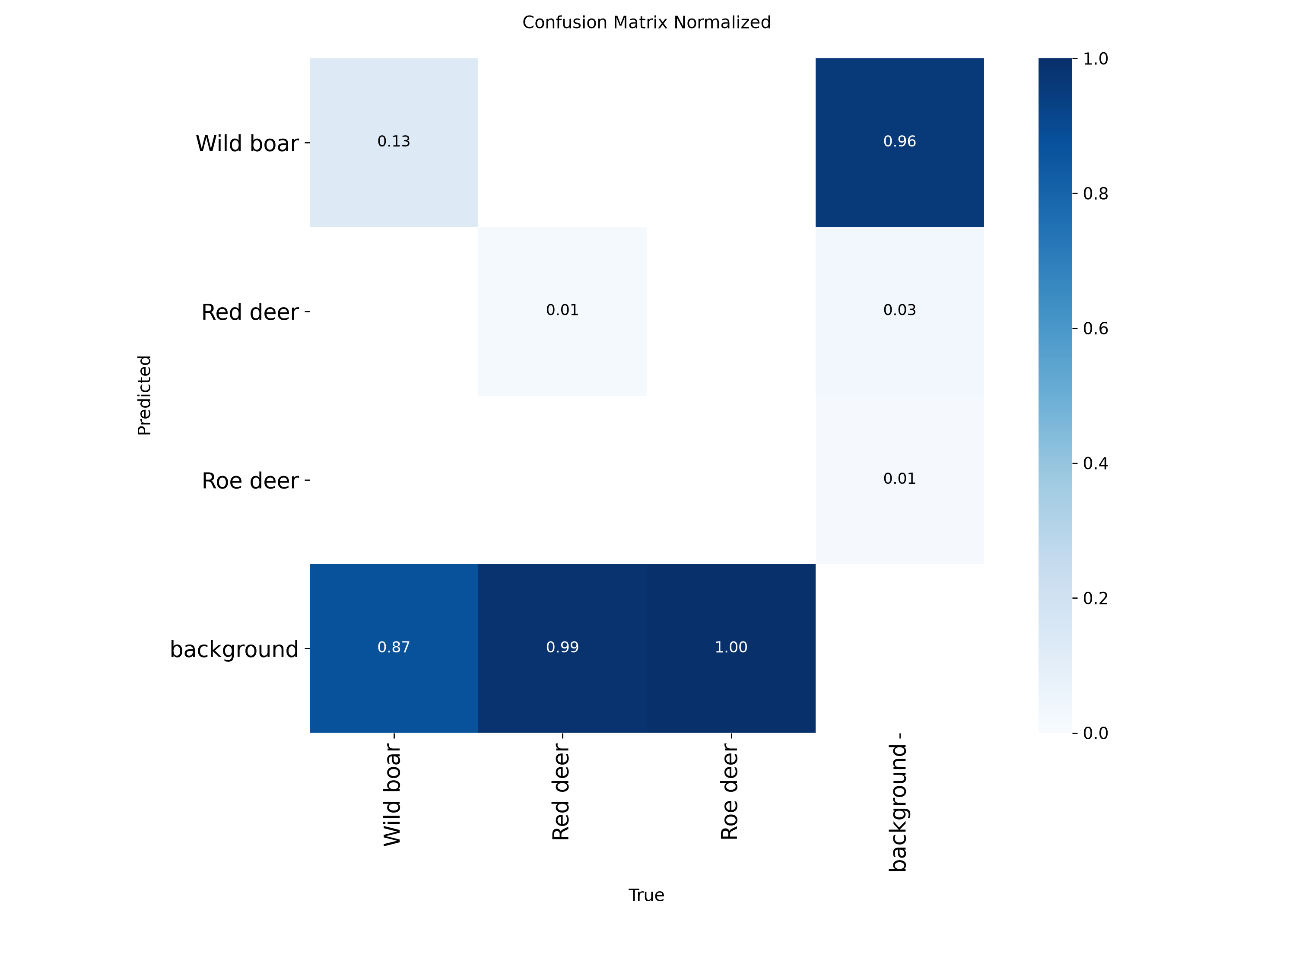
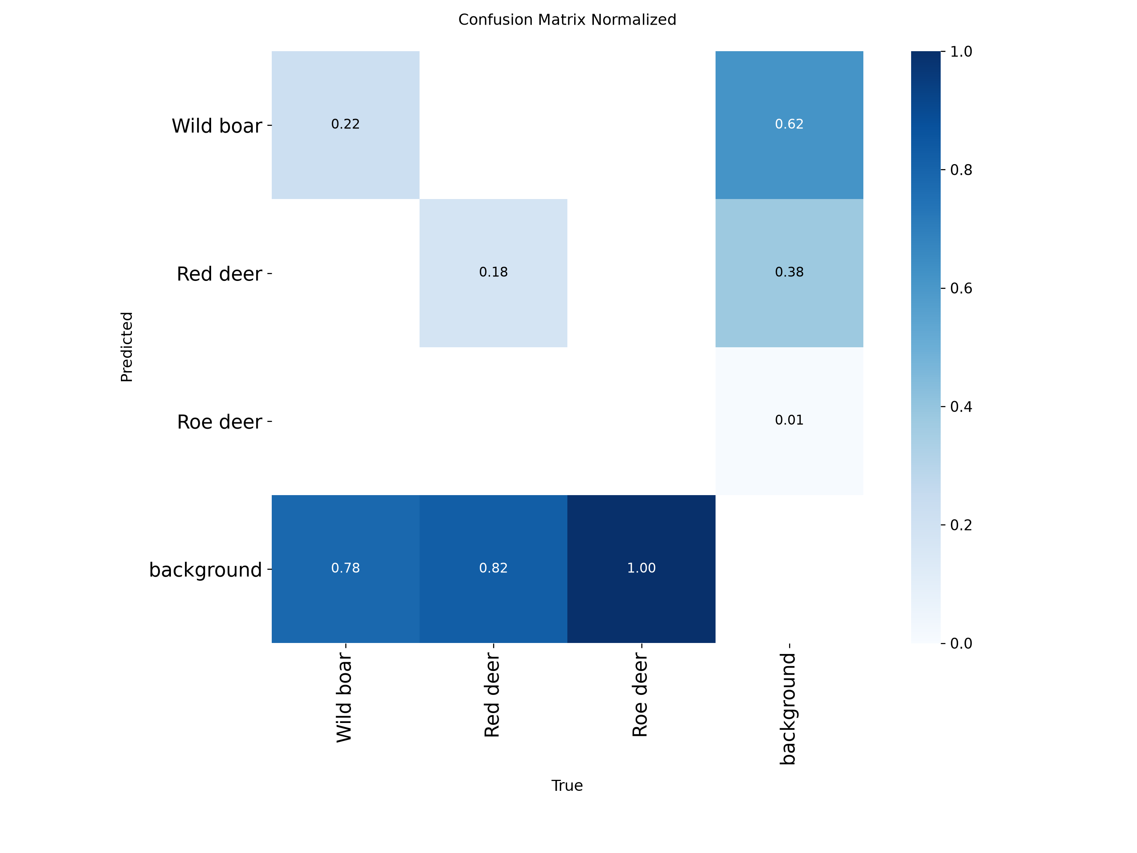
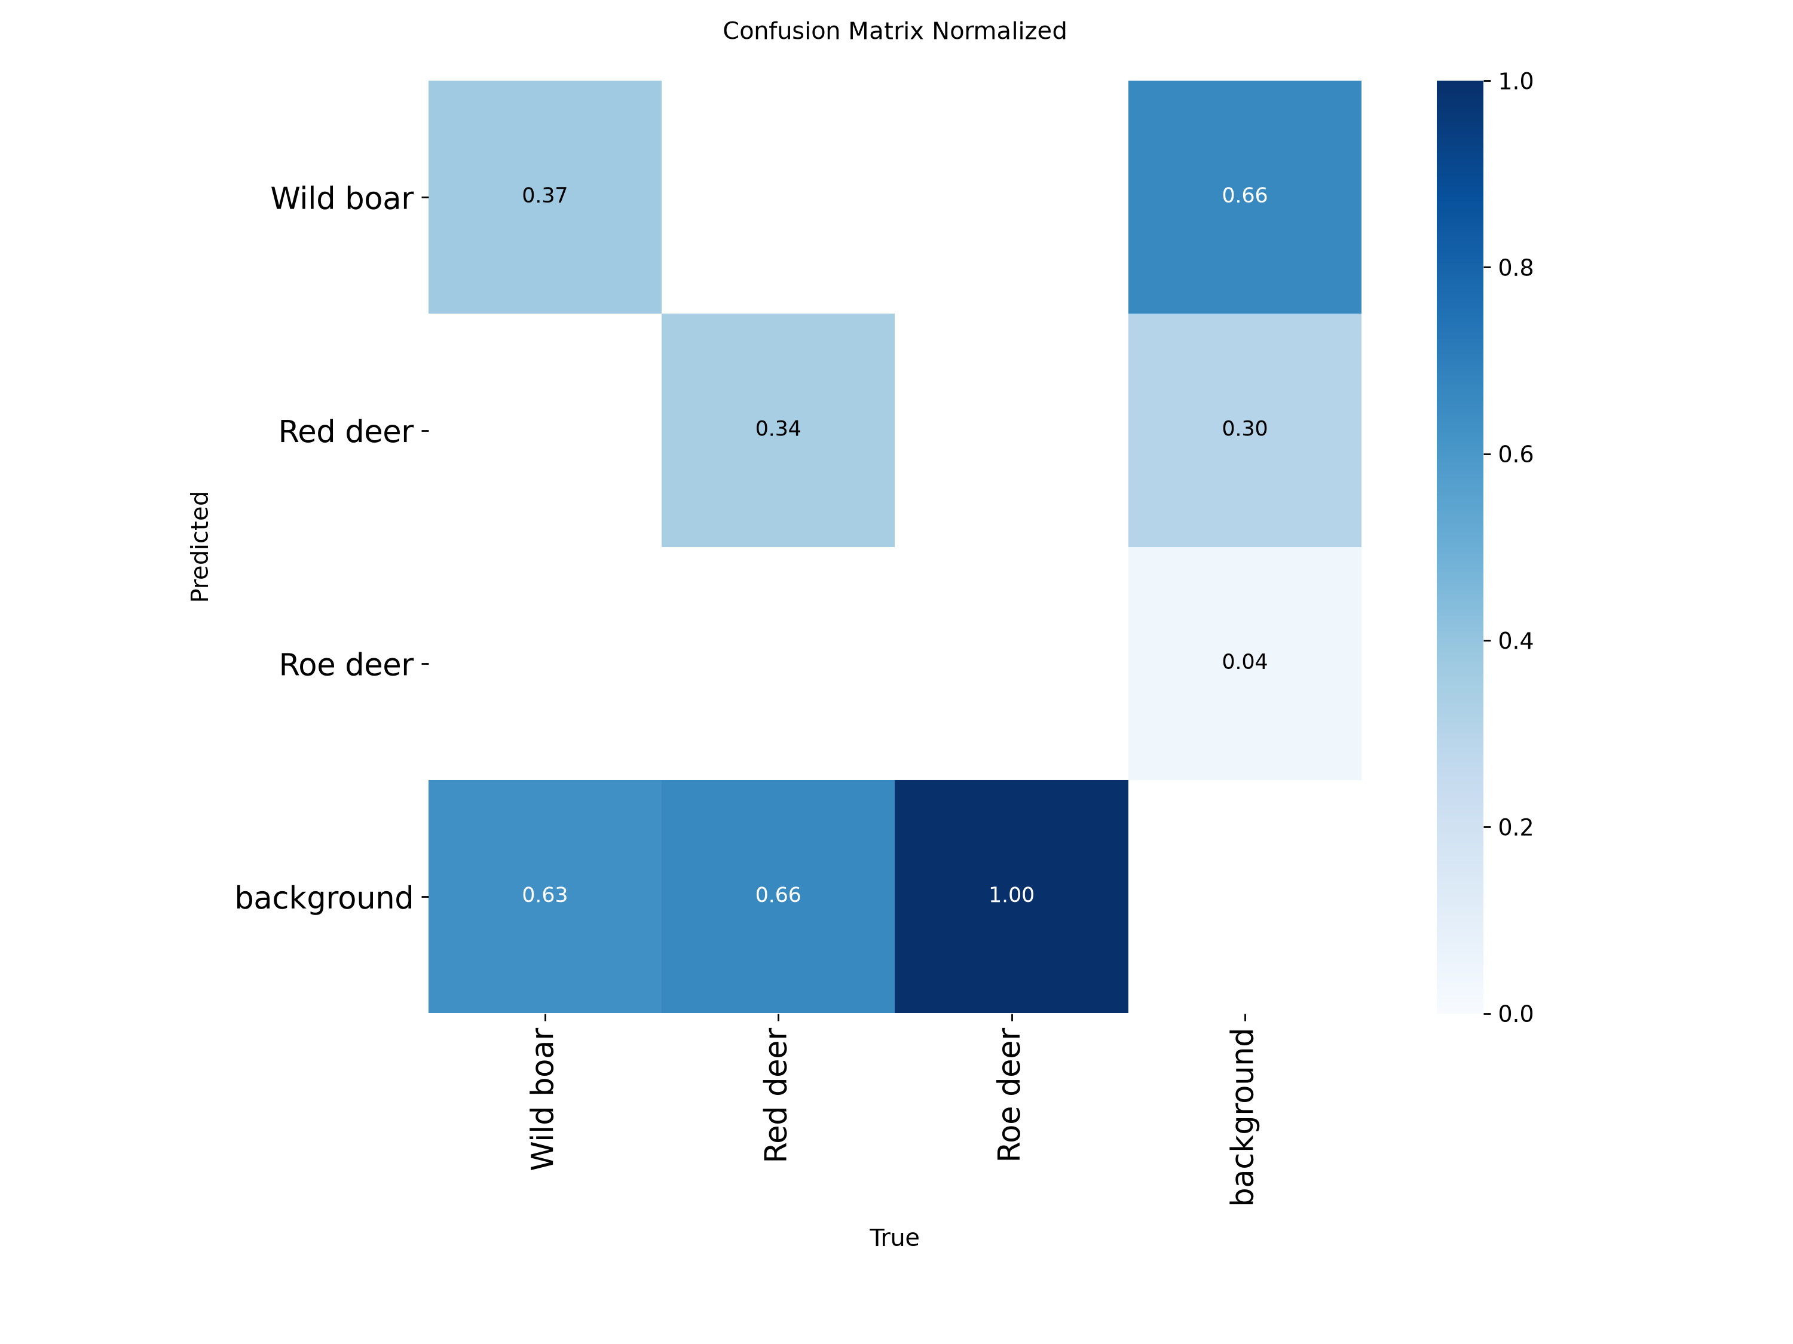
14
/
WHERE THEY FAIL
The battle is detection vs. background — not classification
YOLO26-s · 640 — weakest
YOLO26-l · 1024 — best YOLO
Boar recall 0.13, red 0.01, roe 0.00 — almost everything falls into the background column.
Boar recall climbs to 0.22, red deer to 0.18 — size + resolution light up the diagonal.
RF-DETR-l · 1024 — best overall
Boar 0.37, red deer 0.34 — strongest diagonal, but Roe deer still 0.00.
BAMBI WILDLIFE MOT
FH OÖ HAGENBERG · CIV4
Notes:
Where the detectors fail — the normalized confusion matrices make the failure mode unmistakable: the dominant error is missing the animal entirely, predicting background, not confusing one species for another. Stronger model plus resolution plus architecture steadily recover recall: wild boar 0.13 to 0.22 to 0.37, red deer 0.01 to 0.18 to 0.34. But Roe deer is never detected — zero in all three — the severe class imbalance showing up directly. There simply aren't enough Roe deer examples to learn.

Slide 16
15
/
CONCLUSIONS
Both halves point the same way
TRACKING
DETECTION
THE BINDING CONSTRAINT
BoT-SORT + ReID, per-sequence resets
Ranking is unambiguous
Missed detections & Roe deer
Animals read as background, and Roe deer is effectively undetectable. Class imbalance is the limit , not the model.
Best config (MOTA 0.356, IDF1 0.388) — but every tracker hits the same ~32k FN wall, a detection ceiling.
RF-DETR-L > YOLO26-l@1024 > -l@640 > -s@640. Size, resolution, transformer — in that order of payoff.
BAMBI WILDLIFE MOT
FH OÖ HAGENBERG · CIV4
Notes:
Conclusions. Tracking: BoT-SORT + ReID with per-sequence resets is the best configuration at MOTA 0.356, IDF1 0.388, but every tracker hits the same 32k false-negative wall — a detection ceiling, not an association one. Detection: the ranking is unambiguous — RF-DETR-L 1024 beats YOLO26-l 1024 beats YOLO26-l 640 beats YOLO26-s 640. Model size, resolution and a transformer backbone each add accuracy, in that order. And the dominant failure is missed detections, with Roe deer effectively undetectable — class imbalance is the binding constraint, not the model.

Slide 17
16
/
FUTURE WORK
Where we go next
Attack class imbalance
Push detection further
Close the loop
Oversample / augment Roe & Red deer or add a class-balanced loss — the single highest-leverage fix.
Heavy thermal-contrast augmentation, longer schedules, and finish the RF-DETR-S & full RF-DETR-L runs.
Feed the best detector into BoT-SORT + ReID to attack the ~32k false-negative floor.
THANK YOU
Detection — not tracking — is the bottleneck on thermal aerial wildlife.
By Yasin · Ghaderian Danjuma · Buinitskii
FH OÖ HAGENBERG · CIV4
Notes:
Future work and close. Attack the class imbalance directly — oversample or augment Roe and Red deer, or add a class-balanced loss; the confusion matrices say this is the highest-leverage fix. Push detection with heavy thermal-contrast augmentation and longer schedules, and finish the RF-DETR runs. And close the loop: feed the best trained detector into BoT-SORT + ReID to attack the 32k false-negative floor that ground-truth isolation exposed. Thank you — questions welcome.

