Slide 1
Towards a Dataspace for Cyber Threat Intelligence
Navid Rahimi Danesh
RWTH Aachen, Informatik 5
Lehrstuhl Prof. Decker
Advisors: Mehdi Akbari Gurabi, Ömer Sen

Slide 2



Motivation
The Crucial Role of Collaboration in Cybersecurity
Constant challenge of cyber defense
Interconnected nature of threats
Collective defense
Reinventing the wheel
Sharing information
Attacker motivations, targets, techniques
Vulnerability severity and risk level
Incident response strategies
Approach: sharing cyber threat intelligence (CTI)
1
Notes:
digitalization -> expand attack surface
attackers improve
same vulnerabilities everywhere
same techniques

Slide 3
Motivation
The Challenges of Collaborative CTI ^{[1]}
Requirements
Operational
Inconsistent definitions and terminology
Validating quality
Achieving interoperability and automation
Safeguarding sensitive information
Organizational
The risk of reputation damage
Establishing trust among participants
Economic
Loss of client's confidence and satisfaction
Legal/Policy
The risk of violating privacy laws
Inconsistent regulation in different countries
Hazf Data discoverability
Ok Data Interoperability
Ok Security and privacy
Ok Bidirectionality
Ok Data Sovereignty
Ok Decentralized
Challenge:
Control the access and usage of data
while keeping the benefits of sharing
CTI Platform Requirements
Trust and transparency
Data protection (security, privacy, usage control)
Compliant with regulations
Interoperability and actionability
Bidirectional and collaborative
Adam Zibak and Andrew Simpson. 2019. Cyber Threat Information Sharing: Perceived Benefits and Barriers. In Proceedings of the 14th International Conference on Availability, Reliability and Security (ARES '19)
2
Notes:
Existing platforms have shortcomings
(For transition) Question: that leads us to the concept of data sovereignty

Slide 4
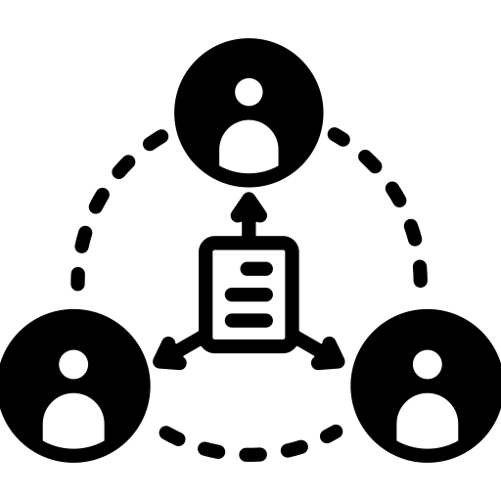
Motivation
Existing Solutions for Sovereign Data Sharing
Data sovereignty and usage control
Right of owner to control the data
Dataspaces and data sovereignty
Example: International Dataspaces (IDS)
Reference Architecture Model
Requirements
Data ecosystem
Security and trust
Federated and open
Data sovereignty
CTI Platform Requirements
Trust and transparency
Data protection (security, privacy, usage control)
Compliant with regulations
Interoperability and actionability
Bidirectional and collaborative
3

Slide 5
Thesis Goal
Investigating the Suitability of Dataspaces for CTI Sharing Use Case
Identifying CTI sharing requirements and scenarios
Challenges of adopting dataspace for identified scenarios
Effect of usage control in protecting sensitive data in different scenarios
Objective:
Investigating the suitability of DS for CTI sharing, developing investigation framework
Old
Identify the specific requirements of the CTI sharing (focused on the energy sector use case)
Explore the capabilities and potentials of dataspaces
Find and tackle key technical challenges
High level architecture design and proof of concept
4
Notes:
To reach this goal I must address the following points

Slide 6
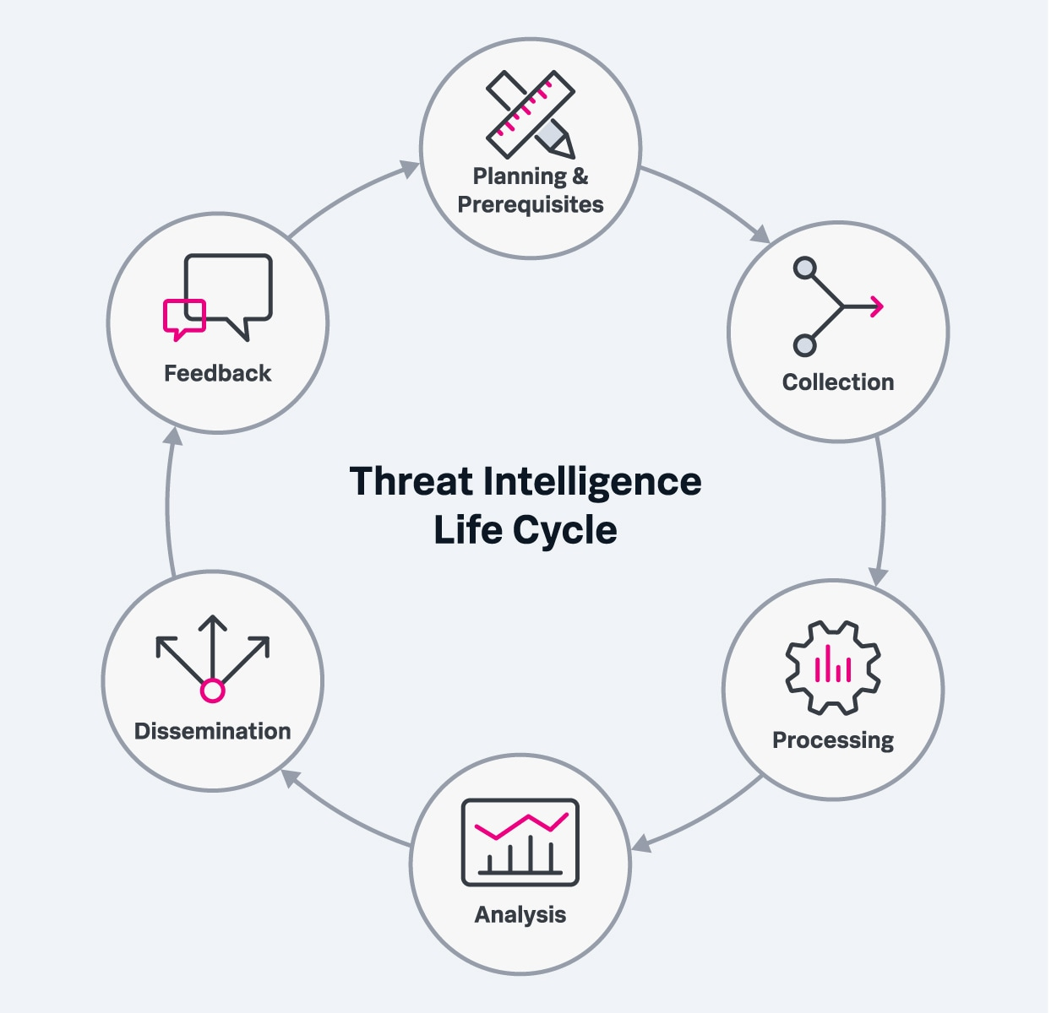
Background and related work
What is Cyber Threat Intelligence
CTI type | Focus | Concerned actor | Lifecycle | Benefit
Strategic – High level insights | Overall threat landscape, attacker motives, attack impacts | Executive management | Long-term | Data driven risk management
Tactical – How? | TTPs, vulnerabilities, mitigation strategies | Security Operations Center (SOC) managers, Security Analysts | Long-term | Efficiency, faster incident response
Technical – What? | Indicator of compromise (IOC) – malware signatures, malicious IPs | System admins, SOC staff | Short-term | Automation
5

Slide 7
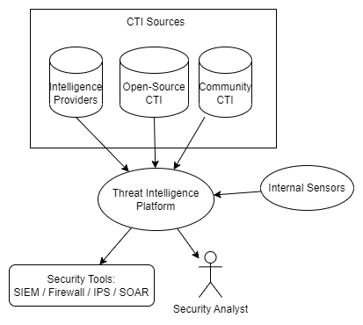
Background and related work
Automation in Cyber threat intelligence
Skip human delay
Reduce costs
Machine-readable formats
STIX
VERIS
IODEF
Structured Threat Information Expression (STIX™)
Trusted Automated Exchange of Intelligence Information (TAXII™)
VERIS
the vocabulary for event recording and incident sharing
IETF RFC 5070: The Incident Object Description Exchange Format (IODEF)
6
Notes:
Transition: Threat Intelligence Platform have different types

Slide 8








Background and related work
Existing Platforms for Cyber Threat Intelligence
Proprietary CTI feeds and services | Community platforms | Open-Source Platforms
✅ Premium curated feeds ❌ Not collaborative ❌ Vendor lock-in | ✅ Collaborative ❌ Centralized ❌ Liability and privacy risks | ✅ Collaborative ✅ Decentralized ❌ Hard establishment of trust ❌ Liability and privacy risks
7
Notes:
Transition: We think dataspaces can solve these issues by implementing usage control.

Slide 9





Background and related work
Initiatives towards dataspace standardization in Europe
Importance of data in businesses
European data strategy – Data governance act
Increate trust in data sharing
Increase data availability
Overcome technical obstacles to the reuse of the data
GDPR
Notable initiatives
International Dataspaces (IDS)
GAIA-X
FIWARE
Big Data Value Association (BDV)
Goals
Facilitate cooperation
Create data and service economy
Data sovereignty
8
Notes:
IDSA: architecture for sovereign data exchange
Ishare: Non-profit legal and technical trust foundation for any data space, Enabling Data Sovereignty for every data holder, Live, federated and distributed governance framework
Ishare: is a uniform set of agreements or schemes that enables organisations to give each other access to their data. Since they all work with the same identification, authentication and authorisation methods, they do not need to keep making new agreements on these topics every time they want to share data. Together, the partners who participate in the iSHARE scheme create a ‘network of trust’, within which they can share data effortlessly. iSHARE is an initiative of the Dutch government’s Logistics Top Sector, and has so far achieved high international recognition and uptake
Gaia-x:
Fiware: A curated framework of Open Source Platform components to accelerate the development of Smart Solutions
BDVA: is an industry-driven organisation with a mission to develop an innovation ecosystem that enables the data-driven digital transformation of the economy and society in Europe.

Slide 10







Background and related work
IDS Use Cases and Adoptions
9
Notes:
Future: Security dataspace

Slide 11
Methodology
Requirement
Analysis
Data Modelling and Architecture Design
Prototyping
Evaluation
10

Slide 12
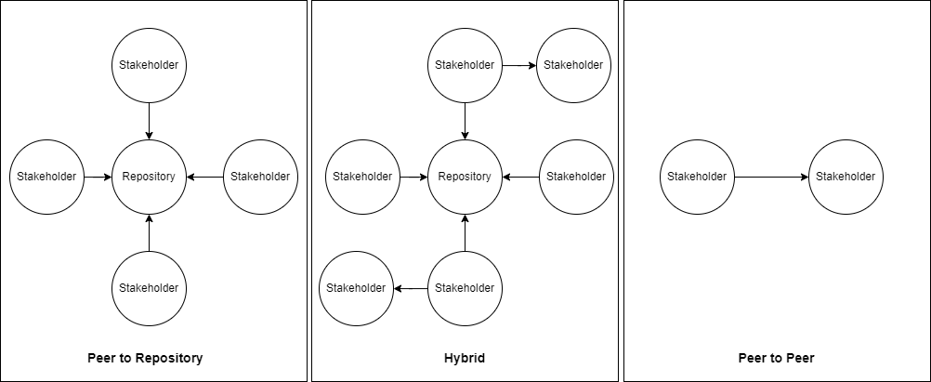
Use case and requirements
CTI Platform Requirements
Trust and transparency
Data protection (security, privacy, usage control)
Compliant with regulations
Interoperability and actionability
Bidirectional and collaborative
Use case: energy sector
Scenarios:
Trusted peer – Peer to peer
Community – Peer to repository
Marketplace -- Hybrid
Requirements
Trust and transparency
Data protection (security, privacy, usage control)
Compliant with regulations
Interoperability and actionability
Bidirectional and collaborative
Federated and open
Data sovereignty
Common policies and rules
Interoperability
Bidirectional
Security and privacy
Federated and open
Data sovereignty
Common policies and rules
Interoperability
Bidirectional
Security and privacy
11

Slide 13
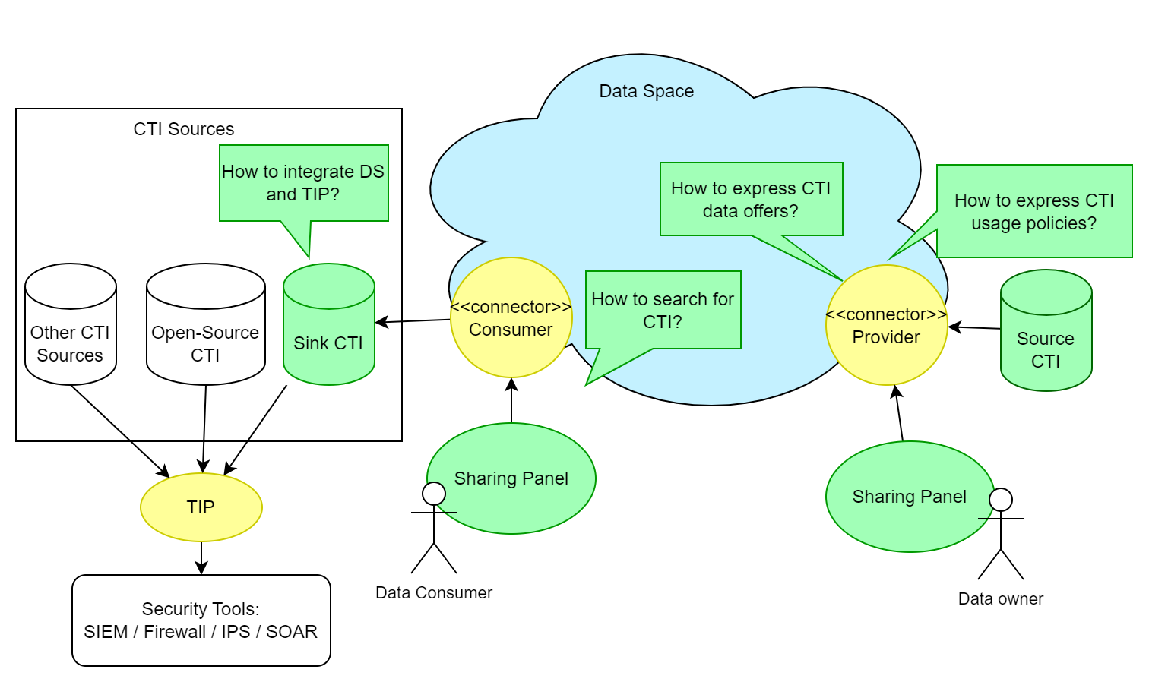
Conceptual approach
Architecture of the CTI Dataspace
12
Notes:
How it fulfills our requirements

Slide 14
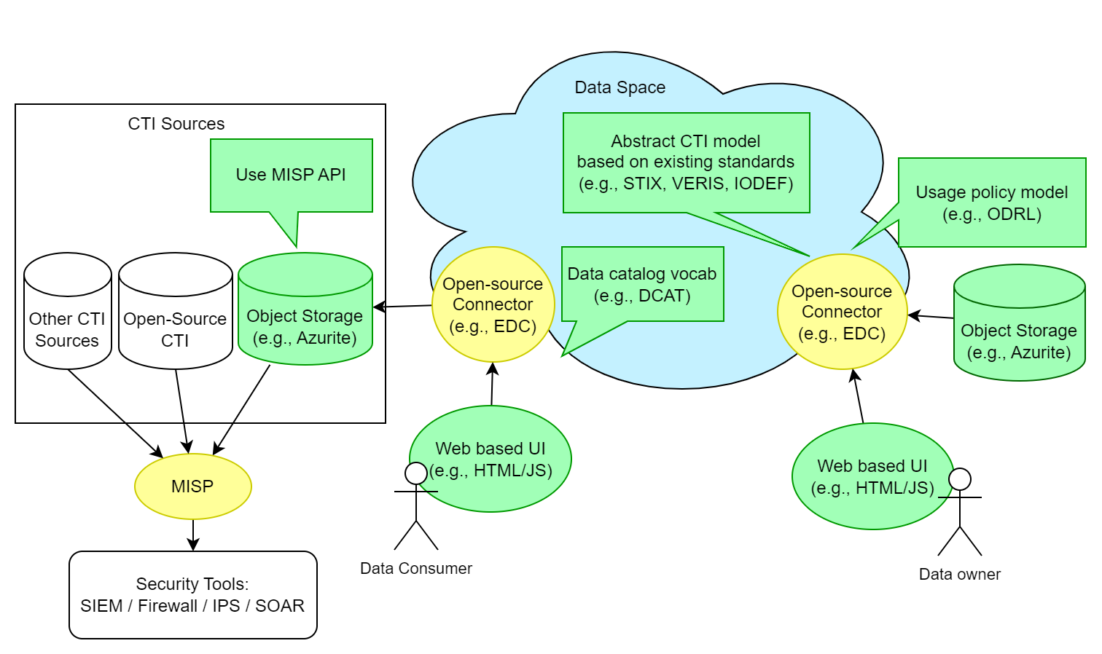
Realization / Implementation
Selected Technologies
13

Slide 15
Evaluation
Verify the architecture
To what extend do the design and models address the requirements?
Comparative security analysis
Baseline: MISP
Which risks are avoided by applying usage control?
Analyze vulnerabilities and threats
How about threats in the energy sector?
Dynamic testing using the prototype
Run scenarios
Measure performance
Simulate some attacks
(Optional) User survey
Adam Zibak and Andrew Simpson. 2019. Cyber Threat Information Sharing: Perceived Benefits and Barriers. In Proceedings of the 14th International Conference on Availability, Reliability and Security (ARES 2019) (ARES ’19), August 26–29, 2019, Canterbury, United Kingdom. ACM, New York, NY, USA, 9 pages. https://doi.org/10.1145/3339252.3340528
Measure the perceived level of the CTI sharing benefits and barriers identified in the literature
Adopt from an existing survey ¹
Participants: A group of 10-20 cyber security practitioners
Questions
Respondent’s role and level of experience
Likert-scale items on their attitude regarding each benefit and barrier
Repeat the questions after demonstrating our prototype
14

Slide 16
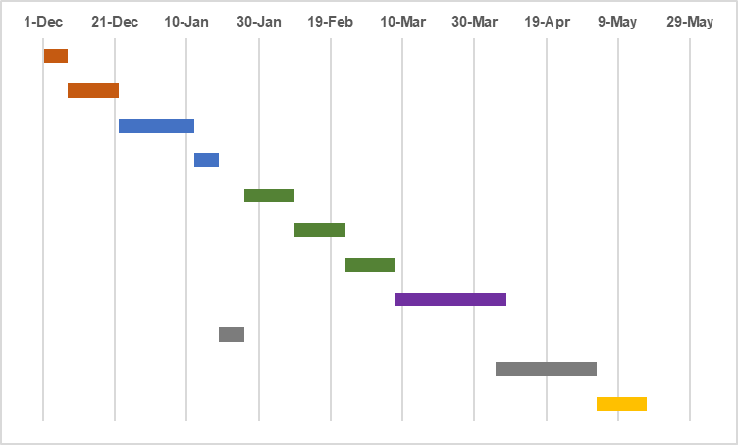
Project plan / timeline / milestones
Milestones
Foundation | Related works
 | Define use case scenarios
Analysis and modelling | Information Modelling
 | System Design
Prototype implementation | Setup dataspace
 | Integration with TIP
 | Sharing panel
Evaluation
Writing | Phase 1
 | Phase 2
Buffer
Foundation (1m)
Related works (1)
Define use case scenarios (2)
Analysis and modelling (1m)
Information Modelling (3w)
Policies
CTI
System Design (1w)
Components
Data Flow
Writing (1w)
Prototype implementation (1.5m)
Setup dataspace (2)
Integration with TIP (2)
Sharing panel (2)
Evaluation (1m)
Writing and buffer (1.5m)
15

Slide 18
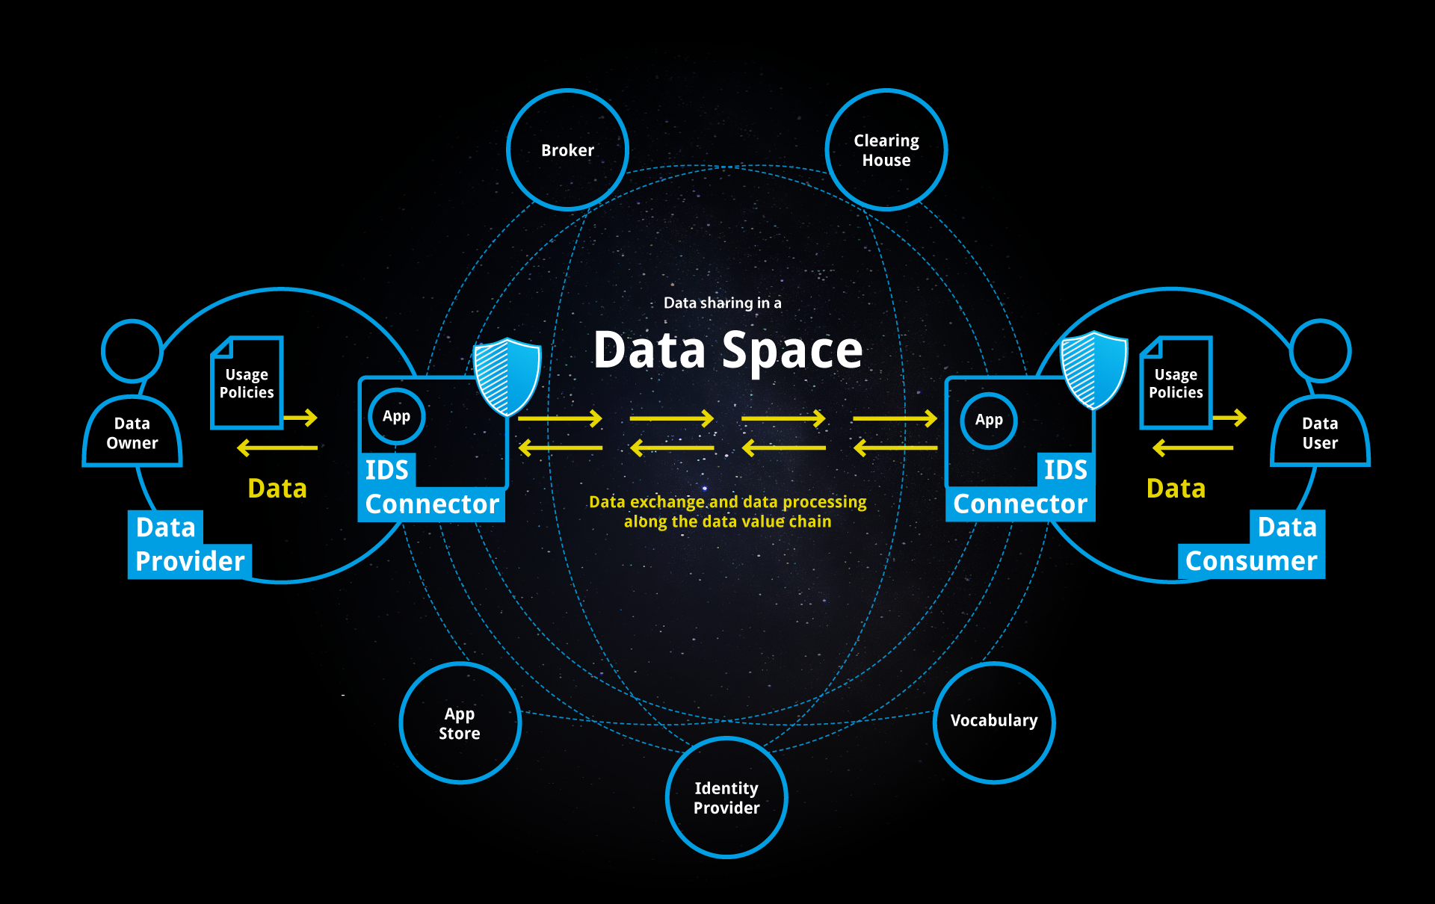
Appendix – Dataspace Architecture
International Dataspaces
Goals
Secure
Sovereignty (Keep control over data)
Federated (not a big player)
Data sharing
Data economy
Deliverables
Reference architecture model – IDS-RAM
Certification
https://internationaldataspaces.org/why/data-spaces/
17
Notes:
less detailed
comparative
- gaia-x

