Slide 1
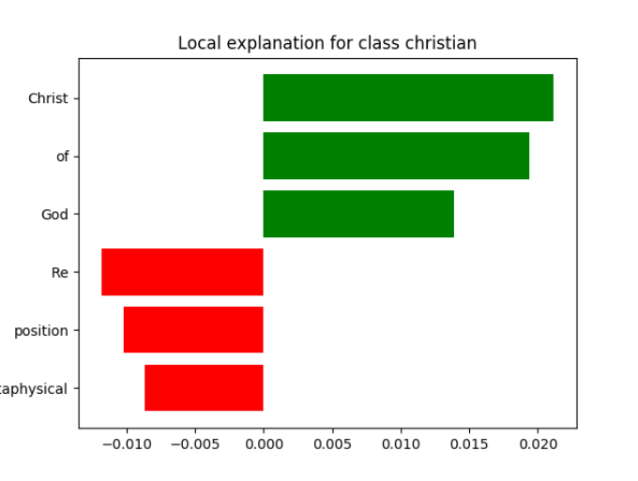
Local explanation for class river bank
Ecology
freshwater
river
interest
stream
called

Slide 2
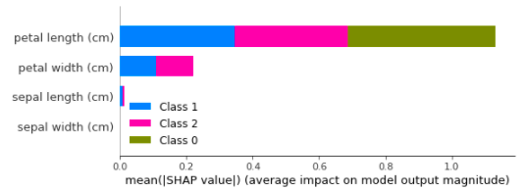
Petal length
Petal width
Sepal length
Versicolor
Virginica
Sepal width
Setosa
Average impact on model output

Slide 3
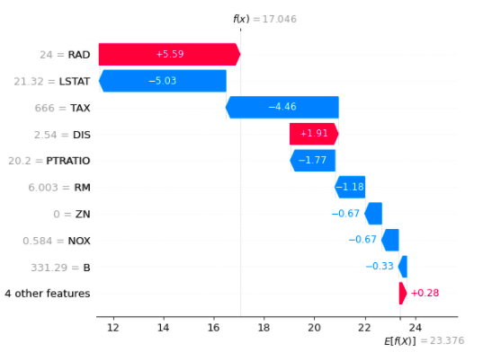
CRIM
RM
DIS
NOX
RAD

Slide 4
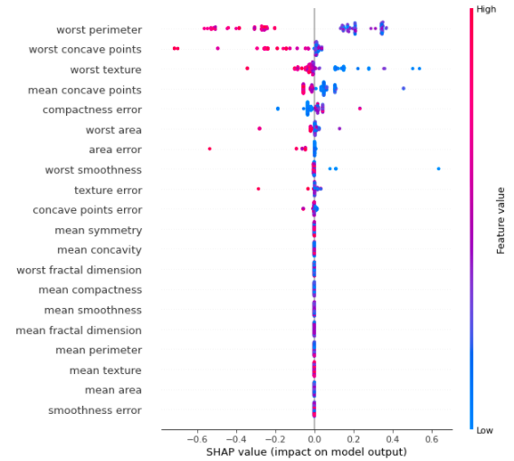
Worst perimeter
Worst concave points
Worst texture
Worst area
Worst smoothness
Worst radius
Worst fractal dim.
Worst concavity
Worst symmetry
Worst concavity

Slide 5
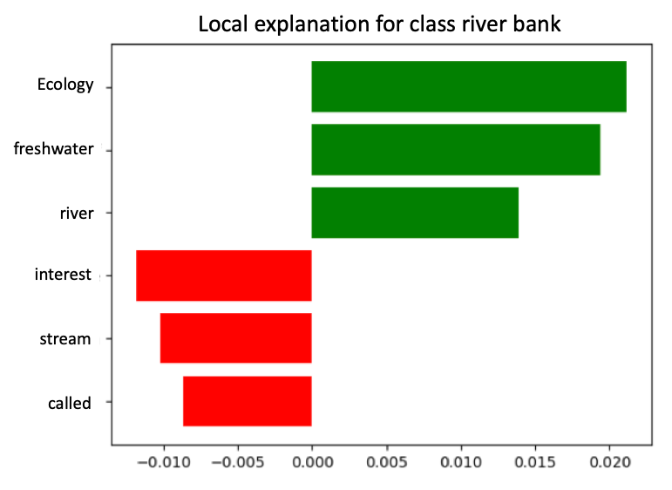
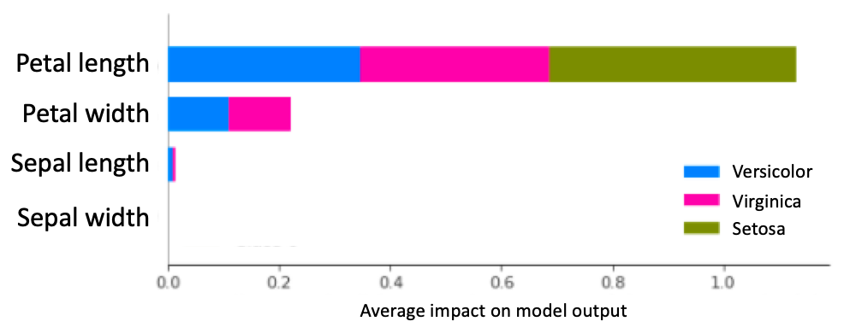
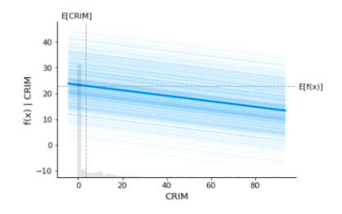
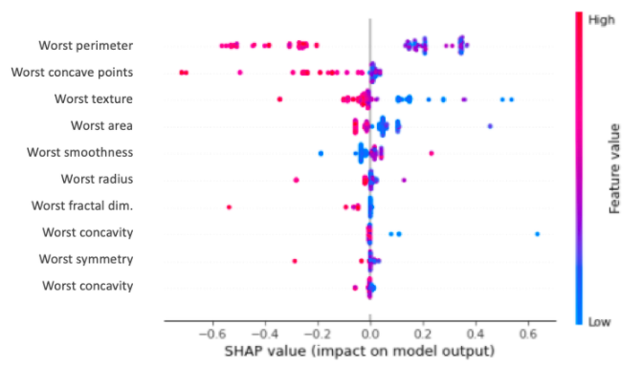
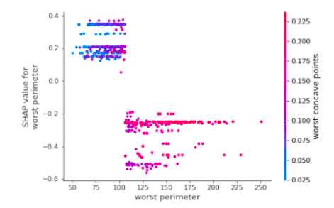
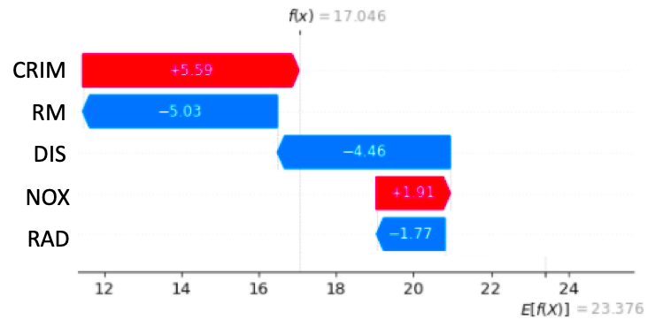
Figure 1
Figure 4
Figure 2
Figure 5
Figure 3
Figure 6

Slide 6
Plot 1
Plot 4
Plot 2
Plot 5
Plot 3
Plot 6

Slide 7
High
Feature Value
Low
SHAP value (impact on model output)

Slide 8
SHAP value for
worst perimeter
Worst concave points
Worst Perimeter

Slide 10
f(x) = 17.046
+5.59
-5.03
-4-46
+1.91
-1.77
E[f(x)] = 23.376

Slide 11
E[CRIM]
E[f(x)]
f(x)|CRIM
CRIM

