Slide 1
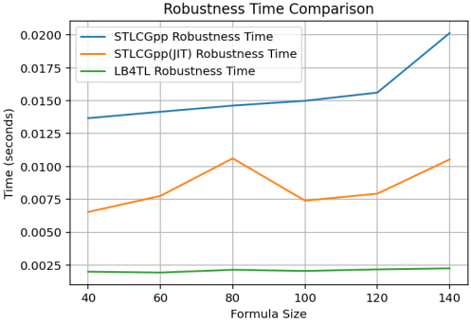
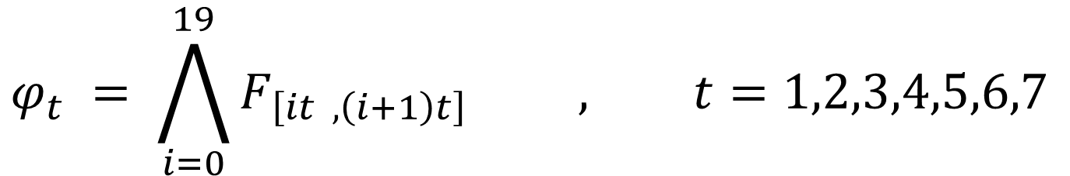
CPU
When the formula does not result in the explosion of the width of the computation graph we outperform STLCG++
$$φ_{t} = \bigwedge_{i=0}^{19}{F_{\left[it , \left(i+1\right)t\right]} } , t=1,2,3,4,5,6,7$$

Slide 2
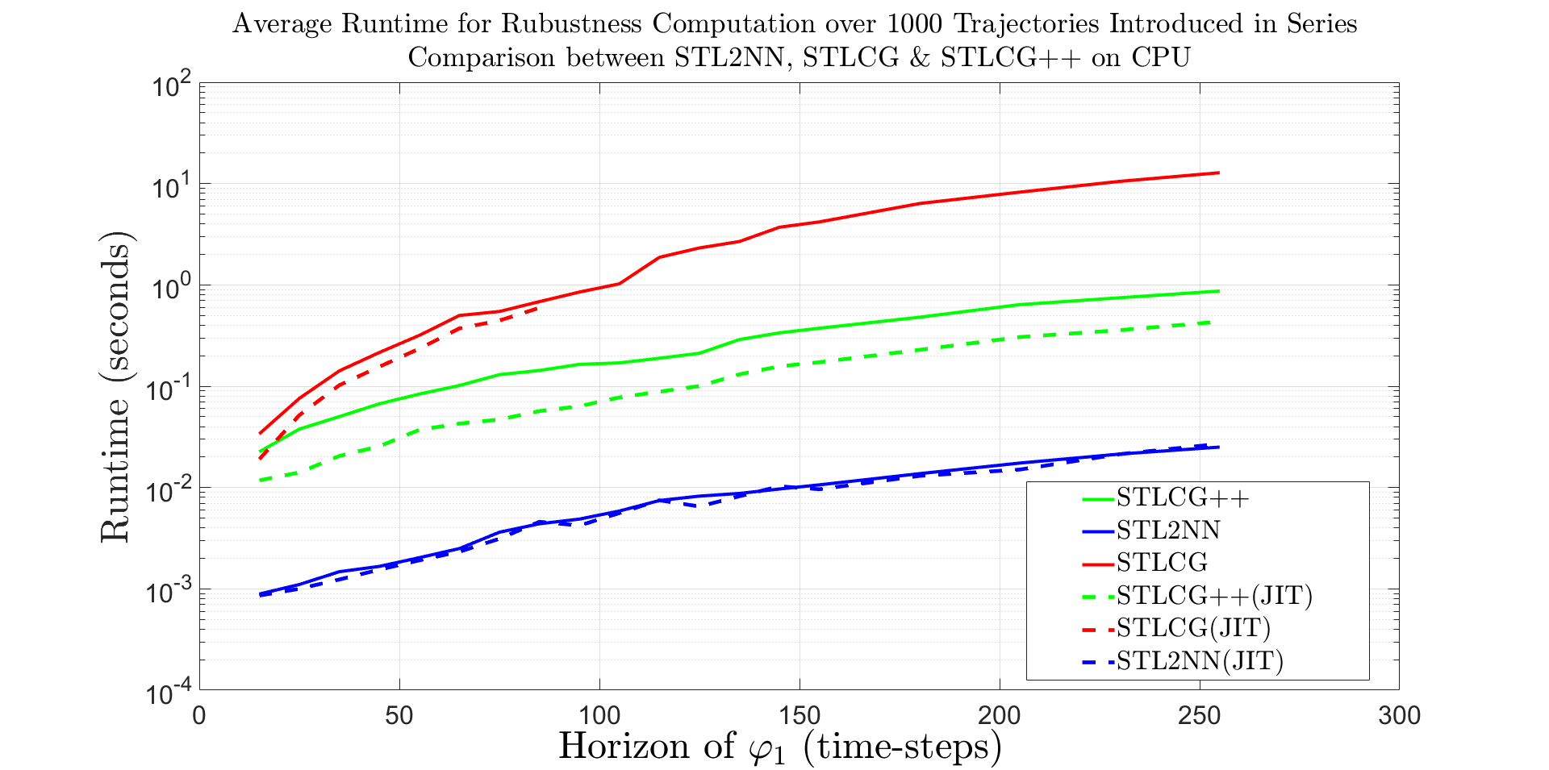
CPU
When the formula does not result in the explosion of the width of the computation graph we outperform STLCG++
$$φ_{1}=F_{\left[0,T\right]} \left( Goal1 then Goal2\right), T=15,20,…, 255$$

Slide 3
However, STL2NN has its own weakness and drawback. Unlike its depth that increases logarithmically, Its width increases linearly with the complexity of the formula. This means, in this case STLCG++ finds a way to take advantage of this drawback and outperforms STL2NN.
Look at an example the results in the explosion of the with of computation graph in the next slide.

Slide 4
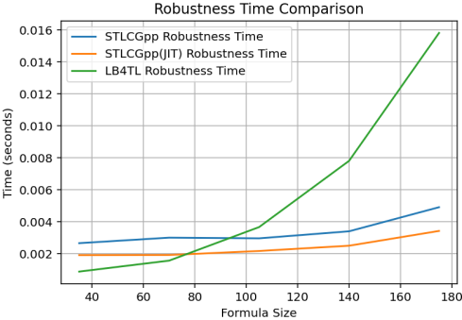
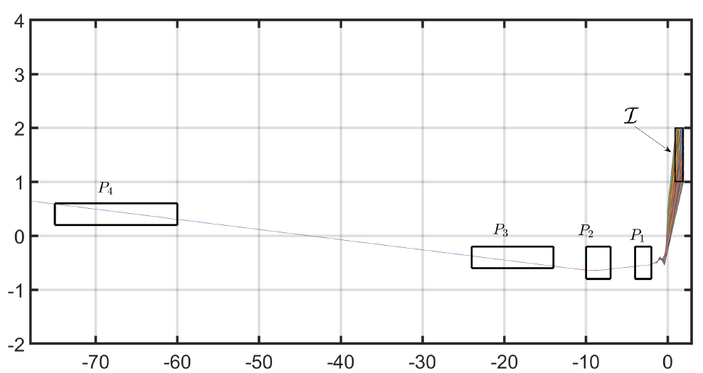
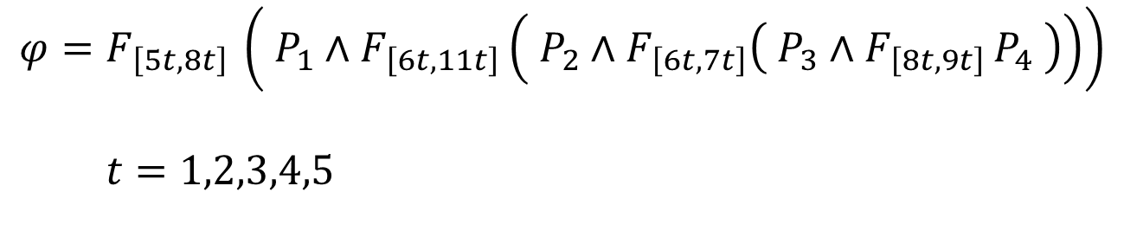
CPU
When the formula results in the explosion of the width of the computation graph we face weakness and STLCG++ finds the opportunity to outperform STL2NN
$$φ=F_{\left[5t,8t\right] }\left( P_{1}∧F_{\left[6t,11t\right]}\left( P_{2}∧F_{\left[6t,7t\right]}\left( P_{3}∧F_{\left[8t,9t\right] }P_{4} \right)\right)\right)$$
$$t=1,2,3,4,5$$

