Slide 1
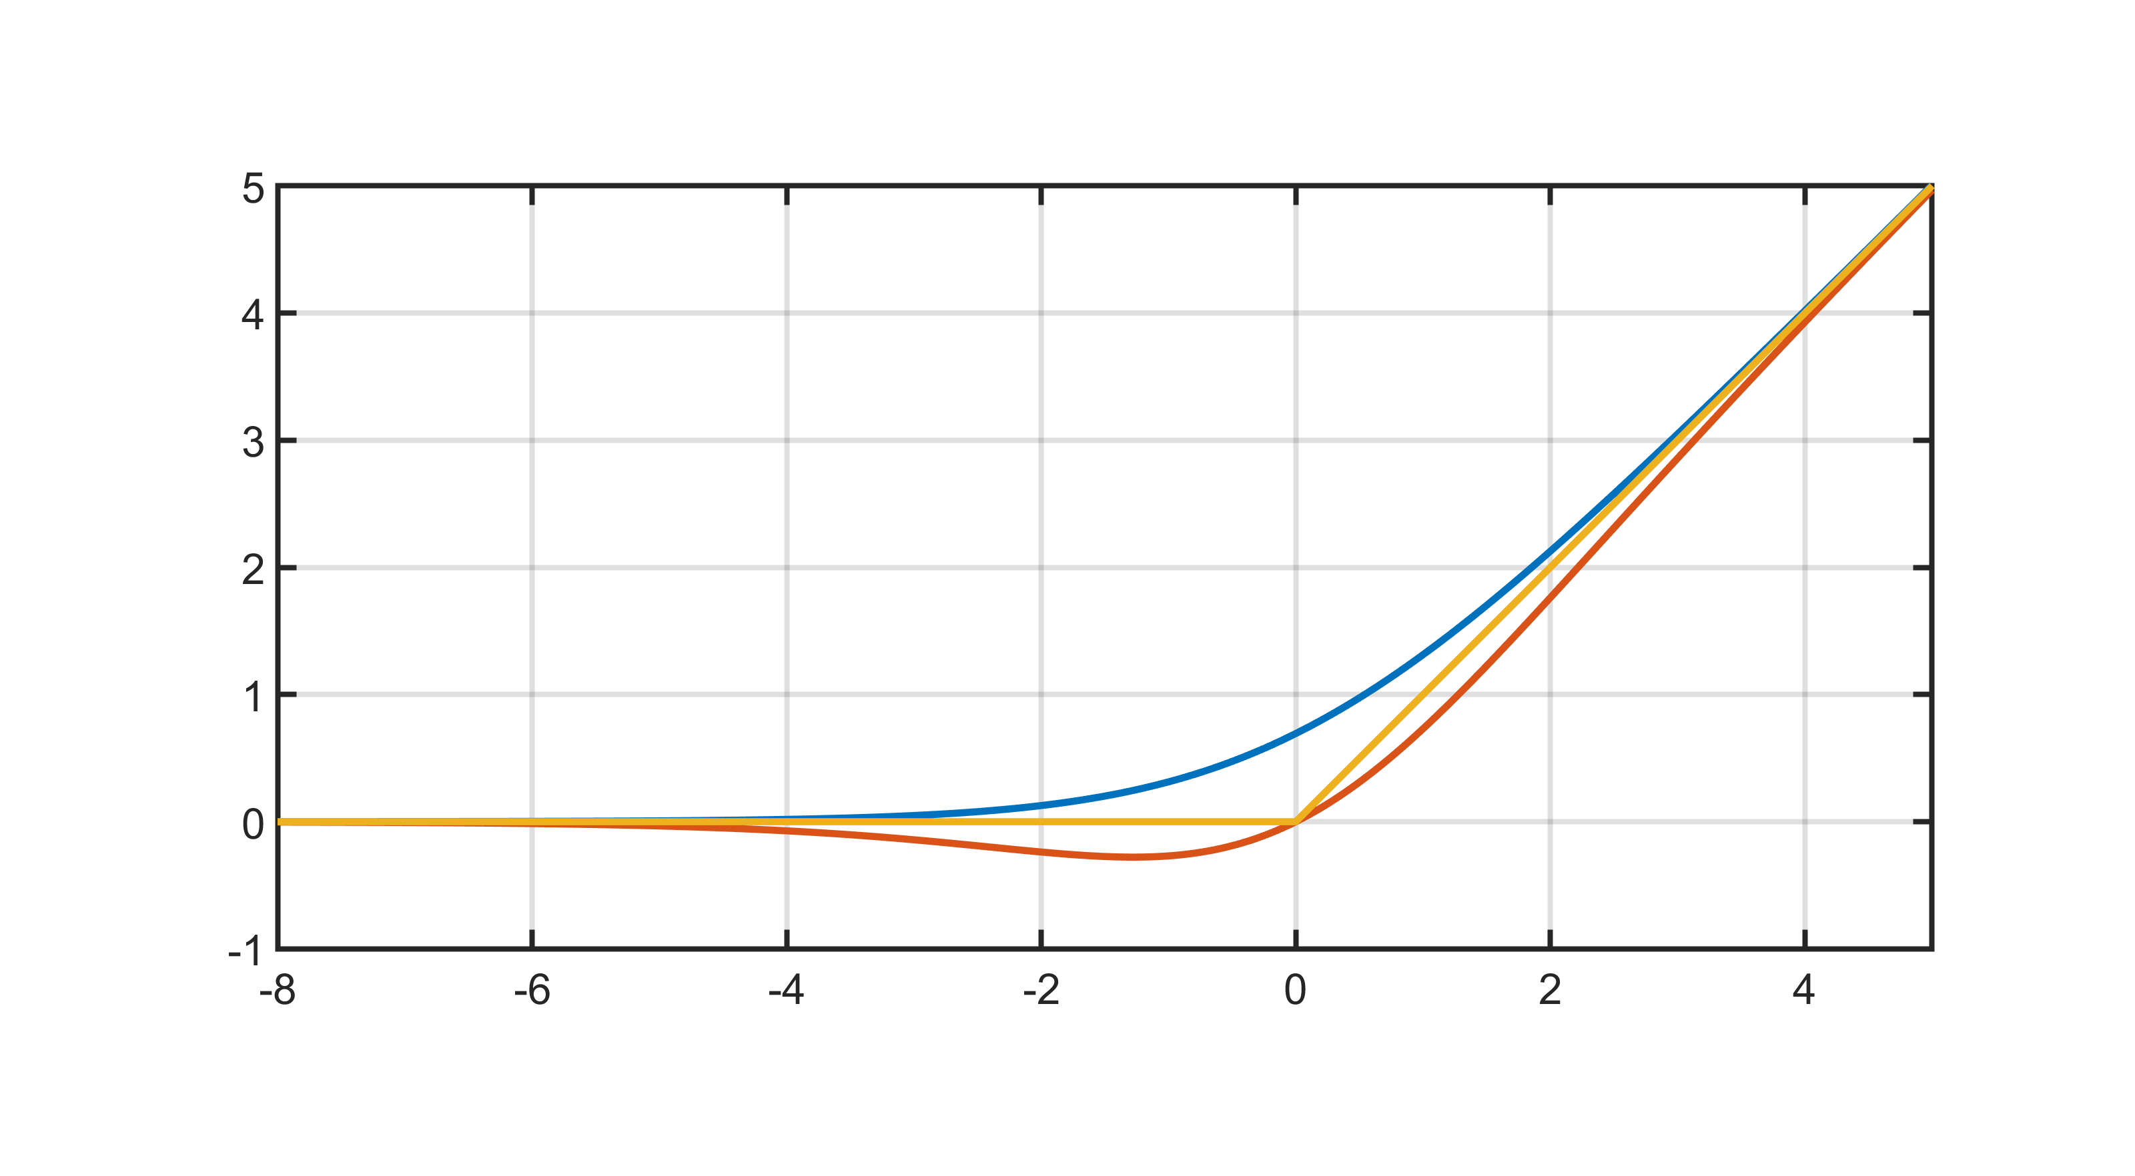
softplus
ReLU
swish

