Slide 1


Customer Shopping Behavior Analysis
Uncovering insights from 3,900 transactions to guide strategic business decisions
DATA SCIENCE PROJECT

Slide 2
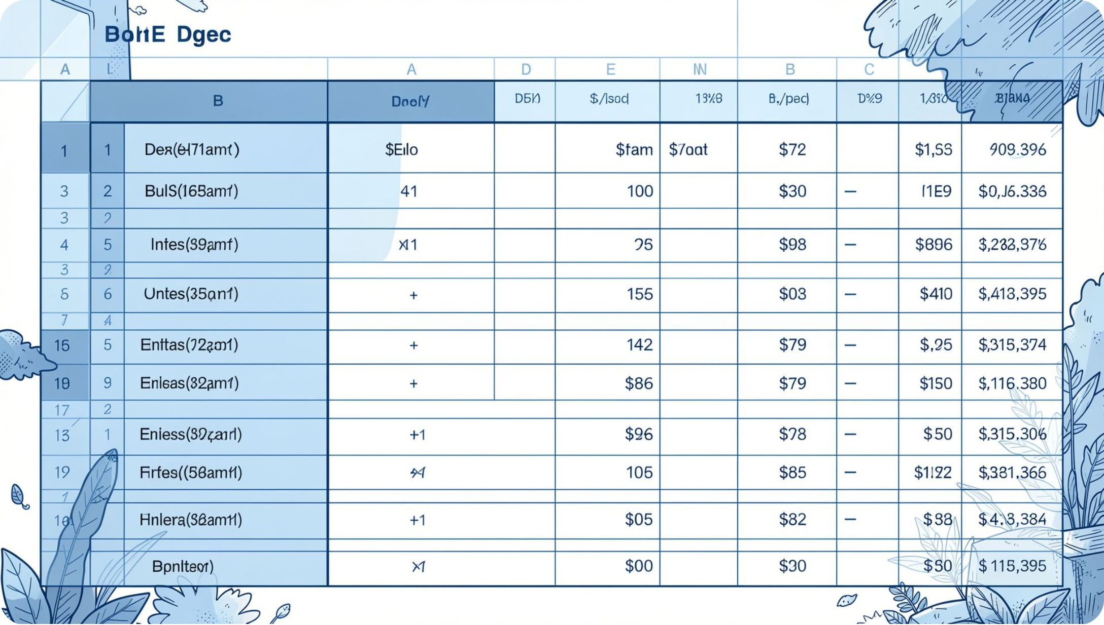
Dataset at a Glance
3,900
18
37
Purchases
Columns
Missing Values
Transactional records analyzed
Features per transaction
In Review Rating column
Key Features
Demographics: Age, Gender, Location, Subscription
Purchase details: Item, Category, Amount, Season
Behavior: Discount, Promo Code, Frequency, Review Rating

Slide 3

Data Preparation in Python
01
Load & Explore
Imported via pandas; used df.info() and .describe()
02
Clean Missing Data
Imputed Review Rating with median per category
03
Feature Engineering
Created age_group and purchase_frequency_days; dropped redundant promo_code_used
04
Database Integration
Loaded cleaned DataFrame into PostgreSQL for SQL analysis

Slide 4
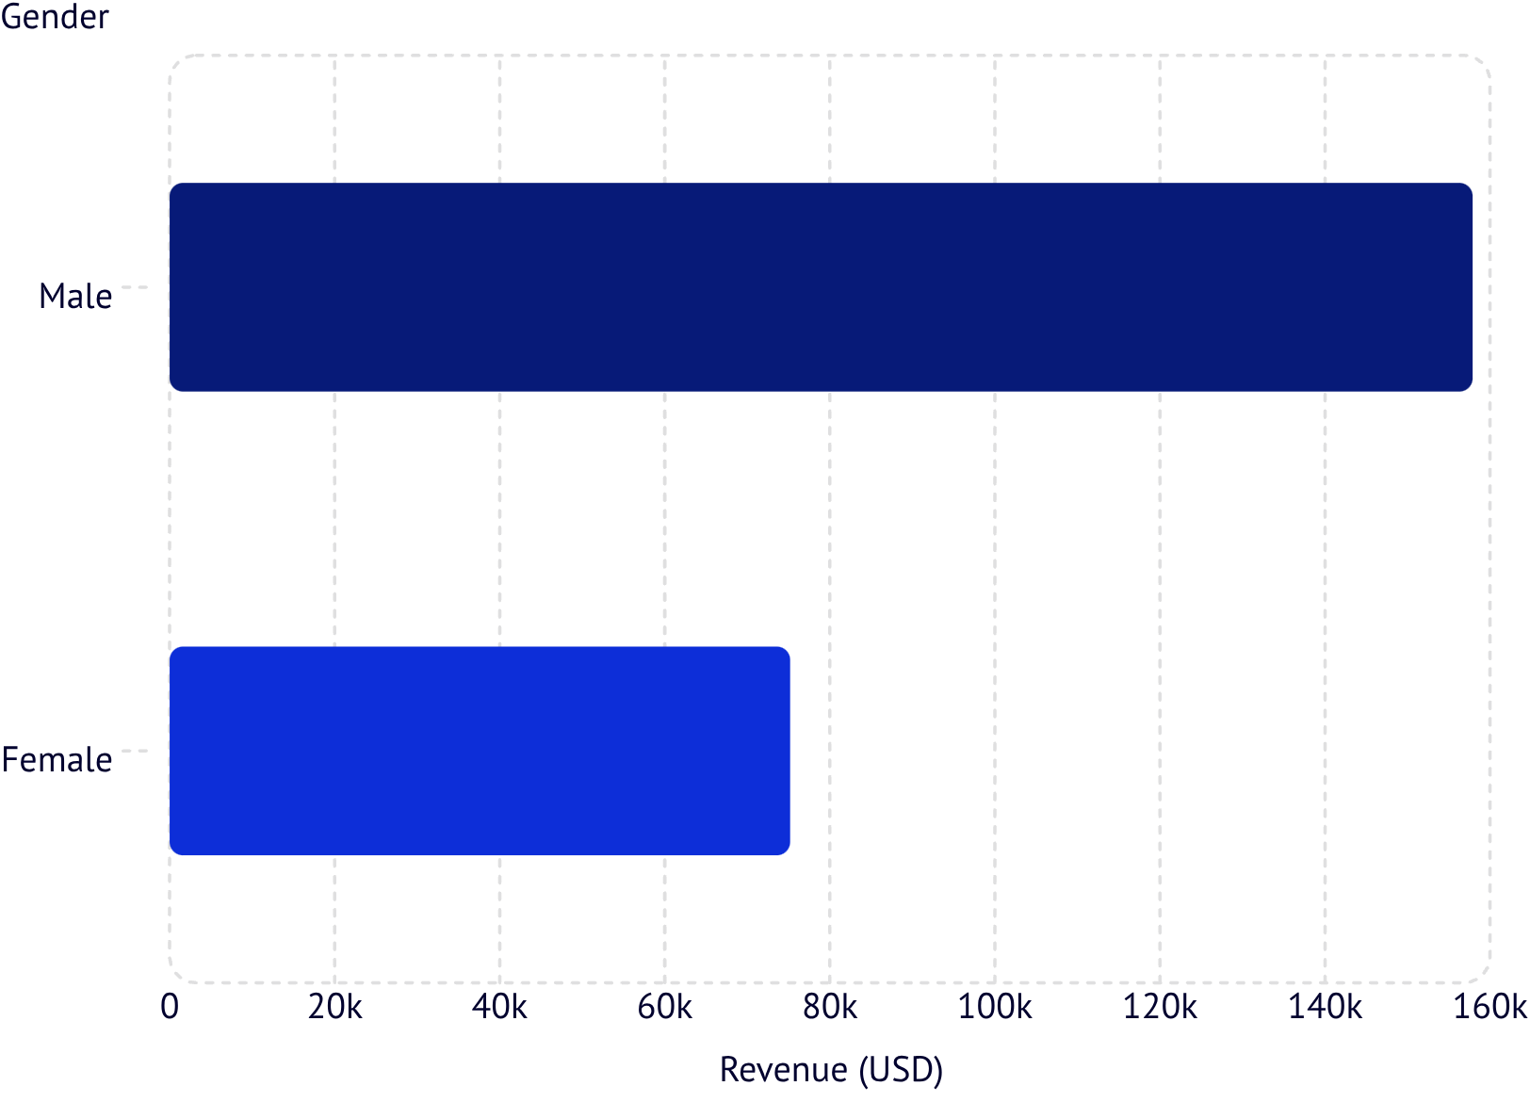
Revenue by Gender
Key Finding
Male customers generated 2× more revenue than female customers
Male
Female
$157,890 · 2,652 customers
$75,191 · 1,248 customers

Slide 5
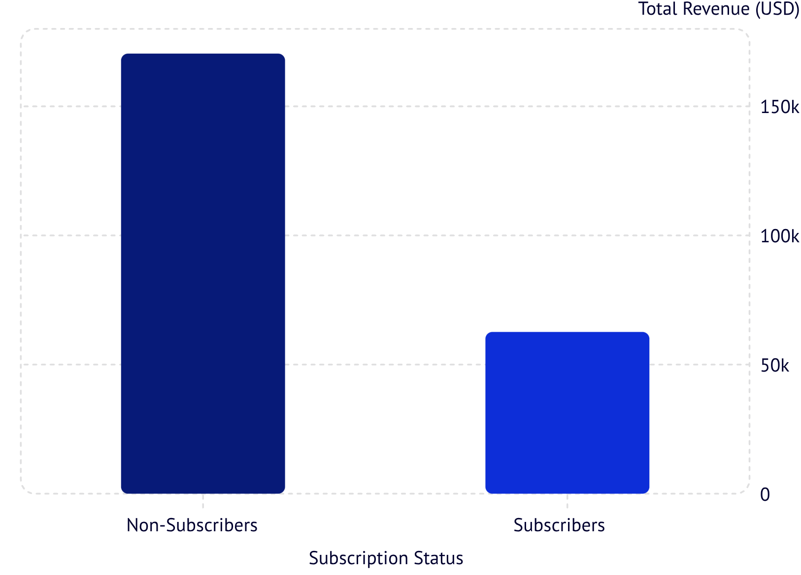

Subscribers vs. Non-Subscribers
Insight
Non-subscribers drive 73% of total revenue despite similar average spend
27% Subscribers
73% Non-Subscribers
1,053 customers · $59.49 avg
2,847 customers · $59.87 avg
Opportunity: Convert high-spend non-subscribers with exclusive benefits

Slide 6
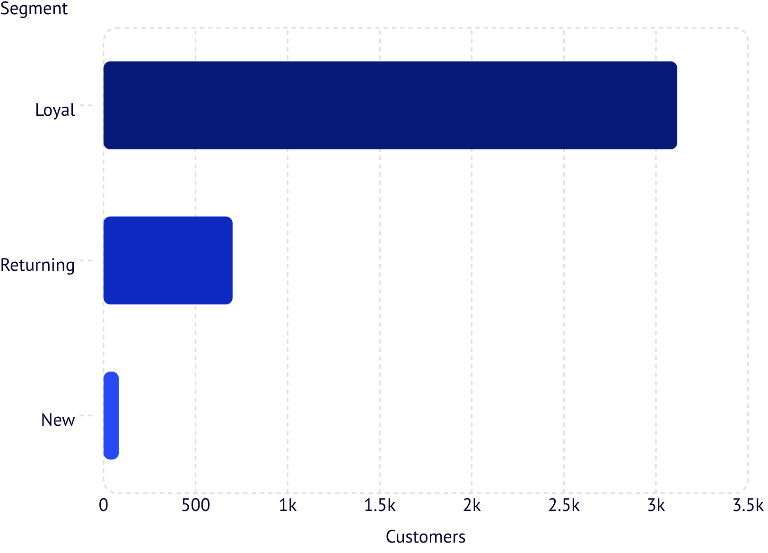

Customer Segmentation
Segment Breakdown
Loyal: 3,116 customers — largest segment
Returning: 701 customers — growth potential
New: 83 customers — acquisition focus
Repeat buyers with 5+ purchases: 958 subscribed vs. 2,518 did not

Slide 7
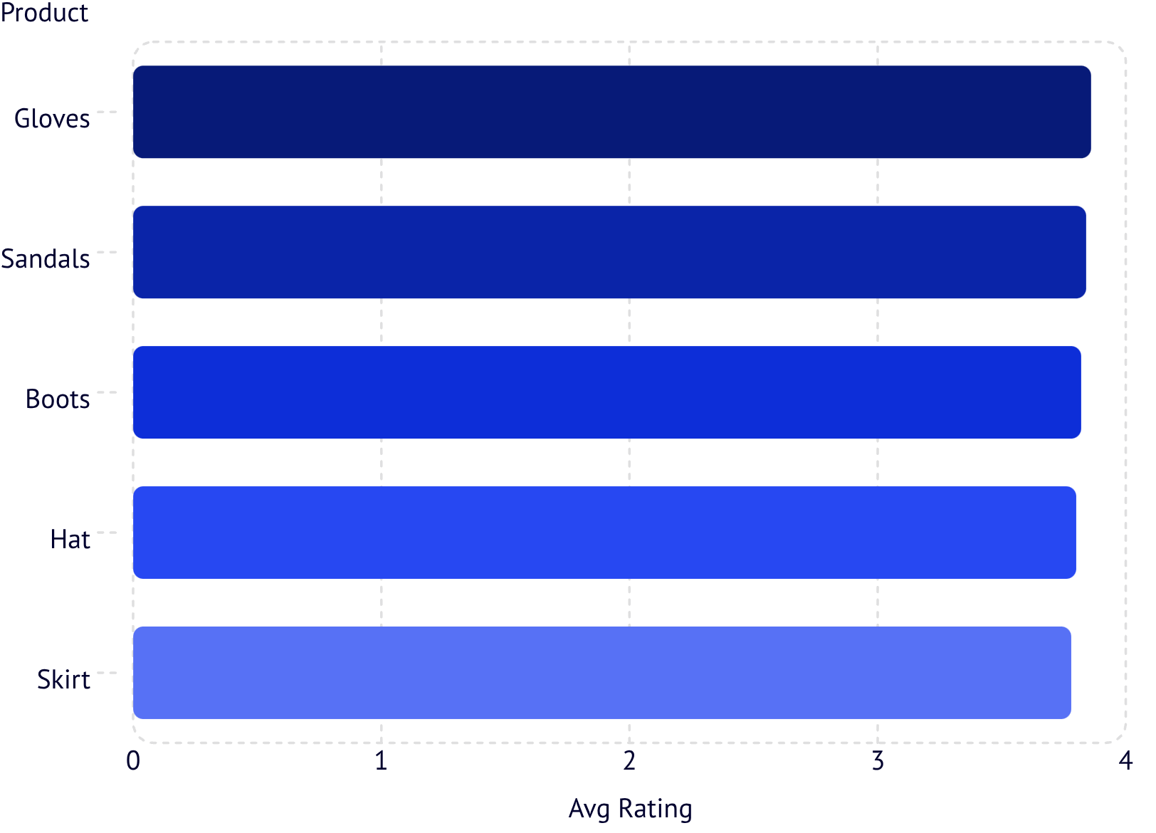
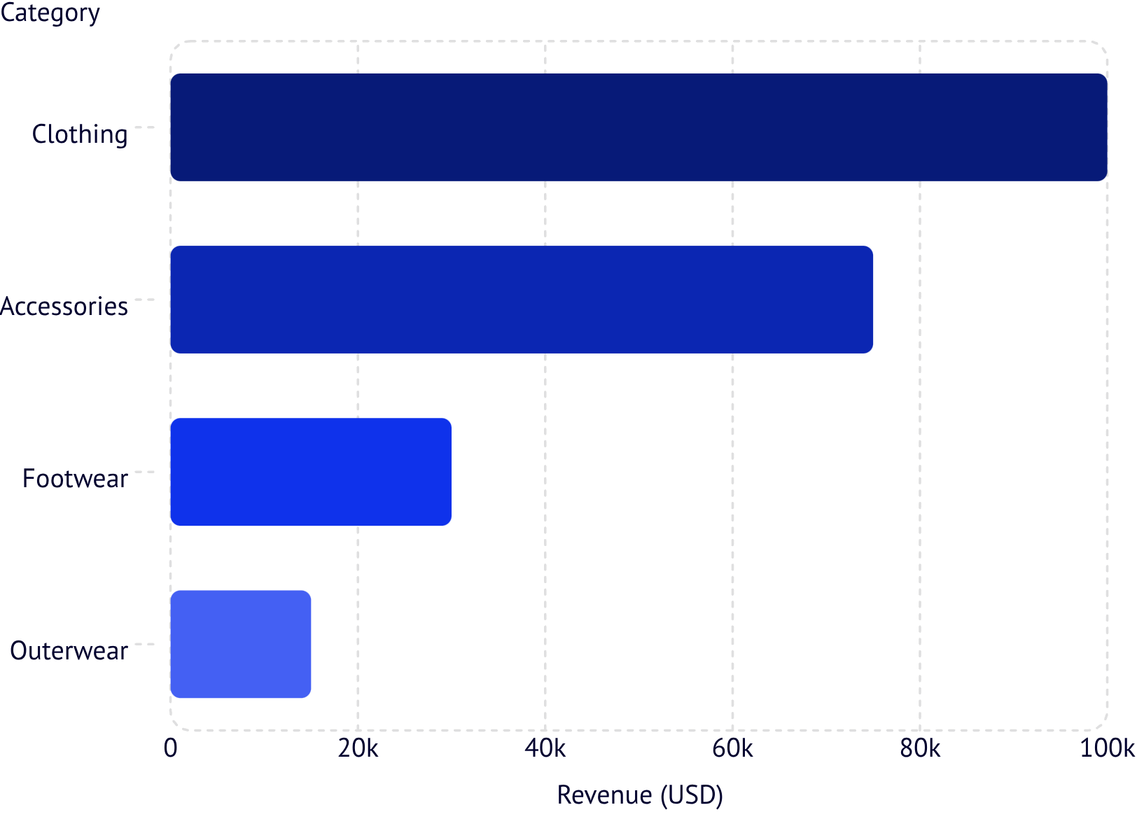
Top Products & Categories
Top 5 by Review Rating
Revenue by Category

Slide 8
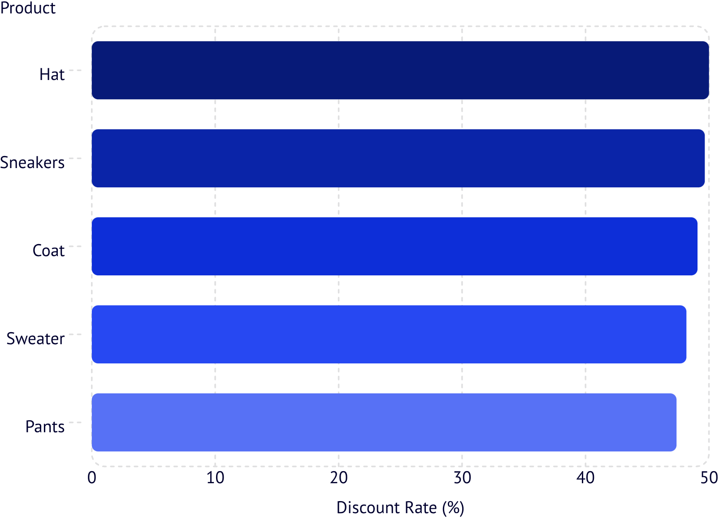


Discount Behavior & Shipping
Products Most Dependent on Discounts
Shipping Type Comparison
Standard Shipping
Express Shipping
Avg purchase: $60.48
Avg purchase: $58.46
Express shippers spend slightly more — potential upsell target

Slide 9
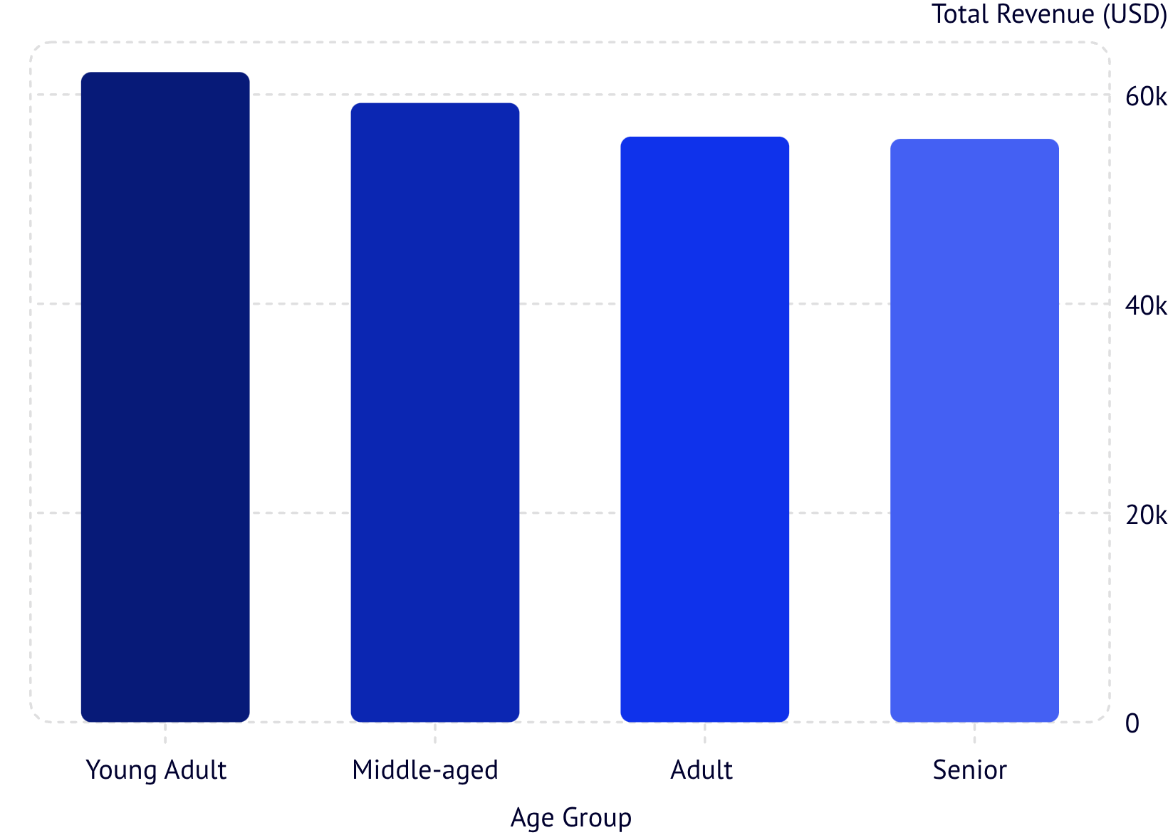
Revenue by Age Group
Key Insight
Young Adults lead revenue, but all groups are relatively balanced — broad targeting viable
Young Adult
Middle-aged
Adult
Senior
$62,143 · highest
$59,197
$55,978
$55,763

Slide 10
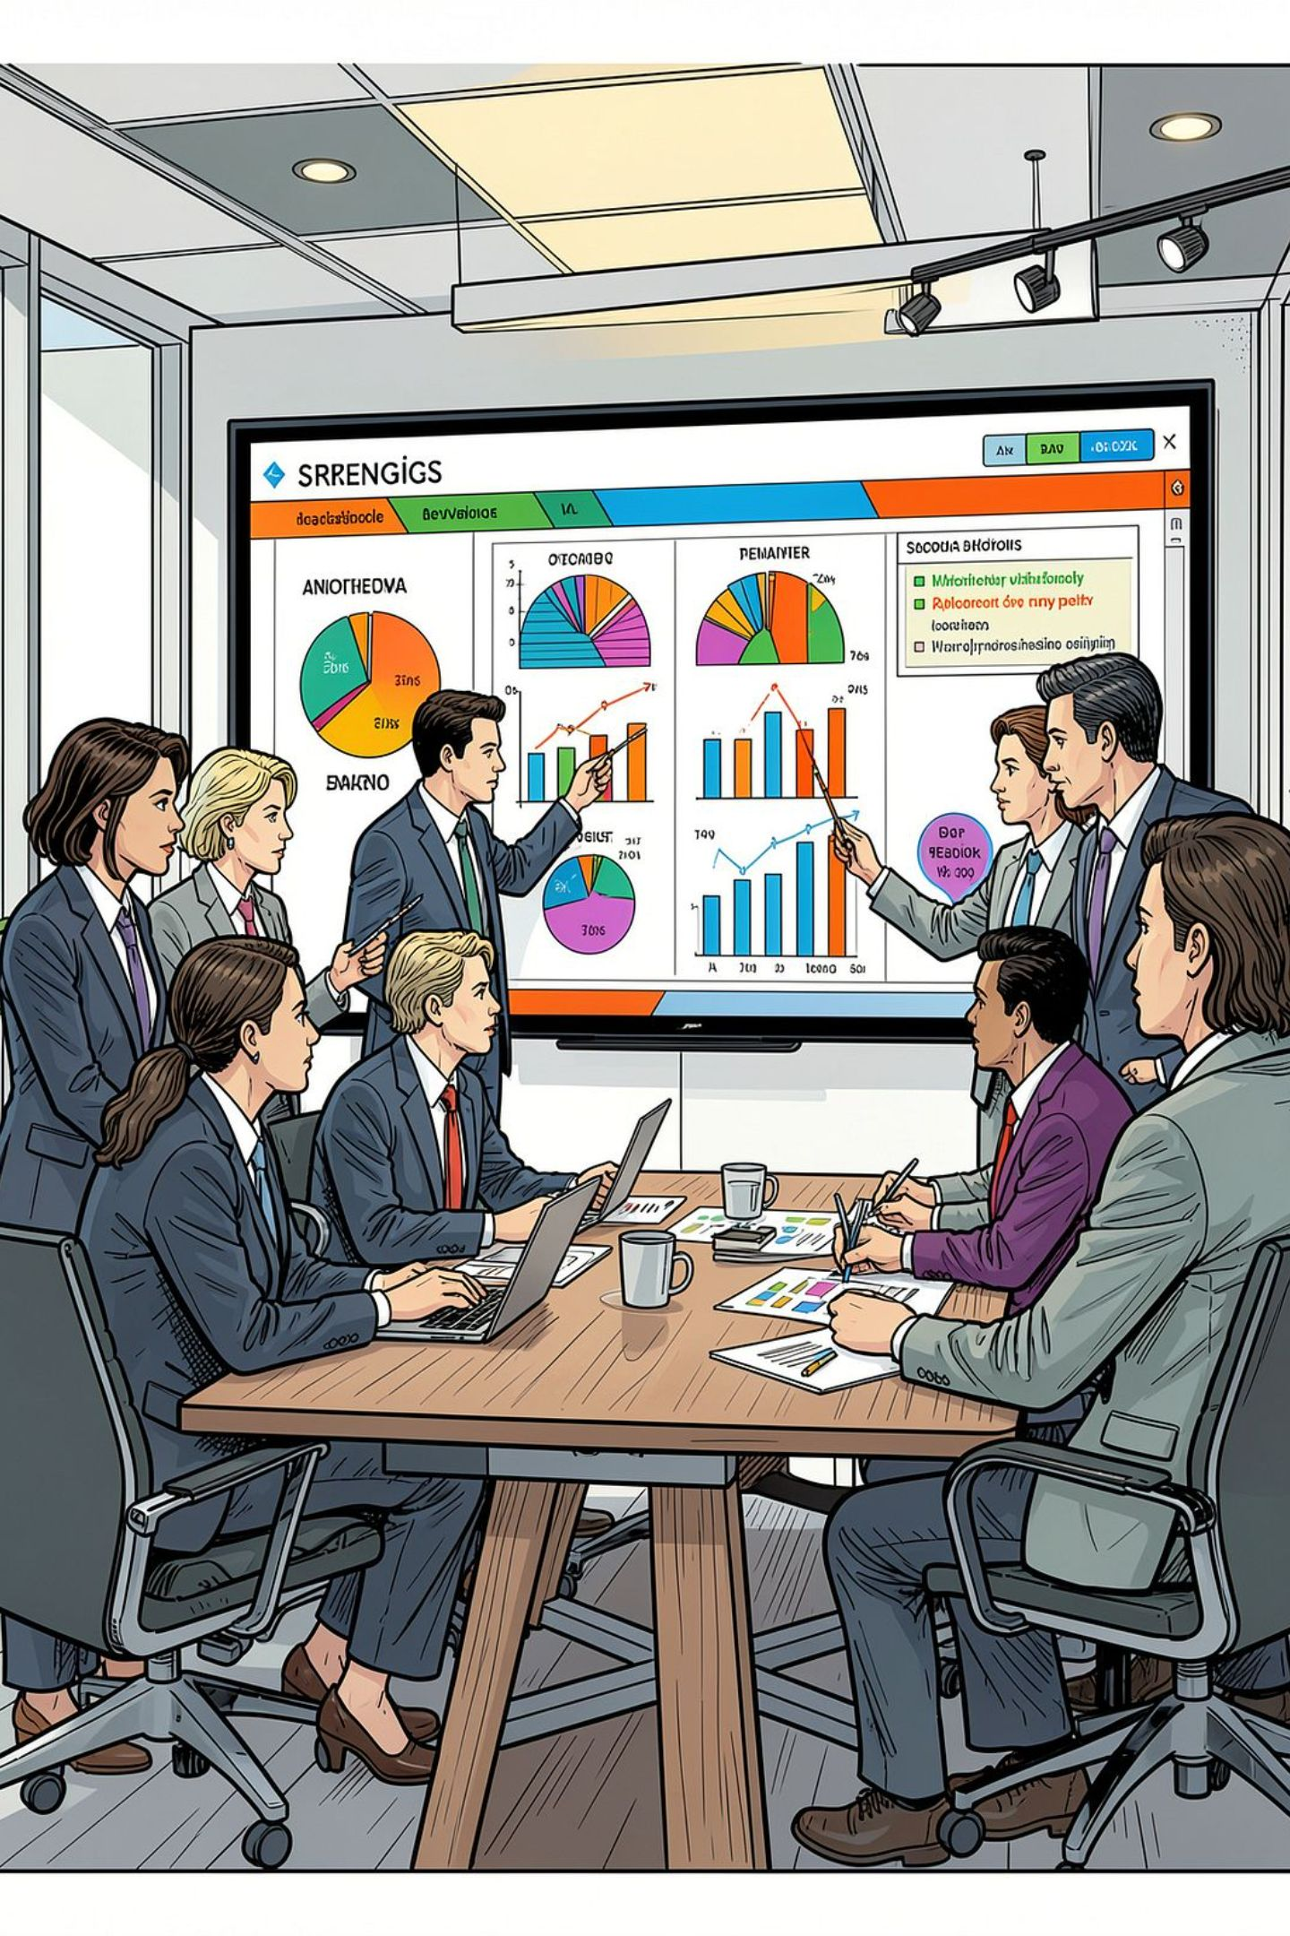




Business Recommendations
Boost Subscriptions
Promote exclusive subscriber benefits
Loyalty Programs
Reward repeat buyers to grow the Loyal segment
Review Discount Policy
Balance sales lift with margin control
Targeted Marketing
Focus on high-revenue age groups & express shippers

