Slide 1

Your First Data Science Program
Welcome to the exciting world of data science programming! This presentation will guide you through creating your first program.
We will analyze a dataset and compute basic statistics using Python. No prior coding experience is needed to start this journey!
NK
by Naveen K

Slide 2
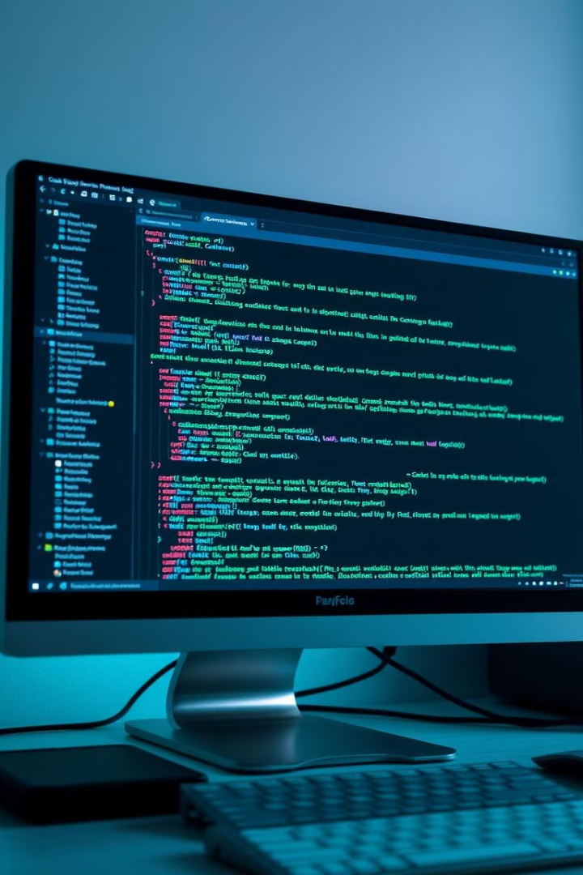
Setting Up Your Environment
Install Python
Choose an Editor
Download Python 3.7+ from python.org.
Select VS Code, Sublime Text, or IDLE.
Run Your Code
Save the file as a `.py` and run it from the terminal.
These steps ensure your environment is ready to write and execute Python code. Let's start building!

Slide 3
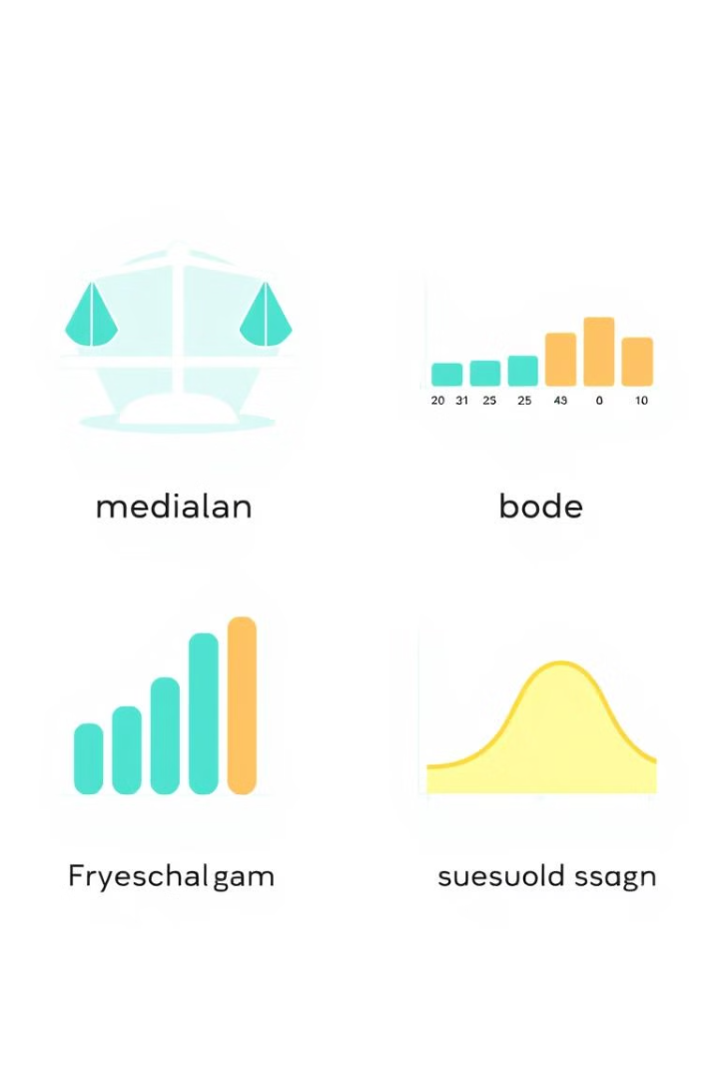



Calculating Descriptive Statistics
Import statistics
Access statistical functions.
Define the Data
Enter your dataset as a list.
Compute Statistics
Calculate mean, median, mode, and standard deviation.
This module will enable you to compute essential descriptive statistics for data analysis.

Slide 4
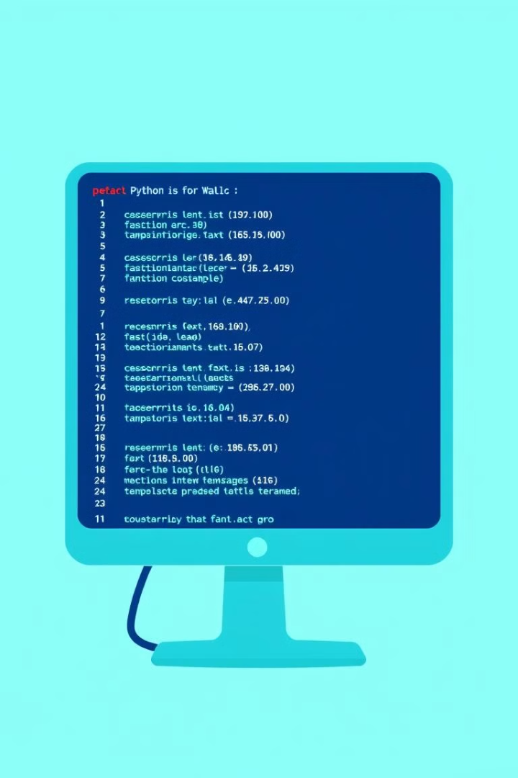



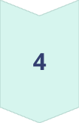
Complete Code Example
Import Module
import statistics
Define Data
data = [22, 28, 24, 30, 26, 22]
Calculate Statistics
mean = statistics.mean(data)
median = statistics.median(data)
mode = statistics.mode(data)
stdev = statistics.stdev(data)
Print Results
print(mean, median, mode, stdev)
This example demonstrates the simple process of calculating statistics. Now you can use it in your own analysis!

