Slide 1
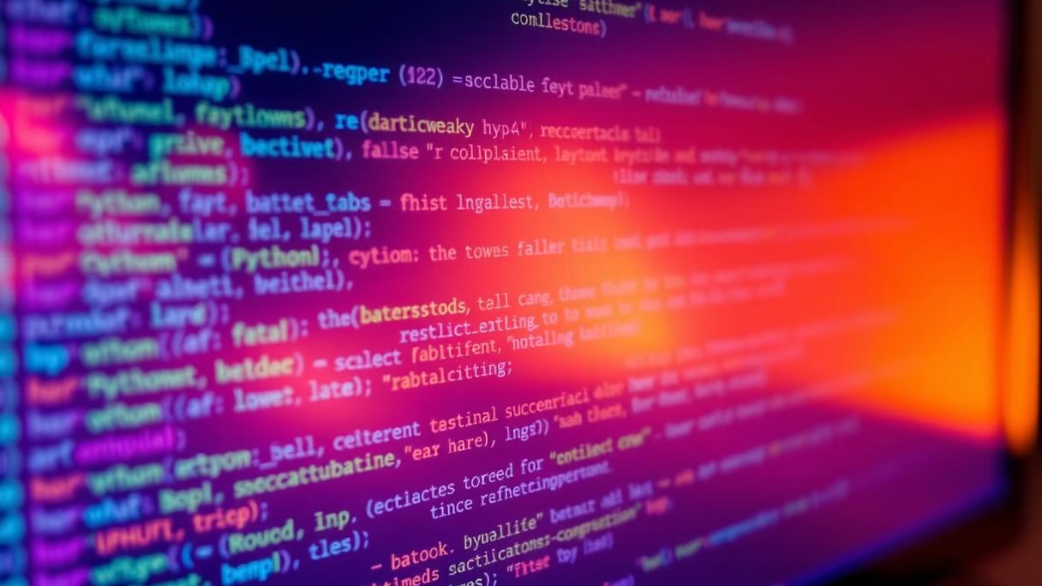
Assignment: Python Basics
This assignment covers the fundamental concepts of Python programming, aimed at beginners with little to no prior coding experience. It introduces Python's core features, its advantages, and the initial steps for setting up a working development environment. Each section includes explanations and simple examples to reinforce learning, culminating in a practical exercise to write and execute basic Python code.
by Naveen K
NK

Slide 2
Introduction to Python
What is Python?
Python is a high-level, interpreted, general-purpose programming language. High-level means that Python abstracts away many of the complexities of machine code, making it easier to write and understand. As an interpreted language, Python code is executed line by line by an interpreter, rather than being compiled into machine code beforehand. This makes Python more flexible and easier to debug. Finally, general-purpose indicates that Python can be used for a wide variety of applications, from web development and data science to automation and scripting.
Why Python?
Python’s popularity stems from several key advantages. Its readability is a major draw, as its syntax emphasizes clarity and conciseness, making code easier to read and maintain. A large community provides extensive support, resources, and libraries, which speeds up development and problem-solving. Python also boasts extensive libraries, such as NumPy, pandas, and Django, that offer pre-built functionalities for tasks ranging from numerical computation to web framework implementation.
Setting up your Python environment
To start coding in Python, you need to set up a development environment. One popular method is using Anaconda, a distribution that includes Python, essential packages, and a package manager. Alternatively, you can use pip, Python's package installer, to manage packages manually. For project-specific dependencies, it's recommended to use virtualenv or venv, which create isolated environments for each project.
Running Python code
Python code can be executed in two primary ways: interactive mode and script execution. Interactive mode allows you to type and execute code line by line in a Python shell, which is useful for quick testing and experimentation. To run a script, you save your code in a .py file and execute it using the Python interpreter. For example, python your_script.py.
Example: Simple "Hello, World!" program
Below is a basic "Hello, World!" program that demonstrates how to print text to the console:
# hello.py print("Hello, World!")
To run this program, save the code in a file named hello.py and execute it from your terminal using the command python hello.py. The output will be:
Hello, World!

