Slide 1
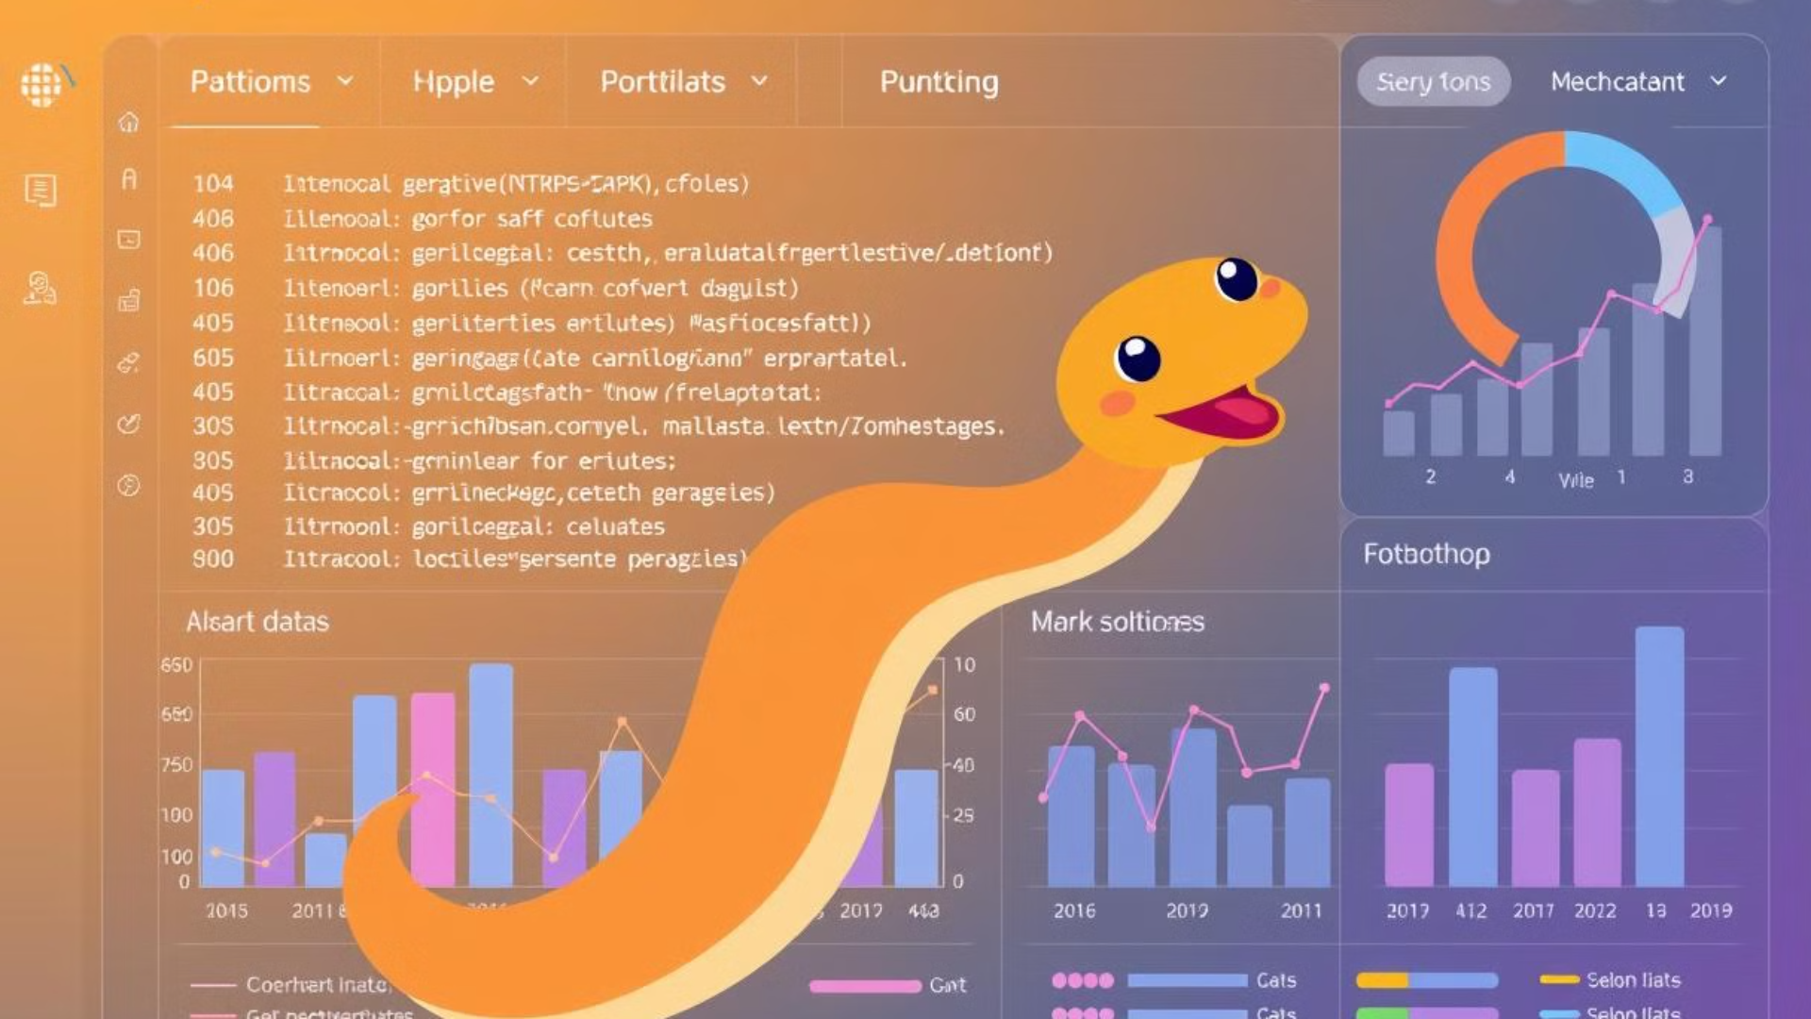
Assignment: Python Data Visualization
This assignment provides a comprehensive exploration of data visualization techniques using Python. It covers essential libraries such as Matplotlib, Seaborn, and Plotly, guiding students through basic and advanced plotting methods, data preparation, and interactive visualizations. Through practical examples and case studies, students will learn how to effectively analyze and present insights from real-world datasets. The assignment culminates in a submission that includes Python scripts, a Jupyter Notebook, and a detailed report, emphasizing code quality, visualization effectiveness, and clarity of insights.
by Naveen K
NK

Slide 2
Introduction to Data Visualization with Python
Data visualization is a critical skill in the field of data science, enabling us to transform raw data into meaningful and understandable insights. It involves the graphical representation of data, making it easier to identify patterns, trends, and outliers. Effective data visualization can enhance decision-making processes and facilitate communication of complex information to a broader audience.
Python offers several powerful libraries for data visualization, with Matplotlib, Seaborn, and Plotly being among the most popular. Matplotlib is a foundational library that provides a wide range of plotting options. Seaborn builds on top of Matplotlib, offering a higher-level interface with visually appealing default styles and specialized statistical plots. Plotly allows for creating interactive visualizations, enabling users to explore data dynamically through zooming, panning, and tooltips.
To get started, you'll need to install these libraries using pip, the Python package installer. Open your terminal or command prompt and run the following commands:
pip install matplotlib seaborn plotly
Choosing the right type of visualization is crucial for effectively communicating your data. Different data types require different visualization techniques. For example, line plots are suitable for showing trends over time, while bar charts are useful for comparing categorical data. Scatter plots can reveal relationships between two numerical variables, and histograms can display the distribution of a single variable.

Slide 3
Basic Plotting with Matplotlib
Matplotlib is a versatile library that serves as the foundation for many other Python visualization tools. It provides a wide array of plotting functions that allow you to create static, interactive, and animated visualizations. Let's explore some basic plot types:
Line Plots: Used to display the relationship between two continuous variables, often showing trends over time. For example, you can plot daily high temperatures for a month to visualize temperature changes.
Scatter Plots: Illustrate the relationship between two numerical variables. Each point on the plot represents a single data point. An example use case is visualizing the relationship between advertising spend and sales.
Bar Charts: Useful for comparing categorical data. Each bar represents a category, and the height of the bar corresponds to the value of that category. For instance, you can compare sales across different product categories.
Histograms: Display the distribution of a single numerical variable by dividing the data into bins and showing the frequency of values within each bin. A practical application is showing the distribution of customer ages.
Customization is key to making your plots clear and informative. Matplotlib provides extensive options for customizing titles, labels, legends, and annotations. Consider the following example:
import matplotlib.pyplot as plt # Sample data days = range(1, 31) temperatures = [75, 77, 78, 80, 82, 81, 79, 78, 77, 76, 75, 74, 73, 74, 76, 78, 80, 82, 83, 82, 81, 80, 79, 78, 77, 76, 75, 74, 73, 72] # Create the plot plt.plot(days, temperatures) # Add title and labels plt.title("Daily Temperatures in July") plt.xlabel("Day") plt.ylabel("Temperature (°F)") # Add a legend plt.legend(["Temperature"]) # Show the plot plt.show()
This code snippet demonstrates how to create a simple line plot and customize it with a title, axis labels, and a legend. Experiment with different customization options to enhance the clarity and impact of your visualizations.

Slide 4
Advanced Visualization with Seaborn
Seaborn is a Python data visualization library built on top of Matplotlib. It provides a high-level interface for creating informative and visually appealing statistical graphics. Seaborn simplifies the process of creating complex visualizations and offers aesthetically pleasing default styles. Let's explore some advanced visualization techniques using Seaborn:
Distribution Plots: Seaborn offers several functions for visualizing distributions, including `distplot`, `kdeplot`, and `rugplot`. `sns.distplot(data)` combines a histogram with a kernel density estimate (KDE) plot, providing a comprehensive view of the data's distribution. `kdeplot` displays the KDE, while `rugplot` shows individual data points along the x-axis. For example, `sns.distplot(house_prices)` visualizes the distribution of house prices.
Categorical Plots: These plots are designed for visualizing relationships between categorical and numerical variables. `boxplot`, `violinplot`, and `countplot` are commonly used. A boxplot displays the distribution of data based on quartiles and outliers. A violinplot combines a boxplot with a KDE, providing a more detailed view of the distribution. A countplot shows the count of observations in each category. For example, `sns.boxplot(x='education', y='income', data=df)` compares the distribution of income across different education levels.
Relational Plots: Used to explore relationships between two or more variables. `scatterplot` displays the relationship between two numerical variables as a collection of points. `lineplot` shows the relationship as a line, often used for time series data. For example, `sns.scatterplot(x='hours_studied', y='exam_score', data=df)` explores the relationship between hours studied and exam scores.
Heatmaps: Useful for visualizing correlation matrices or other two-dimensional data. A heatmap uses colors to represent the values in the matrix, making it easy to identify patterns and correlations. For example, `sns.heatmap(df.corr(), annot=True)` visualizes the correlation between different features in a dataset.
Seaborn also includes built-in datasets like `iris` and `titanic`, which are excellent for practicing and experimenting with different visualization techniques. These datasets provide a variety of data types and relationships to explore.
import seaborn as sns # Load the iris dataset iris = sns.load_dataset('iris') # Create a scatter plot sns.scatterplot(x='sepal_length', y='sepal_width', hue='species', data=iris)
This example demonstrates how to load the `iris` dataset and create a scatter plot showing the relationship between sepal length and sepal width, with different species distinguished by color.

Slide 5
Interactive Visualizations with Plotly
Plotly is a powerful Python library for creating interactive visualizations that can be easily shared online. Interactive plots allow users to zoom, pan, hover, and explore data dynamically, providing a richer and more engaging experience. Plotly supports a wide range of plot types, including scatter plots, line charts, bar charts, and 3D plots. Let's explore some examples:
Scatter Plots: Create interactive scatter plots to visualize relationships between two or more variables. Each point represents a data point, and users can hover over points to see additional information. For example, you can create an interactive scatter plot of stock prices, with tooltips showing the date and price for each point.
Line Charts: Visualize time series data with interactive range sliders. Users can zoom in on specific time periods and explore trends in detail. This is particularly useful for analyzing stock prices, website traffic, or other time-dependent data.
Bar Charts: Create interactive bar charts to compare sales performance across regions or product categories. Users can hover over bars to see exact values and compare different segments of the data.
3D Scatter Plots: Visualize three-dimensional data, such as customer demographics with income, age, and education. These plots allow users to rotate the view and explore the data from different angles.
Plotly Express provides a high-level interface for creating visualizations quickly and easily. For example, you can use `plotly.express` to create a scatter plot with marginal histograms, showing the distribution of each variable along the axes:
import plotly.express as px # Sample data data = px.data.iris() # Create a scatter plot with marginal histograms fig = px.scatter(data, x="sepal_width", y="sepal_length", color="species", marginal_x="rug", marginal_y="histogram") fig.show()
This code snippet demonstrates how to create an interactive scatter plot with marginal histograms using Plotly Express. The `marginal_x` and `marginal_y` parameters add rug plots and histograms along the x and y axes, respectively. Experiment with different plot types and customization options to create engaging and informative interactive visualizations.

Slide 6
Data Preparation and Transformation for Visualization
Before visualizing data, it's often necessary to clean, transform, and aggregate it to ensure accuracy and effectiveness. Data preparation is a crucial step in the data visualization process, as it can significantly impact the quality and interpretability of your visualizations. Here are some key techniques:
Data Cleaning: Handling missing values and outliers is essential for ensuring data quality. Missing values can be imputed using mean, median, or other appropriate methods. Outliers can be identified and removed or transformed to reduce their impact. For example, you can impute missing values using the mean:
import pandas as pd # Sample data with missing values data = {'A': [1, 2, None, 4, 5]} df = pd.DataFrame(data) # Impute missing values with the mean df['A'].fillna(df['A'].mean(), inplace=True)
Data Transformation: Scaling, normalization, and creating new features can improve the performance of visualization algorithms and enhance the interpretability of your data. Scaling and normalization transform numerical features to a similar range, preventing features with larger values from dominating the analysis. For example, you can use `sklearn.preprocessing.StandardScaler` to scale numerical features:
from sklearn.preprocessing import StandardScaler # Sample data data = {'A': [1, 2, 3, 4, 5]} df = pd.DataFrame(data) # Scale the data scaler = StandardScaler() df['A'] = scaler.fit_transform(df[['A']])
Data Aggregation: Grouping and summarizing data can simplify complex datasets and highlight key trends. This involves calculating summary statistics such as mean, median, sum, or count for different groups of data. For example, you can calculate the average sales per month and visualize the trend:
import pandas as pd # Sample sales data data = {'Date': ['2023-01-01', '2023-01-15', '2023-02-01', '2023-02-15'], 'Sales': [100, 150, 200, 250]} df = pd.DataFrame(data) df['Date'] = pd.to_datetime(df['Date']) # Calculate average sales per month monthly_sales = df.groupby(df['Date'].dt.month)['Sales'].mean()
Pandas is a powerful library for data manipulation, providing functions for loading, filtering, and transforming data. For example, you can load a CSV file using `pd.read_csv()` and filter data based on a condition:
import pandas as pd # Load a CSV file df = pd.read_csv('sales_data.csv') # Filter data based on a condition filtered_df = df[df['Region'] == 'North']
By mastering these data preparation and transformation techniques, you can ensure that your visualizations are accurate, informative, and visually appealing.

Slide 7
Case Studies: Visualizing Real-World Datasets
To solidify your understanding of data visualization techniques, let's explore some case studies using real-world datasets:
Analyzing Sales Data: Visualize sales trends, product performance, and customer behavior using a sample sales dataset with columns like 'Date', 'Product', 'Region', and 'Sales'. You can create line charts to visualize sales trends over time, bar charts to compare product performance across regions, and scatter plots to explore the relationship between sales and customer demographics.
Exploring Customer Demographics: Visualize customer segments and identify key characteristics using customer data with columns like 'Age', 'Income', 'Education', and 'Location'. You can create histograms to visualize the distribution of customer ages and incomes, boxplots to compare income levels across different education levels, and maps to visualize customer distribution by location.
Visualizing Social Media Data: Analyze trends, sentiment, and engagement using Twitter data with columns like 'Date', 'Text', 'Retweets', and 'Favorites'. You can create line charts to visualize trends in tweet volume over time, word clouds to visualize the most frequent words in tweets, and sentiment analysis to visualize the distribution of positive, negative, and neutral sentiments.
After creating these visualizations, it's essential to present insights and recommendations based on your findings. For example, you might identify that sales are declining in a particular region and recommend targeted marketing campaigns to boost sales. Or you might discover that a particular product is popular among a specific customer segment and recommend focusing marketing efforts on that segment. Effective communication of insights is crucial for driving data-informed decision-making.
When working with real-world datasets, it's important to consider the context and objectives of your analysis. What questions are you trying to answer? What insights are you hoping to uncover? By keeping these questions in mind, you can ensure that your visualizations are relevant, informative, and actionable.

Slide 8
Conclusion and Submission Guidelines
This assignment has provided a comprehensive introduction to data visualization with Python, covering essential libraries like Matplotlib, Seaborn, and Plotly. You've learned how to create basic and advanced plots, prepare and transform data, and create interactive visualizations. Through practical examples and case studies, you've gained experience in analyzing real-world datasets and presenting insights.
To summarize, the key concepts and techniques covered in this assignment include:
Installing and using Matplotlib, Seaborn, and Plotly.
Creating line plots, scatter plots, bar charts, histograms, and other basic plot types.
Using Seaborn for advanced statistical visualizations.
Creating interactive visualizations with Plotly.
Cleaning, transforming, and aggregating data for visualization.
Analyzing sales data, customer demographics, and social media data.
Presenting insights and recommendations based on visualizations.
Your submission should include the following:
Python script(s) containing the code for your visualizations.
A Jupyter Notebook demonstrating your data analysis and visualization process.
A brief report summarizing your findings and insights.
The grading criteria will focus on:
Code quality: clear, well-documented, and efficient code.
Visualization effectiveness: informative, visually appealing, and appropriate visualizations for the data.
Clarity of insights: clear and concise presentation of findings and recommendations.
The due date for this assignment is [Insert Date]. Please submit a Jupyter Notebook named `visualization_assignment.ipynb` and a PDF report named `visualization_report.pdf`.

