Slide 1
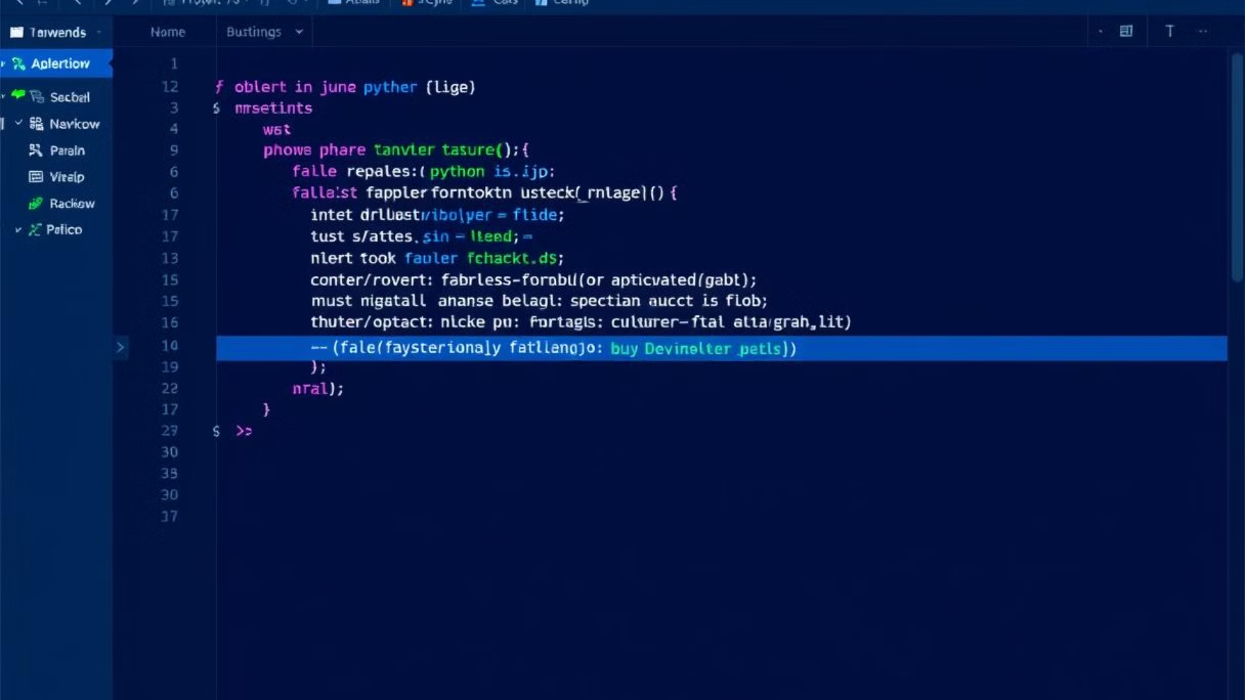
Introduction to Python for Data Science
This document provides an overview of the fundamentals of using Python for data science. Python, a high-level, interpreted, general-purpose programming language, has become a cornerstone in the field of data analysis, machine learning, and scientific computing. Its key features, including readability, extensive libraries, and a large community, make it an ideal choice for both beginners and experts. The document outlines the essential aspects of Python, from setting up the development environment to implementing basic machine learning models, and will guide you through the core concepts and techniques necessary to effectively utilize Python in data science projects.
Python consistently ranks in the top 3 programming languages according to the TIOBE Index, underscoring its popularity and widespread adoption in various industries. Its versatility allows it to be used in a multitude of applications, making it a valuable skill for anyone looking to enter or advance in the field of data science.
We'll start by setting up your environment with Python, Anaconda, and Jupyter Notebook. Anaconda, a distribution, includes Python, essential data science libraries, and tools for package management. Jupyter Notebook is an interactive environment that allows you to write code and documentation.
NK
by Naveen K

Slide 2
Essential Python Libraries for Data Science
Python's extensive library ecosystem is one of its greatest strengths, providing a wealth of tools and functions to tackle almost any data science task. Among the most crucial libraries are NumPy, Pandas, Matplotlib, and Seaborn. Each of these libraries serves a specific purpose, enabling efficient numerical computing, data manipulation, and visualization.
NumPy provides efficient storage and manipulation of numerical data, offering array creation, indexing, slicing, and mathematical operations. NumPy arrays are faster than lists for numerical operations due to memory allocation and optimized algorithms. Pandas is a library for data manipulation and analysis with Pandas DataFrames, which are tabular data structures for data cleaning, transformation, and analysis. Pandas allows for data loading, filtering, grouping, and merging. Matplotlib is a plotting library for creating charts and graphs. Seaborn enhances visualizations with statistical plots and builds on Matplotlib to create appealing statistical graphics. Types of visualization include line plots, scatter plots, bar charts, histograms, and box plots.
These libraries form the backbone of most Python-based data science workflows, enabling users to efficiently process, analyze, and present their findings.

Slide 3
Python Data Structures
Understanding Python's built-in data structures is fundamental to efficient data manipulation and algorithm design. Python offers several versatile data structures, including lists, dictionaries, tuples, and sets, each with unique characteristics and use cases.
Lists are ordered collections of items that can be of different types, and are used for indexing, slicing, appending, inserting, and removing elements. They are dynamic and can grow as needed. Dictionaries are collections of key-value pairs that provide efficient lookups. Tuples are ordered, immutable collections of items often used to represent fixed collections of data and include indexing and slicing. Sets are unordered collections of unique elements used for adding/removing elements, checking membership, and performing operations like union, intersection, and difference.
These data structures enable efficient manipulation and organization of data, forming the basis for more complex data analysis and algorithms. The choice of data structure depends on the specific requirements of the task.

Slide 4
Data Manipulation with Pandas
Pandas is a powerful library that provides tools for data manipulation. It's essential for cleaning, transforming, and preparing data for analysis.
Pandas can read data from CSV, Excel, JSON, and SQL databases. To handle missing values, Pandas can impute them by replacing them with the mean, median, or mode, or by removing them. Real-world datasets often contain 5-20% missing values that must be handled carefully. With Pandas, data can be filtered and selected using boolean indexing, which allows for selection based on conditions. Column selection can be done using column names or indexes.
Pandas also allows data aggregation through GroupBy operations that split data into groups based on one or more columns. Aggregation functions like sum, mean, count, min, and max can be applied to each group. Furthermore, transformations can be applied to columns using lambda functions to create new features, which can improve machine learning model performance by 10-30%.

Slide 5
Data Analysis with Pandas
After data manipulation, Pandas provides tools for analyzing data. This involves descriptive statistics, correlation analysis, pivot tables, and time series analysis.
Pandas provides functions for calculating descriptive statistics of DataFrames, including mean, median, and standard deviation. Correlation coefficients measure the strength and direction of linear relationships between variables, ranging from -1 to +1. Pivot tables allow summarizing data in a table format with rows, columns, and values and are used to aggregate data based on multiple dimensions. For time series analysis, Pandas provides functionalities for working with time series data, such as resampling, shifting, and rolling window calculations.
These functionalities enable data scientists to gain insights into their data and identify patterns and trends. This supports informed decision-making and predictive modeling.

Slide 6
Data Visualization
Data visualization is a crucial step in the data science process, allowing you to communicate insights effectively. Python offers multiple visualization libraries, including Matplotlib and Seaborn, each with its strengths and capabilities.
Matplotlib provides basic plotting functionalities for creating plots and charts, including line plots, scatter plots, bar charts, and histograms. The appearance can be customized with titles, labels, and legends. Seaborn enhances visualizations with distribution plots, regression plots, and categorical plots and offers themes and color palettes.
Visualization best practices include choosing the right chart type, such as bar charts for comparing categories and line plots for showing trends over time. Avoiding chartjunk, using clear labels and titles, and choosing appropriate scales are also important. With data visualization, you can extract meaning from the raw data and present it in a format that is easily understood.

Slide 7
Basic Machine Learning with scikit-learn
Scikit-learn is a library that provides efficient tools for data mining and data analysis. It includes algorithms for classification, regression, clustering, dimensionality reduction, model selection, and preprocessing.
For supervised learning, scikit-learn offers linear regression for predicting continuous values and logistic regression for predicting binary outcomes. Model performance can be evaluated using metrics like mean squared error, accuracy, precision, recall, and F1-score. For unsupervised learning, K-means clustering is used for grouping data points into clusters based on similarity. Splitting data into training and testing sets helps evaluate model performance on unseen data. Cross-validation is used for estimating model performance on unseen data, while hyperparameter tuning uses grid search.
These machine-learning tools allow you to build and evaluate predictive models, enhancing your data science skills.

Slide 8
Conclusion
This document covered the basic concepts and techniques for using Python in data science. It discussed Python, its essential libraries, data structures, manipulation, analysis, visualization, and machine learning. These concepts are the foundation for more advanced topics and real-world applications.
For further learning, online courses, tutorials, books, and communities such as Kaggle, Coursera, edX, DataCamp, and Stack Overflow offer a wealth of information. The practical applications of Python in data science are vast, with real-world examples spanning industries such as finance, healthcare, marketing, and transportation.
Python's versatility, extensive libraries, and strong community support make it an excellent choice for data science tasks. By mastering the concepts outlined in this document, you will be well-equipped to tackle various data science challenges and unlock the potential of data-driven insights.

