Slide 1
TOPIC
Thomas Anderl
Christopher Dick
Timon Höbert
Markus Klein
Julian Lemmel
Card Detector:
Playing Card Recognition with Image Processing

Slide 2
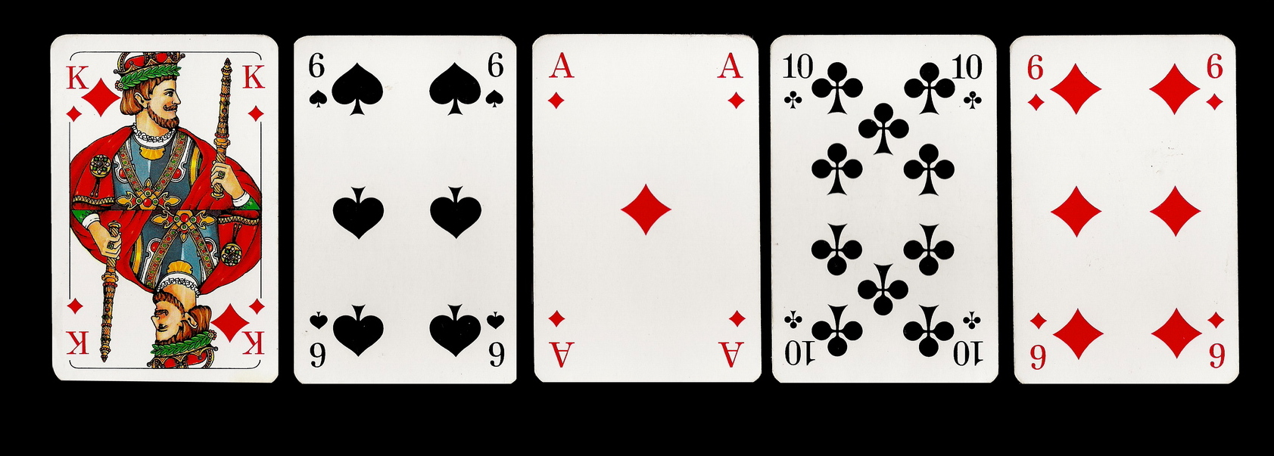
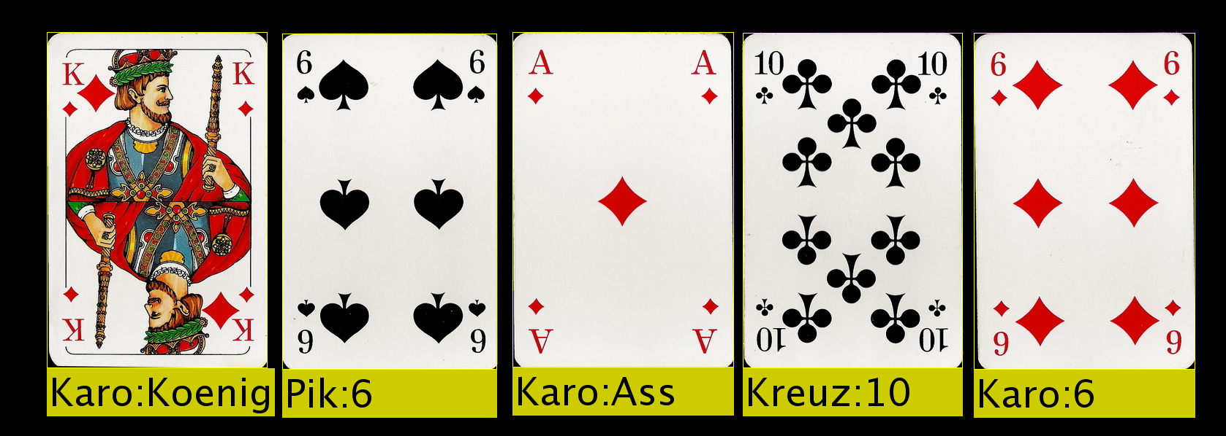
IDEA
Input
card detection
Output
Card Detector: Playing Card Recognition with Image Processing

Slide 3
PROCESS
Input
Image
Preprocessing
Segmentation
Value Detection
Annotation
Output
Image
check input and arguments
smooth input image (gauss)
binary image with Otsu threshold

Slide 4
PROCESS/SEGMENTATION
Input
Image
Preprocessing
Segmentation
Value Detection
Annotation
Output
Image
connected component labeling
bounding boxes (bbox) of labels
sort boxes by area
crop box
if smaller than 90% of first card:
discard
else:
keep and save as card

Slide 5


PROCESS/VALUE DETECTION
Input
Image
Preprocessing
Segmentation
Value Detection
Annotation
Output
Image
value bbox
symbol box
template matching
crop for symbol counting
min()
padAndDelete()

Slide 6


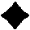



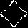


PROCESS/TEMPLATE MATCHING
Input
Image
Preprocessing
Segmentation
Value Detection
Annotation
Output
Image
TEMPLATE MATCHING:
load predefined templates
difference of input symbol and each template
minimum of difference images is symbol
-
-
-
-
=
=
=
=
min

Slide 7
PROBLEMS
NEED TO SOLVE:
implementation of ccl
redo test data (better exposure, additional deck)
NO NEED TO WORK ON YET:
cards not parallel to image edges
self implemented functions extremely slow
costly function calls (relabeling, iterating over all bounding boxes)
version handling

