Slide 1
TOPIC
Thomas Anderl
Christopher Dick
Timon Höbert
Markus Klein
Julian Lemmel
Card Detector:
Playing Card Recognition with Image Processing

Slide 2
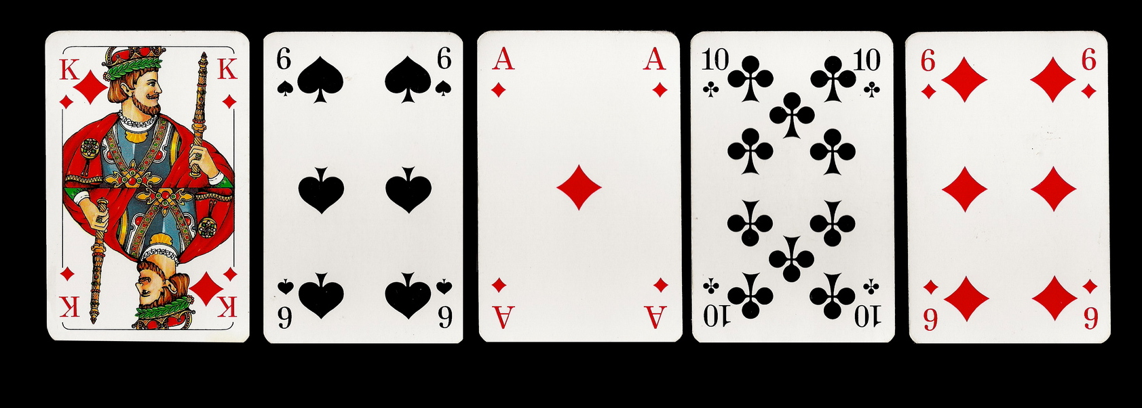
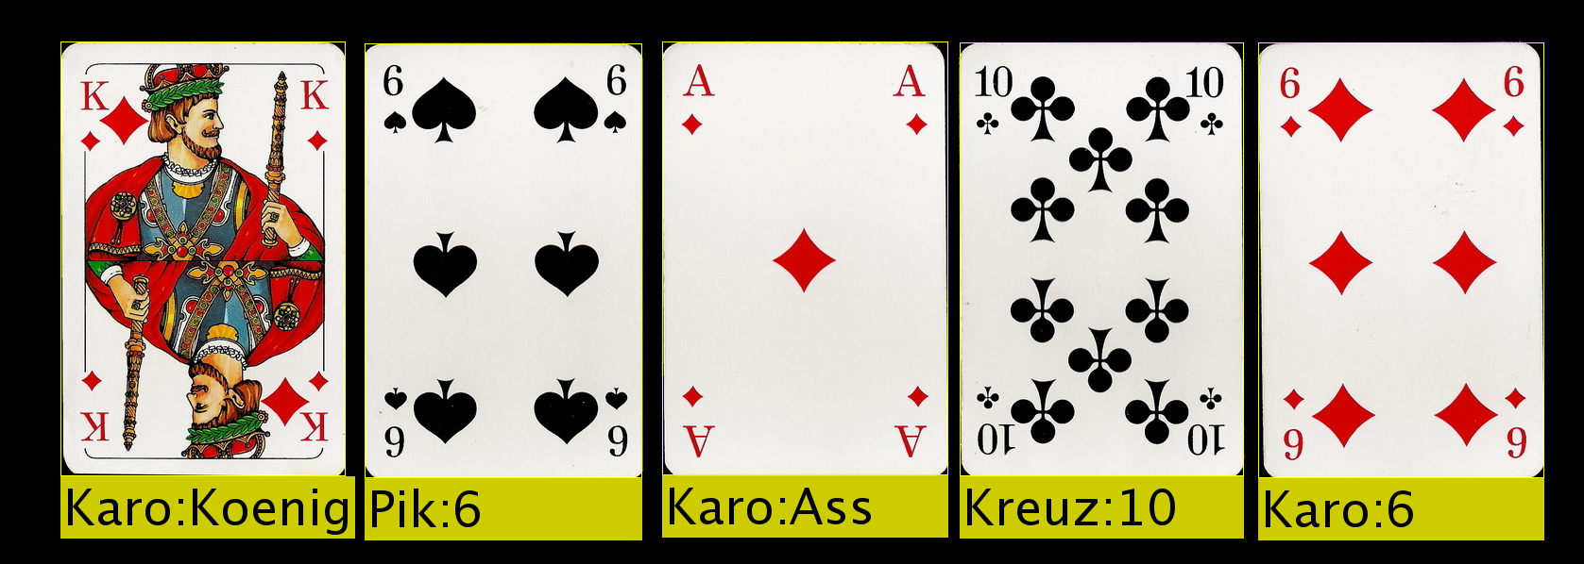
IDEA
Input
card detection
Output

Slide 3
PRECONDITIONS
card deck (french suite):
  colors: Clubs, Spades, Hearts, Diamonds
  ranks: Ace, 2-10, B, D, K
  symmetrical around middle (up-down)
  color and rank at least in upper-left/lower-right corner
background uniform colored and not white
view from above (no perspective distortion)
card edges parallel to image edges (any orientation)
no overlapping of cards

Slide 4
PROCESS
Input
Image
Preprocessing
Segmentation
Value Detection
Annotation
Output
Image
check input and arguments
smooth input image (gauss)
binary image with Otsu threshold

Slide 5
PROCESS/SEGMENTATION
Input
Image
Preprocessing
Segmentation
Value Detection
Annotation
Output
Image
connected component labeling
bounding boxes (bbox) of labels
sort boxes by area
crop box
if smaller than 90% of first card:
discard
else:
keep and save as card

Slide 6
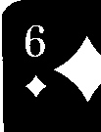

PROCESS/VALUE DETECTION
Input
Image
Preprocessing
Segmentation
Value Detection
Annotation
Output
Image
value bbox
symbol bbox
template matching
crop for symbol counting
min()
padAndDelete()

Slide 7









PROCESS/TEMPLATE MATCHING
Input
Image
Preprocessing
Segmentation
Value Detection
Annotation
Output
Image
TEMPLATE MATCHING:
load predefined templates
difference of input symbol and each template
minimum of difference images is symbol
-
-
-
-
=
=
=
=
min

Slide 8
PROBLEMS
rotation only possible if 90° (others require knowledge about aspect ratio of card)
self implemented functions extremely slow
version handling (minor issues)

Slide 9
EVALUATION

Slide 10
EVALUATION
PROBLEMS
different card sizes (due to relative selection of first card)
template matching (low res. symbols; different fonts)
lighting conditions (reflection, different shades of white)
limited number of stored cards (easily fixed)
RESULTS
satisfying outcome
preconditions became weaker
evaluation based concerns may be fixed with more time

