Slide 1

XIAOMAI
Developed by
Chayut Anegsiripong 63011133
Jirapad Sanguanpan 63011137
Navin Jongyin 63011210
Notes:
Hello our app is call XIAOMAI and is develop by Chayut, Jirapad and Navin

Slide 2
Content
Why XIAOMAI
About XIAOMAI
About Firesbase
Function of XIAOMAI
Notes:
Here are the content of our presentation.

Slide 3
Why XIAOMAI?
XIAOMAI is all in one application
User don’t have to switch to other application all the time
XIAOMAI provide study environment for student
XIAOMAI also is a great application for online study
Notes:
Why should you choose XIAOMAI
XIAOMAI is an all in one application which provide many functions for users to enjoy.
User don't have to switch to other app
XIAOMAI provides a study environment for student and is also a great application for online study.

Slide 4



About XIAOMAI
Language : Java
IDE/Tester : Android Studio
Firebase : Database, Storage, Authentication
Notes:
About XIAOMAI
XIAOMAI is develop with Java and Android Studio with help of firebase use for authentication and storage

Slide 5
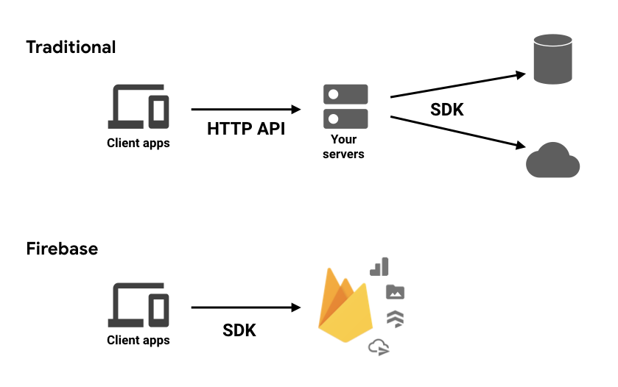
About Firebase
Notes:
So what is Firebase?
Firebase is Google's mobile application development platform that provides functionalities and helps with the backend development of Android, IOS, or web products.
Normally we have to build services by ourselves but with the help of firebase we can focus on the app experience itself.
some of the top functionalities are:
1.Authentication — takes care of getting users logged in and identified.
2.Realtime Database — is Firebase's original database. It's an efficient, low-latency solution for mobile apps that require synced states across clients in realtime.
3.Cloud Firestore — is Firebase's newest database for mobile app development. It builds on the successes of the Realtime Database with a new, more intuitive data model. Cloud Firestore also features richer, faster queries and scales further than the Realtime Database.
4.Cloud Storage — provides massively scalable file storage.

Slide 6
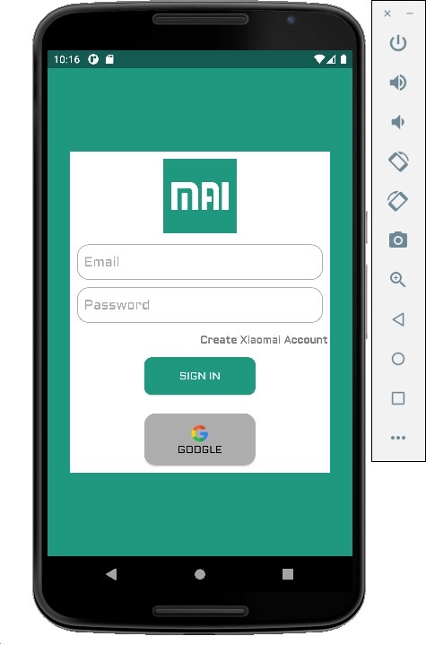
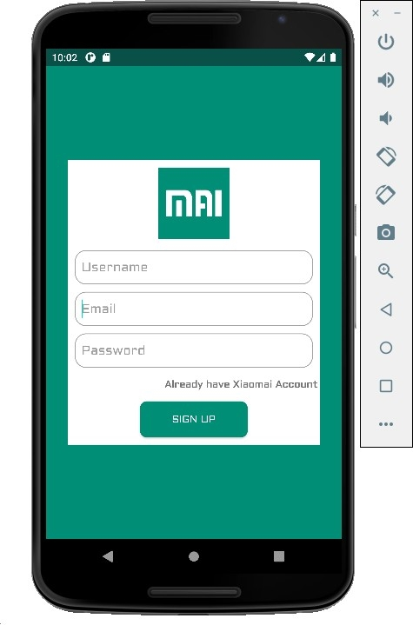
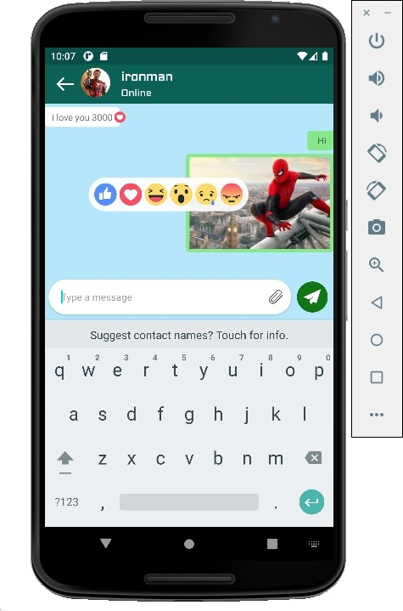
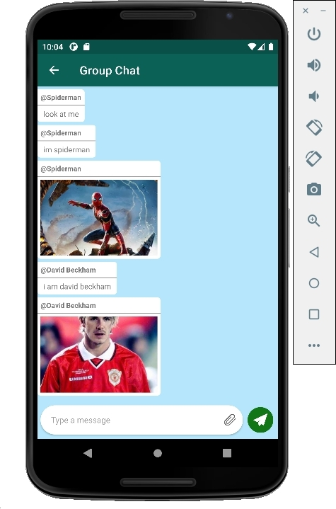
Function of XIAOMAI including:
Main:
- Login System: User can create or sign up account to prevent unauthorized access to confidential data.
- Messaging: User can send message to other user or group in application.

Slide 7
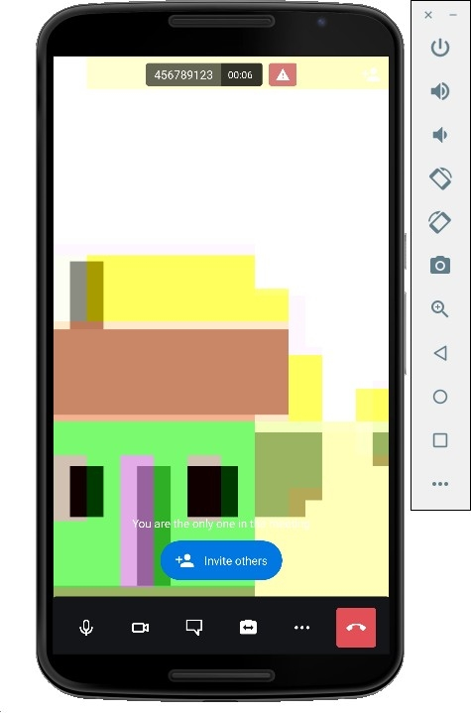
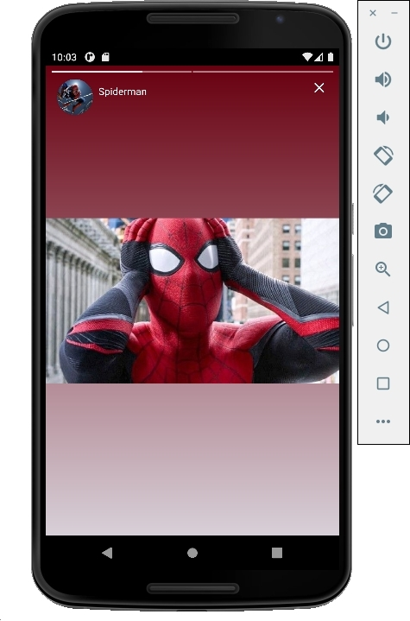
Extra Function of XIAOMAI
- Video Calling: Real-time video chatting with other users.
- Story status: Update your image status to show what you do.
- Screen Sharing: Users are able to share content for other users to see.

Slide 8
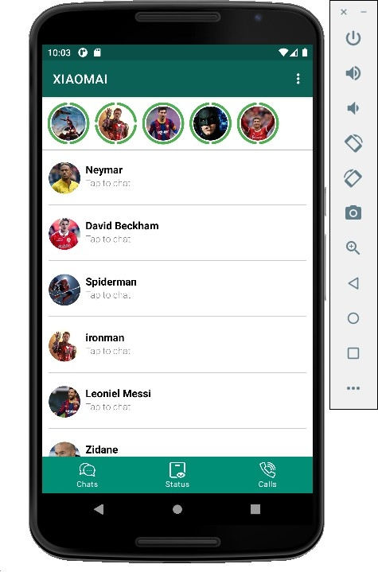
XIAOMAI DEMO

Slide 9
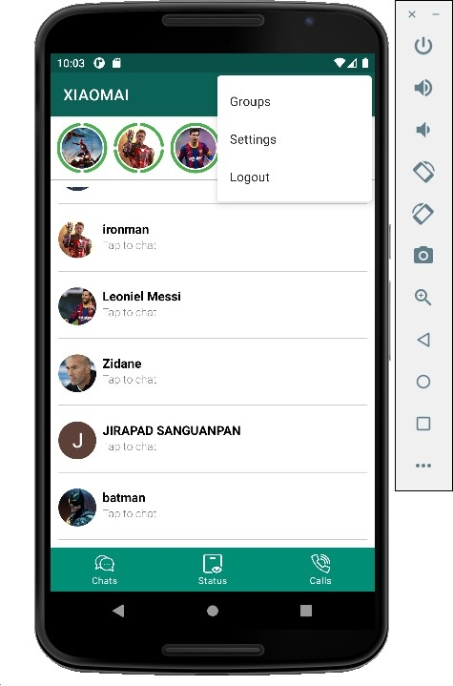
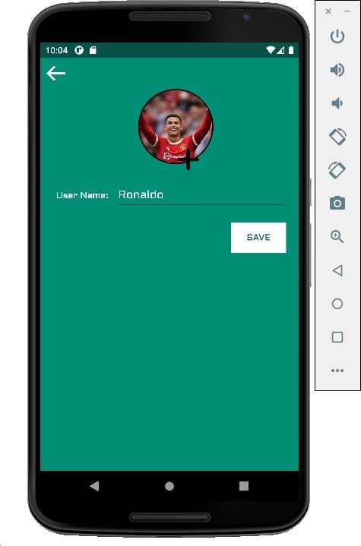
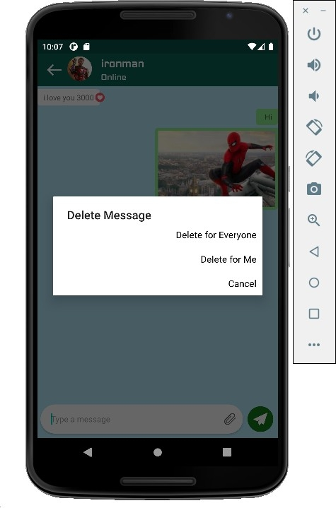

Slide 10
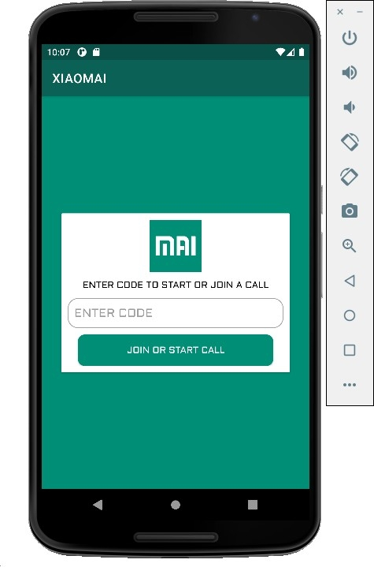
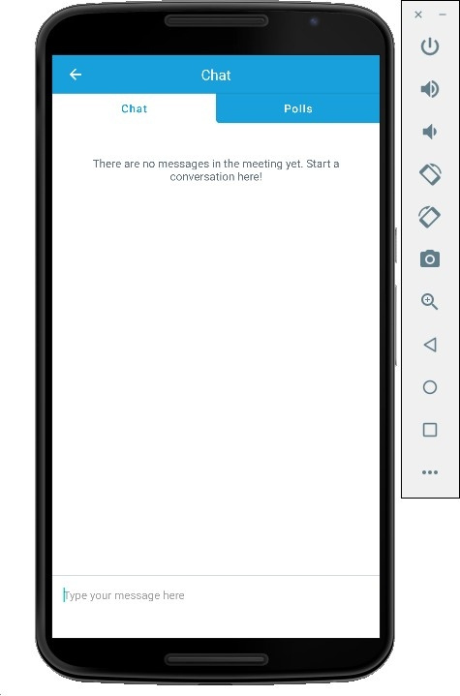
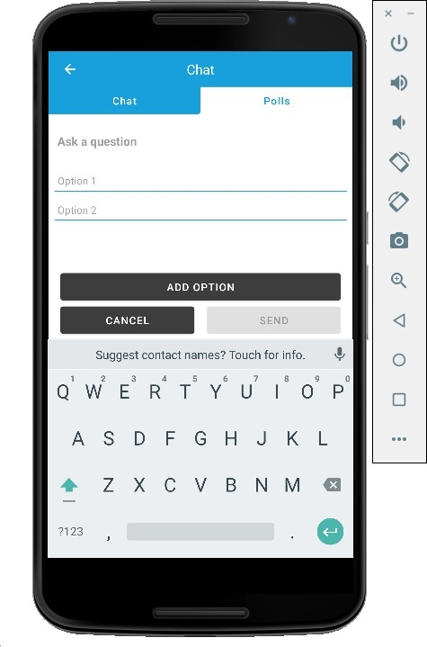
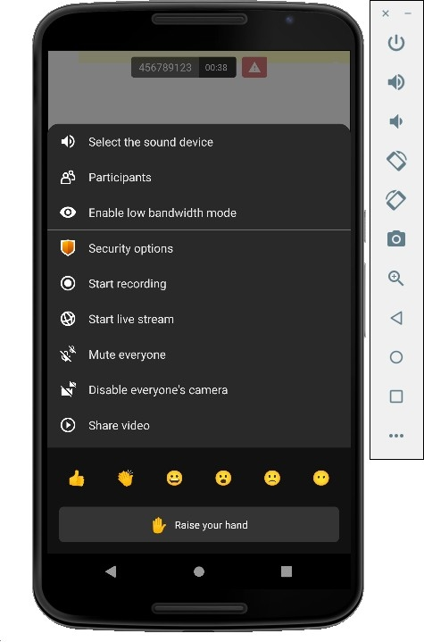

Slide 11

UML Diagram

