Slide 1
Chapter 17
Parallel Processing

Slide 2
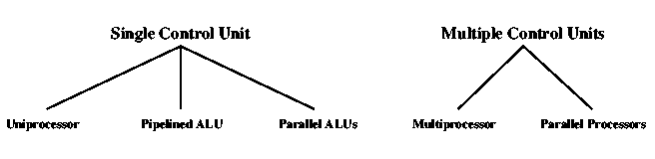
Computer Organizations

Slide 3
Multiple Processor Organization
Single instruction, single data stream – SISD
Single instruction, multiple data stream – SIMD
Multiple instruction, single data stream – MISD
Multiple instruction, multiple data stream- MIMD

Slide 4
Single Instruction, Single Data Stream - SISD
Single processor
Single instruction stream
Data stored in single memory

Slide 5
Single Instruction, Multiple Data Stream - SIMD
Single machine instruction
  Each instruction executed on different set of data by different processors
Number of processing elements
  Machine controls simultaneous execution
    Lockstep basis
  Each processing element has associated data memory
Application: Vector and array processing

Slide 6
Multiple Instruction, Single Data Stream - MISD
Sequence of data
Transmitted to set of processors
Each processor executes different instruction sequence
Not clear if it has ever been implemented

Slide 7
Multiple Instruction, Multiple Data Stream- MIMD
Set of processors
Simultaneously executes different instruction sequences
Different sets of data
Examples: SMPs, NUMA systems, and Clusters

Slide 8
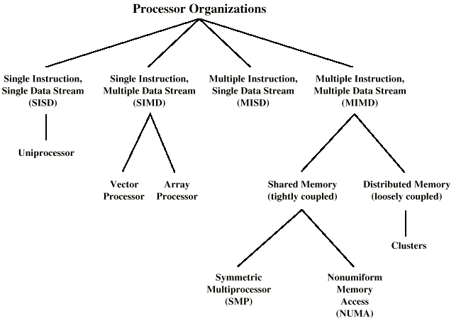
Taxonomy of Parallel Processor Architectures

Slide 9
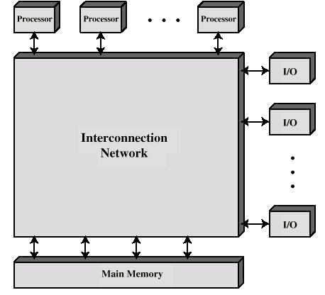
Block Diagram of Tightly Coupled Multiprocessor
Processors share memory
Communicate via that shared memory

Slide 10
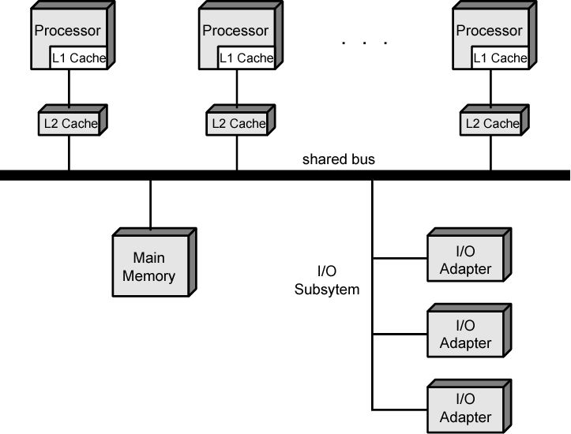
Symmetric Multiprocessor Organization

Slide 11
Symmetric Multiprocessors
A stand alone computer with the following characteristics
  Two or more similar processors of comparable capacity
  Processors share same memory and I/O
  Processors are connected by a bus or other internal connection
  Memory access time is approximately the same for each processor
  All processors share access to I/O
    Either through same channels or different channels giving paths to same devices
  All processors can perform the same functions (hence symmetric)
  System controlled by integrated operating system
    providing interaction between processors
    Interaction at job, task, file and data element levels

Slide 12
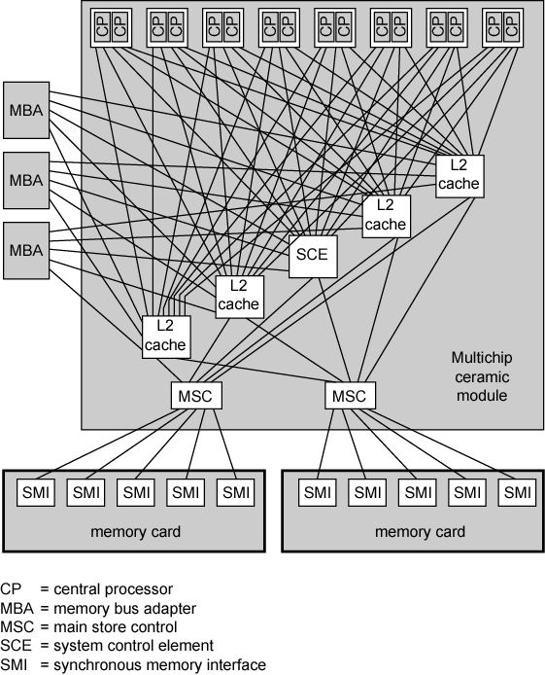
IBM z990
Multiprocessor
Structure

Slide 13
SMP Advantages
Performance
  If some work can be done in parallel
Availability
  Since all processors can perform the same functions, failure of a single processor does not halt the system
Incremental growth
  User can enhance performance by adding additional processors
Scaling
  Vendors can offer range of products based on number of processors

Slide 14
Cache Coherence Problems
Popular solution - Snoopy Protocol
Distribute cache coherence responsibility among cache controllers
Cache recognizes that a line is shared
Updates announced to other caches

Slide 15
Loosely Coupled - Clusters
Collection of independent whole uniprocessors or SMPs
  Usually called nodes
Interconnected to form a cluster
Working together as unified resource
  Illusion of being one machine
Communication via fixed path or network connections

Slide 16
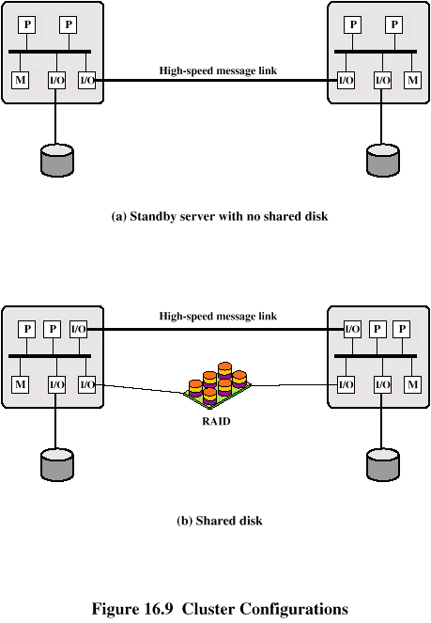
Cluster Configurations

Slide 17
Cluster Benefits
Absolute scalability
Incremental scalability
High availability
Superior price/performance

Slide 18
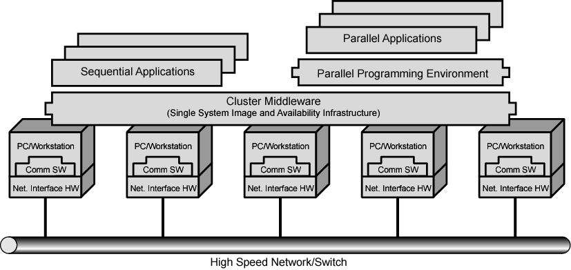
Cluster Computer Architecture

Slide 19
Cluster v. SMP
Both provide multiprocessor support to high demand applications.
Both available commercially
SMP:
  Easier to manage and control
  Closer to single processor systems
    Scheduling is main difference
    Less physical space
    Lower power consumption
Clustering:
  Superior incremental & absolute scalability
  Less cost
  Superior availability
    Redundancy

Slide 20
Nonuniform Memory Access (NUMA)
(Tightly coupled)
Alternative to SMP & Clusters
Nonuniform memory access
  All processors have access to all parts of memory
    Using load & store
  Access time of processor differs depending on region of memory
    Different processors access different regions of memory at different speeds
Cache coherent NUMA ?
  Cache coherence is maintained among the caches of the various processors
  Significantly different from SMP and Clusters

Slide 21
Motivation
SMP has practical limit to number of processors
  Bus traffic limits to between 16 and 64 processors
In clusters each node has own memory
  Apps do not see large global memory
  Coherence maintained by software not hardware
NUMA retains SMP flavour while giving large scale multiprocessing
Objective is to maintain transparent system wide memory while permitting multiprocessor nodes, each with own bus or internal interconnection system

Slide 22
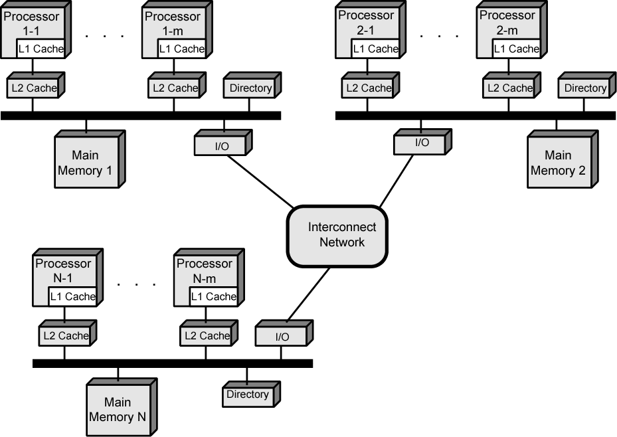
CC-NUMA Organization

Slide 23
NUMA Pros & Cons
Possibly effective performance at higher levels of parallelism than one SMP
Not very supportive of software changes
Performance can breakdown if too much access to remote memory
  Can be avoided by:
    L1 & L2 cache design reducing all memory access
      Need good temporal locality of software
Not transparent
  Page allocation, process allocation and load balancing changes can be difficult
Availability?

Slide 24
Multithreading
Instruction stream divided into smaller streams (threads)
Executed in parallel
There are a wide variety of multithreading designs

Slide 25
Definitions of Threads and Processes
Threads in multithreaded processors may or may not be same as software threads
Process:
  An instance of program running on computer
Thread: dispatchable unit of work within process
  Includes processor context (which includes the program counter and stack pointer) and data area for stack
  Thread executes sequentially
  Interruptible: processor can turn to another thread
Thread switch
  Switching processor between threads within same process
  Typically less costly than process switch

Slide 26
Implicit and Explicit Multithreading
All commercial processors and most experimental ones use explicit multithreading
  Concurrently execute instructions from different explicit threads
  Interleave instructions from different threads on shared pipelines or parallel execution on parallel pipelines
Implicit multithreading is concurrent execution of multiple threads extracted from single sequential program
  Implicit threads defined statically by compiler or dynamically by hardware

Slide 27
Approaches to Explicit Multithreading
Interleaved
  Fine-grained
  Processor deals with two or more thread contexts at a time
  Switching thread at each clock cycle
  If thread is blocked it is skipped
Blocked
  Coarse-grained
  Thread executed until event causes delay
  E.g. cache miss
  Effective on in-order processor
  Avoids pipeline stall
Simultaneous (SMT)
  Instructions simultaneously issued from multiple threads to execution units of superscalar processor
Chip multiprocessing
  Processor is replicated on a single chip
  Each processor handles separate threads

Slide 28
Scalar Processor Approaches
Single-threaded scalar
  Simple pipeline
  No multithreading
Interleaved multithreaded scalar
  Easiest multithreading to implement
  Switch threads at each clock cycle
  Pipeline stages kept close to fully occupied
  Hardware needs to switch thread context between cycles
Blocked multithreaded scalar
  Thread executed until latency event occurs
  Would stop pipeline
  Processor switches to another thread

Slide 29
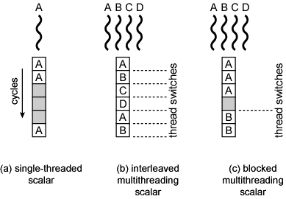
Scalar Diagrams

Slide 30
Multiple Instruction Issue Processors
Superscalar
  No multithreading
Interleaved multithreading superscalar:
  Each cycle, as many instructions as possible issued from single thread
  Delays due to thread switches eliminated
  Number of instructions issued in cycle limited by dependencies
Blocked multithreaded superscalar
  Instructions from one thread
  Blocked multithreading used

Slide 31
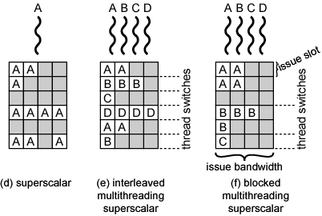
Multiple Instruction Issue Diagram

Slide 32
Multiple Instruction Issue Processors
Very long instruction word (VLIW)
  E.g. IA-64
  Multiple instructions in single word
  Typically constructed by compiler
  Operations may be executed in parallel in same word
  May pad with no-ops
Interleaved multithreading VLIW
  Similar efficiencies to interleaved multithreading on superscalar architecture
Blocked multithreaded VLIW
  Similar efficiencies to blocked multithreading on superscalar architecture

Slide 33
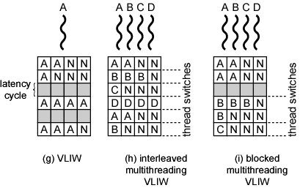
Multiple Instruction Issue Diagram

Slide 34
Parallel, Simultaneous
Execution of Multiple Threads
Simultaneous multithreading
  Issue multiple instructions at a time
  One thread may fill all horizontal slots
  Instructions from two or more threads may be issued
  With enough threads, can issue maximum number of instructions on each cycle
Chip multiprocessor
  Multiple processors
  Each has two-issue superscalar processor
  Each processor is assigned thread
    Can issue up to two instructions per cycle per thread

Slide 35
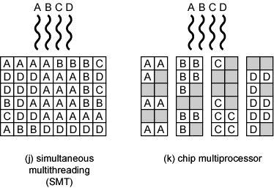
Parallel Diagram

Slide 36
Examples
Some Pentium 4 (single processor)
  Intel calls it hyperthreading
  SMT with support for two threads
  Single multithreaded processor, logically two processors
IBM Power5
  High-end PowerPC
  Combines chip multiprocessing with SMT
  Chip has two separate processors
  Each supporting two threads concurrently using SMT

