Slide 1

Compiled & Presented By
Prof. Abhijit Sarkar
Institute of Engineering & Management
[For BCA 2nd Year]

Slide 2
Hierarchical Data Model
Advantage:-
It is easy to understand
More efficient than ER Model.
Drawbacks:-
Data inconsistency occurs when the parent node is deleted resulting in the deletion of the child node
Wastage of storage space
Complex to design
Absence of structural independency.
Example:-IBM’s Information Management System.

Slide 3
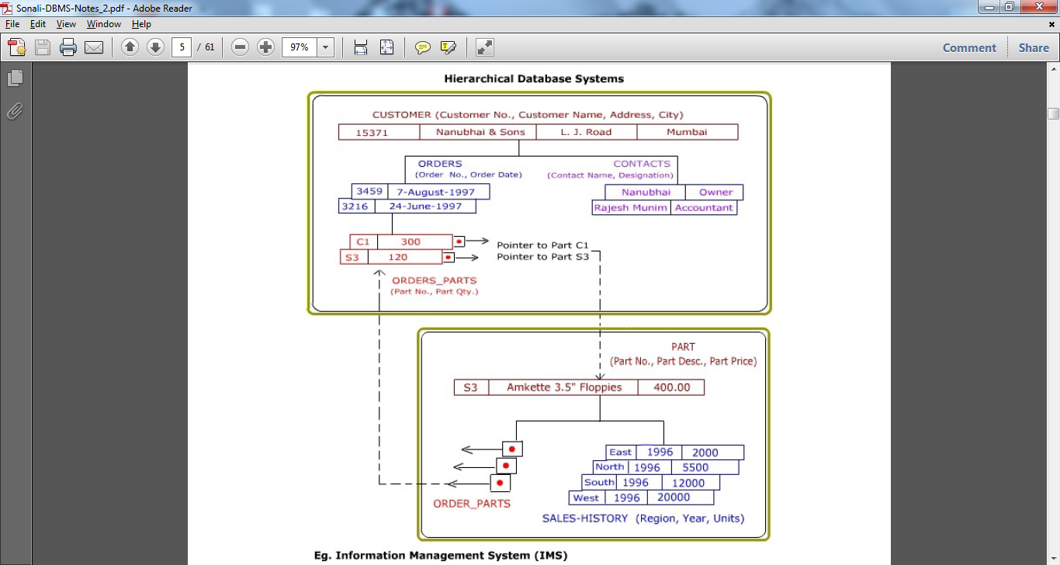

Slide 4
Network Data Model
Advantage:-
It is easy to design than Hierarchical Model.
Data access is easy in network model.
Drawbacks:-
It is complex to design than relational model.
Efficiency are less than the relational model.
Absence of structural independency.
Example:- Computer Associates International Inc.’s Integrated Database Management System (IDMS).

Slide 5
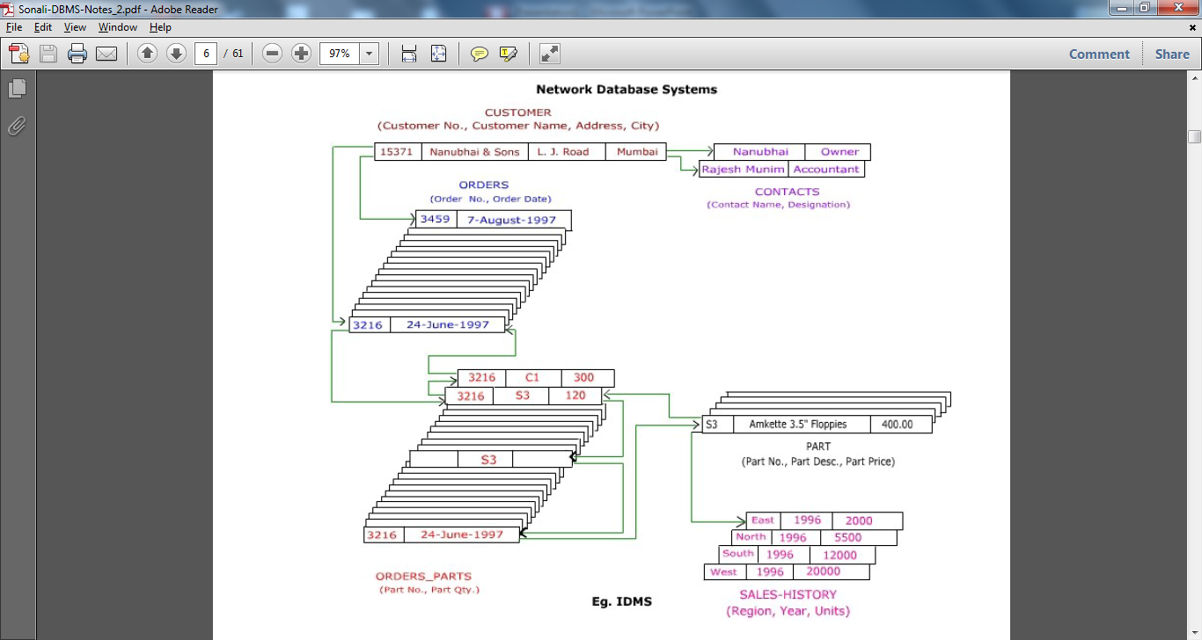

Slide 6
Relational Data Model
Many to many relationship can be easily implemented.
It is useful for representing most of the real world object and relationship among them.
Relational model doesn’t maintain physical connection among records.
Data is organized logically in the forms of rows and columns & it is stored in table.
Structures
  Relations (also called Tables)
  Attributes (also called Columns or Fields)

Slide 7
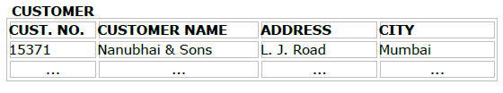
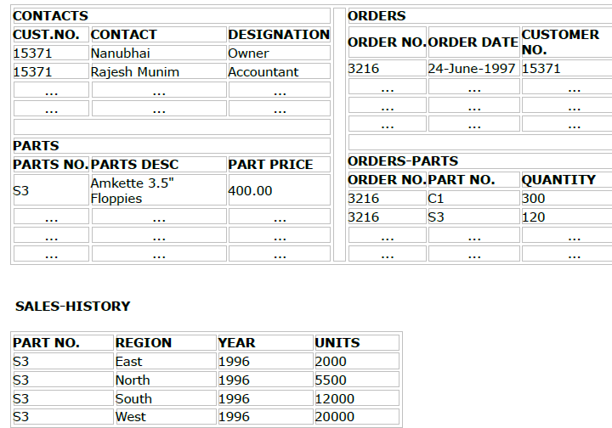

Slide 8
Object based Data Model
It uses a concept such as entity, attribute and there relationship.
This model can be used to describe the data at the conceptual and external level.
Example:- ER Model
Entity set – an abstraction of similar things, e.g. cars, students
  An entity set contains many entities
Attributes: common properties of the entities in a entity sets
Relationship – specify the relations among entities from two or more entity sets

Slide 9

Example of ER Diagram (ER Model)

Slide 10

Relationship in ER Model

Slide 11
Mapping Cardinalities
Mapping cardinalities express the number of entities to which another entity can be associated via a relationship set.
Following are the possible mapping cardinalities:-
One-to-One:- Person-Passport
One-to-Many:- Class-Student
Many-to-One:- Employee-Dept
Many-to-Many:- Employee-Project

Slide 12
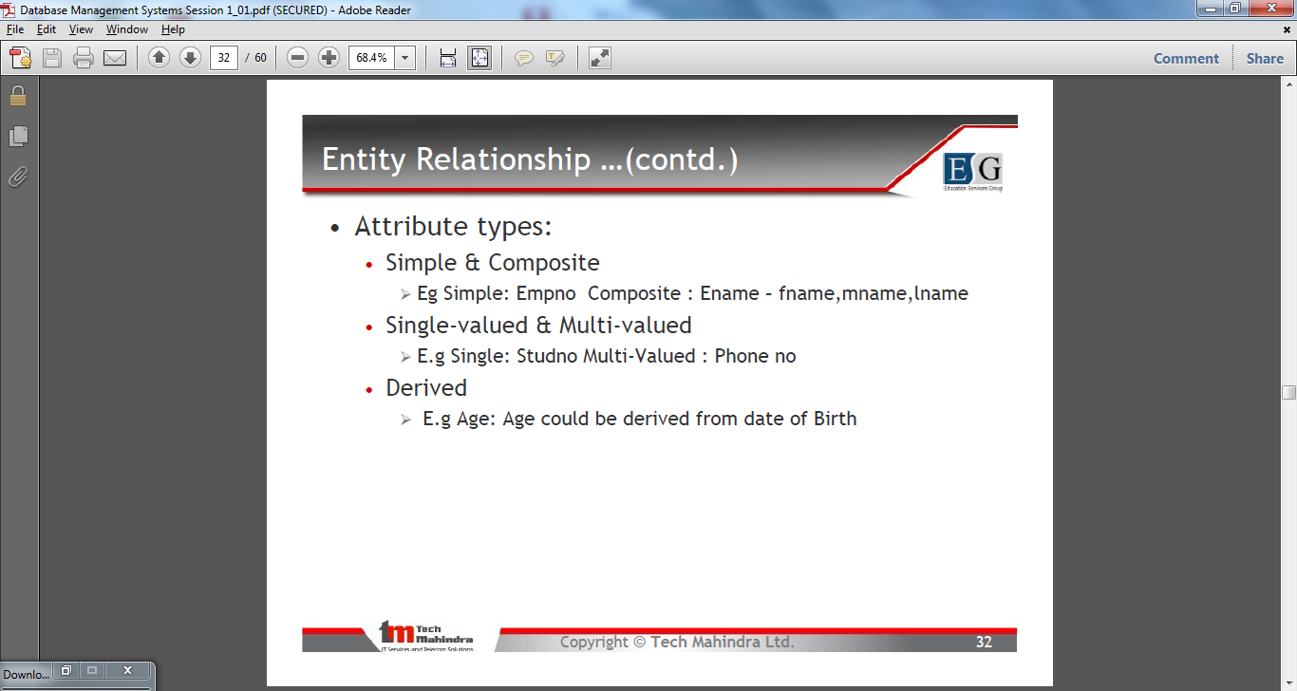
Attributes in ER Model

Slide 13
Keys
A super key of an entity set is a set of one or more attributes whose values uniquely determine each entity.
A candidate key of an entity set is a minimal super key
Although several candidate keys may exist, one of the candidate keys is selected to be the primary key.

Slide 14
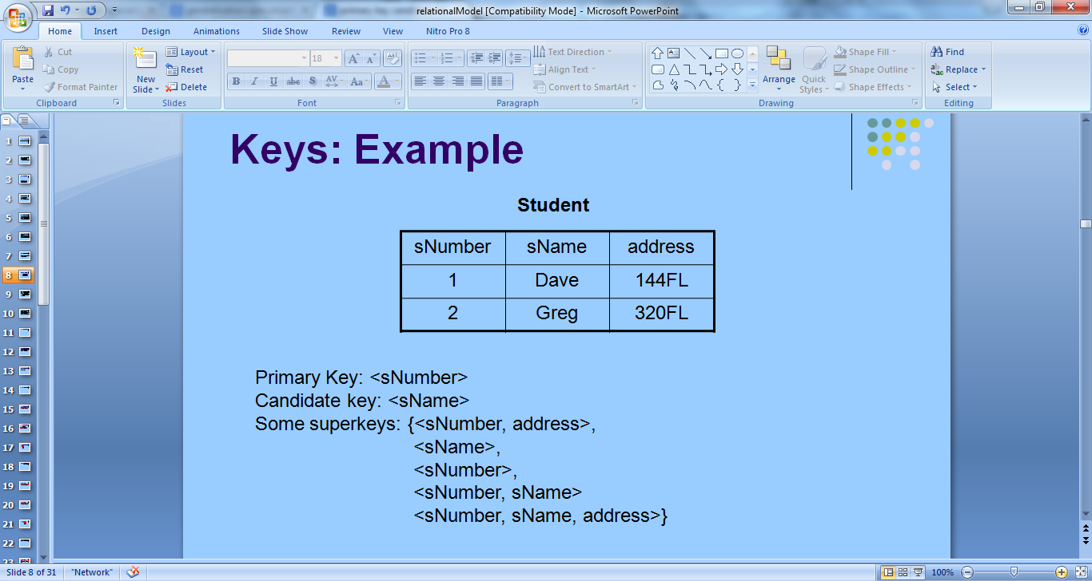
Key Examples
Suggest super keys for the following entity?
What are the candidate keys?
Primary key?

Slide 15
Primary Key Constraints
A set of attributes is a key for a relation if:
  No two distinct tuples can have the same values in all key fields
  A proper subset of the key attributes is not a key.
Superkey: A proper subset of a superkey may be a superkey
If multiple keys, one of them is chosen to be the primary key.
Eg: PRIMARY KEY (Student) = <sNumber>
Primary key attributes cannot take null values

Slide 16
Candidate Keys (SQL: Unique)
Keys that are not primary keys are candidate keys.
Specified in SQL using UNIQUE
Attribute of unique key may have null values !
Eg: Student (sNumber, sName)
PRIMARY KEY (Student) = <sNumber>
CANDIDATE KEY (Student) = <sName>

Slide 17
Violation of key constraints
A relation violates a primary key constraint if:
  There is a row with null values for any attribute of primary key.
  (or) There are 2 rows with same values for all attributes of primary key

Slide 18
Foreign Key Constraints
To specify an attribute (or multiple attributes) S1 of a relation R1 refers to the attribute (or attributes) S2 of another relation R2
Eg: Professor (pName, pOffice)
Student (sNumber, sName, advisor)
PRIMARY KEY (Professor) = <pName>
FOREIGN KEY Student (advisor) REFERENCES Professor (pName)

Slide 19
Foreign Key Constraints
FOREIGN KEY R1 (S1) REFERENCES R2 (S2)
Like a logical pointer
The values of S1 for any row of R1 must be values of S2 for some row in R2 (null values are allowed)
S2 must be a key for R2
R2 can be the same as R1 (i.e., a relation can have a foreign key referring to itself).

Slide 20
Specialization
A lower-level entity set inherits all the attributes and relationship participation of the higher-level entity set to which it is linked.
A lower-level entity set may have additional attributes and participate in additional relationships
It is a designating sub grouping within an entity set.

Slide 21

Example of Specialization

Slide 22
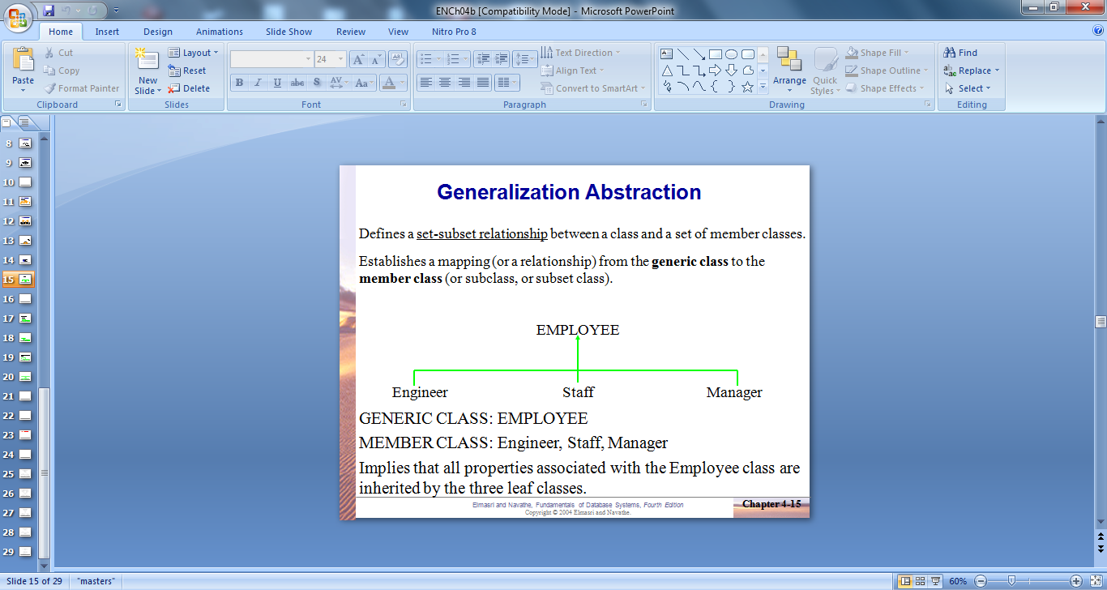
Generalization
Defines a set-subset relationship between a class and a set of member classes.
Establishes a mapping (or a relationship) from the generic class to the member class (or subclass, or subset class).
Commonality is expressed via Generalization.

Slide 23
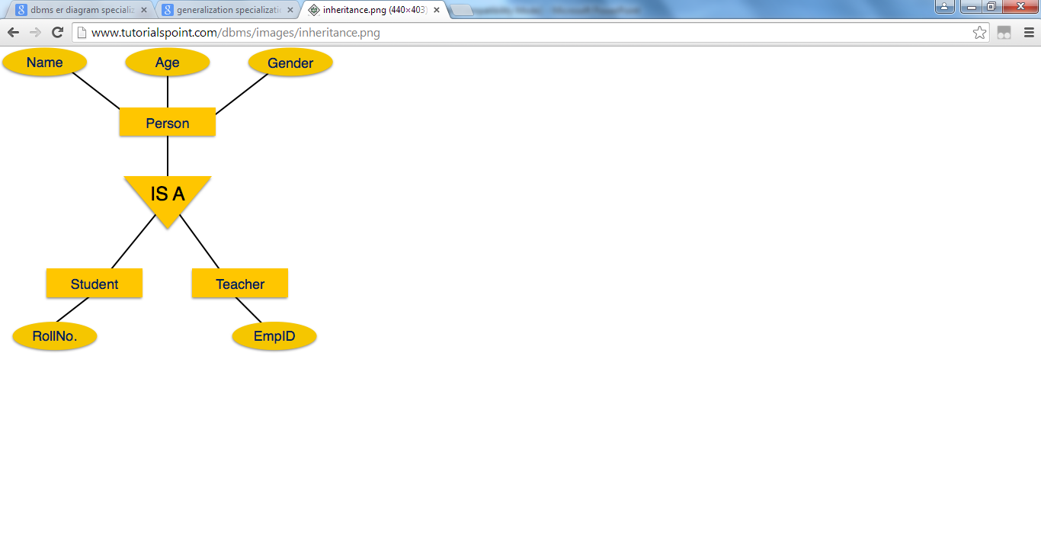
Specialization
Generalization

Slide 24
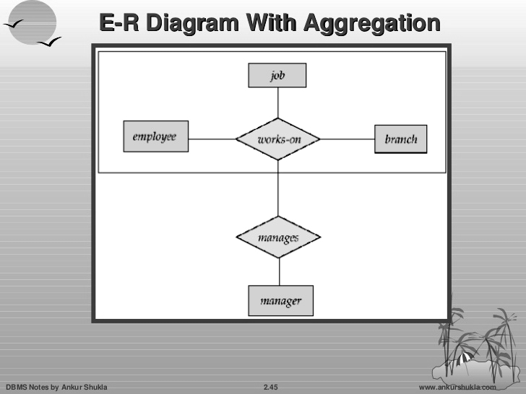
Aggregation
It is a process when relation between two or more entity is treated as a single entity.
It is an abstraction through which relationship are treated as higher level entity.

Slide 25
Transaction
A transaction is a discrete unit of work that must be completely processed or not processed at all.
Action or series of actions, carried out by user or application, which accesses or changes contents of database.
Example: Transferring funds from a checking account to a saving account.

Slide 26
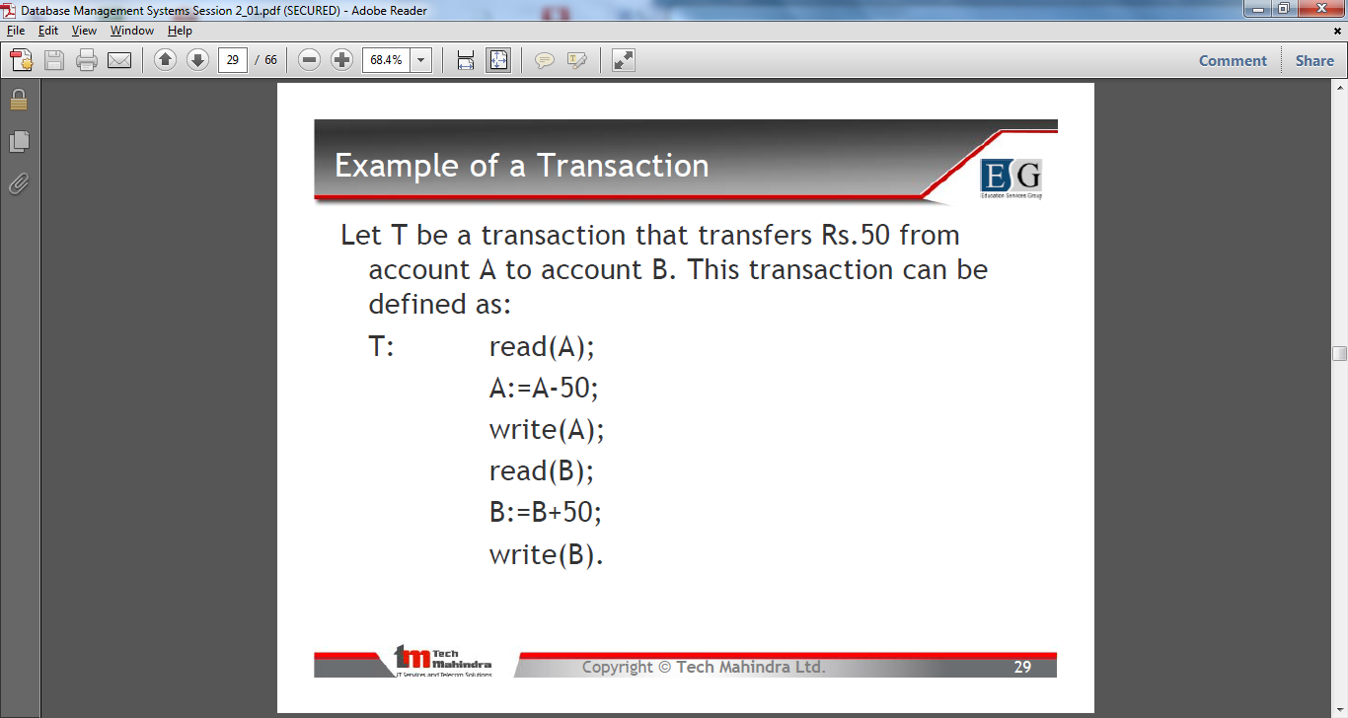
Example of Transaction

Slide 27
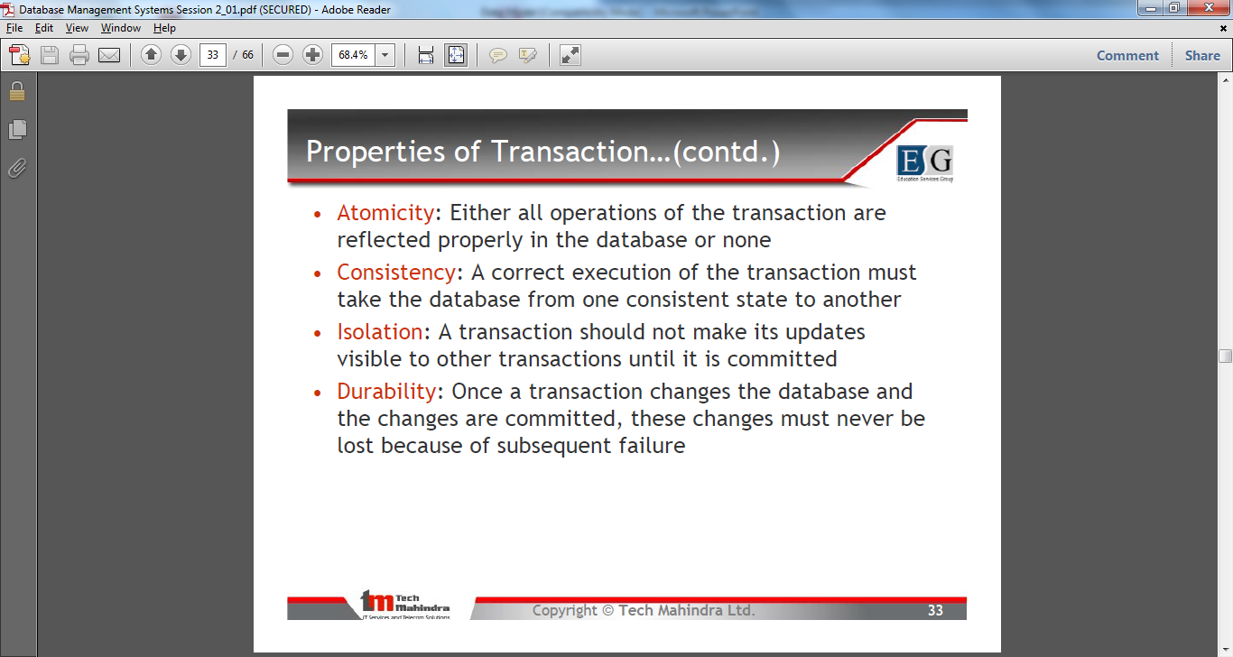
ACID Property of Transaction

Slide 28
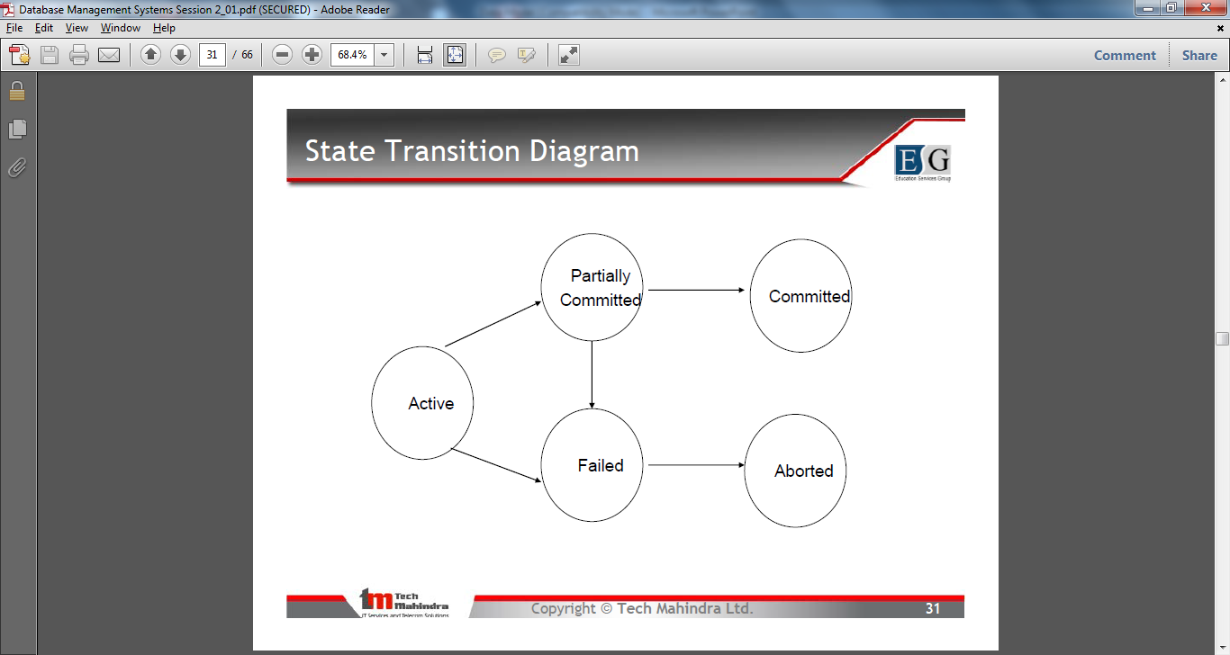
Transaction State Transition Diagram

Slide 29
Transaction States
Active, the initial state; the transaction stays in this state until while it is still executing.
A transition is terminated only if it has either been committed or aborted.
Partially committed, After the final statement has been executed waiting for the ACID property checking.
At this point failure is still possible since changes may have been only done in main memory, a hardware failure could still occur. It follows the state “failed” and “aborted” with all effects undone.

Slide 30
Transaction States
If there is violation in ACID property then also transaction state transits from “partially committed” to “failed”.
If ACID property is satisfied, then transaction transits from “partially committed” to “committed” with the persistence of all changes that have been made.

Slide 31
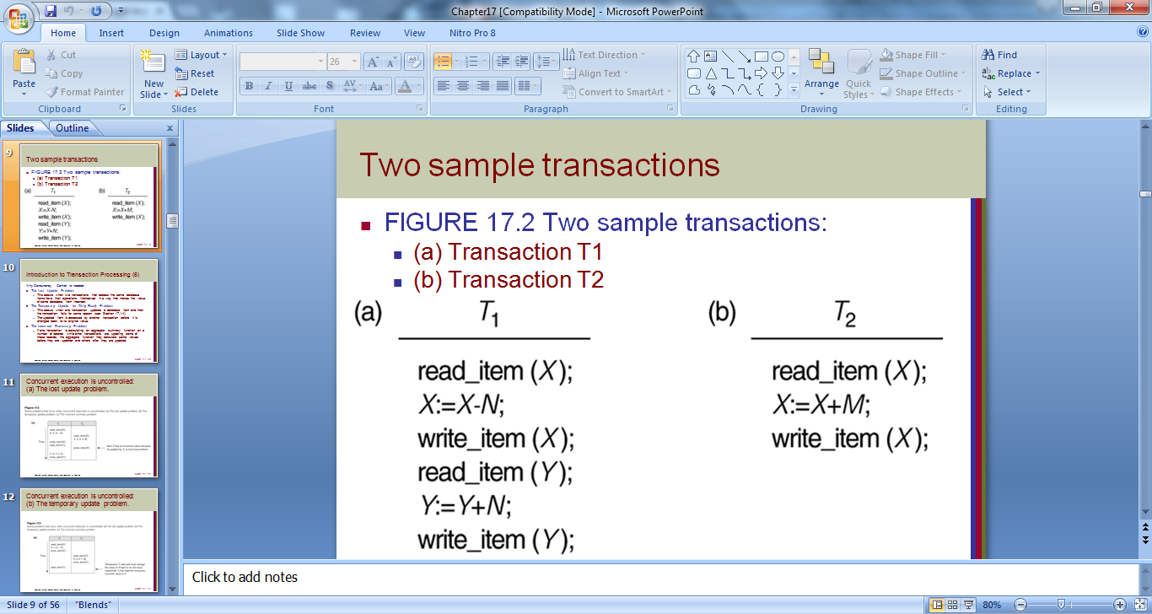

Slide 32
Why Concurrency Control is needed:
The Lost Update Problem
  This occurs when two transactions that access the same database items have their operations interleaved in a way that makes the value of some database item incorrect.
The Temporary Update (or Dirty Read) Problem
  This occurs when one transaction updates a database item and then the transaction fails for some reason.
  The updated item is accessed by another transaction before it is changed back to its original value.
The Incorrect Summary Problem
  If one transaction is calculating an aggregate summary function on a number of records while other transactions are updating some of these records, the aggregate function may calculate some values before they are updated and others after they are updated.

Slide 33
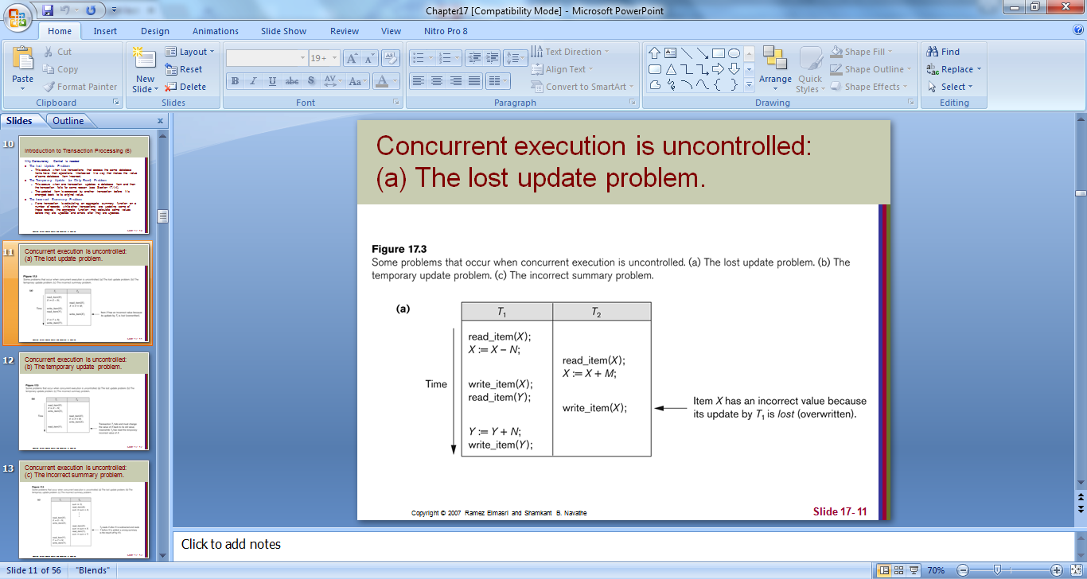
Lost Update problem

Slide 34
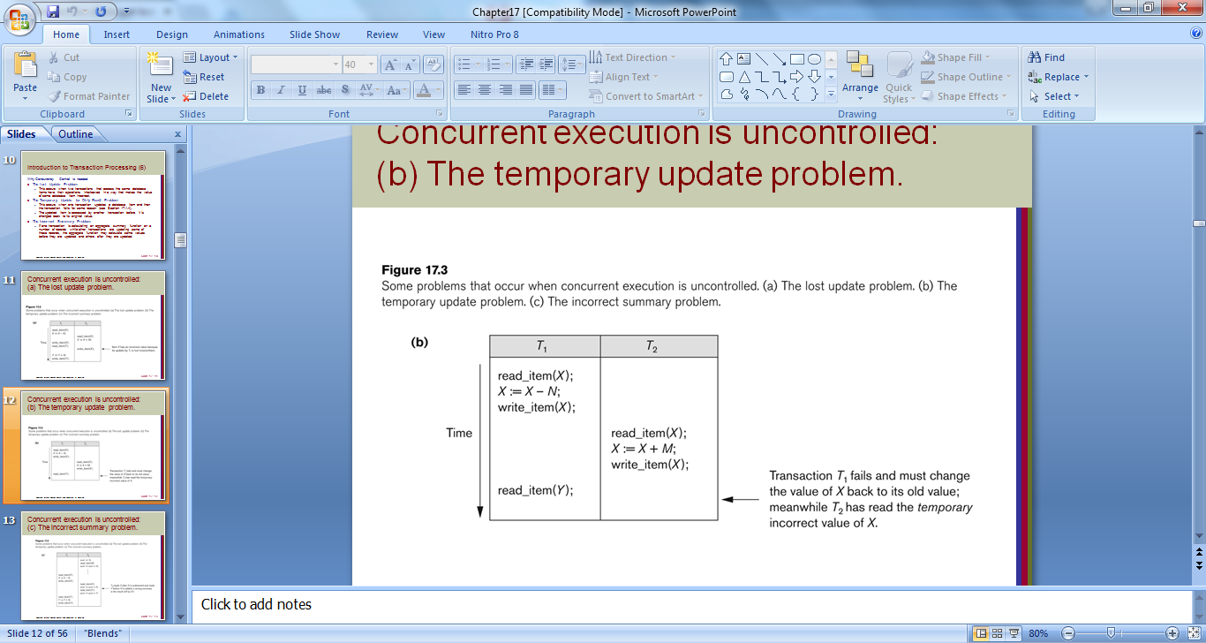
Temporary Update Problem

Slide 35
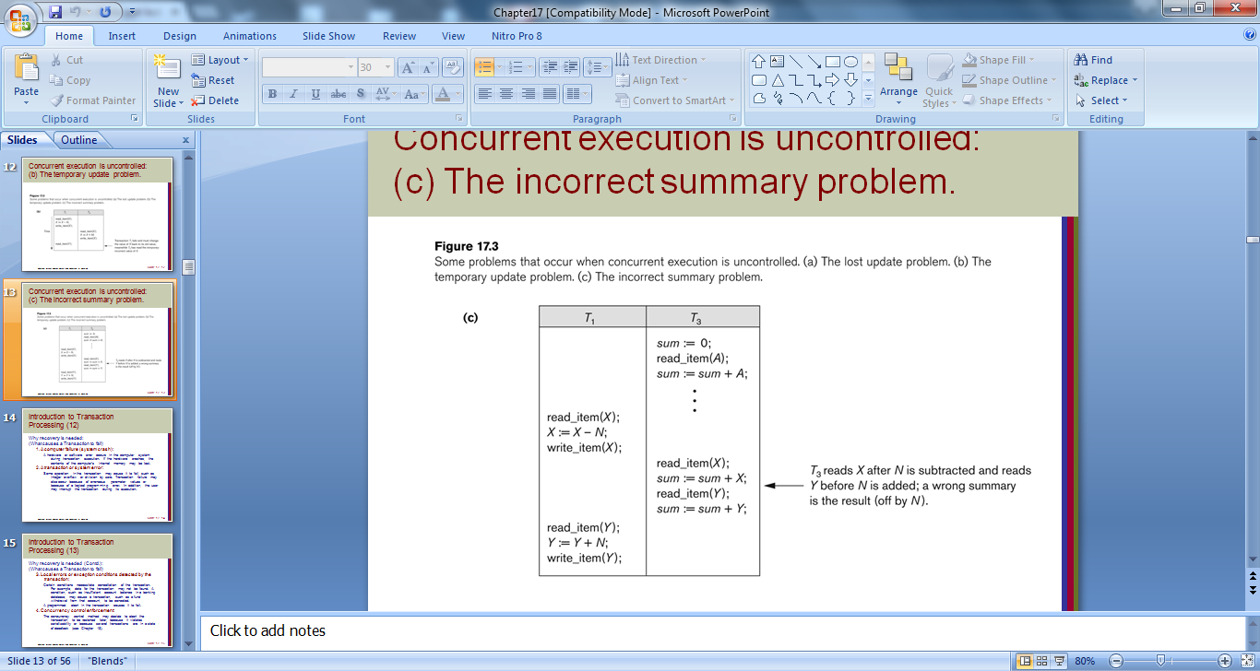
Incorrect Summary Problem

