Slide 1
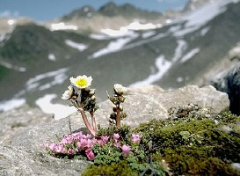
Ecology:
the study of the interactions of living things with each other and their physical environment

Slide 2
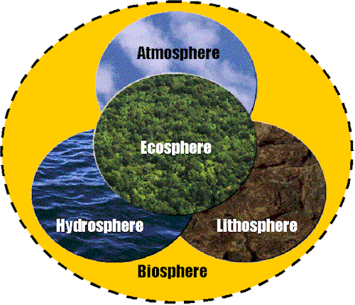

Slide 3
Ecological Organization:
Population: all the members of a species inhabiting a given location
Community: all the interacting populations in a given area
Ecosystem: the living community and the physical environment functioning together as an independent and relatively stable system

Slide 4
4. Biosphere: that portion of the earth where life exists
a. The biosphere is composed of numerous complex ecosystems.
b. An ecosystem involves interactions between abiotic (physical) and biotic (living) factors. The members of the community in the ecosystem and environment must interact to maintain a balance.

Slide 5


An ecosystem is self-sustaining if the following requirements are met:
1. A constant source of energy and a living system capable of incorporating this energy into organic molecules.
2. A cycling of materials between organisms and their environment.

Slide 6
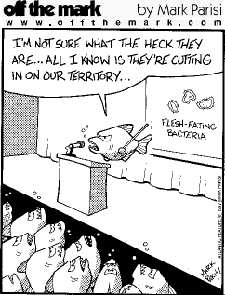
In all environments, organisms with similar needs may compete with each other for resources, including food, space, water, air, and shelter.

Slide 7

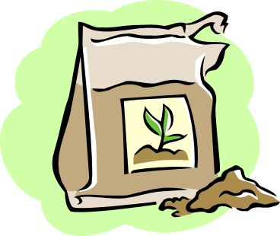
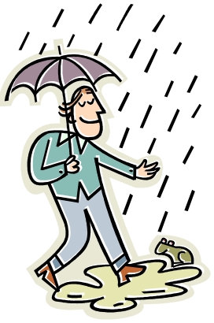
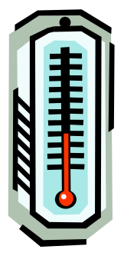

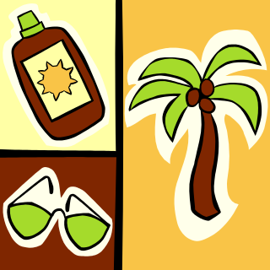

Some Abiotic Factors:
1. intensity of light
2. range of temperatures
3. amount of moisture
4. type of substratum (soil or rock type)
5. availability of inorganic substances such as minerals
6. supply of gases such as oxygen, carbon dioxide, and nitrogen
7. pH

Slide 8
Some examples:
1. A low annual temperature common to the northern latitudes determines in part the species of plants which can exist in that area.
2. The amount of oxygen dissolved in a body of water will help determine what species of fish live there.
3. The dry environment of desert regions limits the organisms that can live there.

Slide 9
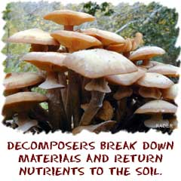
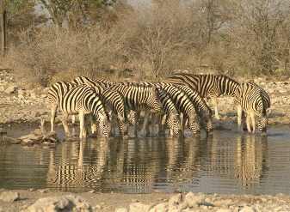

Carrying Capacity
the maximum number of organisms the resources of an area can support
The carrying capacity of the environment is limited by the available abiotic and biotic resources, as well as the ability of ecosystems to recycle the residue of dead organisms through the activities of bacteria and fungi.

Slide 10
Steady State - this occurs when the population remains relatively constant over a number of years. This will occur when the number of births equals the number of deaths.

Slide 11
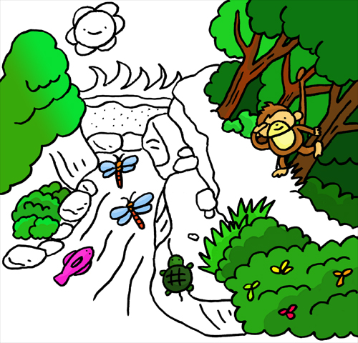
Biotic factors:
all the living things that directly or indirectly affect the environment
** Thus, the organisms, their presence, parts, interaction, and wastes are all biotic factors.

Slide 12



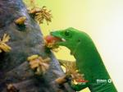

Nutritional Relationships:
Autotrophs: can synthesize their own food from inorganic compounds and a usable energy source
B. Heterotrophs: can NOT synthesize their own food and are dependent on other organisms for their food

Slide 13
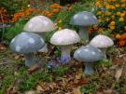



Types of Heterotrophs:
Saprophytes: include those heterotrophic plants, fungi, and bacteria which live on dead matter - AKA decomposers
Herbivores: plant-eating animals
Carnivores: meat-eating animals
Omnivores: consume both plants and meat

Slide 14
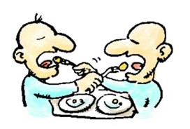
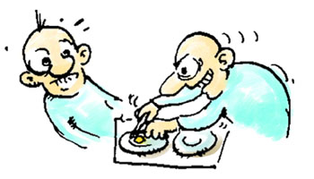
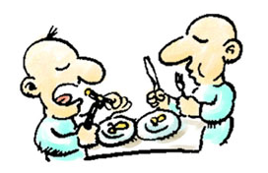
Symbiotic Relationships:
Symbiosis: living together with another organism in close association
Types of (symbiosis):
MUTALISM PARASITISM COMMENSALISM

Slide 15
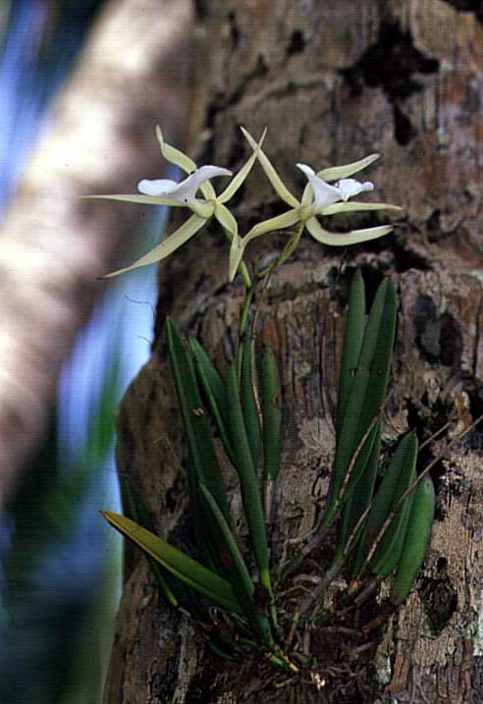
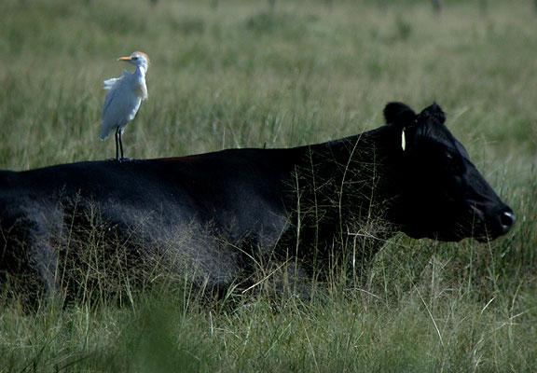
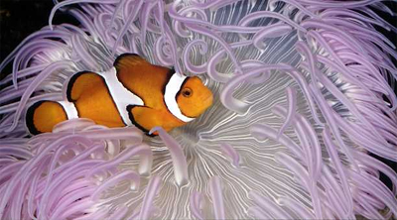
Commensalism: one organism is benefited and the other is unharmed
ex. barnacles on whales, orchids on tropical trees

Slide 16
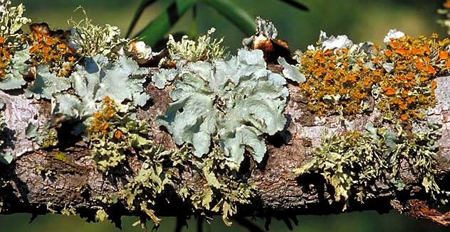
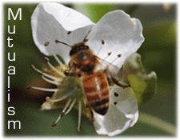
2. Mutualism: both organisms benefit from the association
ex. nitrogen-fixing bacteria on legume nodules, certain protozoa within termites (also ruminants)

Slide 17
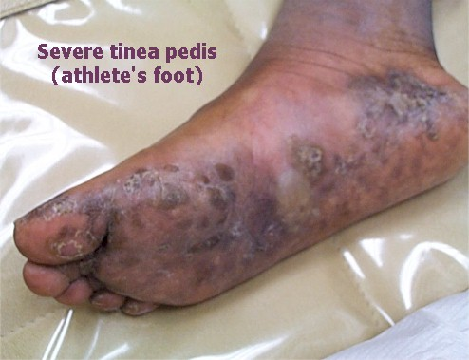
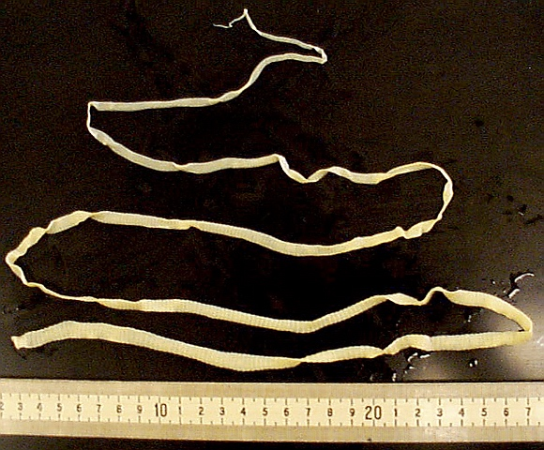
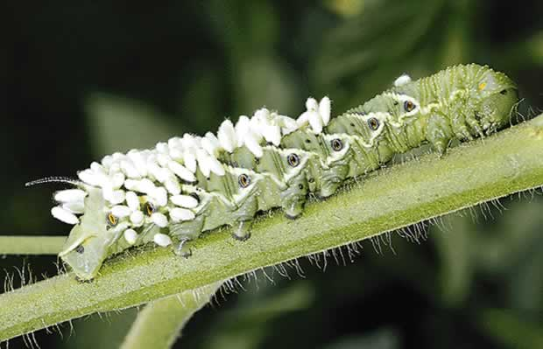
3. Parasitism: the parasite benefits at the expense of the host
ex. athlete's foot fungus on humans, tapeworm and heartworm in dogs

Slide 18
Food Chains and Webs:
If an ecosystem is to be self-sustaining it must contain a flow of energy.
Those life activities that are characteristic of living organisms require an expenditure of energy.

Slide 19



The pathways of energy through the living components of an ecosystem are represented by food chains and food webs.
Producers convert the radiant energy of the sun into the chemical energy of food.

Slide 20
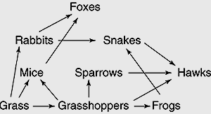

Slide 21
Food chain: involves the transfer of energy from green plants through a series of organisms with repeated stages of eating and being eaten
B. Food web: In a natural community, the flow of energy and materials is much more complicated than illustrated by any one food chain.

Slide 22
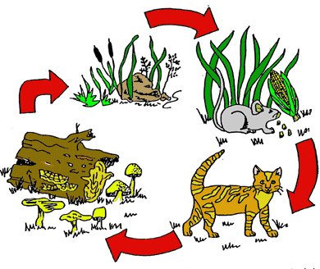
FOOD CHAIN

Slide 23
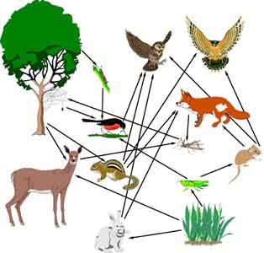
Since practically all organisms may be consumed by more than one species, many interactions occur along the food chains of any community.

Slide 24
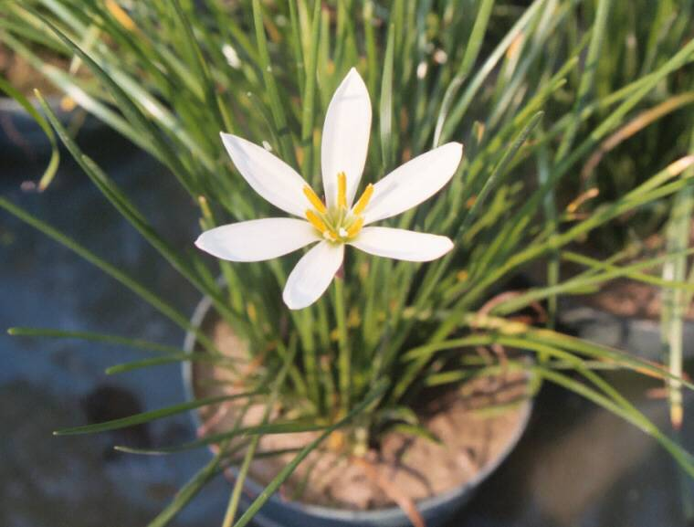
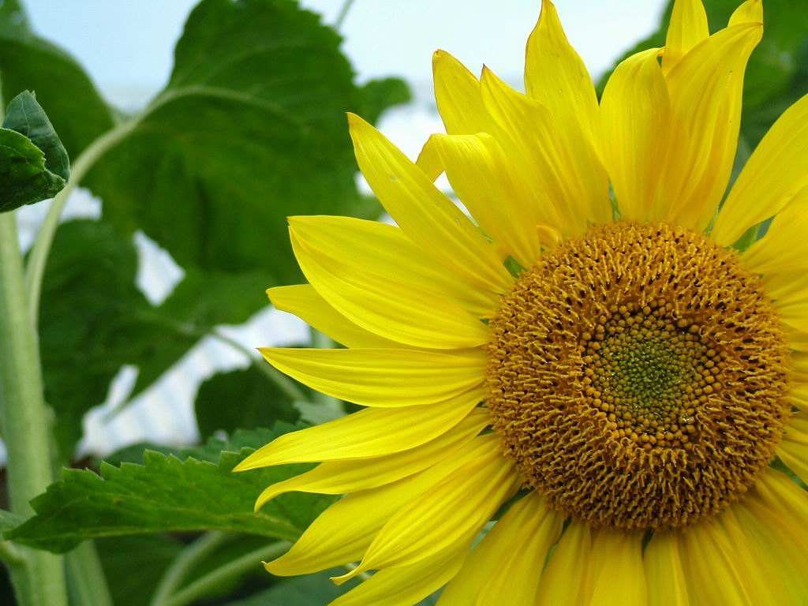
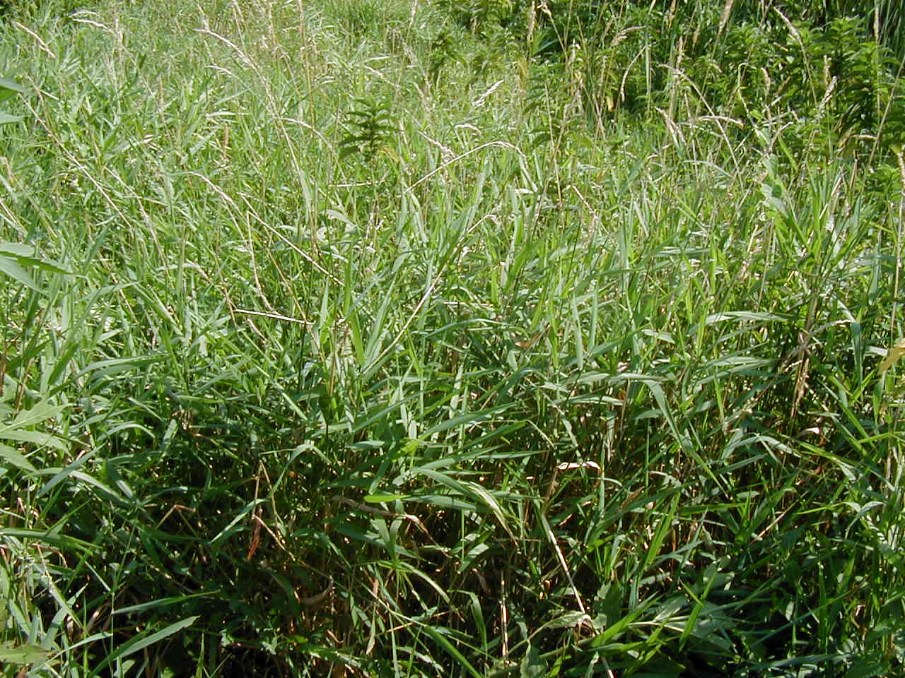
Food Web Interactions:
Producers: (plants) -- the energy of the community is derived from the organic compounds in plants
- (grass in the web above)

Slide 25
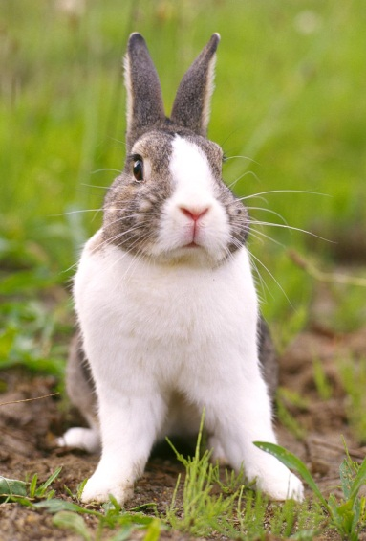
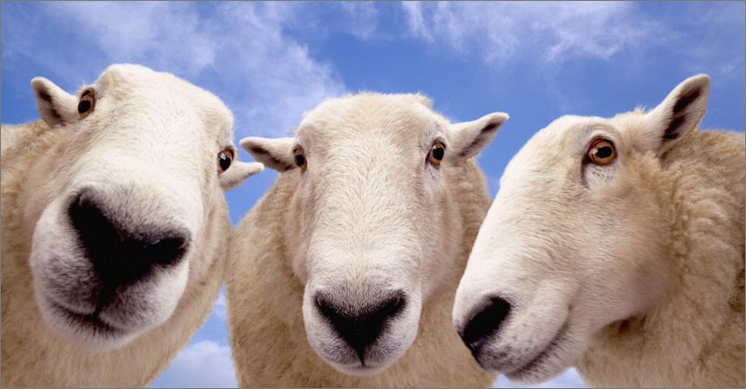

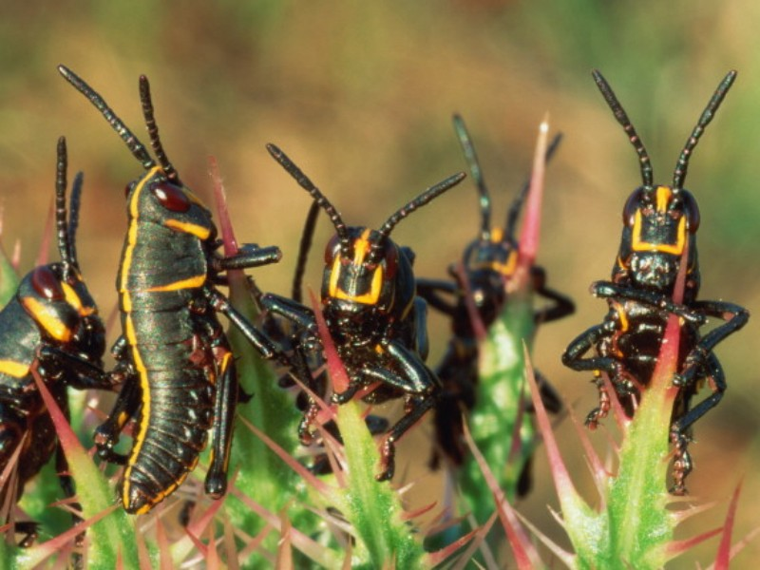
Primary Consumer: (always a herbivore)
- feeds on plants (mice, grasshoppers, and rabbits in the web above)

Slide 26
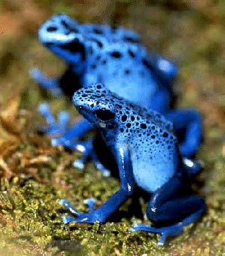
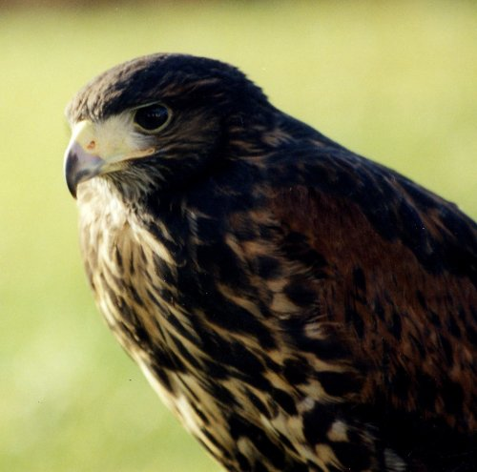
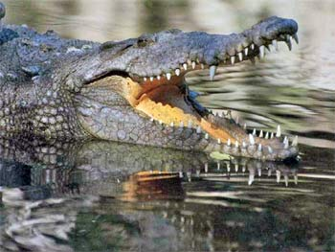
Secondary Consumer: (always a carnivore) -- feeds upon other consumers (frogs, sparrows, snakes, and foxes above) (The hawk is a secondary or 3rd level consumer depending on the availability of food.)
Omnivores may be primary or secondary consumers.

Slide 27
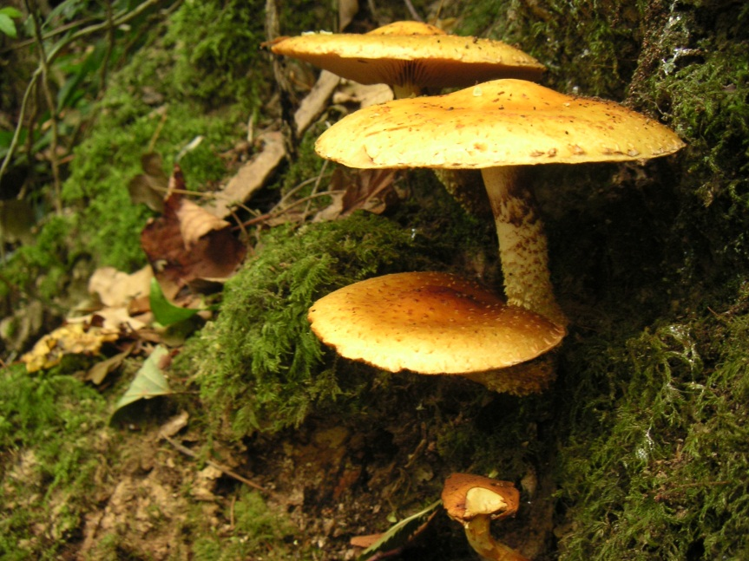
Decomposers: break down organic wastes and dead organisms to simpler substances (ex. bacteria of decay)
** Through decomposition, chemical substances are returned to the environment where they can be used by other living organisms.

Slide 28
Energy Flow:
Energy flows through ecosystems in one direction, typically from the Sun, through photosynthetic organisms, including green plants and algae, through herbivores, to carnivores, and finally decomposers.

Slide 29
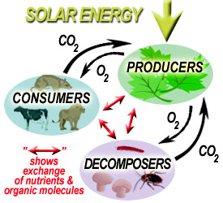

Slide 30
level D = producers
level C = primary consumers
level B= secondary consumers
level A = tertiary consumers
A
B
C
D

Slide 31
The environment may be altered in substantial ways through the activities of organisms, including humans, or when the climate changes.
Although these alterations are sometimes abrupt (ex. Natural disasters), in most cases species replace others, resulting in long-term gradual changes in ecosystems.

Slide 32
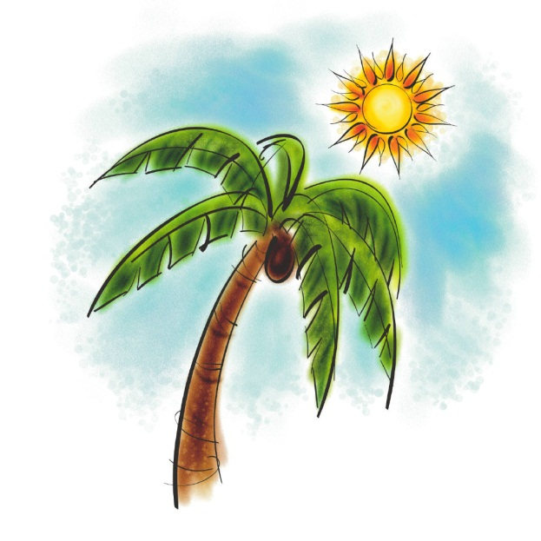
Ecosystems tend to change with time until a stable system is formed.
The type of ecosystem that is formed depends on the climatic limitations of a given geographical area.

Slide 33
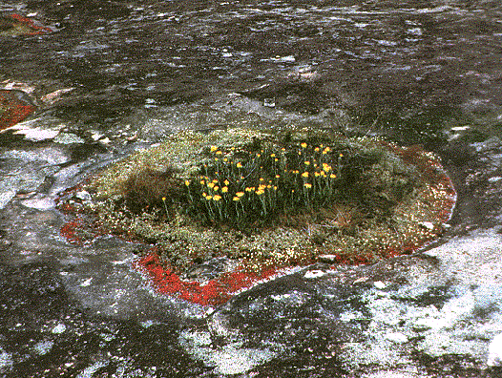
Primary Succession: the development of plant communities on newly formed habitats that previously lacked plants (ex. a lava flow)

Slide 34
Altered ecosystems may reach a point of stability that can last for hundreds or thousands of years.
A climax community persists until a catastrophic change of a major biotic or abiotic nature alters or destroys it.
(ex. forest fires, abandoned farmlands, floods, areas where the topsoil has been removed)

Slide 35
After the original climax community has been destroyed, the damaged ecosystem is likely to recover in stages that eventually result in a stable system similar to the original one.
Ponds and small lakes, for example, fill in due to seasonal dieback of aquatic vegetation and erosion of their banks, and eventually enter into a terrestrial succession terminating in a terrestrial climax community.
FLORA - plant species - dominate in the sense that they are the most abundant food sources

Slide 36
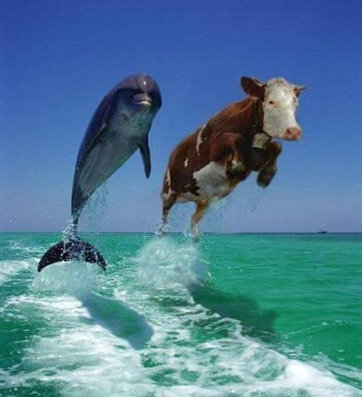
** Plant succession is a major limiting factor for animal succession.
Animal Succession- as the plant community changes so will the animals

Slide 37
** Climax communities are identified by the dominant plant species -- the one that exerts the most influence over the other species present.
Competition: occurs when two different species or organisms living in the same environment (habitat) utilize the same limited resources, such as food, water, space, light, oxygen, and minerals.

Slide 38
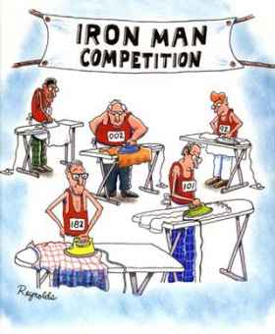
** The more similar the requirements of the organisms involved, the more intense the competition.

Slide 39

Competitive Exclusion Principle
If two different species compete for the same food source or reproductive sites, one species may be eliminated. This establishes one species per niche in a community.

Slide 40
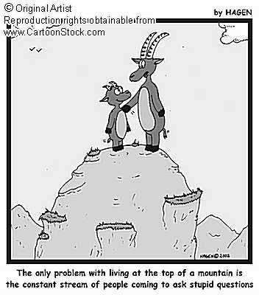
Niche (Job): the organism's role in the community, particularly its role in relation to food with other species.
Habitat - a place where a plant or animal can get the food, water, shelter and space it needs to live.

Slide 41
Carbon-Oxygen Cycle
involves the processes of respiration and photosynthesis.
In respiration, oxygen and glucose are combined releasing energy and producing water and carbon dioxide.
In photosynthesis water and carbon dioxide along with the energy from the sun are combined to produce glucose (containing energy) and oxygen.
Each process compliments the other and the ecosystem maintains its balanced communities.

Slide 42
Nitrogen Cycle
Nitrates (used by plants)
Build plant proteins
Eaten by animals
made into animal proteins
Plants and animals die
bacteria decay
Ammonia (NH3)
Nitrifying Bacteria
Nitrates (used by plants)

Slide 43
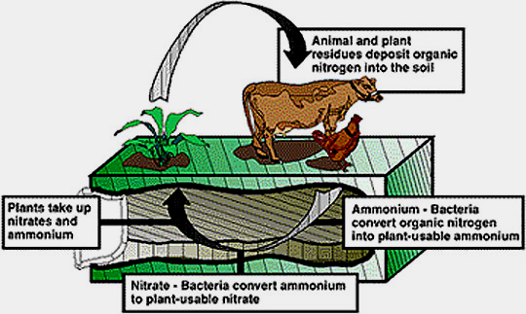

Slide 44
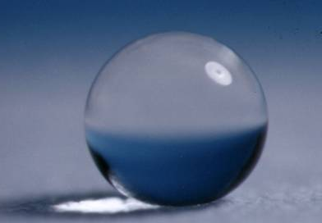
Water Cycle
involves the processes of photosynthesis, transpiration, evaporation and condensation, respiration, and excretion

Slide 45
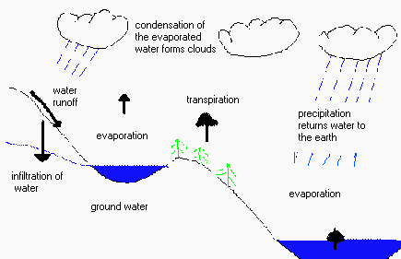

Slide 46
Evolutionary processes have resulted in a diversity of organisms and a diversity of roles in ecosystems.
Biodiversity -- the differences in living things in an ecosystem
Increased biodiversity increases the stability of an ecosystem.
Increased biodiversity increases the chance that at least some living things will survive in the face of large changes in the environment.

Slide 47
Monoculture -- planting one species over a huge area
Monoculture leaves an area more vulnerable to predation or disease.
Biodiversity ensures the availability of a rich variety of genetic material that may lead to future agricultural or medical discoveries with significant value to humans. (If this is lost we lose the sources of these materials for discovery)
Biodiversity adds aesthetic qualities to the environment.

Slide 48
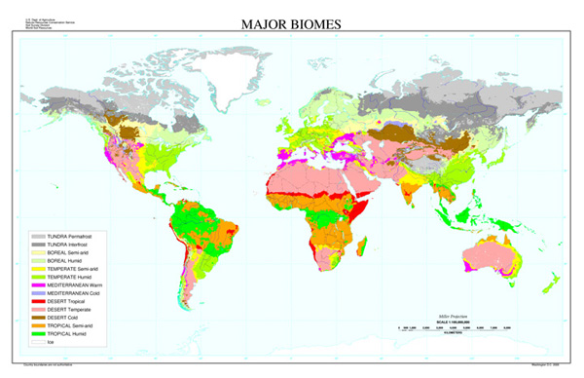
Biomes of the Earth:
BIOME - a large geographical community that has a particular type of Climax community (a dominant type of plant (flora) and animal (fauna) life).

Slide 49
Aquatic Biomes
Aquatic biomes represent the marine ecosystem on Earth
Characteristics:
Temperatures do not vary as much as land biomes (water absorbs and releases heat)
Organisms must maintain water balance

Slide 50

There are two types of Aquatic Biomes:
Marine Biomes-Oceans
    Salt water
    Composes 70% of the earths surface
    Contains many different organisms
    Provides most of the earths food nutrients
    Most oxygen is produced here
  Fresh water Biomes - ponds, lakes, rivers and streams

Slide 51

Biomes
Explore the World Around You!

Slide 52
What is a Habitat?
A habitat is a place where a particular animal or plant species lives.
An artificial habitat is a man made place.
A Biome is

Slide 53
Which habitats do you recognize?
Desert
Rain Forest
Tundra
Prairie
Grassland
Forest
Marine
Zoo

Slide 54
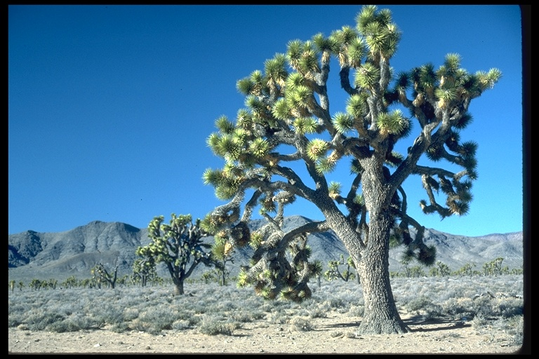
Desert
Super-dry air
Little rain – less than 10 inches a year
High daytime temperatures
Lots of wind
Typical animals include insects, reptiles, birds, and various mammals

Slide 55
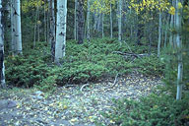
Forest
Covers 1/3 of the Earth’s area
Dominated by trees and woody vegetation
Precipitation is distributed evenly throughout the year
Animal life includes many things such as bears, deer,and rodents

Slide 56
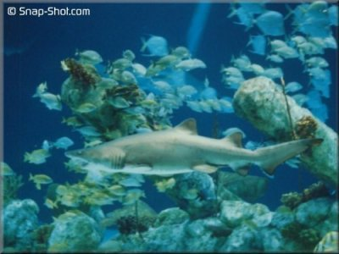
Marine
Water covers nearly 75% of the Earth’s surface
There are numerous species of plans and animals who live here.
These range in size from microscopic organisms to the size of a 100 ft whale.

Slide 57
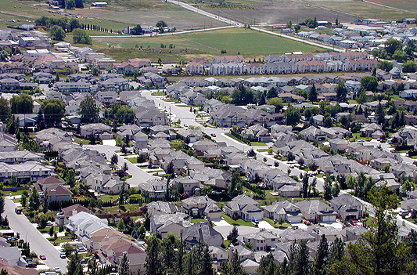
Disruption of Existing Ecosystems
Urbanization - growth of cities has destroyed land and wetlands ruining natural habitats

Slide 58

Poor farming practices - overuse of fields, over grazing by animals and erosion of land.
When crops are harvested, the plants which contain essential nutrients that should be returned to the soil are also taken away.
Therefore the ground is less fertile and will eventually not be able to support crops.

Slide 59

Misuse of Pesticides - The use of pesticides has disrupted food chains.
Examples: DDT has killed beneficial insects. DDT does not break down and eventually becomes concentrated at dangerous levels within the soil.

Slide 60


Slide 61

Nutrient Recycling
The use of packaging material which does not break down, burning of refuse, and the placing of materials in landfills prevents the return of some useful materials to the environment.

Slide 62
C. Soil: much loss of fertile topsoil due to erosion and poor management
  the use of biocides has contaminated the soil (no prior assessment was taken of their environmental impact)
  some causes of topsoil loss include; cutting forests, farming dry grasslands, damming rivers, draining wetlands, etc.
  much valuable farmland has been lost due to increasing urbanization & suburbanization

Slide 63


4. Water: cutting forests has led to increased, uncontrolled runoff
  water pollution leaves water unfit for use and the living things remaining in it unfit for consumption (typical water pollutants include phosphates, heavy metals, and PCB's)

Slide 64
Problems from Acid Rain:
Destruction of limestone and marble monuments due to increased chemical weathering
Acidification of aquatic ecosystems destroying the life in them
Damage forests and other plants in a variety of ways

Slide 65



11. Insects: our chief competitors for food
  we have destroyed many beneficial insects and many enemies of harmful insects with insecticides

Slide 66

12. Land use (includes increasing urbanization and the cultivation of marginal lands)
  this decreases the space and resources available to other species

Slide 67
Endangered animals which are currently responding to conservation efforts and beginning to make a comeback are the whooping crane, bald eagle, and peregrine falcon.
** The future of many species remains in doubt.
Human activities that degrade ecosystems result in a loss of diversity in the living and nonliving environment. These activities are threatening current global stability.

Slide 68
Ways to Reduce Air Pollution
1. Use fuels which contain less pollutant, such as low sulfur coal and oil.
2. Utilize industrial or energy producing processes which minimize the creation of pollutants.
3. Remove pollutants by using such devices as afterburners or catalytic converters before they enter the air.
4. Design new products which meet basic needs without generating pollution.

Slide 69
How can individual and societal choices contribute to improving the environment?

Slide 70

1. Through a greater awareness and application of ecological principles, each individual can help to assure that there will be suitable environments for succeeding generations on our planet.

Slide 71



2. Individuals in society must decide on proposals which involve the introduction of new technologies.
These decisions must assess environmental risks, costs, benefits, and trade-offs.

