Slide 1
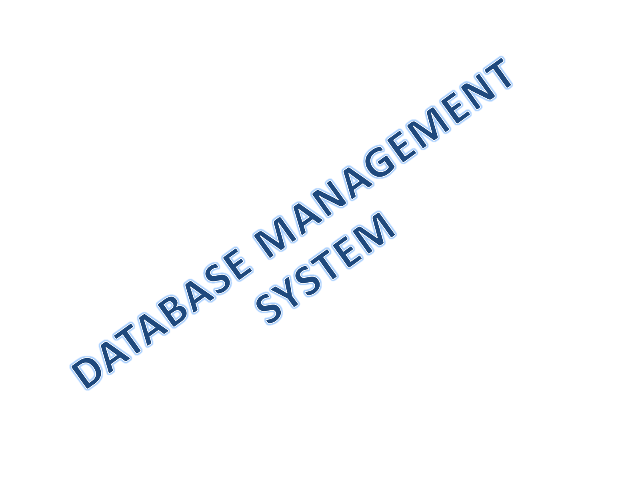

Slide 2





Slide 3
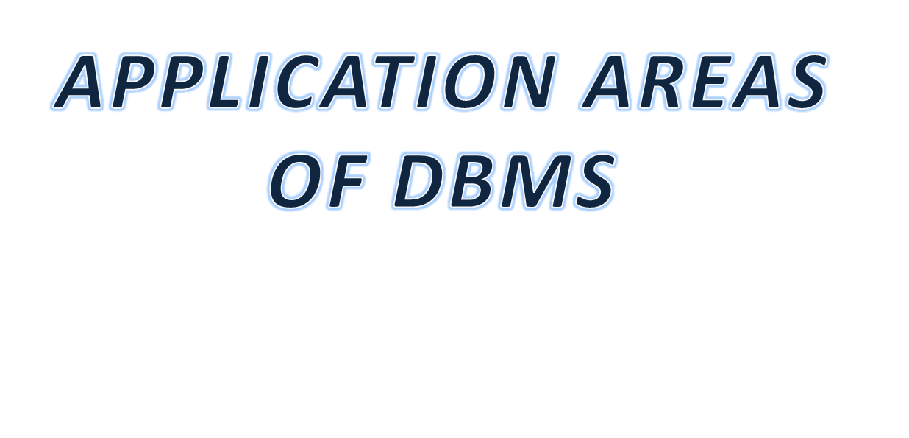
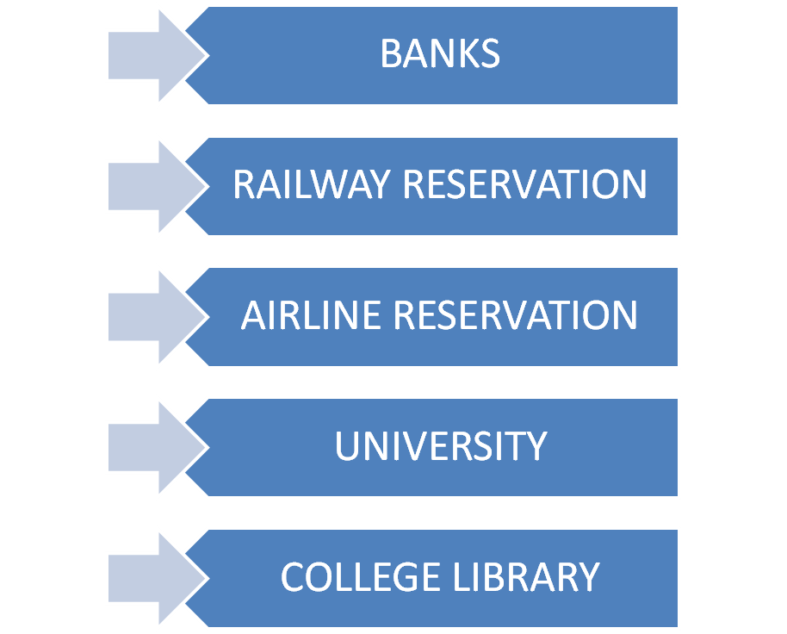

Slide 4

Today we say ‘Banking Systems are computerized’.
But what does this actually mean?
It is the application of networking and DBMS.
Here we are concerned about only the application of
DBMS.

Slide 5
Data are known facts that can be recorded and that have implicit meaning.
Example: name, telephone number, address, etc.
A database is a collection of related data.
Example: Address Book

Slide 6
An address book would generally contain the Postal Address information:-
a) Building name ,
b) Flat number ,
c) Road number ,
d) Area name ,
e) State name ,
f) Pin code , etc.
This address book would generally contain multiple addresses together in one place. Thus Address Book is a database.
The Postal Address information is the data that fills in the database.

Slide 7
A Database Management System is a collection of
programs or a general purpose software system which
enables users to create and maintain a database.
Example: Oracle, Ingress, Sybase, FoxPro, FoxBASE, MS Access, etc.
A Relational Database Management System is a Database
Management System where relationships between tables
can be specified at the time of table creation and data is
stored in the form of related tables.
Example: Oracle, Microsoft SQL Server, MySQL,
IBM DB2, etc.

Slide 8


