Slide 1
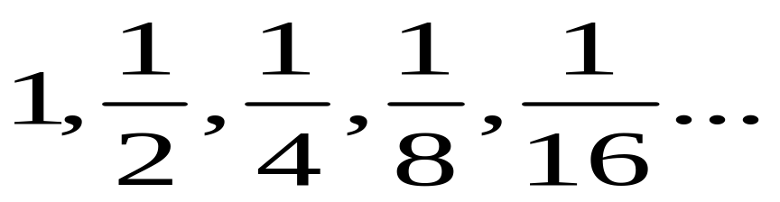
12. 1 A sequence is…
(a) an ordered list of objects.
(b) A function whose domain is a set of integers.
Domain: 1, 2, 3, 4, …,n…
Range a_{1,} a_{2,} a_{3,} a_{4, …} a_{n…}
{(1, 1), (2, ½), (3, ¼), (4, 1/8) ….}

Slide 2
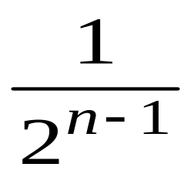
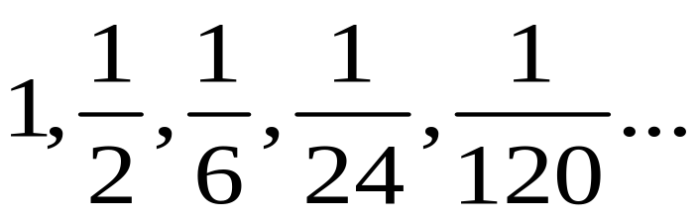
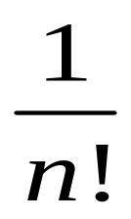
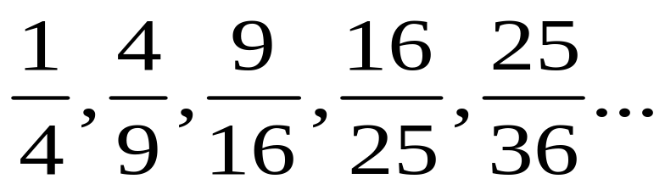
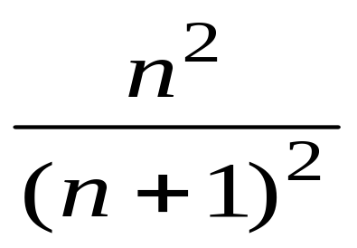
Finding patterns
Describe a pattern for each sequence. Write a formula for the nth term

Slide 3
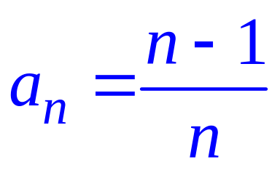
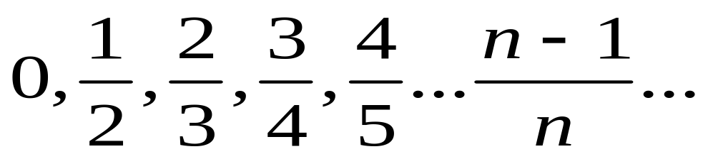
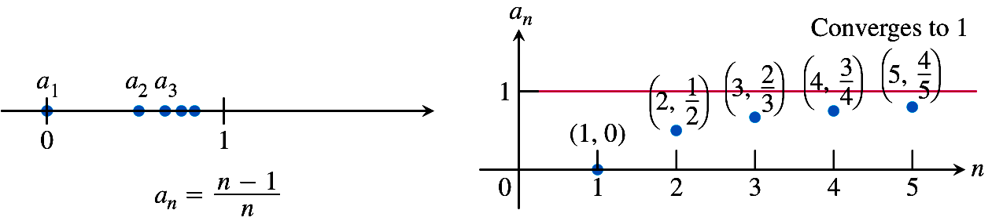
Write the first 5 terms for
On a number line
As a function
The terms in this sequence get closer and closer to 1. The sequence CONVERGES to 1.

Slide 4
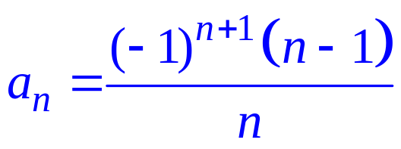
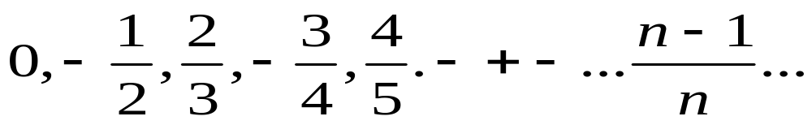
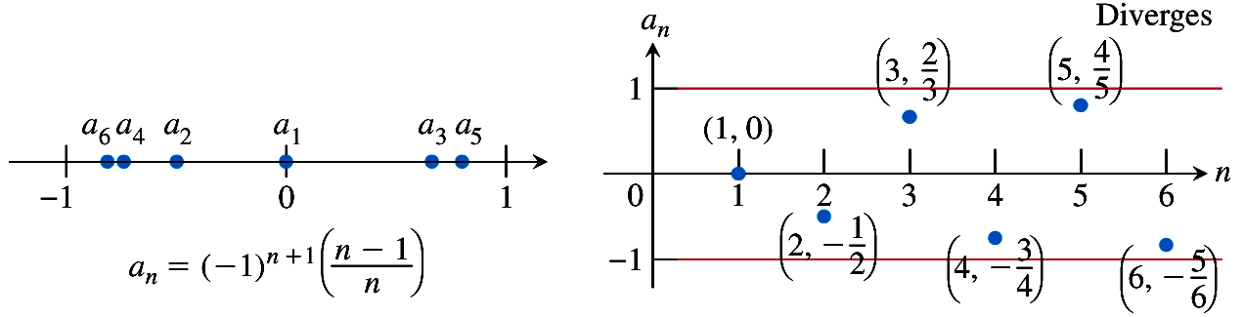
Write the first 5 terms
The terms in this sequence do not get close to
Any single value. The sequence Diverges

Slide 5
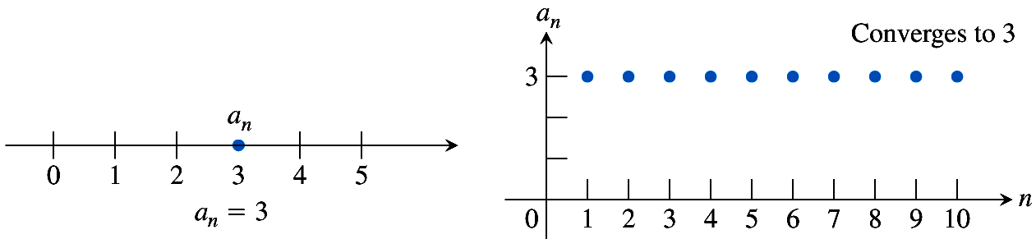
Write the terms for a_{n} = 3
The terms are 3, 3, 3, …3
The sequence converges to 3.

Slide 6
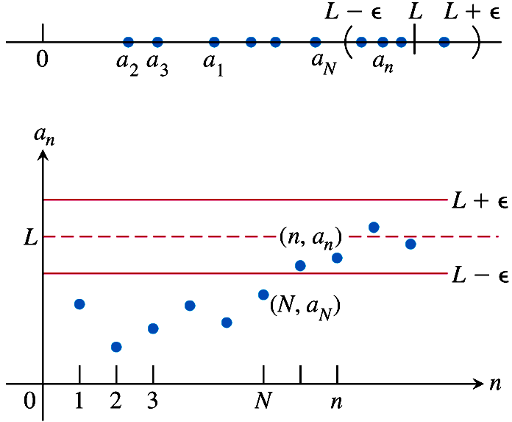
y= L is a horizontal asymptote when sequence converges to L.

Slide 7
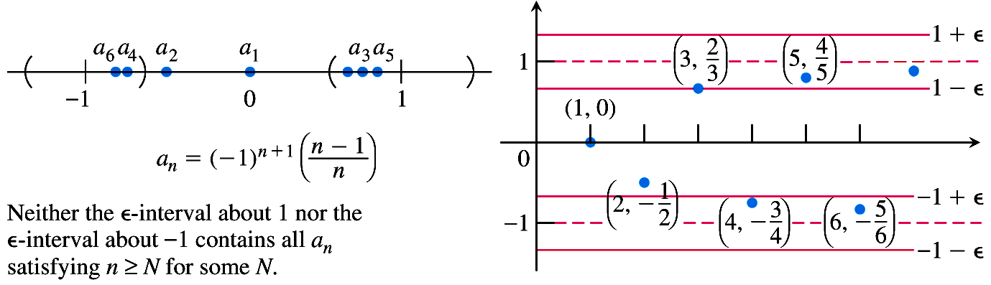
A sequence that diverges

Slide 8
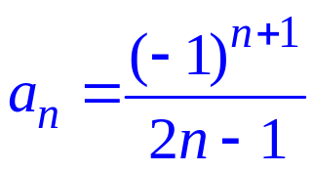
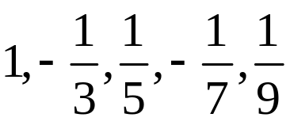
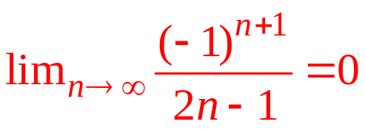
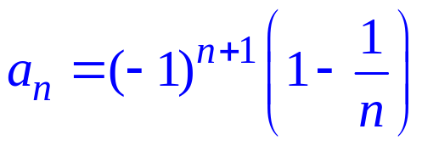
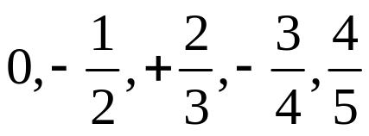
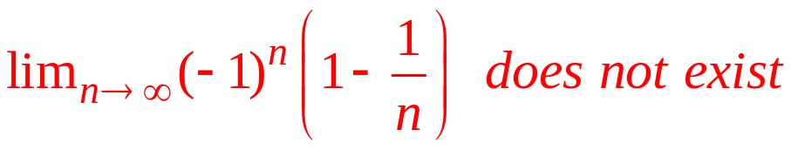
Sequences
Write the first 5 terms of the sequence.
Does the sequence converge? If so, find the value.
The sequence converges to 0.
The sequence diverges.

Slide 9
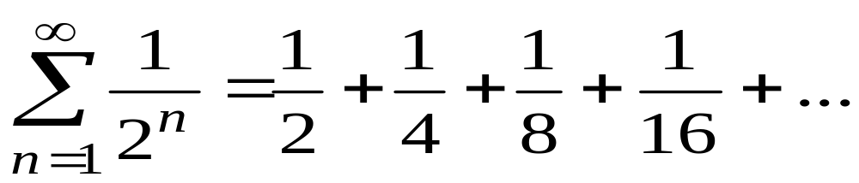
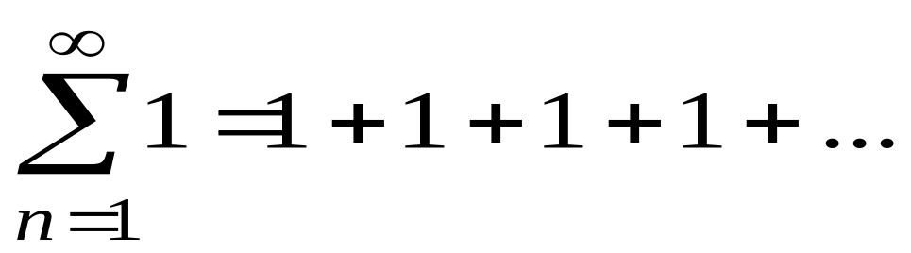
12.2 Infinite Series
Represents the sum of the terms in a sequence.
We want to know if the series converges to
a single value i.e. there is a finite sum.
The series diverges because s_{n} = n. Note that the
Sequence {1} converges.

Slide 10
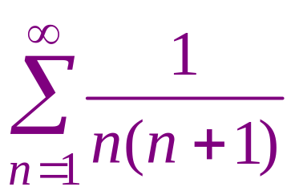
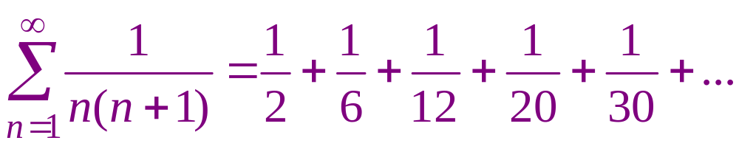

Slide 11
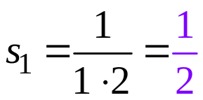
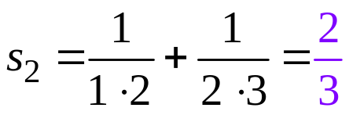
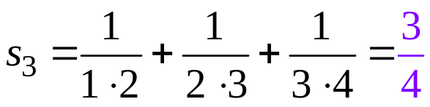
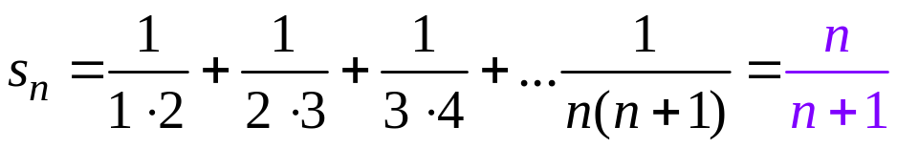
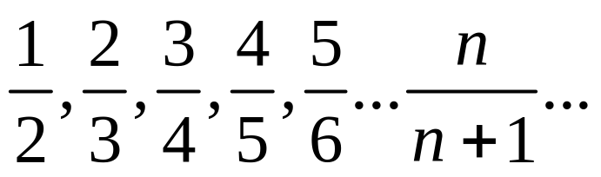
Partial sums of
and
If the sequence of partial sums converges, the series converges
Converges to 1 so series converges.

Slide 12
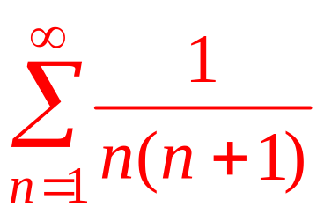
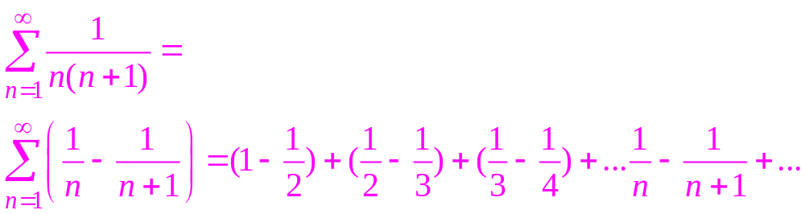
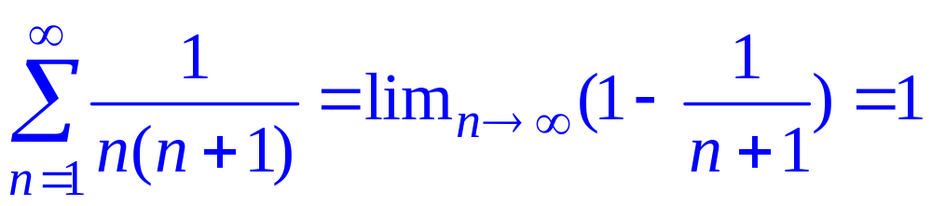
Finding sums
Can use partial fractions to rewrite

Slide 13
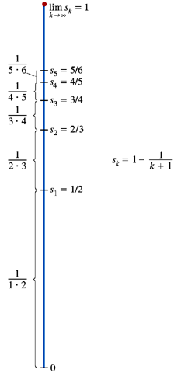
The partial sums of the series
.
Limit

Slide 14
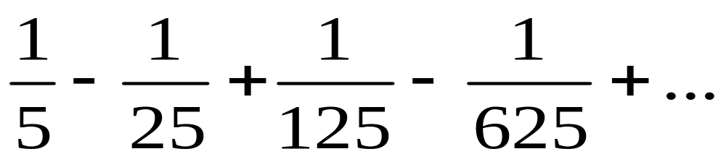
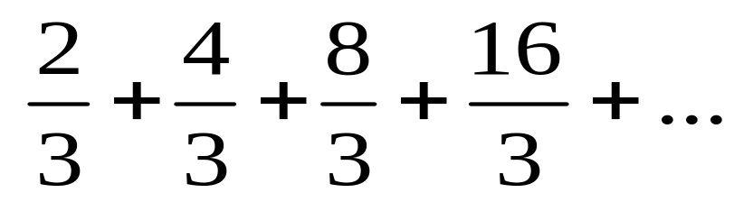
Geometric Series
Each term is obtained from the preceding number by multiplying by the same number r.
Find r (the common ratio)

Slide 15
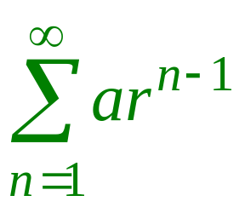
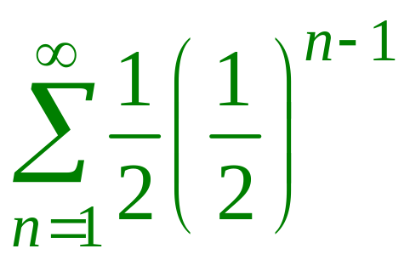
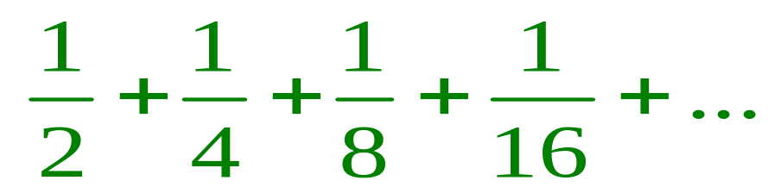
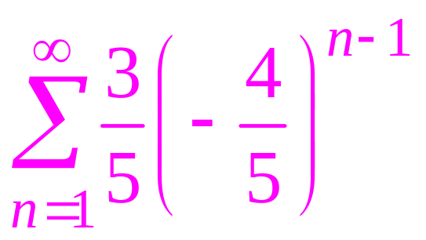
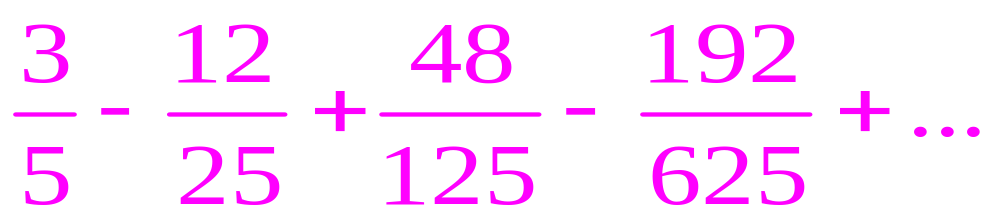
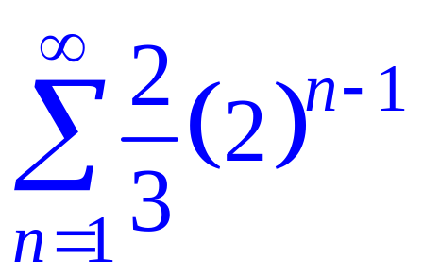
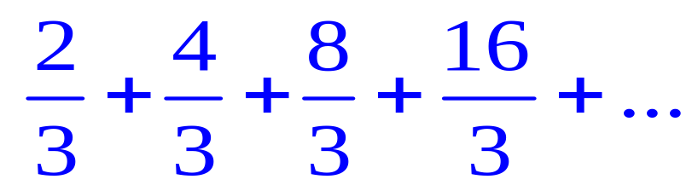
Is a Geometric Series
Where a = first term and r=common ratio
Write using series notation

Slide 16
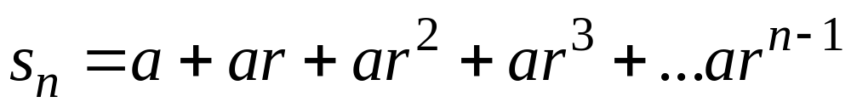
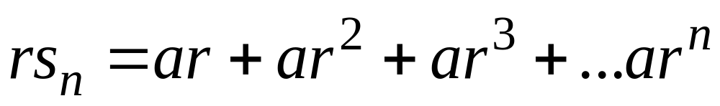
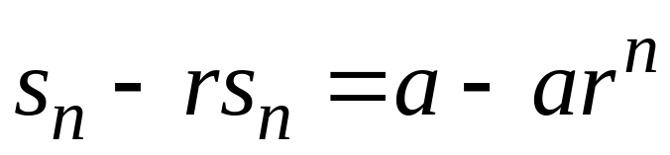
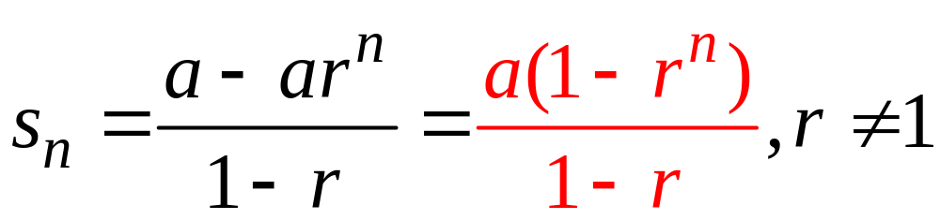
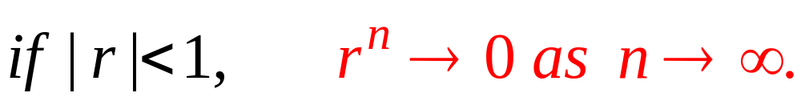
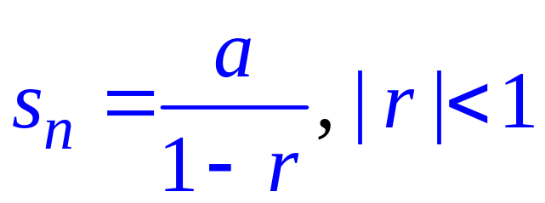
The sum of a geometric series
Sum of n terms
Multiply each term by r
subtract
Geometric series converges to
If r>1 the geometric series diverges.

Slide 17
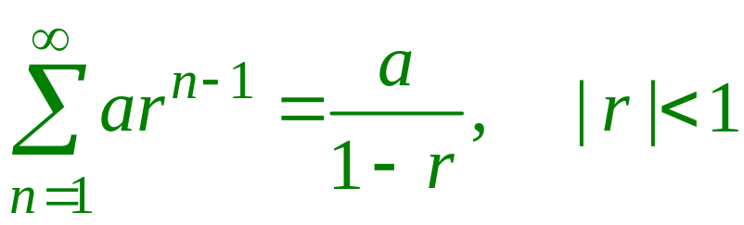


Find the sum of a Geometric Series
Where a = first term and r=common ratio
The series diverges.

Slide 18




Repeating decimals-Geometric Series
The repeating decimal is equivalent to 8/99.

Slide 19
Series known to converge or diverge
1. A geometric series with | r | <1 converges
2. A repeating decimal converges
3. Telescoping series converge
A necessary condition for convergence:
Limit as n goes to infinity for nth term in sequence is 0.
nth term test for divergence:
If the limit as n goes to infinity for the nth term is not 0, the series DIVERGES!

Slide 20




Convergence or Divergence?

Slide 21
A sequence in which each term is less than or equal to the one before it is called a monotonic non-increasing sequence. If each term is greater than or equal to the one before it, it is called monotonic non-decreasing.
A monotonic sequence that is bounded
Is convergent.
A series of non-negative terms converges
If its partial sums are bounded from above.

Slide 22


12. 3 The Integral Test
Let {a_{n}} be a sequence of positive terms. Suppose that a_{n} = f(n) where f is a continuous positive, decreasing function of x for all xN. Then the series and the corresponding integral shown both converge of both diverge.
f(n)
f(x)

Slide 23

The series and the integral both converge or both diverge
Area in rectangle corresponds to term in sequence
Exact area under curve is between
If area under curve is finite, so is area in rectangles
If area under curve is infinite, so is area in rectangles

Slide 24




Using the Integral test
The improper integral diverges
Thus the series diverges

Slide 25




Using the Integral test
The improper integral converges
Thus the series converges

Slide 26


Harmonic series and p-series
Is called a p-series
A p-series converges if p > 1 and diverges
If p < 1 or p = 1.
Is called the harmonic series and it diverges since p =1.

Slide 27






Identify which series converge and which diverge.

Slide 28



12. 4Direct Comparison test
Let
be a series with no negative terms
Converges if there is a series
Where the terms of a_{n} are less than or equal to the terms of c_{n} for all n>N.
Diverges if there is a series
Where the terms of a_{n} are greater than or equal to the terms of d_{n} for all n>N.

Slide 29




Limit Comparison test
Limit Comparison test
Then the following series
and
both converge or both diverge:
and
Amd
Converges then
Converges.
and
Diverges then
Diverges.

Slide 30



Convergence or divergence?

Slide 31




Alternating Series
A series in which terms alternate in sign
or

Slide 32

Alternating Series Test
Converges if:
a_{n} is always positive
a_{n} a_{n+1} for all n  N for some integer N.
a_{n}0
If any one of the conditions is not met, the
Series diverges.

Slide 33


Absolute and Conditional Convergence
A series is absolutely convergent if the corresponding series of absolute values converges.
A series that converges but does not converge absolutely, converges conditionally.
Every absolutely convergent series converges. (Converse is false!!!)

Slide 34




Is the given series convergent or divergent? If it is convergent, its it absolutely convergent or conditionally convergent?

Slide 35


a) Is the given series convergent or divergent? If it is convergent, its it absolutely convergent or conditionally convergent?
This is not an alternating series, but since
Is a convergent geometric series, then the given
Series is absolutely convergent.

Slide 36


b) Is the given series convergent or divergent? If it is convergent, its it absolutely convergent or conditionally convergent?
Converges by the Alternating series test.
Diverges with direct comparison with the harmonic
Series. The given series is conditionally convergent.

Slide 37

c) Is the given series convergent or divergent? If it is convergent, its it absolutely convergent or conditionally convergent?
By the nth term test for divergence, the series
Diverges.

Slide 38


d) Is the given series convergent or divergent? If it is convergent, its it absolutely convergent or conditionally convergent?
Converges by the alternating series test.
Diverges since it is a p-series with p <1. The
Given series is conditionally convergent.

Slide 39


The Ratio Test
Let be a series with positive terms and
Then
The series converges if ρ < 1
The series diverges if ρ > 1
The test is inconclusive if ρ = 1.

Slide 40

The Root Test
Let be a series with non-zero terms and
Then
The series converges if L< 1
The series diverges if L > 1 or is infinite
The test is inconclusive if L= 1.

Slide 41



Convergence or divergence?

Slide 42

Procedure for determining Convergence
.

