Slide 1
SOUMI DUTTA
DSA

Slide 2
STACK
A stack is one of the most important and useful non-primitive linear data structure. It is an ordered collection of items into which new data items may be added/inserted and from which items may be deleted at only one end, called the top of the stack. As all the addition and deletion in a stack is done from the top of the stack, the last added element will be first removed from the stack. That is why the stack is also called Last-in-First-out (LIFO).
The primitive operations performed on the stack are as follows:
PUSH: The process of adding (or inserting) a new element to the top of the stack is called PUSH operation. Pushing an element to a stack will add the new element at the top.
After every push operation the top is incremented by one. If the array is full and no new element can be accommodated, then the stack overflow condition occurs.
POP: The process of deleting (or removing) an element from the top of stack is called POP operation. After every pop operation the stack is decremented by one. If there is no element in the stack and the pop operation is performed then the stack underflow condition occurs.

Slide 3
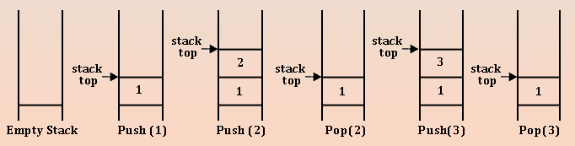
STACK
Stack (LIFO): Stack follows the rule of last in first out rule. Mainly two action are performed by stack one is push and other is pop. The last thing which we placed or push on stack is the first thing we can get when we pop. A stack is a list of element with insertion and deletion at one end only.

Slide 4
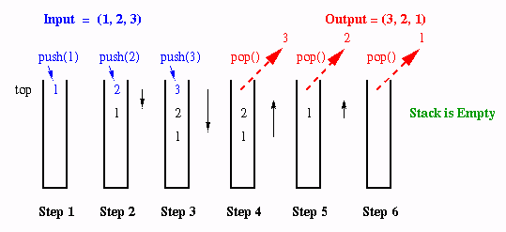
STACK OPERATION (PUSH/INSERTION)
int stack[5],top=-1,N=5;
void push(int item)
{
if(top==N-1)
printf(“Overflow”);
else
{
top++;
stack[top]=item;
}
}

Slide 5
STACK OPERATION (POP/DELETION)
void pop()
{
if(top==-1)
printf(“Underflow”);
else
{
item=stack[top];
printf(“Deleted item: %d”,item);
top--;
}
}

Slide 6
STACK OPERATION (DISPLAY)
void display()
{
if(top==-1)
printf(“Underflow”);
else
{
for(i=0;i<=top;i++)
printf(“%d”,stack[i]);
}
}

Slide 7
APPLICATION OF STACK
There are a number of applications of stacks; three of them are discussed briefly in the preceding sections.
  Stack is internally used by compiler when we implement (or execute) any recursive function. If we want to implement a recursive function non-recursively, stack is programmed explicitly.
  Stack is also used to evaluate a mathematical expression and to check the parentheses in an expression.

Slide 8
RECURSION
Recursion occurs when a function is called by itself repeatedly; the function is called recursive function. The general algorithm model for any recursive function contains the following steps:
Prologue: Save the parameters, local variables, and return address.
2. Body: If the base criterion has been reached, then perform the final computation and go to step 3; otherwise, perform the partial computation and go to step 1 (initiate a recursive call).
3. Epilogue: Restore the most recently saved parameters, local variables, and return address.

Slide 9
RECURSION VS ITERATION
Recursion of course is an elegant programming technique, but not the best way to solve a problem, even if it is recursive in nature. This is due to the following reasons:
1. It requires stack implementation.
2. It makes inefficient utilization of memory, as every time a new recursive call is made a new set of local variables is allocated to function.
3. Moreover it also slows down execution speed, as function calls require jumps, and saving the current state of program onto stack before jump.
Moreover recursive functions are often easier to implement & maintain, particularly in case of data structures which are by nature recursive. Such data structures are queues, trees, and linked lists.

Slide 10
TOWER OF HANOI
The initial setup of the problem is shown below. Here three pegs (or towers) X, Y and Z exists. There will be four different sized disks, say A, B, C and D. Each disk has a hole in the center so that it can be stacked on any of the pegs. At the beginning, the disks are stacked on the X peg, that is the largest sized disk on the bottom and the smallest sized disk on top.
Here we have to transfer all the disks from source peg X to the destination peg Z by using an intermediate peg Y. Following are the rules to be followed during transfer :
**1. Transferring the disks from the source peg to the destination peg such that at any point of transformation no large size disk is placed on the smaller one.
**2. Only one disk may be moved at a time.
**3. Each disk must be stacked on any one of the pegs.

Slide 11
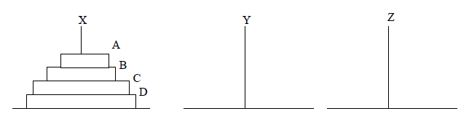
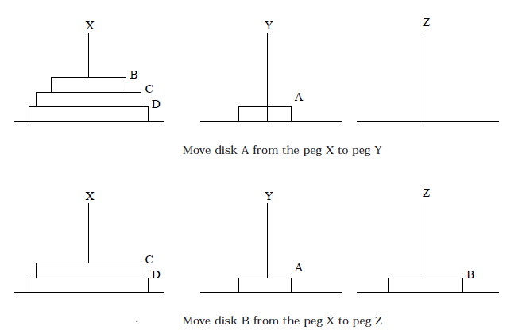
TOWER OF HANOI

Slide 12
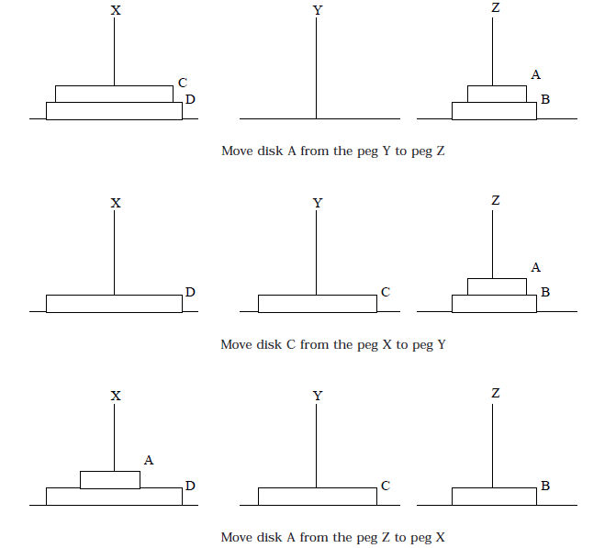
TOWER OF HANOI

Slide 13
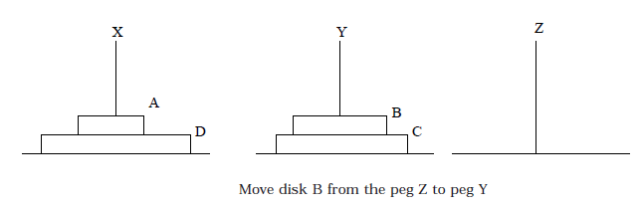
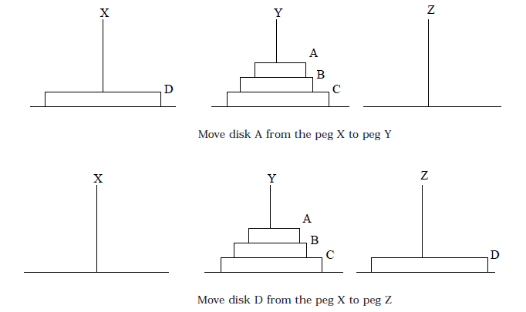
TOWER OF HANOI

Slide 14
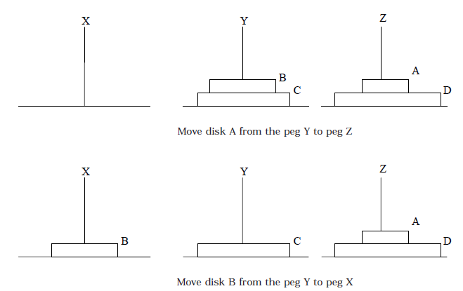
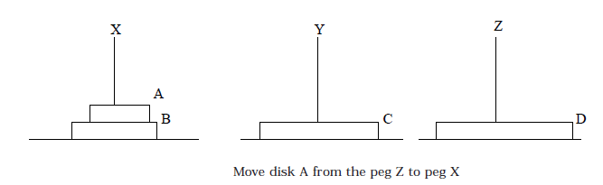
TOWER OF HANOI

Slide 15
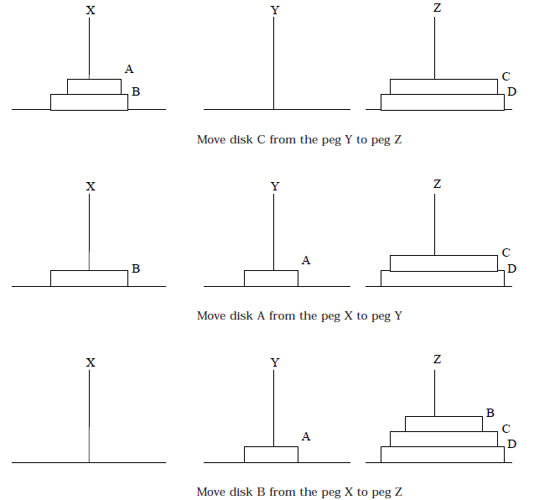
TOWER OF HANOI

Slide 16
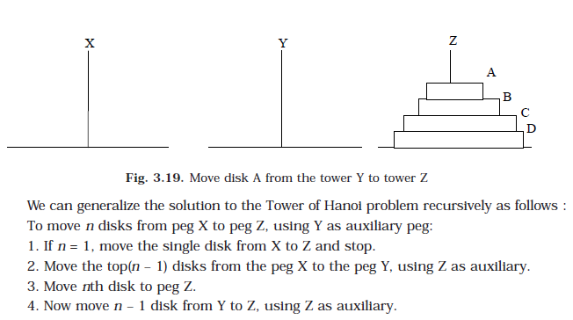
TOWER OF HANOI

Slide 17
#include <stdio.h>
#include <conio.h>
void towers(int, char, char, char);
void main()
{
int num;
clrscr();
printf("Enter the number of disks : ");
scanf("%d", &num);
printf("The sequence of moves involved in the Tower of Hanoi are :\n");
towers(num, 'A', 'C', 'B');
getch();
}
void towers(int num, char frompeg, char topeg, char auxpeg) {
if (num == 1)
{
printf("\n Move disk 1 from peg %c to peg %c", frompeg, topeg);
return;
}
towers(num - 1, frompeg, auxpeg, topeg);
printf("\n Move disk %d from peg %c to peg %c", num, frompeg, topeg);
towers(num - 1, auxpeg, topeg, frompeg);
}

Slide 18
ALGORITHM
The objective of the game is to transfer the disks from the leftmost pole to the rightmost pole, without ever placing a larger disk, on the top of a smaller disk. Only one disk may be moved at a time, and each disk must always be placed around one of the poles. The general strategy is to consider one of the poles to be the origin, and another to be the destination. The third pole will be used for intermediate storage, thus allowing the disks to be moved without placing a larger disk over a smaller disk. Assume there are n disks, numbered from smallest to largest, as above figure. If th disks are initially stacked on the left pole, the problem of moving all n disks to the right pole can be started using following Algorithm.
Algorithm
1. Declare necessary variables such as n, A, B, C etc.
2. Input number of disks
3. If n=1
move single disk from peg A to peg C and stop.
Else
move the top (n-1) disks from peg A to peg B using peg C as auxiliary.
4. Move remaining disks from peg A to peg C.
5. Move (n-1) disks from peg B to peg C using peg A as auxiliary

Slide 19
EXPRESSION
Another application of stack is calculation of postfix expression. There are basically three types of notation for an expression (mathematical expression; An expression is defined as the number of operands or data items combined with several operators.)
Infix notation : The infix notation is what we come across in our general mathematics, where the operator is written in-between the operands.
Example: A + B
2. Prefix notation : The prefix notation is a notation in which the operator(s) is written before the operands, it is also called polish notation.
Example: + A B
3. Postfix notation : In the postfix notation the operator(s) are written after the operands, so it is called the postfix notation (post means after), it is also known as suffix notation or reverse polish notation.
Example: A B+

Slide 20
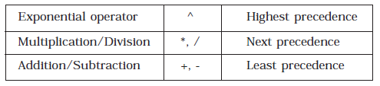
EXPRESSION
Thus expression A + B * C can be interpreted as A + (B * C). Using this alternative method we can convey to the computer that multiplication has higher precedence over addition.
Operator precedence
Give postfix form for A + [ (B + C) + (D + E) * F ] / G
A + {[ (BC +) + (DE +) * F ] / G}
A + [ (BC +) + (DE + F *] / G}
A + [ (BC + (DE + F * +] / G} .
A + [ BC + DE + F *+ G / ]
ABC + DE + F * + G / +

Slide 21
EXPRESSION
Problem 3.4.2.2. Give postfix form for (A + B) * C / D + E ^ A / B
[(AB + ) * C / D ] + [ (EA ^) / B ]
[(AB + ) * C / D ] + [ (EA ^) B / ]
[(AB + ) C * D / ] + [ (EA ^) B / ]
AB + ) C * D / (EA ^) B / +
AB + C * D / EA ^ B / +

Slide 22
POSTFIX EXPRESSION ALGORITHM
P is an arithmetic expression written in infix notation. This algorithm finds the equivalent postfix expression Q. The algorithm uses a stack to temporarily hold the operators and left parentheses. The algorithm uses a stack to temporarily hold the operators and left parentheses. The
postfix expression Q will be constructed from left to right using the operands from P and operators, which are removed from stack. We begin by pushing a left parenthesis onto stack and adding a right parenthesis at the end of P. the algorithm is completed when the
stack is empty.

Slide 23
POSTFIX EXPRESSION ALGORITHM
1. Push “(” onto stack, and add“)” to the end of P.
2. Scan P from left to right and repeat Steps 3 to 6 for each element of P until the stack is empty.
3. If an operand is encountered, add it to Q.
4. If a left parenthesis is encountered, push it onto stack.
5. If an operator ⊗ is encountered, then:
(a) Repeatedly pop from stack and add P each operator (on the top of stack), which has the same precedence as, or higher precedence than ⊗.
(b) Add ⊗ to stack.
6. If a right parenthesis is encountered, then:
(a) Repeatedly pop from stack and add to P (on the top of stack until a left parenthesis is encountered.
(b) Remove the left parenthesis. [Do not add the left parenthesis to P.]
7. Exit.

Slide 24
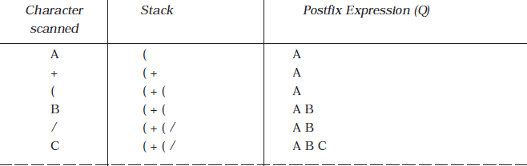
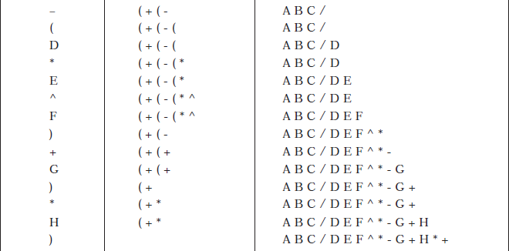
POSTFIX EXPRESSION ALGORITHM
P = A + ( B / C - ( D * E ^ F ) + G ) * H

