Slide 1
Project Analysis / Decision Making
Engineering 90
Dr. Gregory Crawford

Slide 2
Four Ways to do Project Analysis
Statistical / Regression Analysis
(forecasting)
Sensitivity Analysis
Monte Carlo Simulations
Decision Trees
Decision Tree

Slide 3

What’s the difference?
Each shows a manager different aspects of the decision he/she faces:
Regression / Statistical Forecasting is a way to estimate future sales growth based on current or past performances.
Sensitivity Analysis shows her how much each variable affects the NPV.
Monte Carlo gives a statistical breakdown of the possible outcomes.
Decision Trees are visual representations of the average outcome.

Slide 4
Regression and
Statistical Forecasting
Mathematically model past sales of either same product or similar product
Projects future sales as a function of these past sales with respect to time
We will talk about two types of regression
Linear Regression
Polynomial Regression
(but there are many more, logarithmic, exponential, etc)

Slide 5

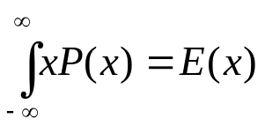
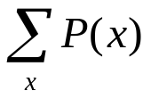
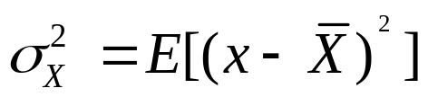
Quick primer on Statistics and Probability
Definitions:
Expected Value of x: E(x) = ; as P(x) represents the probability of x.
(Note that = 1 and that the because P(x) represents
a probability density function)
Variance of x:
Standard Deviation = the sq. root of the variance
Median = “the center of the set of numbers”; or the point m such that P(x < m)< ½ and P(x > m)> ½ .

Slide 6
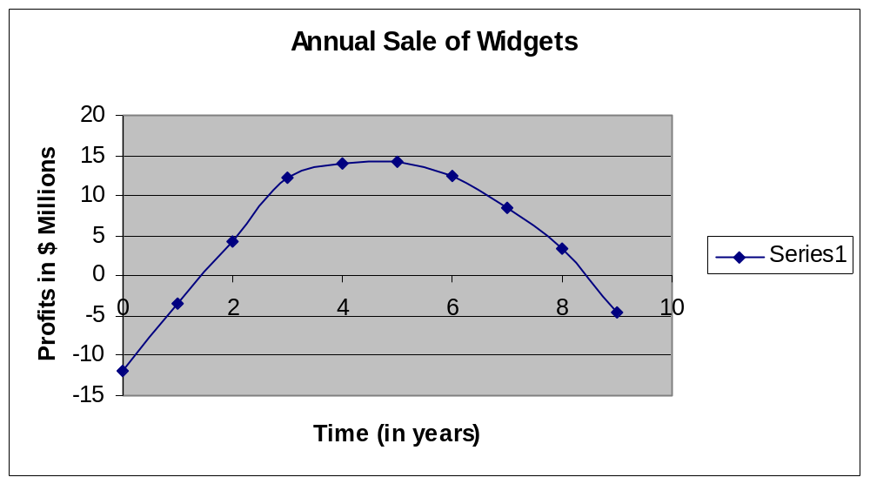
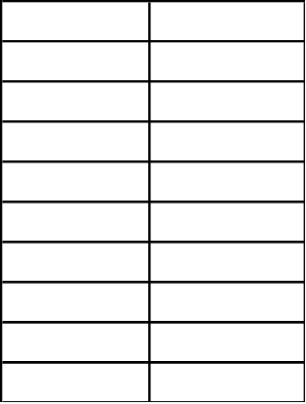
Simple Example – Widget Sales
Data Points

Slide 7
Widgets (cont.)
Suppose Greg plans on releasing
the next generation widget.
(old widget data on previous page)
He already has sales of:
  Year 1 = $0.5 million
  Year 2 = $5.1 million
  Year 3 = $13.0 million
What should he estimate his
future sales to be?

Slide 8
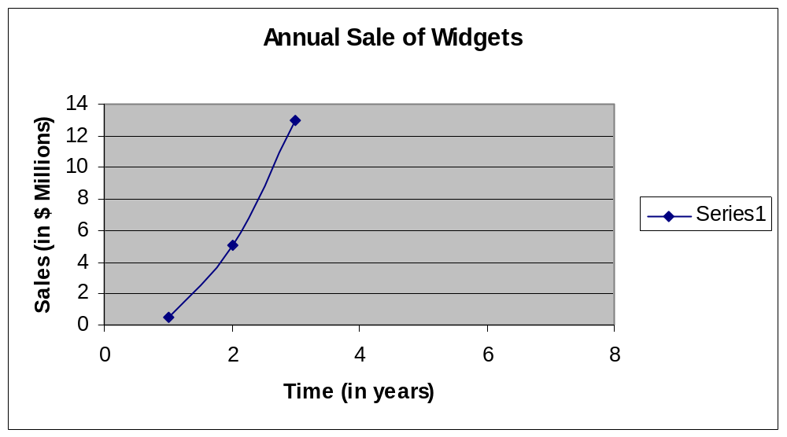
Mmmm… more widgets

Slide 9
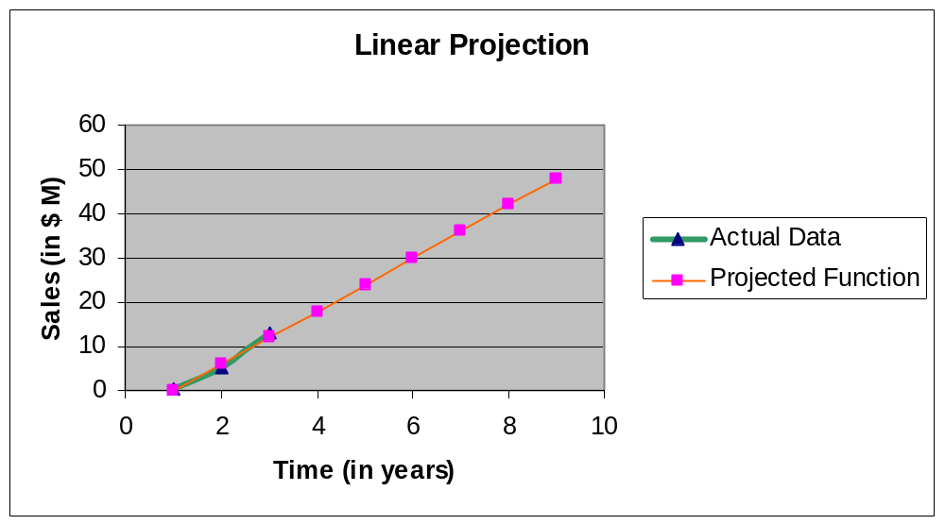
Linear Projections
Propose that sales is:
Assume f(x) = 6t - 5, where t = number of years

Slide 10

Regression –
Least Squares
Is there a formal way to get this estimation function?
Fit a line such that the square of the vertical deviations between the function and the data points is minimized

Slide 11
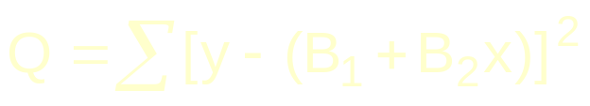
Derivation of Least Squares Regression
Assume you have an arbitrary straight line:
y = B₁ + B₂x [note, this is simply y = mx + b]
Let q = the distance between the function point and the actual data point; therefore
q = y – (B₁ + B₂x)
The square of q is = [ y – (B₁ + B₂)]²
The sum of all of the squares of q we will denote Q
function
q
•
Data point

Slide 12
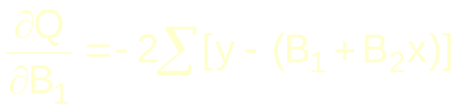
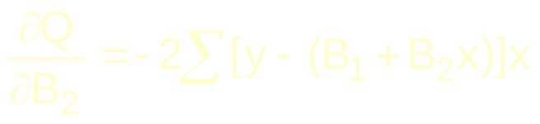
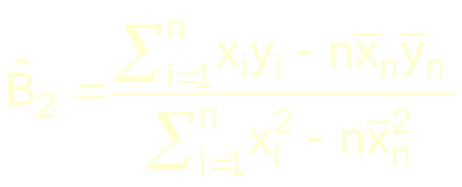

Derivation Continued…
Recall, we want to minimize Q, so using partial derivatives and setting them = 0 we get
Setting these equations equal to zero and solving for B₁ and B₂ gives us...
Which will yield the equation y = B₁ + B₂x ?
x = Average x, y = Average y

Slide 13

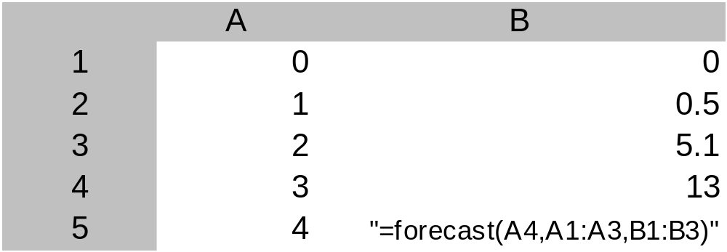
Using Microsoft Excel for Regression
Of course, no one really does this by hand any more…
Plot your data points in adjacent columns
Use “=forecast(x, previous data f(x), previous data x)”
This is a linear-fit regression command

Slide 14
What’s wrong with this picture?
First, it is unrealistic to have infinitely rising sales
Second, it doesn’t fit with Greg’s previous widget product’s sales, which eventually decline
Let’s try to find a function that takes the first set of widget sales into account.

Slide 15
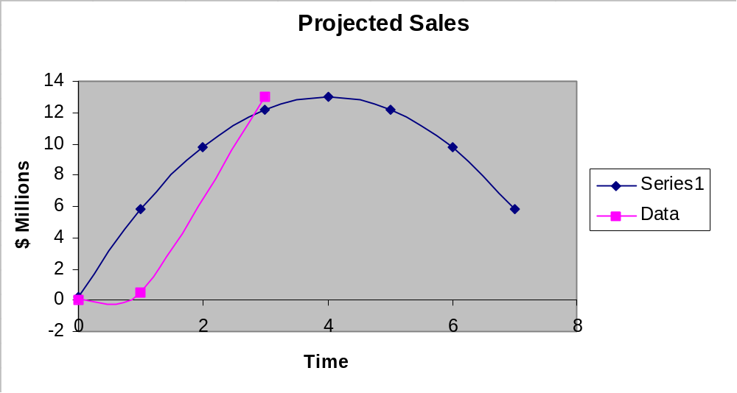
F(x) = ax² + bx + c
New function
data
In fact, the function is f(x) = -.8(x-4)² + 13

Slide 16
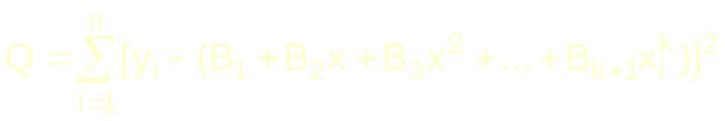
Least Squares Regression for Polynomials
(You are not responsible for this material)
Minimize the sum Q of the squares of these differences:
This will yield a (k+1)x(k+1) matrix of equations that can be solved for B_{i}, yielding the equation:
f(x) = B₁ + B₂x + B₃x² + … + B_{n}x^{(n-1)}

Slide 17
Summary
Least squares regression is a common scientific & engineering practice.
In business, it can be used to forecast possible future trends.
You’re responsible for linear least squares regression only.

Slide 18

Sensitivity Analysis
Set up an Excel spreadsheet that will calculate your projects NPV
Individually change your assumptions to see how the NPV changes with respect to different variables
Helps to determine how much to spend on additional information

Slide 19

Jalopy Motor’s Example
Suppose that you forecast the
following for an electric
scooter project:
Market Size of .9 (worst case)– 1.1 million (best case) customers
Market Share of between 4% (wc)and 16% (bc) after the first year
Unit price between $3,500 (wc) and $3,800 (bc)
Unit cost (variable) between $3,600 (wc) and $2,750 (bc)
Fixed costs between $40 (wc) and 20 million (bc).
From Principles of Corporate Finance, (c) 1996 Brealey/Myers

Slide 20
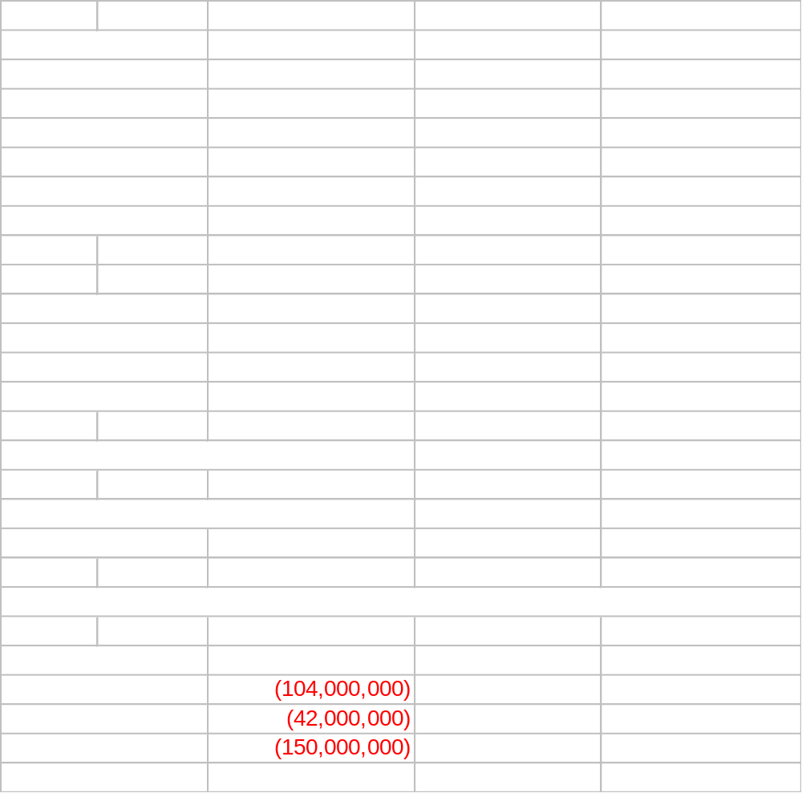
Jalopy Example (cont.)

Slide 21
Explanations
NPV is calculated by subtracting the initial investment from the sum of yearly $30M net cash flow.
  NPV = - 150 + 30 [1 – (1.1)¹⁰ / .1] = $34.3
Net Cash Flow is defined as net profit plus the tax savings you get from depreciation

Slide 22
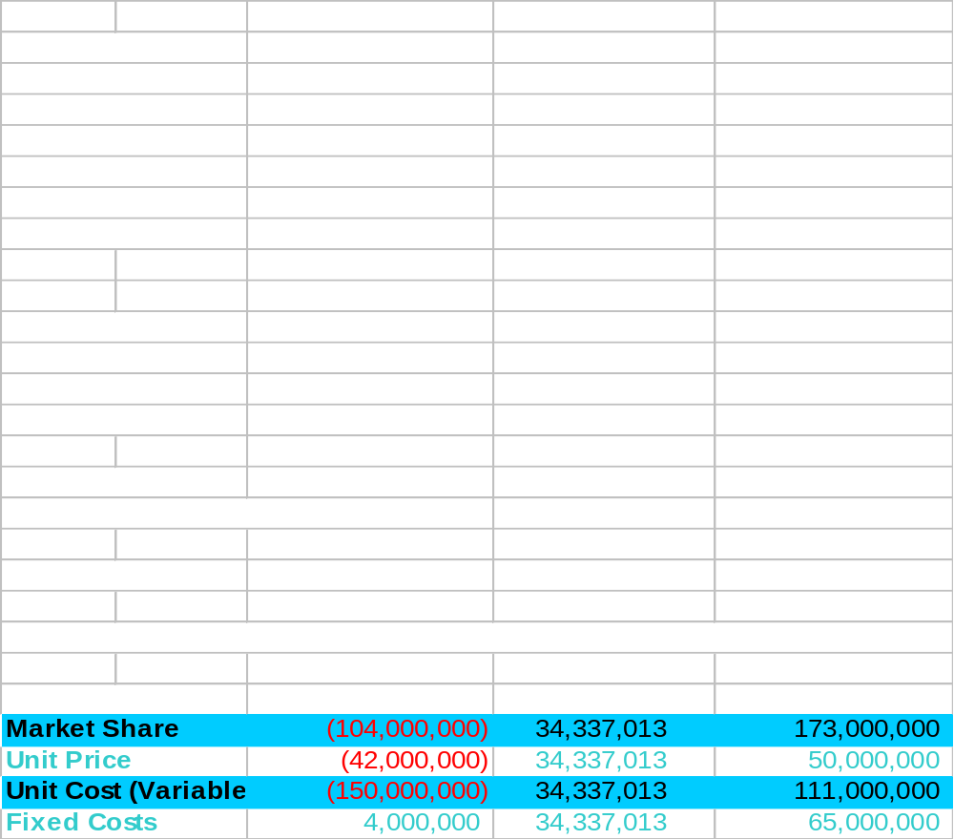
Jalopy Example (cont.)
Notes:
Talk about increasing the budget for market analysis and increasing the budget for R and D to lower the Unit Cost.

Slide 23
Monte Carlo Simulations
Simulations are a tool for considering all possibilities
Step 1 – Model the project (where are choices made, where are the chances)
Step 2 – Assign Probabilities to outcomes (assumption)
Step 3 – Simulate the Cash Flows (use a computer simulation program)
The result will be a probability distribution.

Slide 24
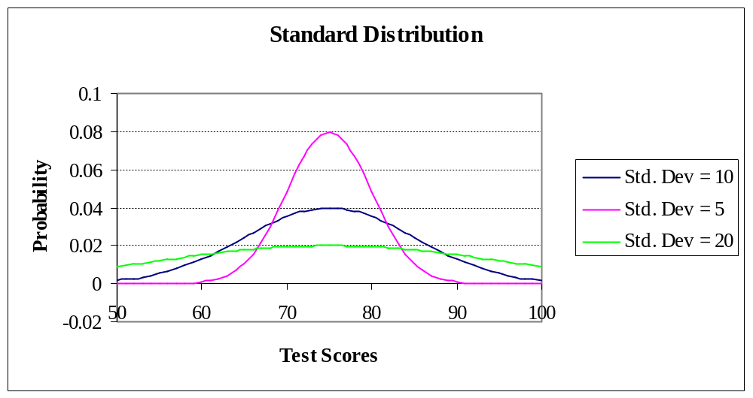
Monte Carlo Simulation (cont.)
(test scores example)
Notes:
Everyone has seen this type of distribution for test scores.
Mean = 75; and you see how the students scored; the different lines show different std. dev

Slide 25

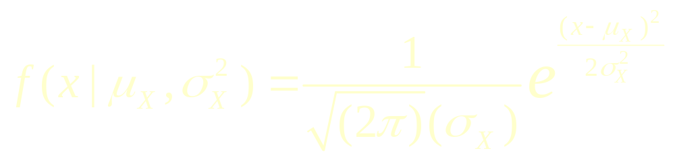
Equations (Mmmm… Math)
Normal Distribution: f(x | μ and σ)
Standard Normal Distributions have a mean (μ_{x}) of 0 and a variance (σ²) of 1

Slide 26
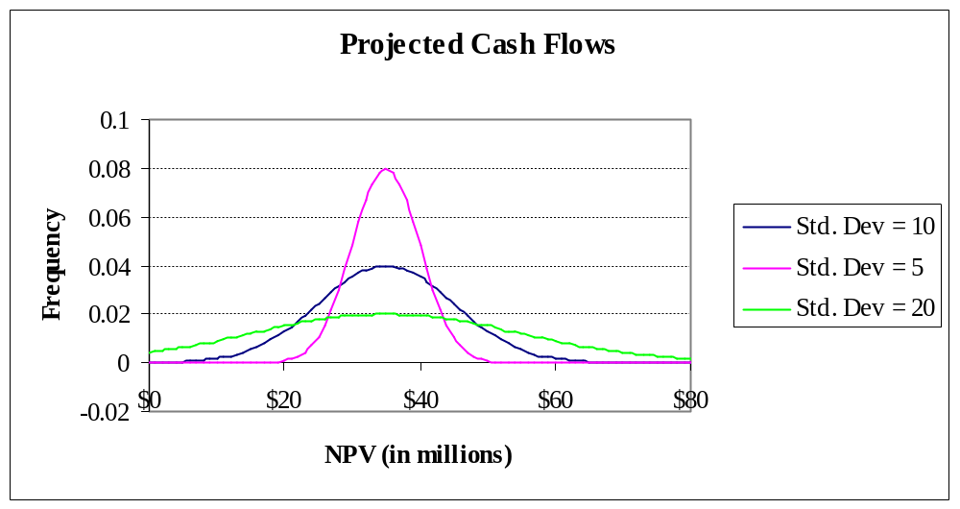
Monte Carlo Simulations
(projected cash flow)
Cost of project
The distribution shows the percentage of times the program predicts NVP above cost of project.
Notes:
Here – you see the probability of meeting your cash flow…. Assume the cost of the project is $30 Million (represented by the red bar). You can see what the probability of achieving that amount is.

Slide 27
Summary Monte Carlo
You are not responsible for this on the test.
Statistical breakdown of possible outcomes.
Dealing with continuous distribution.

Slide 28
What is a Decision Tree?
A Visual Representation of Choices, Consequences, Probabilities, and Opportunities.
A Way of Breaking Down Complicated Situations Down to Easier-to-Understand Scenarios.
Decision Tree

Slide 29

Easy Example
A Decision Tree with two choices.
Go to Graduate School to get my MBA.
Go to Work “in the Real World”

Slide 30
Notation Used in Decision Trees
A box is used to show a choice that the manager has to make.
A circle is used to show that a probability outcome will occur.
Lines connect outcomes to their choice
or probability outcome.

Slide 31

Easy Example - Revisited
What are some of the costs we should take into account when deciding whether or not to go to business school?
Tuition and Fees
Rent / Food / etc.
Opportunity cost of salary
Anticipated future earnings

Slide 32
Simple Decision Tree Model
2 Years of tuition: $55,000, 2 years of Room/Board: $20,000; 2 years of Opportunity Cost of Salary = $100,000
Total = $175,000.
PLUS → Anticipated 5 year salary after Business School = $600,000.
NPV (business school) = $600,000 - $175,000 = $425,000
Go to Graduate School to get my MBA.
Go to Work “in the Real World”
First two year salary = $100,000 (from above), minus expenses of $20,000.
Final five year salary = $330,000
NPV (no b-school) = $410,000
Is this a realistic model?
What is missing?
Go to Business School

Slide 33

The Yeaple Study (1994)
Benefits of Learning
School Net Value ($)
Harvard $148,378
Chicago $106,378
Stanford $97,462
MIT (Sloan) $85,736
Yale $83,775
Northwestern $53,526
Berkeley $54,101
Wharton $59,486
UCLA $55,088
Virginia $30,046
Cornell $30,974
Michigan $21,502
Dartmouth $22,509
Carnegie Mellon $18,679
Texas $17,459
Rochester - $307
Indiana - $3,315
North Carolina - $4,565
Duke - $17,631
NYU - $3,749
According to Ronald Yeaple, it is only profitable to go to one of the top 15 Business Schools – otherwise you have a NEGATIVE NPV!
(Economist, Aug. 6, 1994)

Slide 34

Things he may have missed
Future uncertainty (interest rates,
future salary, etc)
Cost of Living differences
Type of Job [utility function = f($, enjoyment)]
Girlfriend / Boyfriend / Family concerns
Others?
Utility Function = f ($, enjoyment, family, location, type of job / prestige, gender, age, race) Human Factors Considerations

Slide 35

Mary’s Factory
Mary is a manager of a gadget factory. Her factory has been quite successful the past three years. She is wondering whether or not it is a good idea to expand her factory this year. The cost to expand her factory is $1.5M. If she does nothing and the economy stays good and people continue to buy lots of gadgets she expects $3M in revenue; while only $1M if the economy is bad.
If she expands the factory, she expects to receive $6M if economy is good and $2M if economy is bad.
She also assumes that there is a 40% chance of a good economy and a 60% chance of a bad economy.
(a) Draw a Decision Tree showing these choices.

Slide 36

Decision Tree Example
.4
40 % Chance of a Good Economy
Profit = $6M
Expand Factory
Cost = $1.5 M
.6
60% Chance Bad Economy
Profit = $2M
.4
Good Economy (40%)
Profit = $3M
Don’t Expand Factory
Cost = $0
.6
Bad Economy (60%)
Profit = $1M
NPV_{Expand} = (.4(6) + .6(2)) – 1.5 = $2.1M
NPV_{No Expand} = .4(3) + .6(1) = $1.8M
$2.1 > 1.8, therefore you should expand the factory

Slide 37

Example 2 – Joe’s Garage
Joe’s garage is considering hiring another mechanic. The mechanic would cost them an additional $50,000 / year in salary and benefits. If there are a lot of accidents in Providence this year, they anticipate making an additional $75,000 in net revenue. If there are not a lot of accidents, they could lose $20,000 off of last year’s total net revenues. Because of all the ice on the roads, Joe thinks that there will be a 70% chance of “a lot of accidents” and a 30% chance of “fewer accidents”. Assume if he doesn’t expand he will have the same revenue as last year.
Draw a decision tree for Joe and tell him what he should do.

Slide 38

Example 2 - Answer
.7
70% chance of an increase in accidents
Profit = $70,000
Hire new mechanic
Cost = $50,000
.3
30% chance of a decrease in accidents
Profit = - $20,000
Don’t hire new mechanic
Cost = $0
Estimated value of “Hire Mechanic” =
NPV =.7(70,000) + .3(- $20,000) - $50,000 = - $7,000
Therefore you should not hire the mechanic

Slide 39
Mary’s Factory –
With Options
A few days later she was told that if she expands, she can opt to either (a) expand the factory further if the economy is good which costs 1.5M, but will yield an additional $2M in profit when economy is good but only $1M when economy is bad, (b) abandon the project and sell the equipment she originally bought for $1.3M, or (c) do nothing.
(b) Draw a decision tree to show these three options for each possible outcome, and compute the NPV for the expansion.

Slide 40

Decision Trees, with Options
Expand further – yielding $8M (but costing $1.5)
.4
Stay at new expanded levels – yielding $6M
Good Market
Reduce to old levels – yielding $3M (but saving $1.3 - sell equipment)
.6
Expand further – yielding $3M (but costing $1.5)
Bad Market
Stay at new expanded levels – yielding $2M
Reduce to old levels – yielding $1M (but saving $1.3 in equipment cost)

Slide 41

Present Value of the Options
Good Economy
  Expand further = 8M – 1.5M = 6.5M
  Do nothing = 6M
  Abandon Project = 3M + 1.3M = 4.3M
Bad Economy
  Expand further = 3M – 1.5M = 1.5M
  Do nothing = 2M
  Abandon Project = 1M + 1.3M = 2.3M

Slide 42

NPV of the Project
So the NPV of Expanding the factory is:
NPV_{Expand} = [.4(6.5) + .6(2.3)] - 1.5M = $2.48M
Therefore the value of the option is
2.48 (new NPV) – 2.1 (old NPV) = $380,000
You would pay up to this amount to exercise that option.

Slide 43
Mary’s Factory –
Discounting
Before Mary takes this to her boss, she wants to account for the time value of money. The gadget company uses a 10% discount rate. The cost of expanding the factory is borne in year zero but the revenue streams are in year one.
(c) Compute the NPV in part (a) again, this time account the time value of money in your analysis. Should she expand the factory?

Slide 44

Time Value of Money
.4
40 % Chance of a Good Economy
Profit = $6M
Expand Factory
Cost = $1.5 M
.6
60% Chance Bad Economy
Profit = $2M
.4
Good Economy (40%)
Profit = $3M
Don’t Expand Factory
Cost = $0
.6
Bad Economy (60%)
Profit = $1M
Year 0
Year 1

Slide 45

Time Value of Money
Recall that the formula for discounting money as a
function of time is: PV = S (1+i)^{-n}
[where i = interest / discount rate; n = number of years /
S = nominal value]
So, in each scenario, we get the Present Value (PV) of the
estimated net revenues:
a) PV = 6(1.1)⁻¹ = $5,454,454
b) PV = 2(1.1)⁻¹ = $1,818,181
c) PV = 3(1.1)⁻¹ = $2,727,272
d) PV = 1(1.1)⁻¹ = $0.909,091

Slide 46

Time Value of Money
Therefore, the PV of the revenue
streams (once you account for the
time value of money) are:
PV_{Expand} =.4(5.5M) + .6(1.82M) = $3.29M
PV_{Don’t Ex.} = 0.4(2.73) + 0.6(.910) = 1.638
So, should you expand the factory?
Yes, because the cost of the expansion is $1.5M, and that means the NPV = 3.29 – 1.5 = $1.79 > $1.64
Note that since the cost of expansion is borne in year 0, you don’t discount it.

Slide 47

Stephanie’s
Hardware Store
Stephanie has a hardware store and
she is deciding whether or not to buy
Adler’s Hardware store on Wickendon
Street. She can buy it for $400,000; however it would take one year to renovate, implement her computer inventory system, etc.
The next year she expects to earn $600,000 if the economy is good and only $200,000 if the economy is bad. She estimates a 65% probability of a good economy and a 35% probability of a bad economy. If she doesn’t buy Adler’s she knows she will get $0 additional profits.
Taking the time value of money into account, find the NPV of the project with a discount rate of 10%

Slide 48

Answer to
Stephanie’s Problem
65 % Chance of a Good Economy
Profit = $600,000
Buy Adler’s
Cost = $400,000
35% Chance Bad Economy
Profit = $200,000
Don’t Buy
Cost = $0
Additional Revenue = $0
Year 0
Year 1

Slide 49

Should she buy?
NPV of purchase =
  .65(600,000/1.1) + .35(200,000/1.1) – 400,000
  = $18,181.82
Therefore, she should do the project!
What happens if the discount rate = 15%?
  The NPV = 0, so it probably is not worth it.
What happens if the discount rate = 20%?
  The NPV = - $16,666.67; so you should not buy!

