Slide 1
Decision Making Under Risk Continued: Decision Trees
MGS3100 - Chapter 8
Slides 8b

Slide 2
Problem: Jenny Lind
(Text Problems 8-16)
Jenny Lind is a writer of romance novels. A movie company and a TV network both want exclusive rights to one of her more popular works. If she signs with the network, she will receive a single lump sum, but if she signs with the movie company, the amount she will receive depends on the market response to her movie. What should she do?

Slide 3
Payouts and Probabilities
Movie company Payouts
  Small box office - $200,000
  Medium box office - $1,000,000
  Large box office - $3,000,000
TV Network Payout
  Flat rate - $900,000
Probabilities
  P(Small Box Office) = 0.3
  P(Medium Box Office) = 0.6
  P(Large Box Office) = 0.1

Slide 4
Jenny Lind - Payoff Table
Decisions | States of Nature
 | Small Box Office | Medium Box Office | Large Box Office
Sign with Movie Company | $200,000 | $1,000,000 | $3,000,000
Sign with TV Network | $900,000 | $900,000 | $900,000
Prior Probabilities | 0.3 | 0.6 | 0.1

Slide 5
Jenny Lind - How to Decide?
What would be her decision based on:
  Maximax?
  Maximin?
  Expected Return?

Slide 6
Using Expected Return Criteria
EV_{movie}=0.3(200,000)+0.6(1,000,000)+0.1(3,000,000)
= $960,000 = EVUII or EV_{Best}
EV_{tv} =0.3(900,000)+0.6(900,000)+0.1(900,000)
= $900,000
Therefore, using this criteria, Jenny should select the movie contract.

Slide 7
Something to Remember
Jenny’s decision is only going to be made one time, and she will earn either $200,000, $1,000,000 or $3,000,000 if she signs the movie contract, not the calculated EV of $960,000!!
Nevertheless, this amount is useful for decision-making, as it will maximize Jenny’s expected returns in the long run if she continues to use this approach.

Slide 8
Expected Value of Perfect Information (EVPI)
What is the most that Jenny should be willing to pay to learn what the size of the box office will be before she decides with whom to sign?

Slide 9
EVPI Calculation
EVwPI (or EV_{c})
=0.3(900,000)+0.6(1,000,000)+0.1(3,000,000) = $1,170,000
EV_{Best} (calculated to be EV_{Movie} from the previous page)
=0.3(200,000)+0.6(1,000,000)+0.1(3,000,000) = $960,000
EVPI = $1,170,000 - $960,000 = $210,000
Therefore, Jenny would be willing to spend up to $210,000 to learn additional information before making a decision.

Slide 10
Using Decision Trees
Can be used as visual aids to structure and solve sequential decision problems
Especially beneficial when the complexity of the problem grows

Slide 11
Decision Trees
Three types of “nodes”
  Decision nodes - represented by squares (□)
  Chance nodes - represented by circles (Ο)
  Terminal nodes - represented by triangles (optional)
Solving the tree involves pruning all but the best decisions at decision nodes, and finding expected values of all possible states of nature at chance nodes
Create the tree from left to right
Solve the tree from right to left

Slide 12
Example Decision Tree
Chance
node
Event 1
Decision
node
Event 2
Decision 1
Event 3
Decision 2

Slide 13
Jenny Lind Decision Tree
Small Box Office
$200,000
Sign with Movie Co.
Medium Box Office
$1,000,000
Large Box Office
$3,000,000
Small Box Office
$900,000
Sign with TV Network
Medium Box Office
$900,000
Large Box Office
$900,000

Slide 14
Jenny Lind Decision Tree
Small Box Office
ER
?
.3
$200,000
Sign with Movie Co.
.6
Medium Box Office
$1,000,000
ER
?
.1
Large Box Office
$3,000,000
Small Box Office
ER
?
.3
$900,000
Sign with TV Network
.6
Medium Box Office
$900,000
.1
Large Box Office
$900,000

Slide 15
Jenny Lind Decision Tree - Solved
Small Box Office
ER
960,000
.3
$200,000
Sign with Movie Co.
.6
Medium Box Office
$1,000,000
ER
960,000
.1
Large Box Office
$3,000,000
Small Box Office
ER
900,000
.3
$900,000
Sign with TV Network
.6
Medium Box Office
$900,000
.1
Large Box Office
$900,000

Slide 16
Class Exercise: A Glass Factory
A glass factory specializing in crystal is experiencing a substantial backlog, and the firm's management is considering three courses of action:
A) Arrange for subcontracting
B) Construct new facilities
C) Do nothing (no change)
The correct choice depends largely upon demand, which may be low, medium, or high. By consensus, management estimates the respective demand probabilities as 0.1, 0.5, and 0.4.
Given the payoffs on the next page, manually create and solve this problem using a decision tree.
Notes:
20

Slide 17
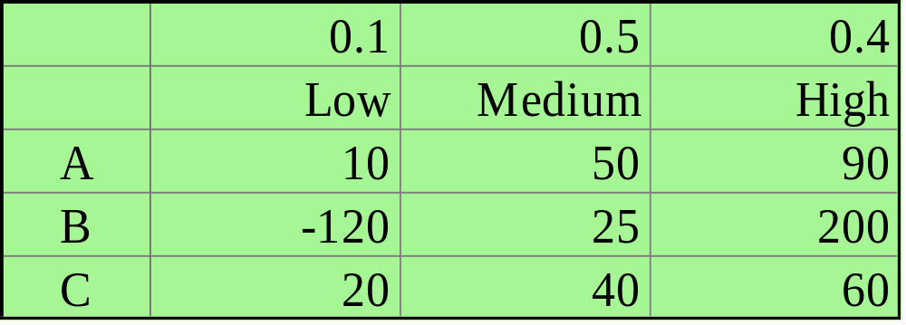
A Glass Factory: The Payoff Table
The management estimates the profits when choosing from the three alternatives (A, B, and C) under the differing probable levels of demand. These profits, in thousands of dollars are presented in the table below:
Notes:
21

Slide 18
Class Exercise: Drawing a Decision Tree
A Gambling Referendum
A gambling referendum has been placed on the ballot in River City. ABC Entertainment is considering whether or not to submit a bid to manage the new gambling business. ABC must decide whether or not to hire a market research firm (Gallup). If Gallup is hired, they will obtain a prediction that the referendum will either pass or fail. Following this, they will learn if their bid is a winning one. Set up the decision tree with all event nodes and decision nodes, and label all branches. Do not include any probabilities or payoffs.
Notes:
20

Slide 19
Using TreePlan To Solve Decision Tree Problems With Excel
Use TreePlan, an add-in for Excel, to set up and solve decision tree problems.
TreePlan program consists of single Excel add-in file, TREEPLAN.XLA, which can be found on CD-ROM that accompanies the M&W text.

Slide 20
Installing TreePlan
Insert student CD Rom for M&W text
Click on Start
Click on Run
Type: d:\html\Treeplan\Treeplan.xla
(Note: If “d” is not your CD Rom drive, replace the “d” with the appropriate drive name.)
Select “Enable macros”
You are done!

Slide 21
Using TreePlan
Creating a Decision Tree Using TreePlan
Once TreePlan is installed and loaded, follow these steps to set up and solve decision tree problems.
  Starting TreePlan:
    Start Excel and open a blank worksheet.
    Place cursor in cell B1. (This is important!)
    Select Tools|Decision Tree from Excel’s main menu.

Slide 22
Problem: Marketing Cellular Phones
The design and product-testing phase has just been completed for Sonorola’s new line of cellular phones.
Three alternatives are being considered for a marketing/production strategy for this product:
1. Aggressive (A)
Major commitment from the firm
Major capital expenditure
Large inventories of all models
Major global marketing campaign

Slide 23
2. Basic (B)
Move current production to Osaka
Modify current line in Tokyo
Inventories for only most popular items
Only local or regional advertising
3. Cautious (C)
Use excess capacity on existing phone
lines to produce new products
Minimum of new tooling
Production satisfies demand
Advertising at local dealer discretion
Management decides to categorize the level of
demand as either strong (S) or weak (W).

Slide 24
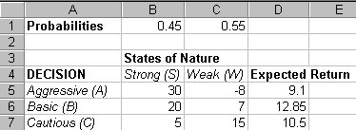
Managements best estimate of the probability of a strong or weak market.
Net profits measured in millions of dollars.
The optimal decision if you are risk-indifferent is to select B which yields the highest expected payoff.

Slide 25

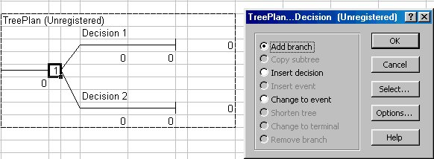
In the resulting dialog, click on New Tree.
By default, a tree is displayed with 2 decision nodes. To add another node, click on the decision node and hit Ctrl-t to bring up a menu in which you can select the Add Branch option.

Slide 26
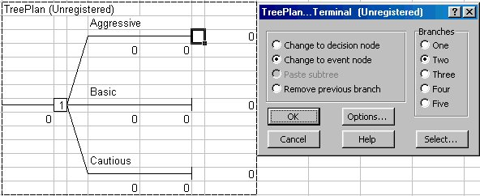
After labeling the three branches, replace the terminal node with a random event node by clicking on the terminal node and hitting Ctrl-t to bring up the menu from which you will select Change to event node and two branches.

Slide 27
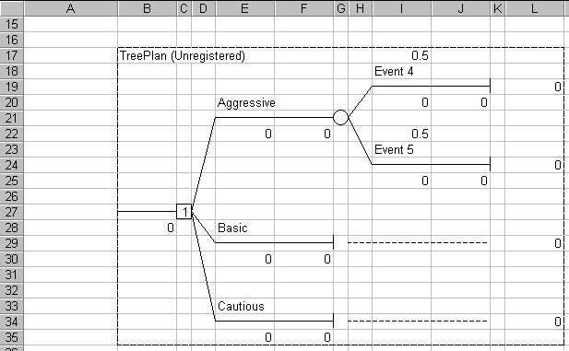
Here is the resulting decision tree:
By default, the probabilities for each of
the 2 random events are 0.5.

Slide 28
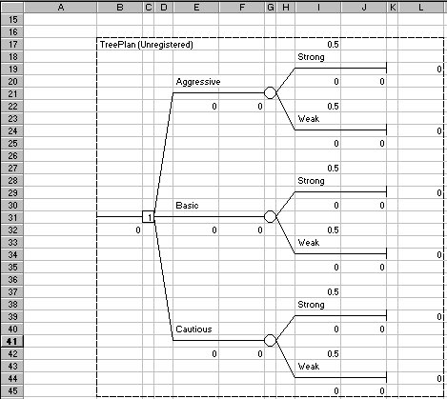
Repeat the last few steps for remaining decisions.
Initial decision node. Choose from three alternatives.
Event node with states of nature branches.
Terminal node (since it is not followed by another node)
Terminal positions

Slide 29
APPENDING THE PROBABILITIES
AND TERMINAL VALUES
Now we must append some additional information in order to use this decision tree to find the optimal decision.
Assign the terminal value (the return associated with each terminal position).
Additionally, probabilities will be assigned to each branch emanating from each circular node.

Slide 30
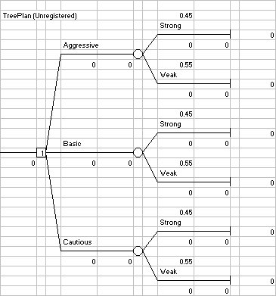
First change the probabilities from 0.5 to:
=B1
=C1

Slide 31
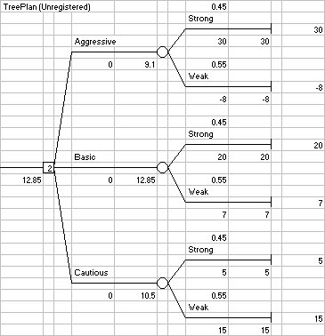
Next, change the terminal values:
=B5
=C5
=B6
=C6
=B7
=C7

Slide 32
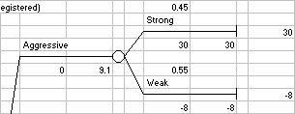
FOLDING BACK
Using a decision tree to find the optimal solution is called “solving the tree.”
To solve a decision tree, one works backward (i.e., from right to left) by folding back the tree.
First the terminal branches are folded back by calculating an expected value for each terminal node. For example,
Expected terminal value = 30(0.45) + (-8)(0.55) = 9.10

Slide 33
Next, choose the alternative that yields the highest expected terminal value.
Of the three expected values, choose 12.85, the branch associated with the Basic strategy.
This decision is indicated in the TreePlan by
the number 2 in the decision node.

Slide 34
Class Exercise in Creating a Decision Tree: A Glass Factory
Repeat the previous exercise using TreePlan.
Vary the inputs to determine when the optimal decision will change.
Notes:
20

