Slide 1
Decision Analysis
Ch. 8
22C:145 AI

Slide 2
What is a Decision Tree?
A Visual Representation of Choices, Consequences, Probabilities, and Opportunities.
A Way of Breaking Down Complicated Situations Down to Easier-to-Understand Scenarios.
Decision Tree

Slide 3

Easy Example
A Decision Tree with two choices.
Go to Graduate School to get my master in CS.
Go to Work “in the Real World”

Slide 4
Notation Used in Decision Trees
A box is used to show a choice that the manager has to make.
A circle is used to show that a probability outcome will occur.
Lines connect outcomes to their choice
or probability outcome.

Slide 5
Example Decision Tree
Chance
node
Event 1
Decision
node
Event 2
Decision 1
Event 3
Decision 2

Slide 6

Easy Example - Revisited
What are some of the costs we should take into account when deciding whether or not to go to graduate school?
Tuition and Fees
Rent / Food / etc.
Opportunity cost of salary
Anticipated future earnings

Slide 7
Simple Decision Tree Model
1.5 Years of tuition: $30,000, 1.5 years of Room/Board: $20,000; 1.5 years of Opportunity Cost of Salary = $100,000
Total = $150,000.
PLUS → Anticipated 5 year salary after Graduate School = $600,000.
NPV (graduate school) = $600,000 - $150,000 = $450,000
Go to Graduate School to get my master in CS.
Go to Work “in the Real World”
First 1.5 year salary = $100,000 (from above), minus expenses of $20,000.
Final five year salary = $330,000
NPV (no grad-school) = $410,000
Is this a realistic model?
What is missing?
Go to Graduate School

Slide 8

The Yeaple Study (1994)
Benefits of Learning
School Net Value ($)
Harvard $148,378
Chicago $106,378
Stanford $97,462
MIT (Sloan) $85,736
Yale $83,775
Northwestern $53,526
Berkeley $54,101
Wharton $59,486
UCLA $55,088
Virginia $30,046
Cornell $30,974
Michigan $21,502
Dartmouth $22,509
Carnegie Mellon $18,679
Texas $17,459
Rochester - $307
Indiana - $3,315
North Carolina - $4,565
Duke - $17,631
NYU - $3,749
According to Ronald Yeaple, it is only profitable to go to one of the top 15 Business Schools – otherwise you have a NEGATIVE NPV (net present value)!
(Economist, Aug. 6, 1994)

Slide 9

Things he may have missed
Future uncertainty (interest rates,
future salary, etc)
Cost of living differences
Type of Job [utility function = f($, enjoyment)]
Girlfriend / Boyfriend / Family concerns
Others?
Utility Function = f ($, enjoyment, family, location, type of job / prestige, gender, age, race) Human Factors Considerations

Slide 10

Example – Joe’s Garage
Joe’s garage is considering hiring another mechanic. The mechanic would cost them an additional $50,000 / year in salary and benefits. If there are a lot of accidents in Iowa City this year, they anticipate making an additional $75,000 in net revenue. If there are not a lot of accidents, they could lose $20,000 off of last year’s total net revenues. Because of all the ice on the roads, Joe thinks that there will be a 70% chance of “a lot of accidents” and a 30% chance of “fewer accidents”. Assume if he doesn’t expand he will have the same revenue as last year.
Draw a decision tree for Joe and tell him what he should do.

Slide 11

Example - Answer
.7
70% chance of an increase in accidents
Profit = $70,000
Hire new mechanic
Cost = $50,000
.3
30% chance of a decrease in accidents
Profit = - $20,000
Don’t hire new mechanic
Cost = $0
Estimated value of “Hire Mechanic” =
NPV =.7(70,000) + .3(- $20,000) - $50,000 = - $7,000
Therefore you should not hire the mechanic

Slide 12
Problem: Jenny Lind
Jenny Lind is a writer of romance novels. A movie company and a TV network both want exclusive rights to one of her more popular works. If she signs with the network, she will receive a single lump sum, but if she signs with the movie company, the amount she will receive depends on the market response to her movie. What should she do?

Slide 13
Payouts and Probabilities
Movie company Payouts
  Small box office - $200,000
  Medium box office - $1,000,000
  Large box office - $3,000,000
TV Network Payout
  Flat rate - $900,000
Probabilities
  P(Small Box Office) = 0.3
  P(Medium Box Office) = 0.6
  P(Large Box Office) = 0.1

Slide 14
Jenny Lind - Payoff Table
Decisions | States of Nature
 | Small Box Office | Medium Box Office | Large Box Office
Sign with Movie Company | $200,000 | $1,000,000 | $3,000,000
Sign with TV Network | $900,000 | $900,000 | $900,000
Prior Probabilities | 0.3 | 0.6 | 0.1

Slide 15
Jenny Lind - How to Decide?
What would be her decision based on:
  Maximax?
  Maximin?
  Expected Return?

Slide 16

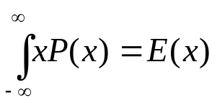
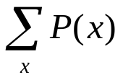
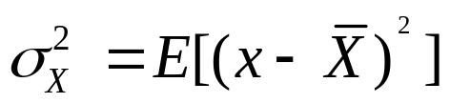
Quick primer on Statistics and Probability
Definitions:
Expected Value of x: E(x) = ; as P(x) represents the probability of x.
(Note that = 1 and that the because P(x) represents
a probability density function)
Variance of x:
Standard Deviation = the sq. root of the variance
Median = “the center of the set of numbers”; or the point m such that P(x < m)< ½ and P(x > m)> ½ .

Slide 17
Using Expected Return Criteria
EV_{movie}=0.3(200,000)+0.6(1,000,000)+0.1(3,000,000)
= $960,000 = EVUII or EV_{Best}
EV_{tv} =0.3(900,000)+0.6(900,000)+0.1(900,000)
= $900,000
Therefore, using this criteria, Jenny should select the movie contract.

Slide 18
Something to Remember
Jenny’s decision is only going to be made one time, and she will earn either $200,000, $1,000,000 or $3,000,000 if she signs the movie contract, not the calculated EV of $960,000!!
Nevertheless, this amount is useful for decision-making, as it will maximize Jenny’s expected returns in the long run if she continues to use this approach.

Slide 19
Using Decision Trees
Can be used as visual aids to structure and solve sequential decision problems
Especially beneficial when the complexity of the problem grows

Slide 20
Decision Trees
Three types of “nodes”
  Decision nodes - represented by squares (□)
  Chance nodes - represented by circles (Ο)
  Terminal nodes - represented by triangles (optional)
Solving the tree involves pruning all but the best decisions at decision nodes, and finding expected values of all possible states of nature at chance nodes
Create the tree from left to right
Solve the tree from right to left

Slide 21
Jenny Lind Decision Tree
Small Box Office
$200,000
Sign with Movie Co.
Medium Box Office
$1,000,000
Large Box Office
$3,000,000
Small Box Office
$900,000
Sign with TV Network
Medium Box Office
$900,000
Large Box Office
$900,000

Slide 22
Jenny Lind Decision Tree
Small Box Office
ER
?
.3
$200,000
Sign with Movie Co.
.6
Medium Box Office
$1,000,000
ER
?
.1
Large Box Office
$3,000,000
Small Box Office
ER
?
.3
$900,000
Sign with TV Network
.6
Medium Box Office
$900,000
.1
Large Box Office
$900,000

Slide 23
Jenny Lind Decision Tree - Solved
Small Box Office
ER
960,000
.3
$200,000
Sign with Movie Co.
.6
Medium Box Office
$1,000,000
ER
960,000
.1
Large Box Office
$3,000,000
Small Box Office
ER
900,000
.3
$900,000
Sign with TV Network
.6
Medium Box Office
$900,000
.1
Large Box Office
$900,000

Slide 24
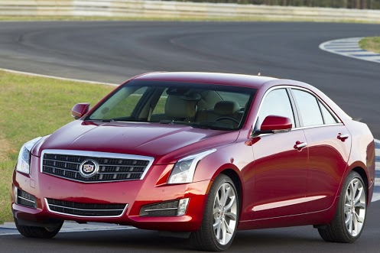
Sam’s Car Deal
Sam has the opportunity to buy a 1996 Spiffycar for $10,000, and he has a prospect who would be willing to pay $11,000 for the auto if it’s in excellent mechanical shape. Sam determines that everything except for the transmission is in excellent shape. If the transmission is bad, it will cost $3000 to fix it. He has a friend who can run a test on the transmission. The test is not always accurate: 30% of the time it judges a good transmission to be bad and 10% of the time it judges a bad transmission to be good. Sam knows that 20% of the 1996 Spiffycars have bad transmission.
Draw a decision tree for Sam and tell him what he should do.

Slide 25
Sam’s Car Deal
T: Test judges that the transmission is bad.
A: Transmission is good.
P(T | A) = .3 P(T | not A) = .9
P(T) = P(T | A) P(A) + P(T | not A) P(not A)
= (.3)(.8) + (.9)(.2) = .42
P(A | T) = P(T | A) P(A) / P(T) = (.3)(.8)/(.42) = .571429
EV(Tran1) = (.571429)($11000) + (.428571)($8000) = $9714
Similarly, EV(Tran2) = $10897

Slide 26
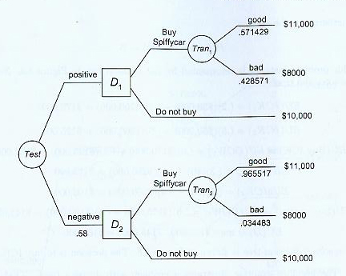
Sam’s Car Deal

Slide 27
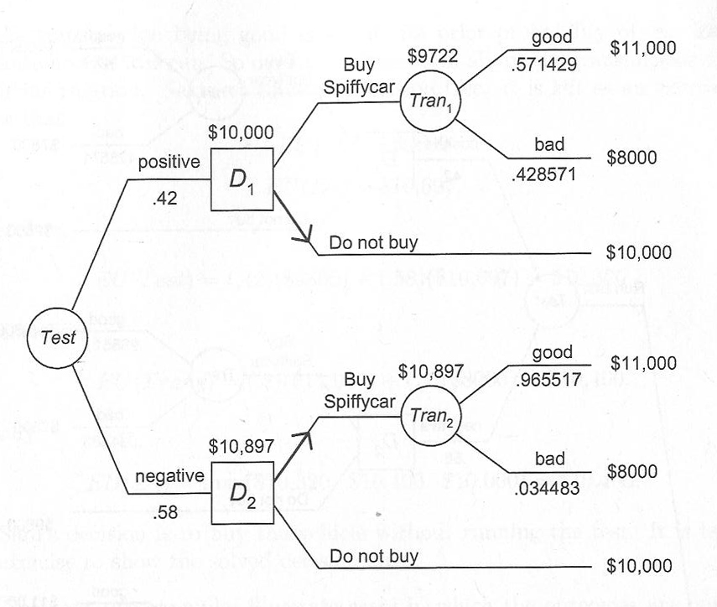
Sam’s Car Deal

Slide 28
Sam’s Car Deal
Suppose Sam is in the same situation as the previous example, except that the test is not free. Rather, it costs $200. So Sam must decide whether to run the test, buy the car without running the car, or keep his $10,000.
Draw a decision tree for Sam and tell him what he should do.

Slide 29
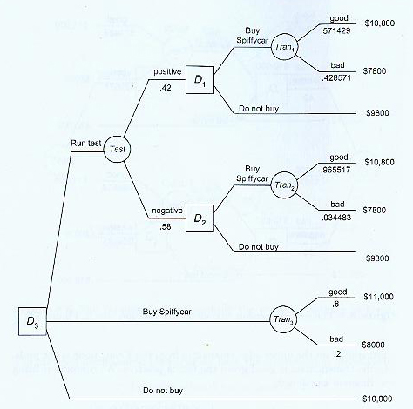
Sam’s Car Deal
EV(D1) =
$9800
EV(D2) =
$10,697
EV(Tran3) =
(.8)$11000 +
(.2)$8000 =
$10400

Slide 30

Mary’s Factory
Mary is the CEO of a gadget factory.
She is wondering whether or not it is a good idea to expand her factory this year. The cost to expand her factory is $1.5M. If she expands the factory, she expects to receive $6M if economy is good and people continue to buy lots of gadgets, and $2M if economy is bad.
If she does nothing and the economy stays good she expects $3M in revenue; while only $1M if the economy is bad.
She also assumes that there is a 40% chance of a good economy and a 60% chance of a bad economy.
Draw a Decision Tree showing these choices.

Slide 31

Decision Tree Example
.4
40 % Chance of a Good Economy
Profit = $6M
Expand Factory
Cost = $1.5 M
.6
60% Chance Bad Economy
Profit = $2M
.4
Good Economy (40%)
Profit = $3M
Don’t Expand Factory
Cost = $0
.6
Bad Economy (60%)
Profit = $1M
EV_{Expand} = (.4(6) + .6(2)) – 1.5 = $2.1M
EV_{No Expand} = .4(3) + .6(1) = $1.8M
$2.1 > 1.8, therefore you should expand the factory

Slide 32
Mary’s Factory –
Discounting
Before Mary takes this to the board, she wants to account for the time value of money. The gadget company uses a 10% discount rate (interest). The cost of expanding the factory is paid in year zero but the revenue streams are in year one.
Compute the NPV again, this time accounts the time value of money in your analysis. Should she expand the factory?

Slide 33

Time Value of Money
.4
40 % Chance of a Good Economy
Profit = $6M
Expand Factory
Cost = $1.5 M
.6
60% Chance Bad Economy
Profit = $2M
.4
Good Economy (40%)
Profit = $3M
Don’t Expand Factory
Cost = $0
.6
Bad Economy (60%)
Profit = $1M
Year 0
Year 1

Slide 34

Time Value of Money
The formula for discounting money as a function of time is:
PV = S (1+i)^{-n}
where i = interest (discount rate); n = number of years;
S = nominal value
So, in each scenario, we get the Present Value (PV) of the
estimated net revenues:
a) PV = 6(1.1)⁻¹ = $5,454,454
b) PV = 2(1.1)⁻¹ = $1,818,181
c) PV = 3(1.1)⁻¹ = $2,727,272
d) PV = 1(1.1)⁻¹ = $0.909,091

Slide 35

Time Value of Money
Therefore, the PV of the revenue
streams (once you account for the
time value of money) are:
PV_{Expand} =.4(5.5M) + .6(1.82M) = $3.29M
PV_{No Exp.} = 0.4(2.73) + 0.6(.910) = $1.638M
So, should you expand the factory?
Yes, because the cost of the expansion is $1.5M, and that means the NPV = 3.29 – 1.5 = $1.79 > $1.638
Note that since the cost of expansion is paid in year 0, you don’t discount it.

Slide 36

Stephanie’s
Hardware Store
Stephanie has a hardware store and
she is deciding whether or not to buy
Adler’s Hardware store. She can buy it for $400,000; however it would take one year to renovate, implement her computer inventory system, etc.
The next year she expects to earn an additional $600,000 if the economy is good and only $200,000 if the economy is bad. She estimates a 65% probability of a good economy and a 35% probability of a bad economy. If she doesn’t buy Adler’s she knows she will get $0 additional profits.
Taking the time value of money into account, find the NPV of the project with a discount rate of 10%

Slide 37

Answer to
Stephanie’s Problem
65 % Chance of a Good Economy
Additional Profit = $600,000
Buy Adler’s
Cost = $400,000
35% Chance Bad Economy
Additional Profit = $200,000
Don’t Buy
Cost = $0
Additional Revenue = $0
Year 0
Year 1

Slide 38

Should she buy?
NPV of purchase =
  .65(600,000/1.1) + .35(200,000/1.1) – 400,000
  = $18,181.82
Therefore, she should do the project!
What happens if the discount rate = 15%?
  The NPV = 0, so it probably is not worth it.
What happens if the discount rate = 20%?
  The NPV = - $16,666.67; so you should not buy!

Slide 39
Influence Diagrams:
Bayesian Network with Chance, Decision and Utility nodes
Box : Decision node, value of the parent is known at the time the decision is made.
Circle: Chance node, value of the node is probabilistically dependent on the value of the parent.
Diamond: Utility node, the value of the node is deterministically dependent on the value of the parent.
Bayesian Network: A DAG G with conditional probability and
I(X, ND_{X} | PA_{X}) for every X in G.

Slide 40
Sam’s Car Deal
Sam has the opportunity to buy a 1996 Spiffycar for $10,000, and he has a prospect who would be willing to pay $11,000 for the auto if it’s in excellent mechanical shape. Sam determines that everything except for the transmission is in excellent shape. If the transmission is bad, it will cost $3000 to fix it. He has a friend who can run a test on the transmission. The test is not always accurate: 30% of the time it judges a good transmission to be bad and 10% of the time it judges a bad transmission to be good. Sam knows that 20% of the 1996 Spiffycars have bad transmission.
Draw a decision tree for Sam and tell him what he should do.

Slide 41
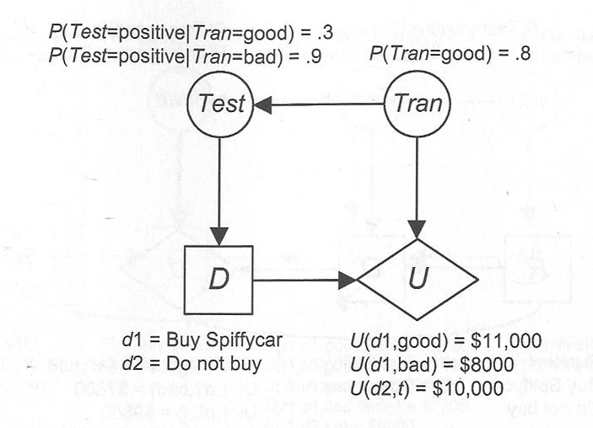
A simple influence diagram
If Test=positive, what decision to make?

Slide 42
A simple influence diagram
EU(d1 | positive)
= E(U | d1, positive)
EU(d2 | positive)
= E(U | d2, positive)
EU(D | positive)
= max {
EU(d1 | positive),
EU(d2 | positive) }
If Test=positive, what decision to make?

Slide 43
A simple influence diagram
EU(d1 | positive)
= E(U | d1, positive)
= P(good | d1, positive) U(d1, good) + P(bad | d1, positive) U(d1, bad)
= (.571429)($11000) + (.428571)($8000) = $9714
EU(d2 | positive)
= E(U | d2, positive) = $10000
EU(D | positive)
= max { EU(d1 | positive), EU(d2 | positive) }
= max\{ $9714, $10,000 } = $10,000
If Test=positive, what decision to make?

Slide 44
Sam’s Car Deal
T: Test judges that the transmission is bad.
A: Transmission is good.
P(T | A) = .3 P(T | not A) = .9
P(T) = P(T | A) P(A) + P(T | not A) P(not A)
= (.3)(.8) + (.9)(.2) = .42
P(A | T) = P(T | A) P(A) / P(T) = (.3)(.8)/(.42) = .571429
EV(Tran1) = (.571429)($11000) + (.428571)($8000) = $9714
Similarly, EV(Tran2) = $10897

Slide 45
Sam’s Car Deal
Suppose Sam is in the same situation as the previous example, except that the test is not free. Rather, it costs $200. So Sam must decide whether to run the test, buy the car without running the car, or keep his $10,000.
Draw a decision tree for Sam and tell him what he should do.

Slide 46
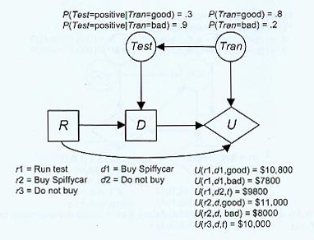
A simple influence diagram
Should we run the test?

Slide 47
A simple influence diagram
EU(r1)
= ?
Should we run the test?

Slide 48
A simple influence diagram
EU(r1) = P(d1,good | r1) U(r1, d1, good) +
P(d1,bad | r1) U(r1, d1, bad) +
P(d2,good | r1) U(r1, d2, good) +
P(d2,bad | r1) U(r1, d2, bad)
= P(d1, good) U(r1, d1, good) +
P(d1, bad) U(r1, d1, bad) +
P(d2, good) U(r1, d2, good) +
P(d2, bad) U(r1, d2, bad)
= (.56)($10800)+(.02)($7800)+(.24+.18)($9800)
= $10,320
where
P(d1, good) = P(d1 | good) P(good)
P(d1 | good) = P(d1 | positive)P(positive | good) +
P(d1 | negative)P(negative | good)
= P(negative | good) = .7

Slide 49

Mary’s Factory –
With Options
A few days later another economist told her that if she expands, she has three options once she knows how the economy does: (a) expand further the factory if the economy is good which costs an additional 1.5M, but will yield an additional $2M in profit when economy is good but only $1M when economy is bad, (b) abandon the project and sell the equipment she originally bought for $1.3M, or (c) do nothing.
Draw a decision tree to show these three options for each possible outcome, and compute the EV for the expansion.

Slide 50

Decision Tree with options after chance node
Expand further – yielding $8M (but costing $1.5)
.4
Stay at new expanded levels – yielding $6M
Good Market
Reduce to old levels – yielding $3M (but saving $1.3 - sell equipment)
.6
Expand further – yielding $3M (but costing $1.5)
Bad Market
Stay at new expanded levels – yielding $2M
Reduce to old levels – yielding $1M (but saving $1.3 in equipment cost)

Slide 51

Present Value of the Options
Good Economy
  Expand further = 8M – 1.5M = 6.5M
  Do nothing = 6M
  Abandon Project = 3M + 1.3M = 4.3M
Bad Economy
  Expand further = 3M – 1.5M = 1.5M
  Do nothing = 2M
  Abandon Project = 1M + 1.3M = 2.3M

Slide 52

NPV of the Project
So the EV of Expanding the factory is:
NPV_{Expand} = [.4(6.5) + .6(2.3)] - 1.5M = $2.48M
Therefore the value of the option is
2.48 (new NPV) – 2.1 (old NPV) = $380,000
You could pay the economist up to this amount to exercise that option.

