Slide 1
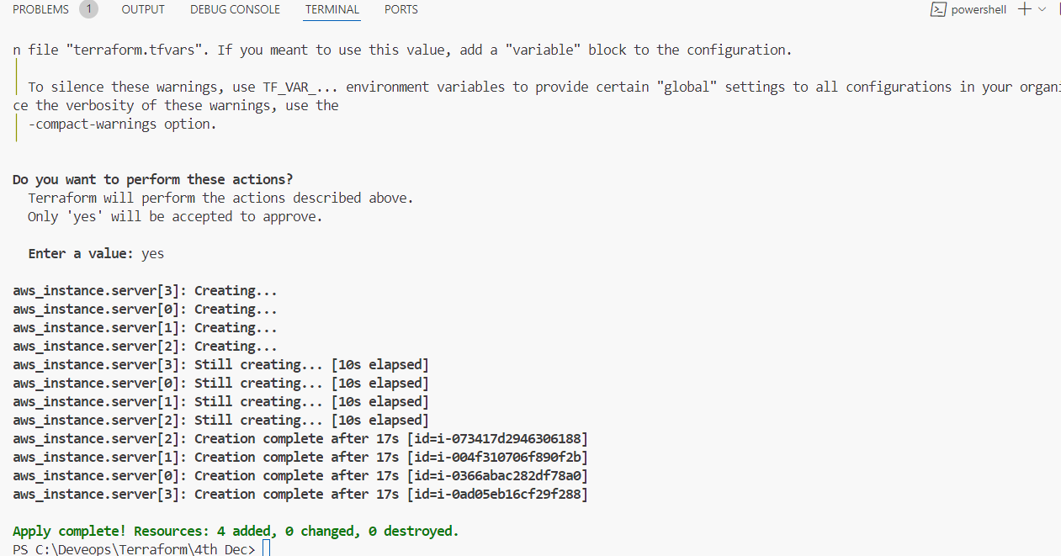
Lab 1 Task1
Using the count meta Argument in Terraform

Slide 2
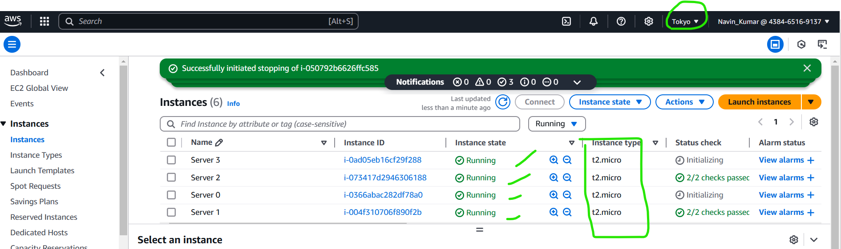
Using the count meta Argument in Terraform

Slide 3
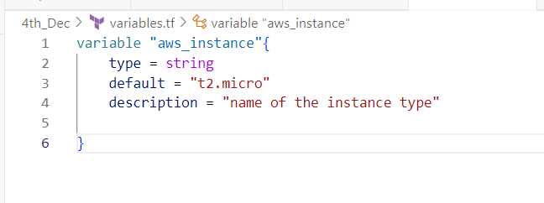
Variable file

Slide 4
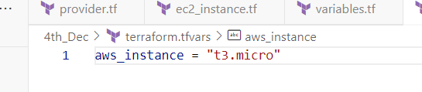
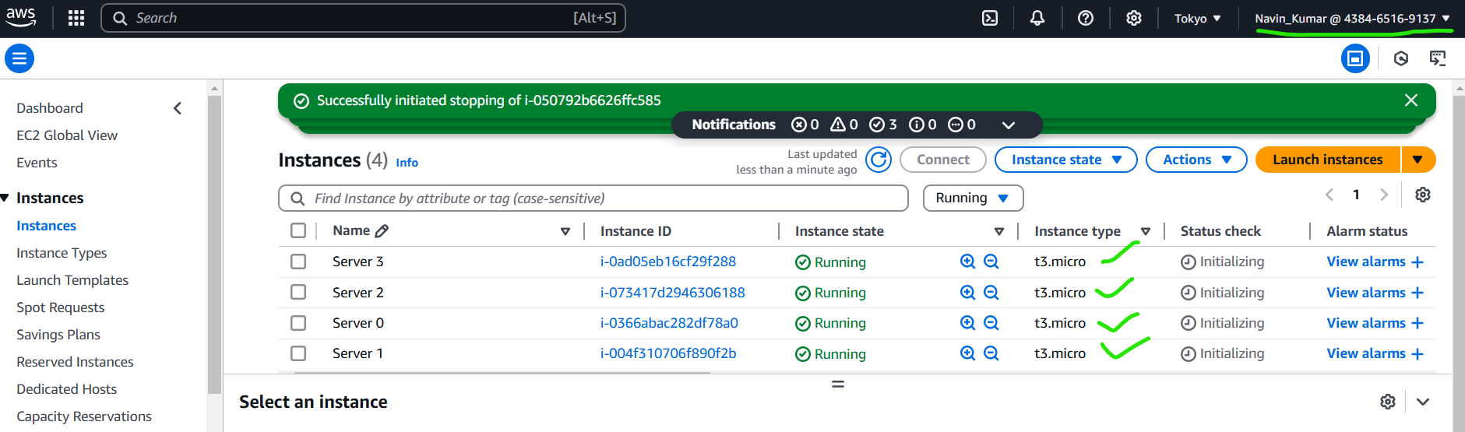
tfvar variable
code
Code , Execution below in terminal
terraform apply -var-file="terraform.tfvars"

Slide 5
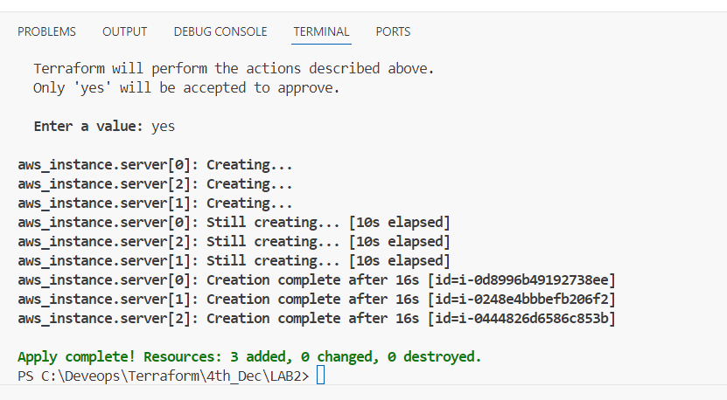
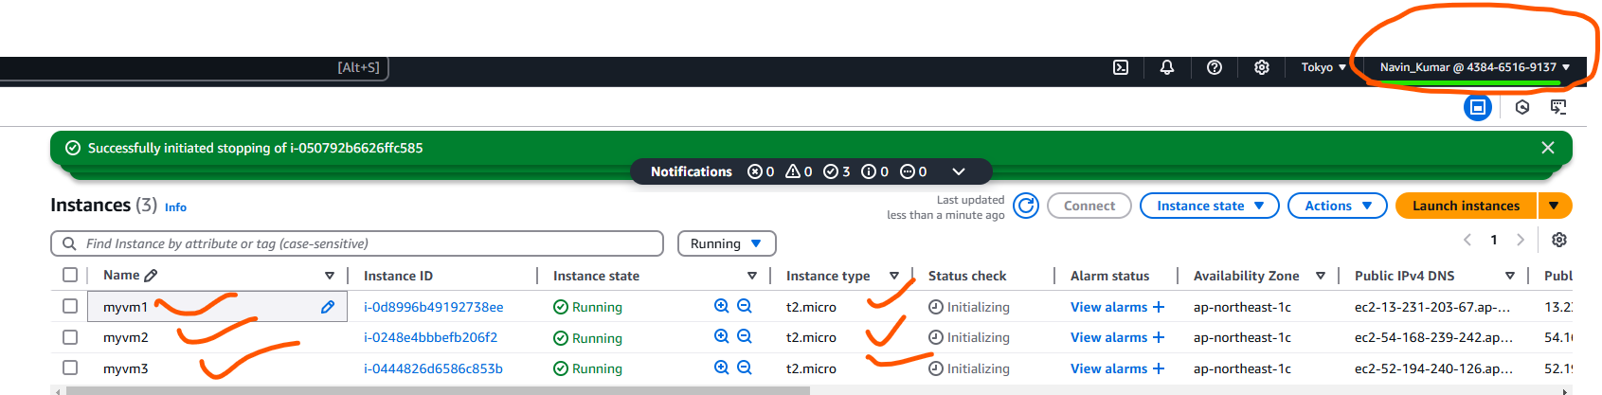
Lab1 , Task 2

