Slide 1
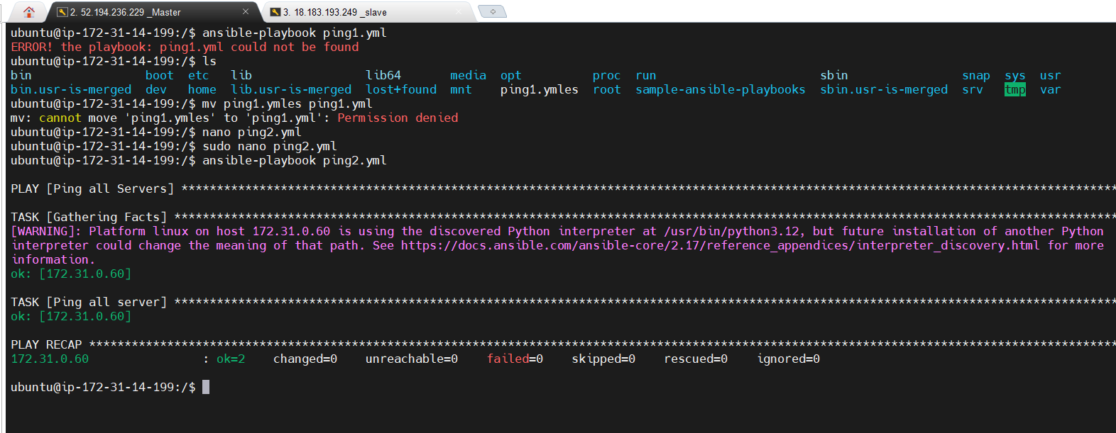
Create your first Ansible playbook

