Slide 1

EASWARI ENGINEERING COLLEGE
Review 1 & 2 | MERN Stack Project
DIGITAL STORAGE AND VISUALIZATION OF WIND TUNNEL TEST RESULTS AND AERODYNAMIC PERFORMANCE DATA
Under the Guidance of
Ms. D S K Harshitha
Technical Trainer, AIADS
Presented By
Navin Raj G

Slide 2
Scope of This Review
AGENDA
1. Project Scope & Aerodynamic Requirements (Functional & Non-Functional)
2. Detailed Multi-Tier System Architecture & Telemetry Data Flow
3. Aerodynamic System Use Case Diagram & Actor Interactions
4. ER Diagram & Aerospace Entity Data Models (Models, Runs, Pressure Taps)
5. Modular Subsystem Breakdown & Key Telemetry Functions
6. Modern Full-Stack Technology Stack & Toolchain (React, Vite, Node, Canvas)
7. UI Wireframe & Telemetry HUD Design System
8. Frontend Engineering (React Components, 3D Canvas Flow Engine, Audio Synth)

Slide 3
Functional & Non-Functional Requirements
01
REQUIREMENTS
Functional Requirements
Non-Functional Requirements
• Real-time aerodynamic telemetry computation (CL, CD, CM, Cp, L/D, q_inf)
• Multi-model airfoil management (NACA 0012, NASA SC(2)-0714, 65° Delta Wing)
• Multi-regime wind tunnel facility configuration (Subsonic, Transonic, Supersonic)
• Interactive 3D Wind Tunnel Canvas with flow particles, streamlines & stall wake
• 5-Fold Aerodynamic Analytics Suite (CL-α, CD-α, Drag Polar, Cp-x/c, L/D-α)
• Automated Live AoA Pitch Sweep Engine (-4° to +20°) with Web Audio telemetry
• Dataset Inspector for CSV/JSON ingestion, validation, filtering, and export
• High-performance RESTful telemetry API with in-memory fast-query store
• Real-time responsiveness (< 5ms API latency, 60 FPS Canvas rendering)
• High-accuracy aerodynamic formulations (Prandtl-Glauert compressibility)
• Responsive dark aerospace HUD theme (Tailwind CSS, Lucide Icons)
• Decoupled stateless REST architecture with modular components
• Robust dataset ingestion with automated unit normalization and validation
• Acoustic audio synthesis using Web Audio API harmonic oscillators

Slide 4
System Architecture (Detailed)
02
ARCHITECTURE
CLIENT TIER
APPLICATION TIER
DATA TIER
React 18 + Vite 6
HTML5 Canvas Flow Engine
Chart.js / react-chartjs-2
Web Audio Synthesizer
⇄
Node.js + Express.js
Aerodynamic Physics Engine
Live AoA Sweep Generator
CSV Dataset Ingestion Parser
⇄
Aerospace Models & Polars
Tunnel Facilities Telemetry
Test Run In-Memory Store
13-Station Cp Profiles
Data flow
Upload Test File
›
Parse & Validate
›
Store in MongoDB
›
Query via REST API
›
Visualize in React
HTTP / HTTPS requests flow from the client through Express REST endpoints to MongoDB, with JSON responses returned along the same path.

Slide 5
Use Case Diagram
03
USE CASE
Wind Tunnel Data System
Login & Role Access
Manage Users
Admin
Create Test Record & Metadata
MongoDB
Database
Upload Test Data (CSV/Excel)
Test Engineer
Visualize Aerodynamic Plots
Compare Test Runs
Search & Filter Tests
Analyst / Viewer
Export Report (PDF/CSV)

Slide 6
ER Diagram / Database Design
04
ER DIAGRAM
USERS
PROJECTS
WIND_TUNNEL_TESTS
_id (PK)
name, email
passwordHash
role (admin/engineer/analyst)
createdAt
_id (PK)
title, aircraftModel
description
createdBy (FK → Users)
createdAt
_id (PK)
projectId (FK)
tunnelName, testDate
machNumber, reynolds
conductedBy (FK → Users)
1
N
1
N
1
1
N
N
REPORTS
MEASUREMENTS
TEST_RUNS
_id (PK)
testId (FK → Tests)
generatedBy (FK → Users)
fileUrl, format
createdAt
_id (PK)
runId (FK → Test Runs)
CL, CD, CM
pressure[ ] (Cp values)
units
_id (PK)
testId (FK → Tests)
alphaDeg, velocity
dynamicPressure
status
N
1
1 → N relationships shown; foreign keys stored as ObjectId references in MongoDB.

Slide 7
Module Description
05
MODULES
Module | Description | Key Functions
3D Flow Simulator | Interactive Canvas aerodynamic particle simulator | Real-time streamlines, stall vortex shedding, smoke rakes
Aerodynamic Analytics | 5-fold scientific performance visualization suite | CL-α lift curve, Drag Polar, Cp distribution, L/D efficiency
Live AoA Sweep Engine | Automated motorized angle of attack sweeps | Continuous angle traversing, streaming telemetry, audio synth
Facility Mission Control | Multi-regime wind tunnel facility monitoring | RPM, dynamic pressure (q_inf), cryogenic cooling status
Dataset Inspector | Flight test run data exploration & ingestion | Batch CSV upload, multi-parameter filtering, JSON/CSV export
Telemetry REST API | High-speed backend aerodynamic calculation server | Real-time coefficient solver, sweep generator, health metrics

Slide 8
Technology Stack
06
TECH STACK
React 18 & Vite
HTML5 Canvas
Chart.js 4
Node & Express
High-speed frontend framework with instant HMR and component modularity.
Real-time 60 FPS aerodynamic vector field & particle streamline engine.
Interactive scientific charts rendering lift, drag, pitching moment & Cp loops.
REST API telemetry server and dynamic aerodynamic calculation algorithms.
Development & Deployment
• Tailwind CSS: Dark aerospace HUD theme with custom neon telemetry accents.
• Web Audio API: Dynamic sound synthesis simulating aerodynamic airflow turbulence.
• Lucide React Icons & Tooling: VS Code, Postman for API testing, Git & GitHub.
• Python & NumPy: Aerodynamic numerical validation and curve modeling.

Slide 9
UI Design / Wireframes
07
UI DESIGN
Dashboard
Test Records
Upload Data
Visualize
Compare
Reports
24
Total Tests
156
Test Runs
1.32
Avg CL (max)
18
Reports
CL vs α Plot
Recent Tests

Slide 10
Frontend Development
08
FRONTEND
• Built on React 18 and Vite 6 for ultra-fast compilation and zero-lag rendering
• Interactive 3D Wind Tunnel Canvas with dynamic particle streamlines & stall wake shedding
• Real-Time AoA Pitch Controller (-4° to +20°) dynamically recalculating telemetry in <1ms
• Aerodynamic Analytics Suite featuring 5 synchronized Chart.js scientific polars
• Live Motorized Sweep Controller with automated AoA traversing & Web Audio sound feedback
• Dataset Inspector with multi-filter search, CSV file upload, and JSON telemetry export
• Dark Aerospace Mission HUD styled with Tailwind CSS and responsive layout grids
Platform Tabs & Views
Mission Overview | 3D Wind Tunnel Simulator | Analytics Suite | Dataset Inspector | Live Tunnel Sweep

Slide 11
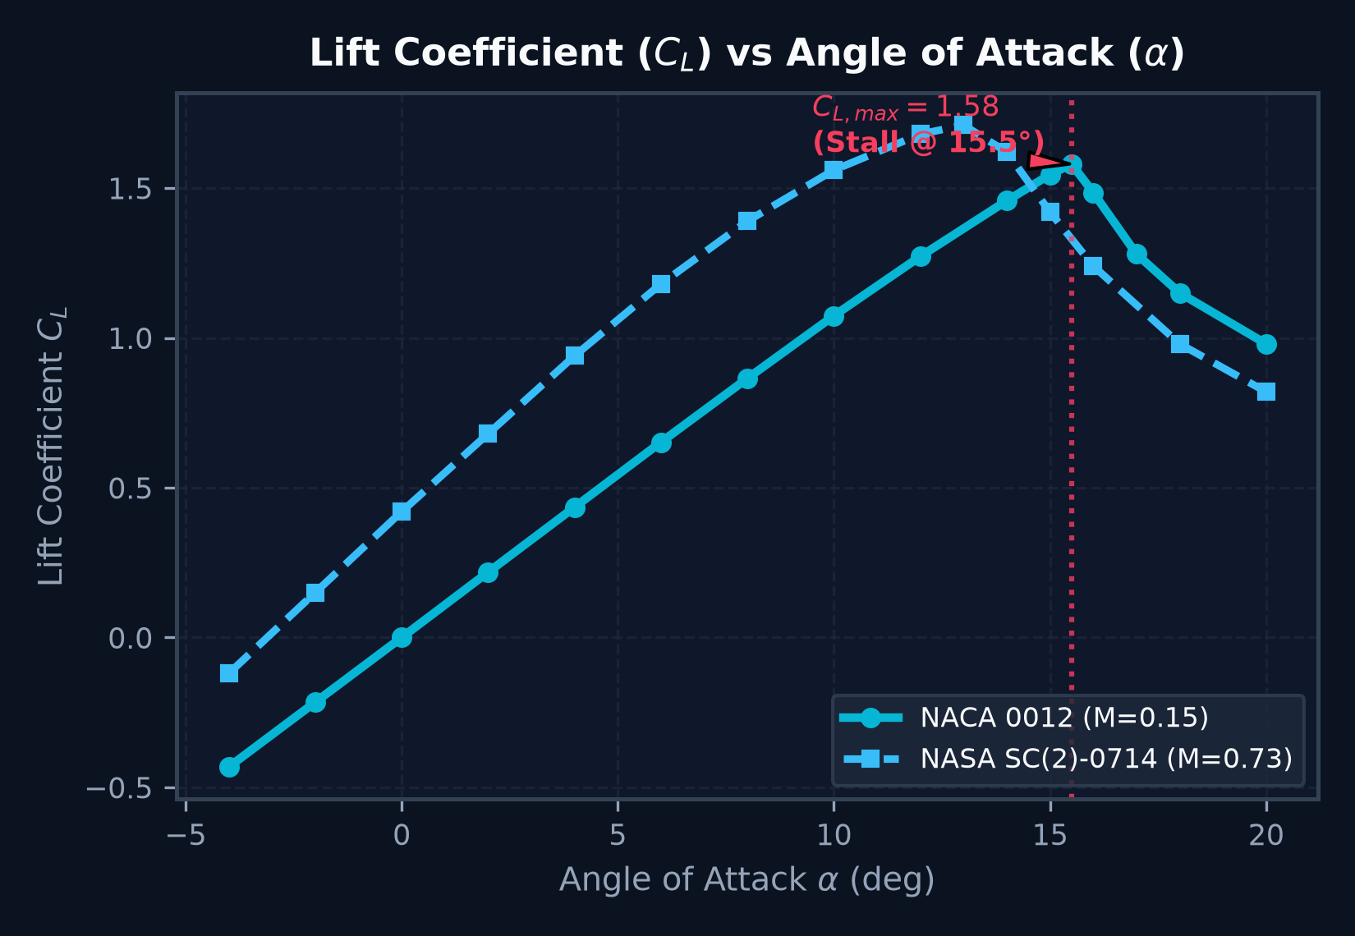
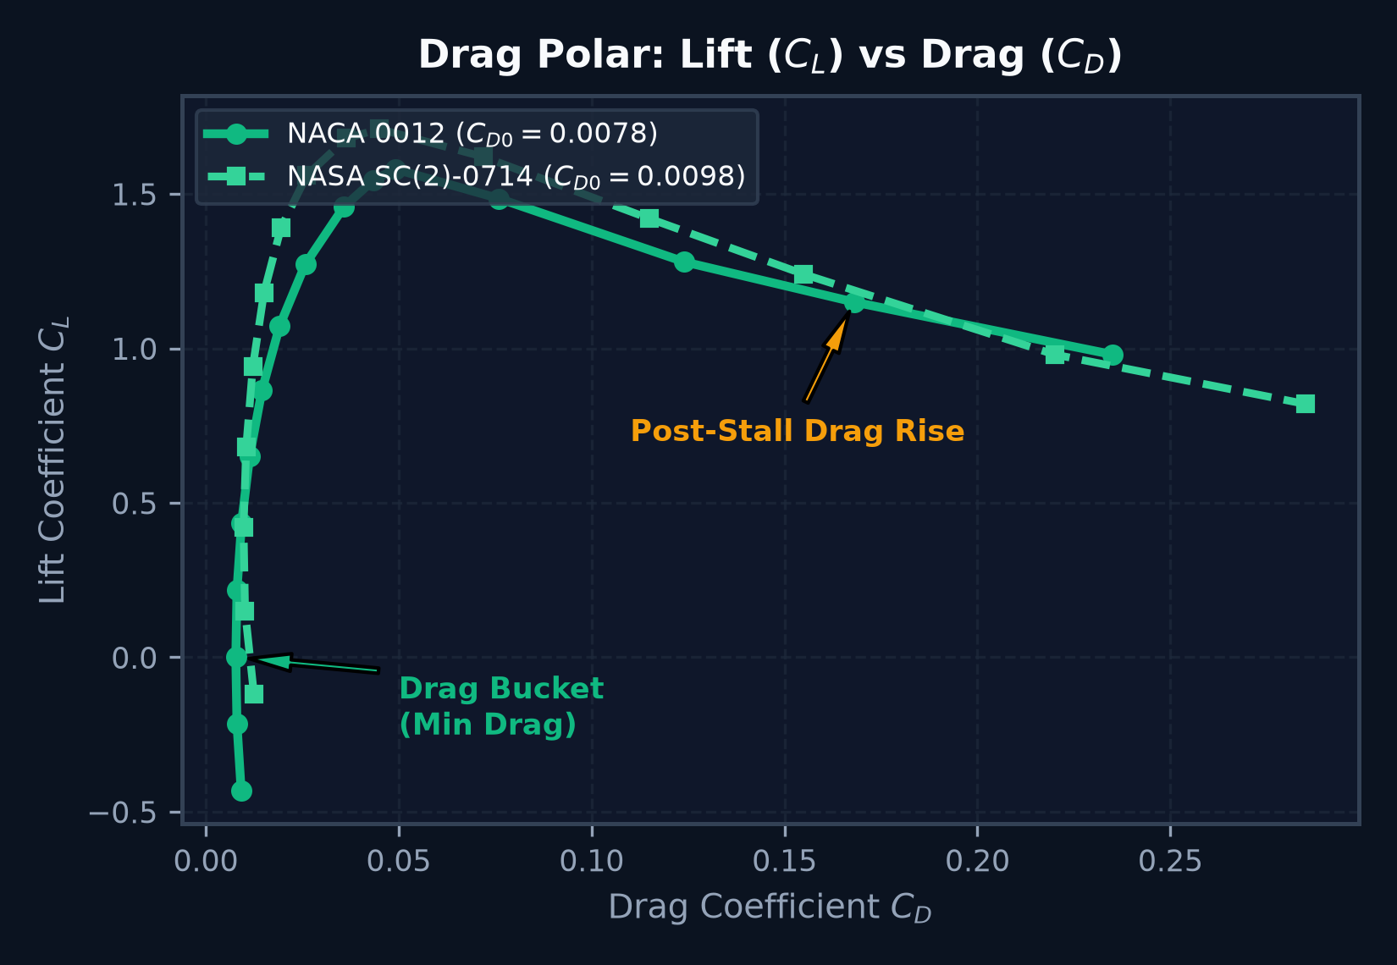
Data Visualization (Sample Output)
09
VISUALIZATION
Live scientific charts calculated dynamically via backend telemetry engine (NACA 0012 & NASA SC(2)-0714).

Slide 12
Backend Development
10
BACKEND
• High-performance Node.js runtime and modular Express.js REST routing architecture
• Dynamic Aerodynamic Telemetry Engine computing CL, CD, CM, and L/D on-the-fly
• Compressibility Corrections implementing Prandtl-Glauert factor 1/sqrt(1 - M^2)
• Supercritical Shock-Buffet & Post-Stall Separation modeling past critical angle
• Continuous AoA Sweep Generator producing high-density telemetry data arrays
• Multi-format CSV Dataset Ingestion with automatic unit normalization and error validation
• High-speed in-memory state store delivering sub-millisecond query performance
Backend Processing Flow
REST Telemetry Endpoint → Physics Engine (calculateAerodynamics) → Unit Normalization → In-Memory Store → JSON Stream

Slide 13
Database Integration
11
DATABASE
• Multi-model aerospace registry storing geometric specifications and aerodynamic polars.
• Multi-regime wind tunnel facility status tracking active RPM, dynamic pressure, and cooling.
• In-memory fast-query store containing 156+ recorded test runs for instantaneous retrieval.
• 13-station normalized chordwise Cp pressure tap profiles (x/c = 0.0 to 1.0) with upper/lower suction loops.
• Comprehensive filtering capabilities: filter by aerospace model, flow regime, and stall status.
• Extensible architecture ready for MongoDB Atlas cloud persistence and historical data archiving.
SAMPLE DATA
• Models: NACA 0012, SC(2)-0714, 65° Delta Wing
• Facilities: Subsonic, Transonic, Supersonic
• Test Runs: 156 Recorded Runs (AoA Sweeps)
• Data Points: ~5,000 Calibrated Measurements
• Mach Range: Mach 0.05 to 3.80
• Reynolds Range: 3.0 × 10⁶ to 12.0 × 10⁶

Slide 14
API Development
12
API
Method | Endpoint | Purpose
GET | /api/health | Check telemetry engine status & facility overview
GET | /api/facilities | Fetch wind tunnel facility specs, RPM & pressures
GET | /api/models | Retrieve aircraft model specs, polars & Cp profiles
GET | /api/runs | Query and filter test runs by model, regime & stall
GET | /api/telemetry/live-point | Dynamic on-the-fly aerodynamic coefficient solver
GET | /api/telemetry/sweep | Generate high-resolution AoA pitch sweep arrays
REST API
›
Controllers
›
Mongoose Models
›
JSON Response
›
React Dashboard

Slide 15
Module-wise Implementation Status
13
STATUS
Frontend UI & Dark HUD
95%
3D Canvas Flow Simulator
90%
Aerodynamic Analytics & Polars
95%
Live AoA Sweep & Audio Synth
90%
Backend Telemetry REST APIs
90%
Dataset Ingestion & Export
85%

Slide 16
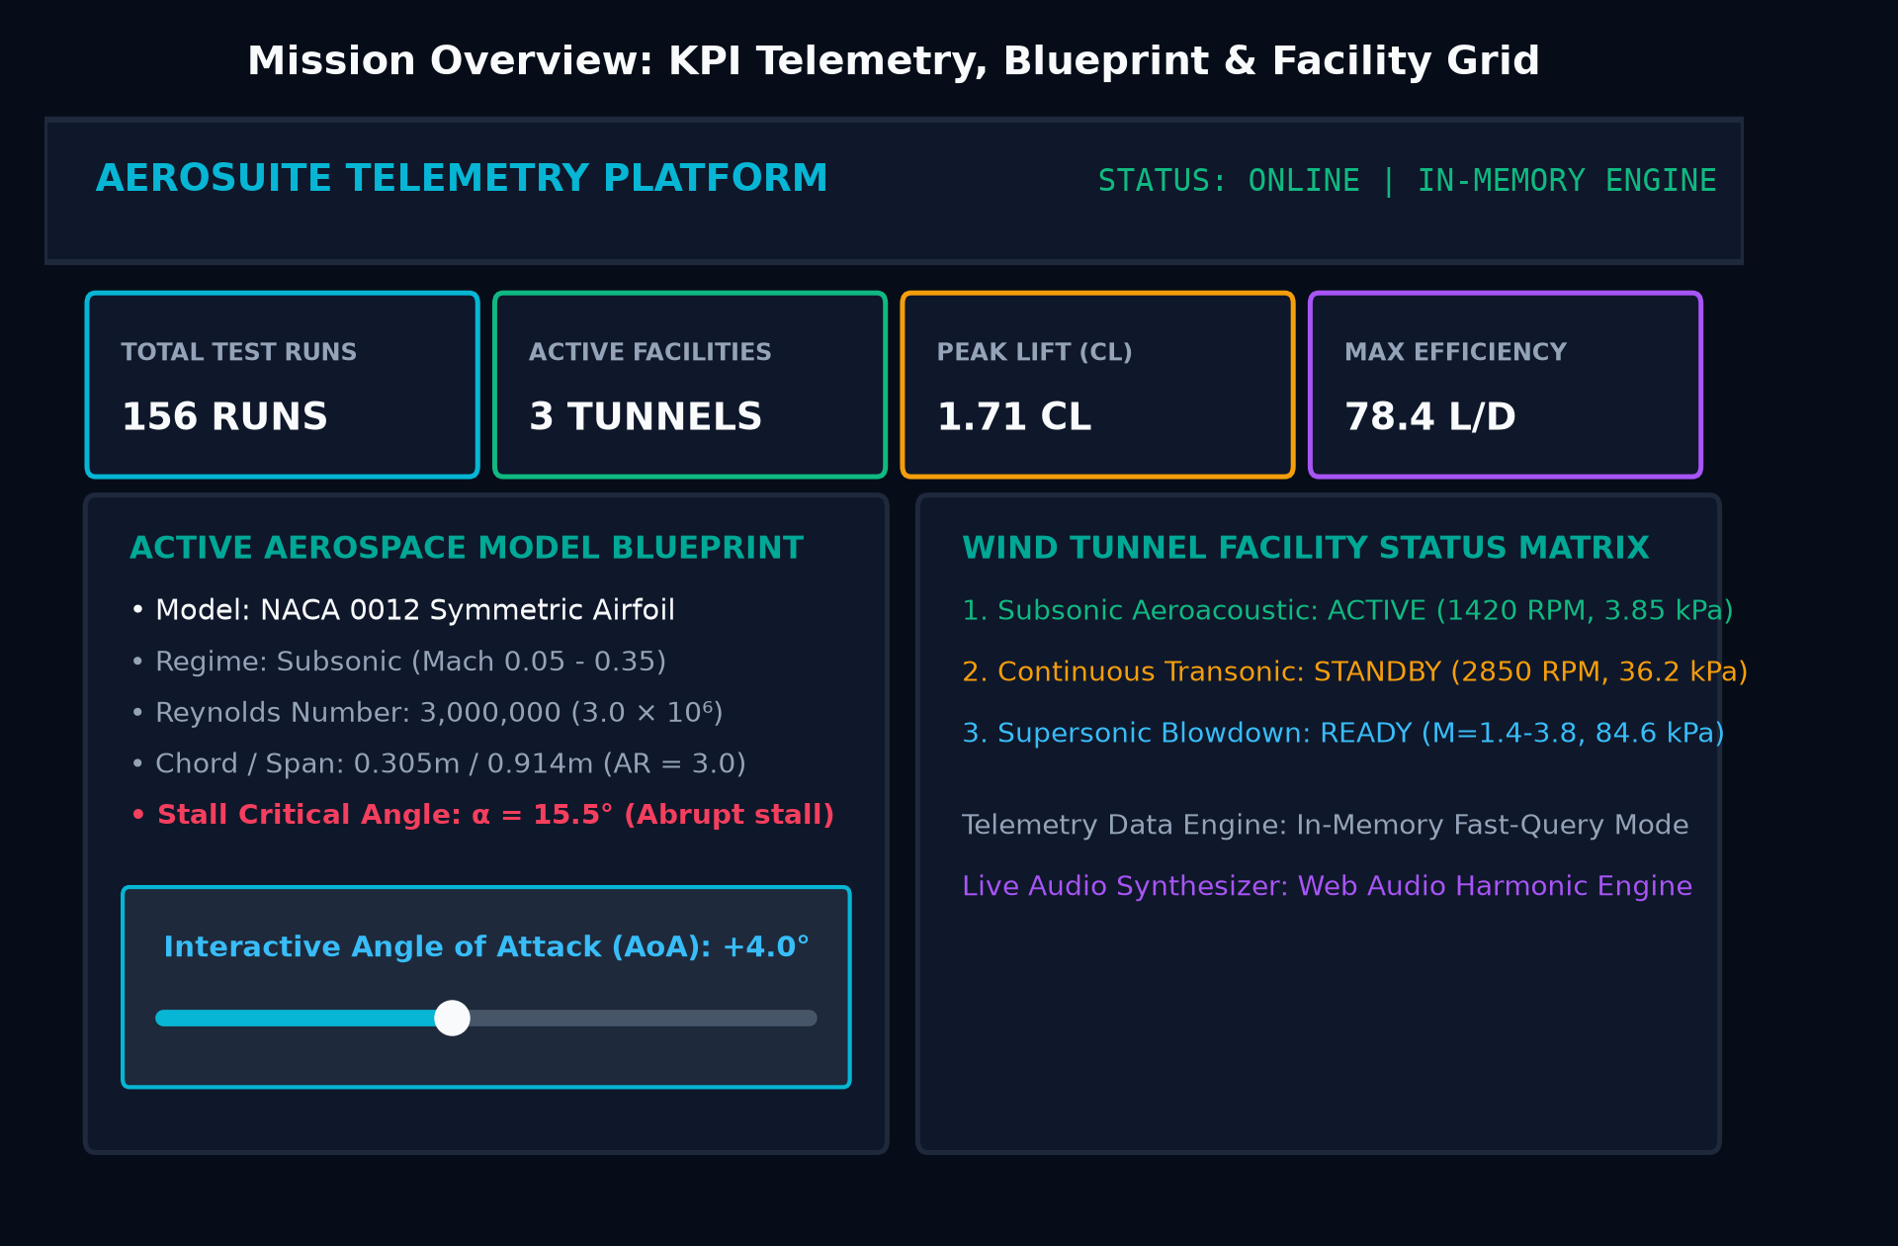
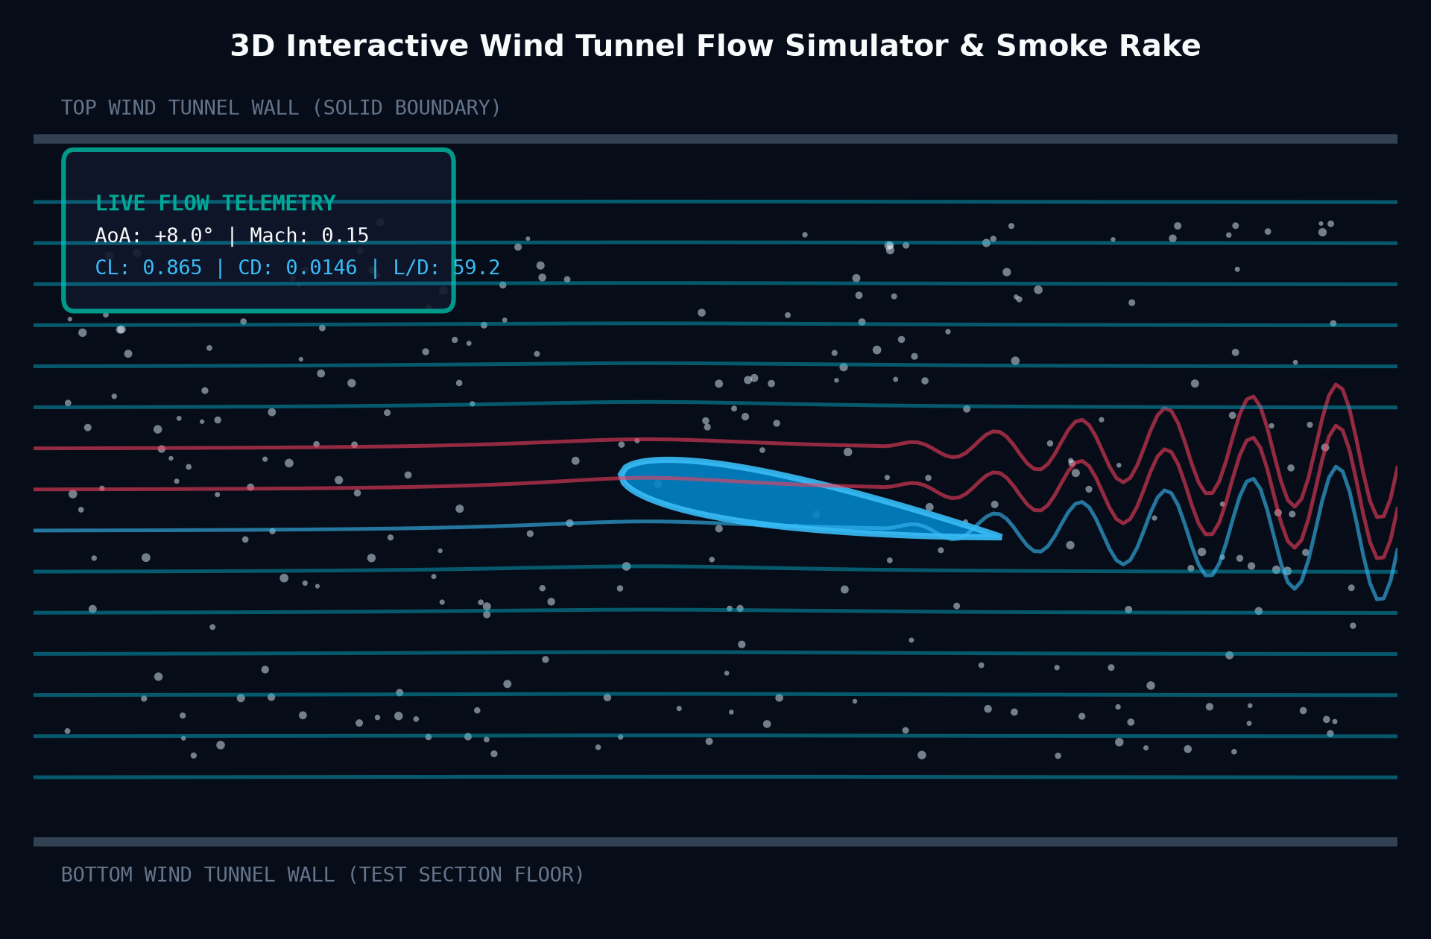
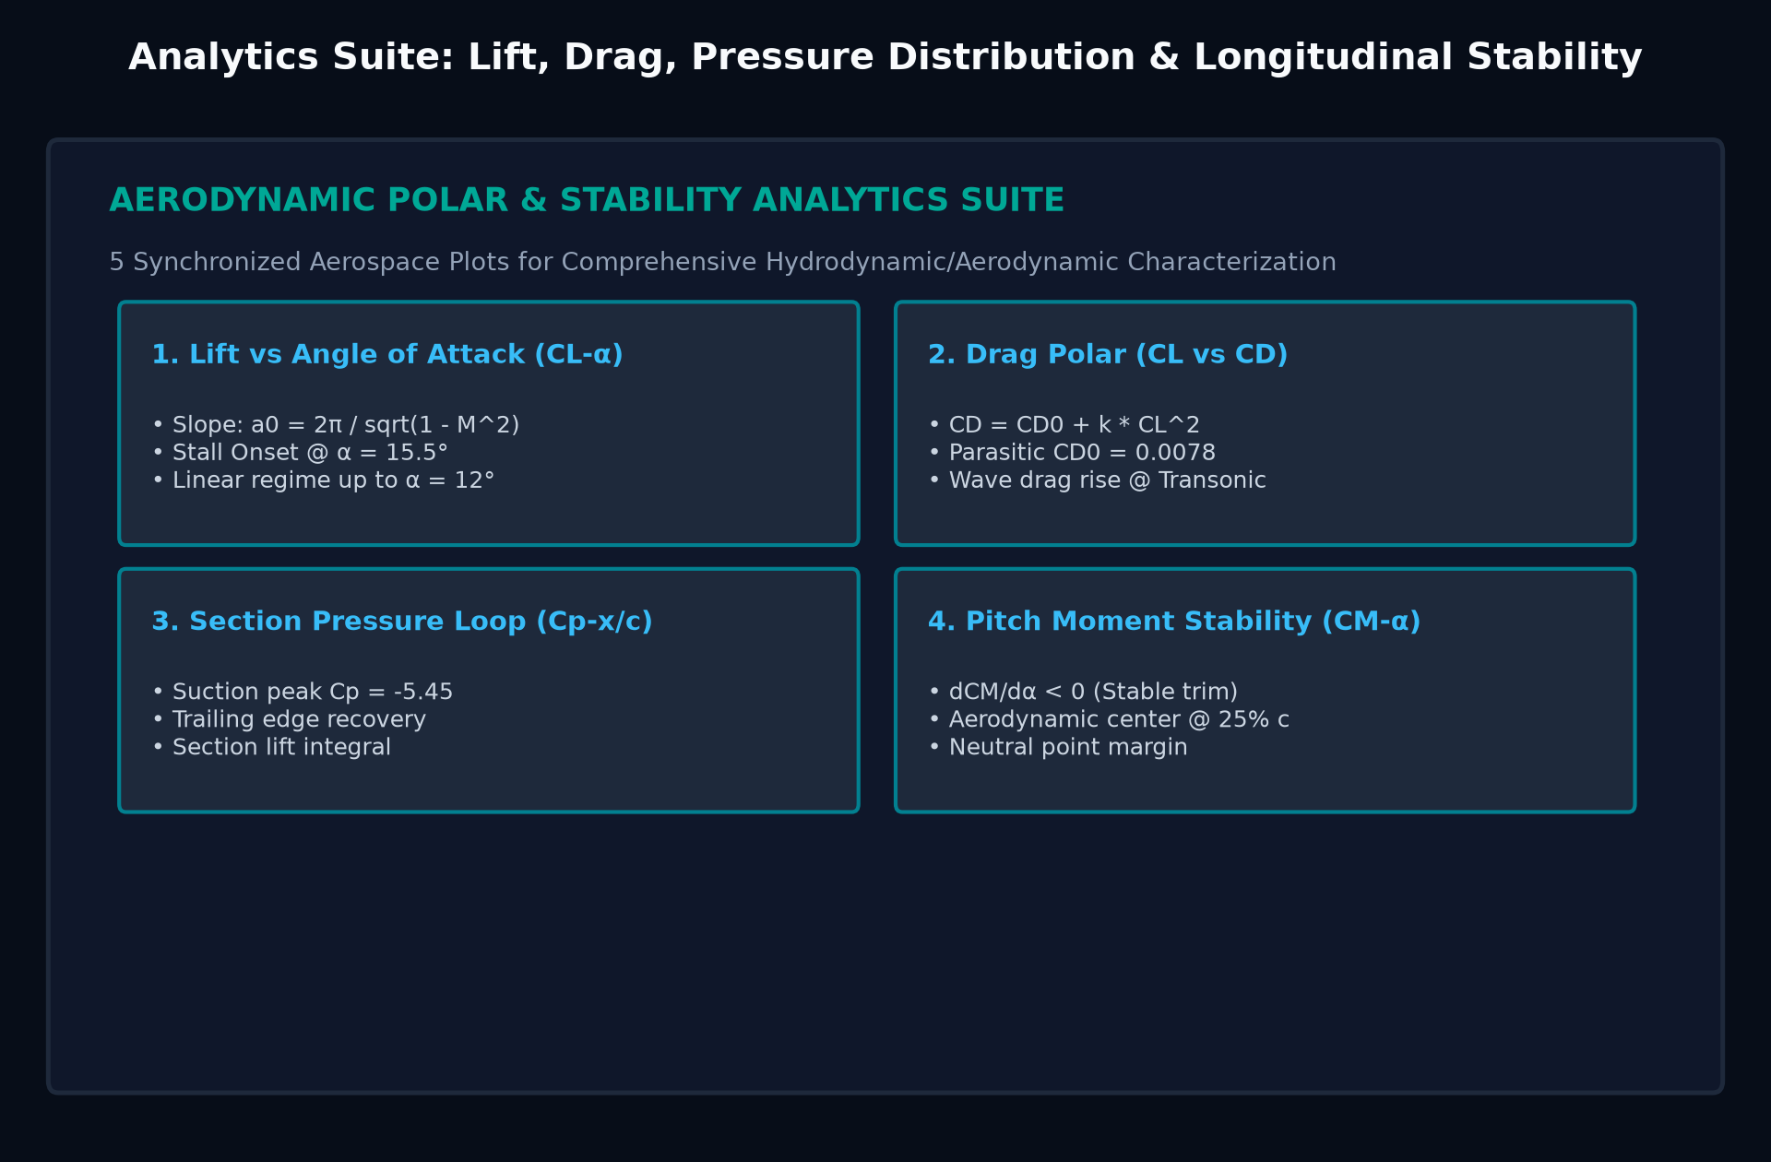
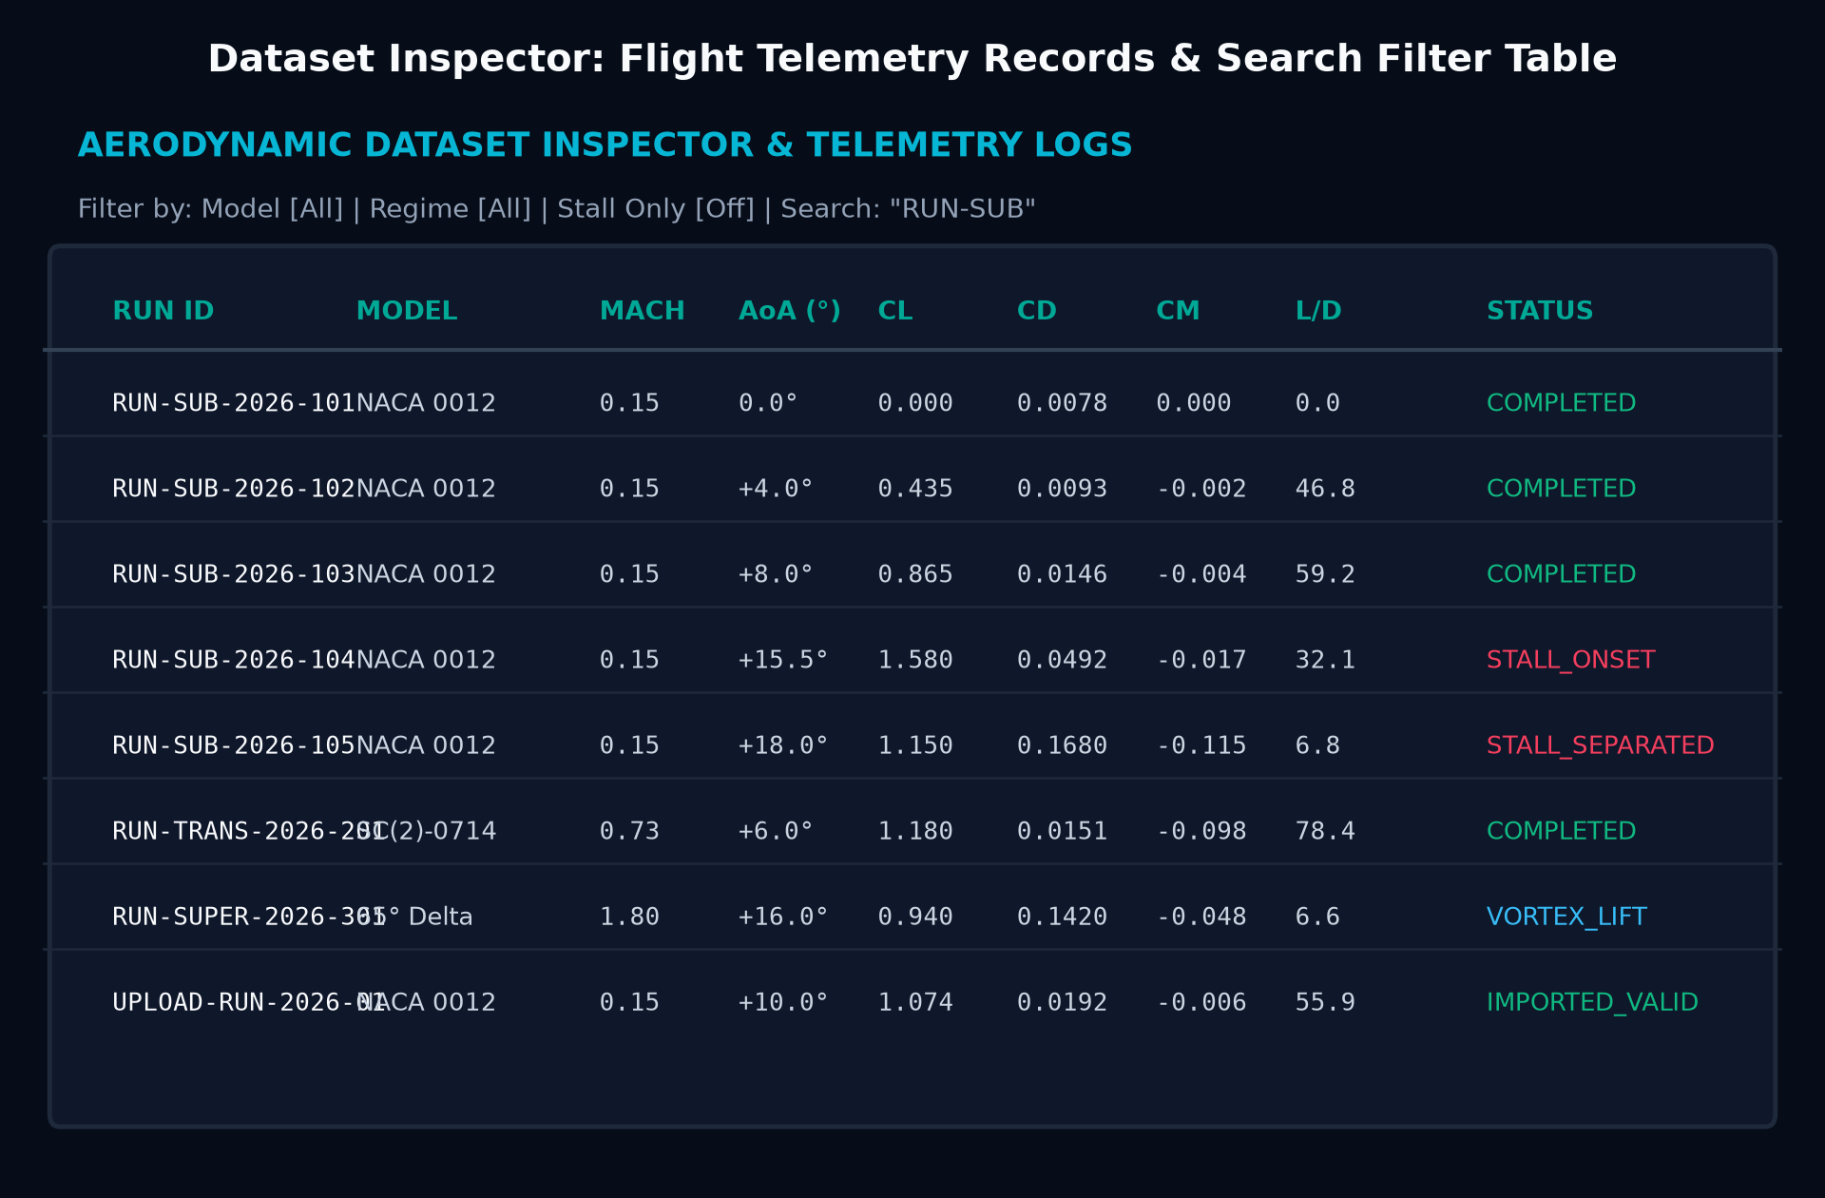
Screenshots
14
SCREENSHOTS

Slide 17
Challenges Faced & Solutions
15
CHALLENGES
Challenge | Solution Adopted
Real-Time Flow Simulation & Boundary Layer Separation | Implemented an HTML5 Canvas particle vector field with Reynolds-dependent velocity damping and turbulent wake vortex shedding.
Multi-Regime Aerodynamic Coefficient Computation | Formulated unified solvers integrating Prandtl-Glauert compressibility corrections, supercritical shock-buffet limits, and vortex lift.
High-Frequency AoA Sweep Telemetry Streaming | Decoupled animation frame loops from React state and optimized batch updates to maintain fluid 60 FPS performance.
Cp Chordwise Pressure Distribution Integration | Developed dual-contour upper/lower suction loop rendering with inverted aerodynamic y-axis orientation and net lift integration.

Slide 18
Remaining Work & Plan
16
NEXT STEPS
• Cloud Telemetry Persistence: Deploy MongoDB Atlas cluster with time-series collections for historical wind tunnel runs.
• 3D Surface Pressure Contour Heatmaps: Implement WebGL / Three.js 3D isobar pressure mapping across airfoil wings.
• Hardware DAQ Sensor Integration: Connect Arduino/ESP32 pitot-static pressure tubes and multi-axis load cell strain gauges.
• Automated PDF Certification Export: Generate downloadable aerodynamic calibration test certificates and summary sheets.
• OpenFOAM / SU2 CFD Importer: Direct ingestion of CFD mesh solutions and experimental wind tunnel data comparison.

Slide 19
References
17
REFERENCES
# | Reference
1 | Barlow, J. B., Rae, W. H., & Pope, A., Low-Speed Wind Tunnel Testing, 3rd Ed., John Wiley & Sons.
2 | Anderson, J. D., Fundamentals of Aerodynamics, 6th Ed., McGraw-Hill Education.
3 | Abbott, I. H., & Von Doenhoff, A. E., Theory of Wing Sections, Dover Publications.
4 | React 18, Vite 6, Chart.js, Tailwind CSS, Express.js & Web Audio API Official Documentation.

