Slide 1
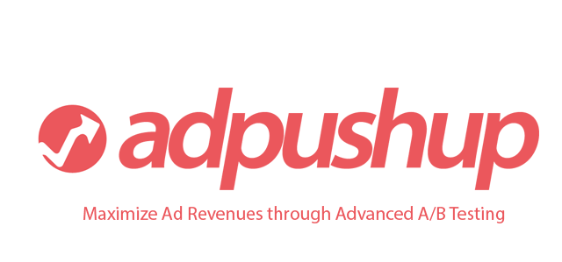
Ad Revenue Optimization
for Web Publishers

Slide 2
Problem
Display Advertising CTRs (click through rates) have been falling^{[1]} constantly and one of the primary reason behind it is banner blindness.
Current Players such as Ad Networks/Exchanges/SSPs help publishers improve the CTR/RPM primarily by making the ads more relevant (through user bucketing/targeting), improving the fill rates and finding the highest bidder for each impression (RTB).
But they have no direct control over the last mile of the road, which is the placement of ads on the publisher’s website.
^{[1]} DoubleClick for Advertisers, a cross section of regions, January and December 2009, Published July 2010

Slide 3
Solution
Publishers can optimize their ad revenues by testing different ad placements, ad sizes and ad types, which improves the CTR (Click through rate) and RPM (Revenue per Thousand Impressions) for them.
Further, using constant optimization, they can easily fight the big evil called Banner Blindness.

Slide 4
Why Now?
AdTech is growing. Display Advertising (display, mobile and video) is forecasted to grow from approximately $43 billion in 2012 to $90 billion in 2017^{[1]}.
AdTech investments have been able to do IPOs recently (Rubicon, Rocketfuel, Marin). Outbrain, RadiumOne and more to file soon.
A/B Testing is a hot market (Optimizely, VWO) and no one is using it for Publishers, yet.
^{[1]} Rubicon S-1 Filing (http://www.sec.gov/Archives/edgar/data/1595974/000119312514034389/d652651ds1.htm)

Slide 5
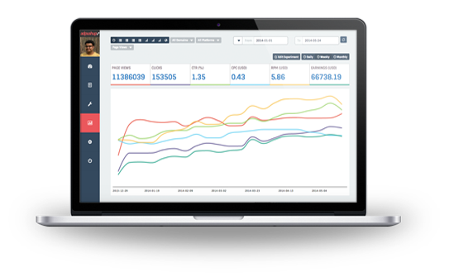
Product
AdPushup uses advanced A/B Testing (a proprietary multi-arm bandit solution) to web publishers optimize ad revenues by using advanced a/b testing between different ad placements, ad sizes, ad colors and types (such as image vs text).
All this simply by using a simple visual editor and no programming knowledge.
After finding the best variation, It keeps a check on banner blindness to keep your placements optimized at all times and can help fight AdBlock.

Slide 6
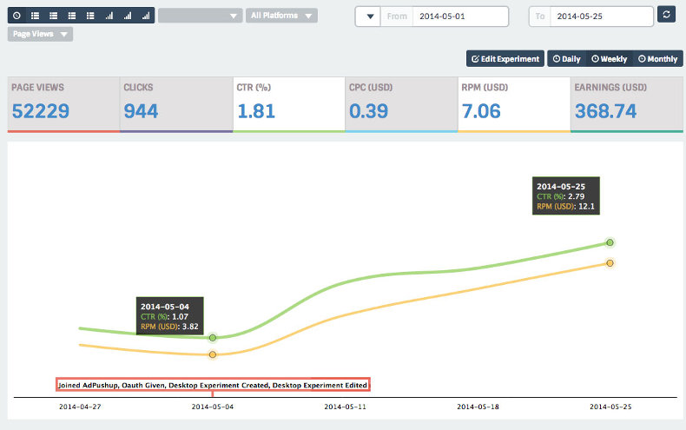
Case Study
RPM (Revenue per thousand impressions) Optimized from $3.82 to $12.1

Slide 7
Milestones
May 2013 – Starts as weekend project.
Aug 2013 – PoC Testing using JS Hacks.
Jan 2014 – Founders commit full-time.
March 2014 – First private beta release. Enrollment begins.
May 2014 – We’re optimizing 10 million monthly ad impressions.

Slide 8
Traction
March 2014 500,000 impressions
April 2014 3 Million impressions
May 2014 10 million impressions
June 2014 32 million impressions

Slide 9
The Plan
To monetize using a hybrid model after hitting critical mass (1 Billion impressions).
We can monetize by:
1) SaaS plans (fixed prices based on impressions) for Large Publishers.
2) Serving additional ad units (display/native) for the medium and long tail.
3) Helping publisher monetize the inventory being lost to Ad Blockers

Slide 10
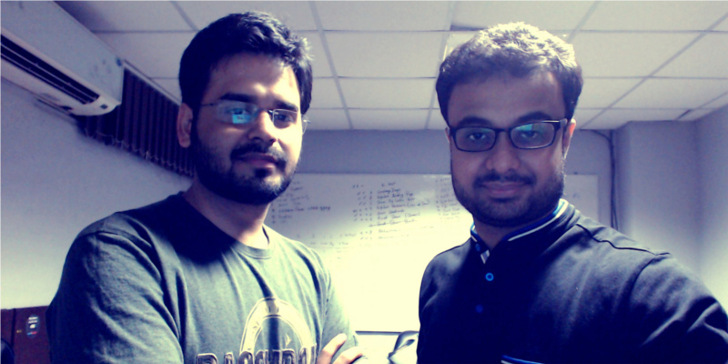
Founders
Ankit Oberoi
Co-founded Innobuzz (2007) – InfoSec Training & Products, MNC – Empanelled with CERT-IN, DSCI & NASSCOM.
Pre-Innobuzz, web solutions business.
Atul Agarwal
Co-founded Innobuzz (2007).
Pre-Innobuzz, UGC websites (monetized with AdSense).
Team Size: 4 People (including founders)

Slide 11
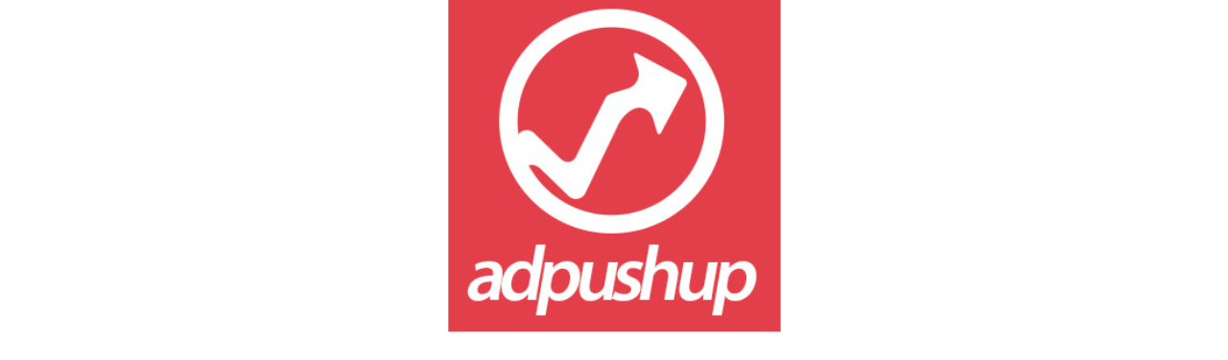
Thank you for your time.
www.adpushup.com ankit@adpushup.com

