Slide 1
🏦 Retail Banking BI Dashboard – Q1 2024
Branch Performance | Digital Adoption | Customer Segmentation | Account Position

Slide 2

Executive Summary
📈 Key Q1 Highlights
Total account balances reached £14M across all 6 branches by quarter-end.
Canary Wharf led in account balances, account openings and transaction volumes.
Premium accounts represented only 2.3% (5 of 217) of accounts opened this quarter.
97 customers (5.5%) were classified as “Silent Wealthy” (low activity, high balance).
Branch transactions outnumbered digital by a factor of 2.1×, highlighting digital lag.

Slide 3
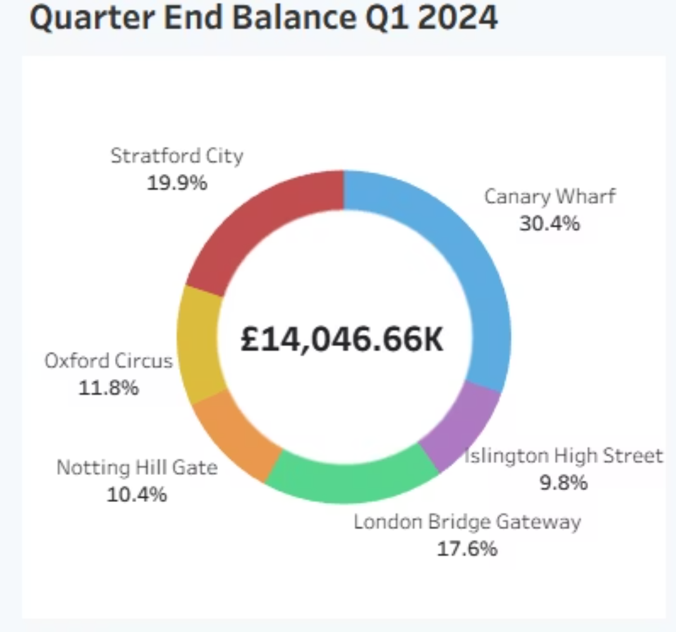
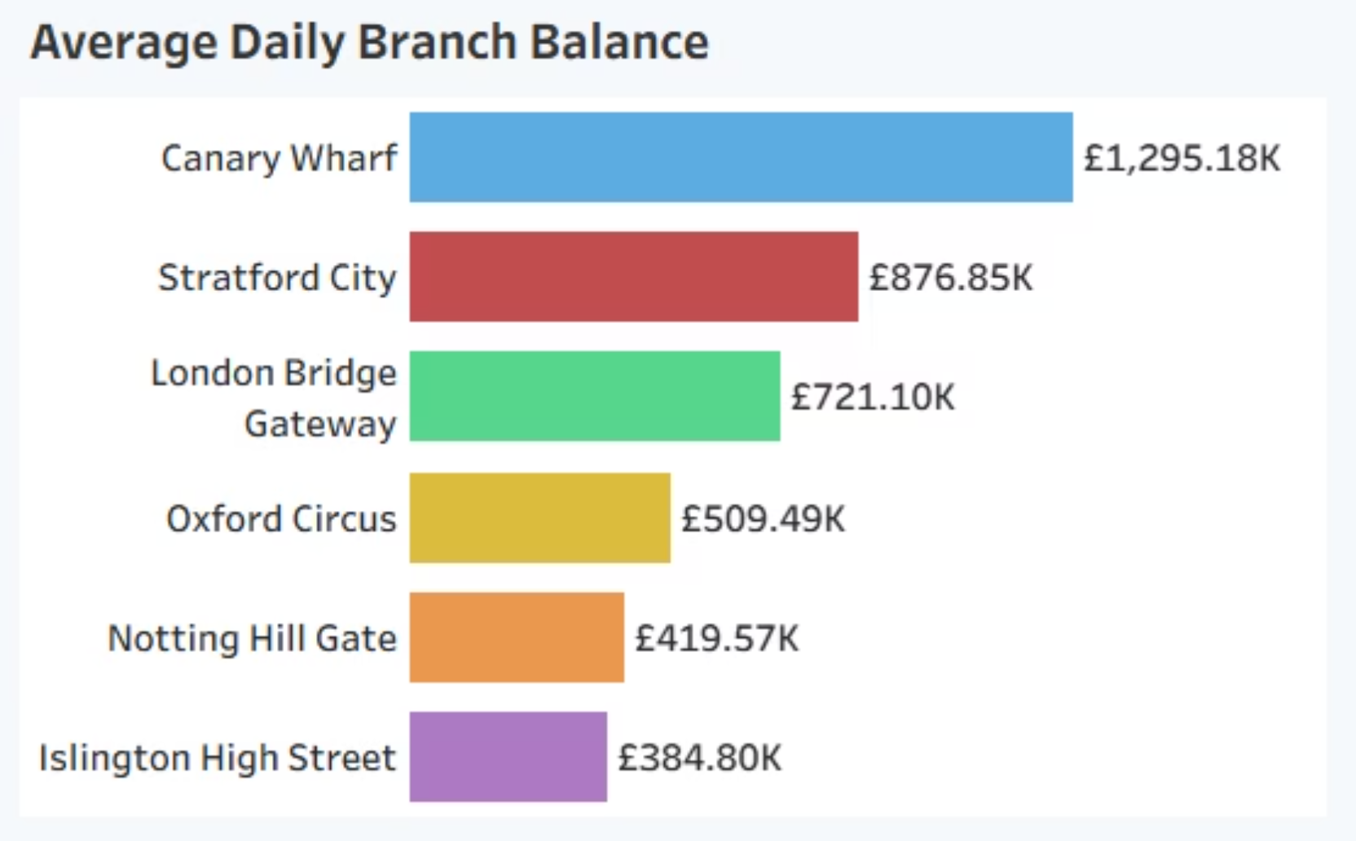
Branch Performance Overview
💰 Total Balance & Daily Activity
📈 Canary Wharf consistently led in account balances and transactions, contributing the highest share of both average daily and quarter-end balances.

Slide 4
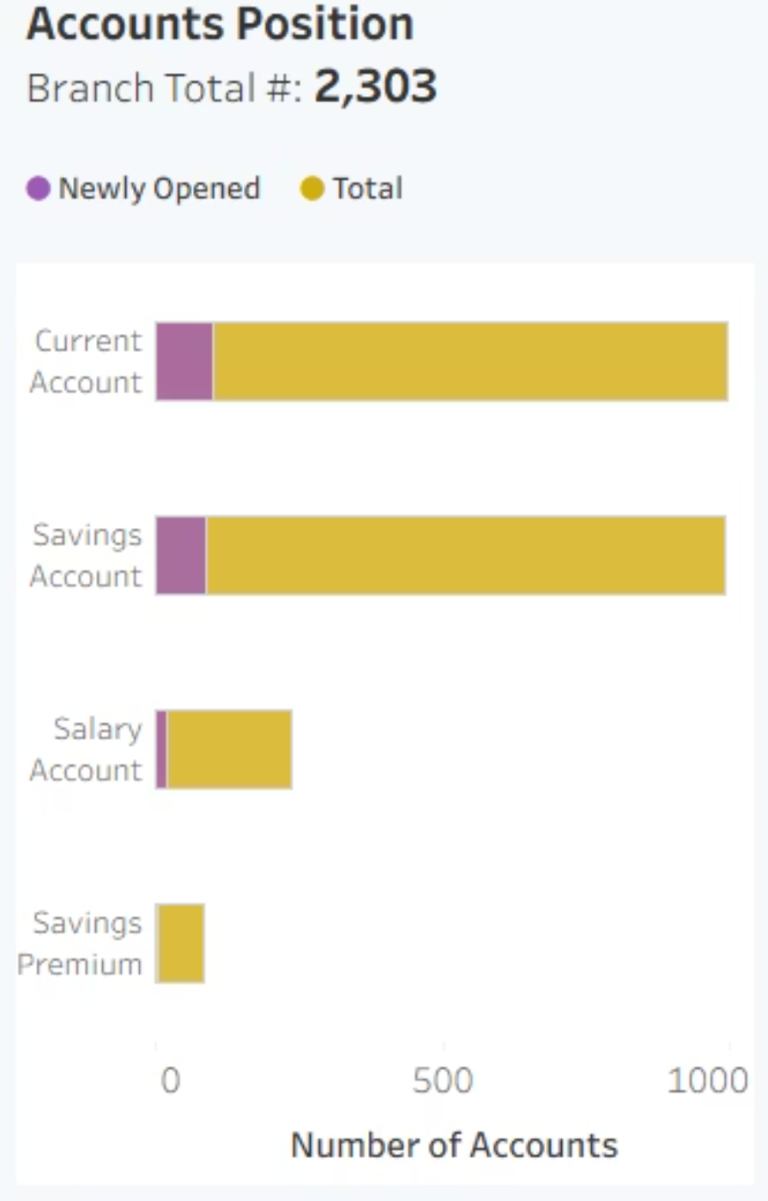
Account Overview
📊 Account Base & Q1 Openings
217 new accounts opened in Q1 2024
Only 5 Premium accounts opened — an underutilized opportunity
Growth was driven by savings and current accounts — strong candidates for premium conversion upsell campaigns.

Slide 5
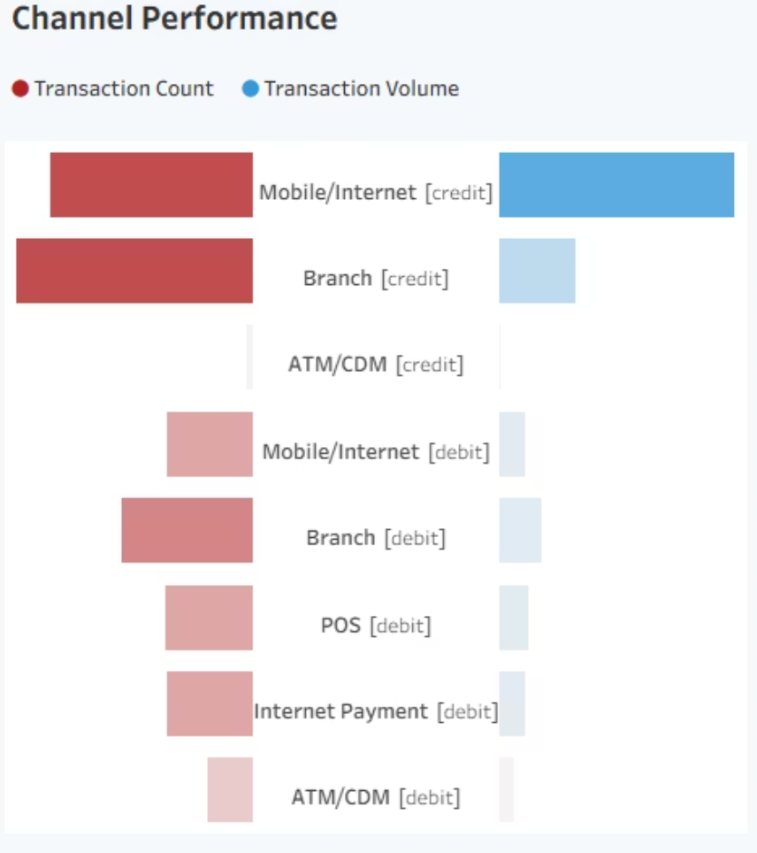
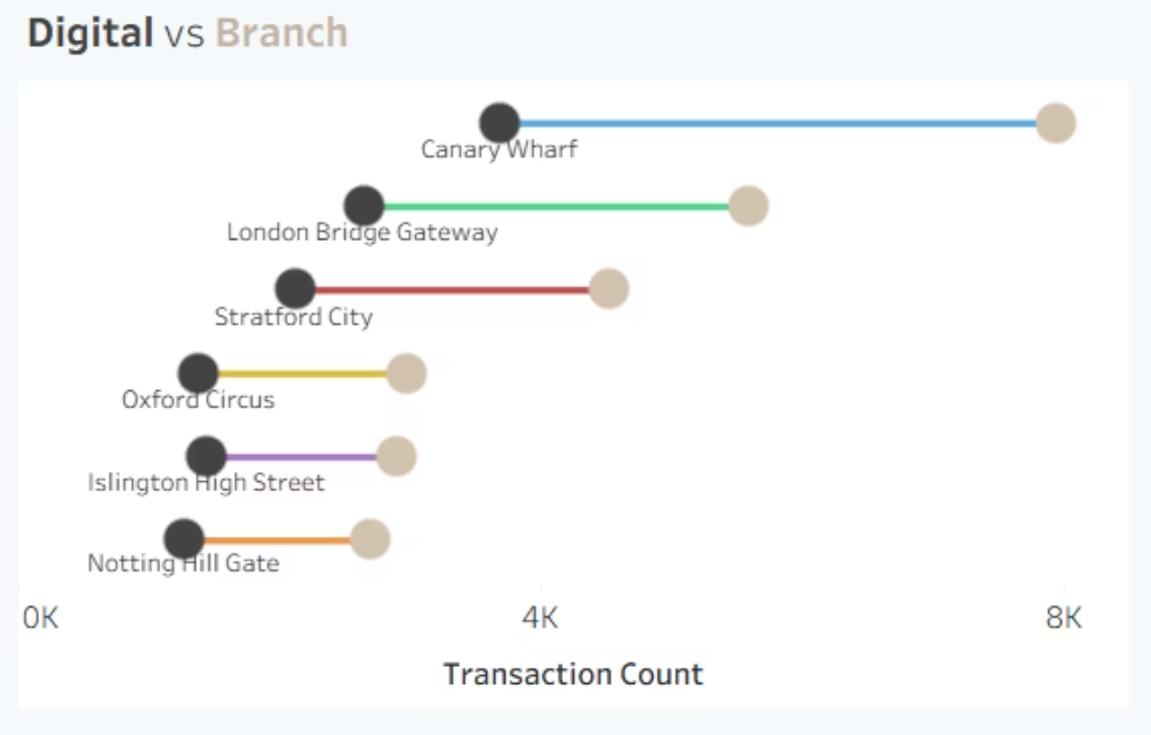
Channel Performance
🧭 Digital vs. Branch Insights
Tornado chart: transaction count vs. volume by channel.
Side-by-side bar: digital vs. branch usage per branch.
A 2:1 branch-to-digital ratio indicates branches where targeted digital adoption efforts can drive operational efficiency and cost reduction.

Slide 6
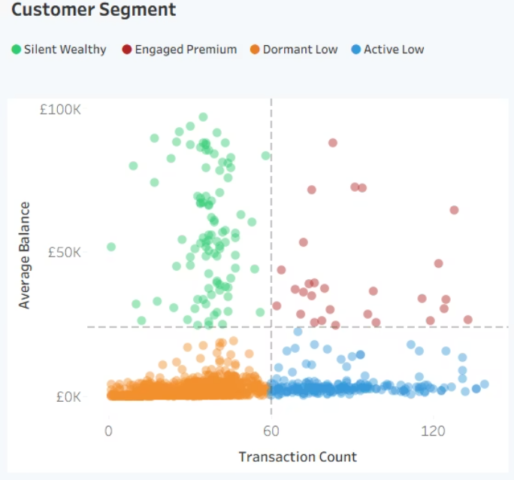
Customer Segments & Targeting
🎯 Segment Strategy
Silent Wealthy
High balance, low activity
💼 Wealth management, deposits, insurance, investment products
Engaged Premium
High balance, high activity
📈 Credit cards, investments, loyalty rewards,
consumer loans
Active Low
Low balance, high activity
💳 Debit card rewards, overdraft, mobile banking features
Dormant Low
Low balance, low activity
📣 Awareness campaigns, potential cleanup or conversion
🧠 Segmentation enables targeted, personalized engagement — improving marketing efficiency and customer ROI.

Slide 7

Recommendations & Next Steps
✅ Strategic Actions
Tap into Silent Wealthy Customers
Boost Digital Adoption to Reduce Branch Loads
Upsell to Active Savings Customers
Launch high-touch offers: concierge banking, priority services.
Focus on digital education and mobile-first incentives in underperforming branches.
Convert high-usage savings accounts to premium or bundled financial products.
Reinforce High-Performing Branches
Embed Segment Intelligence
Canary Wharf should be supported with increased staffing and high-value product training.
Integrate segmentation logic into CRM tools for proactive cross-sell/retention.

