Slide 1








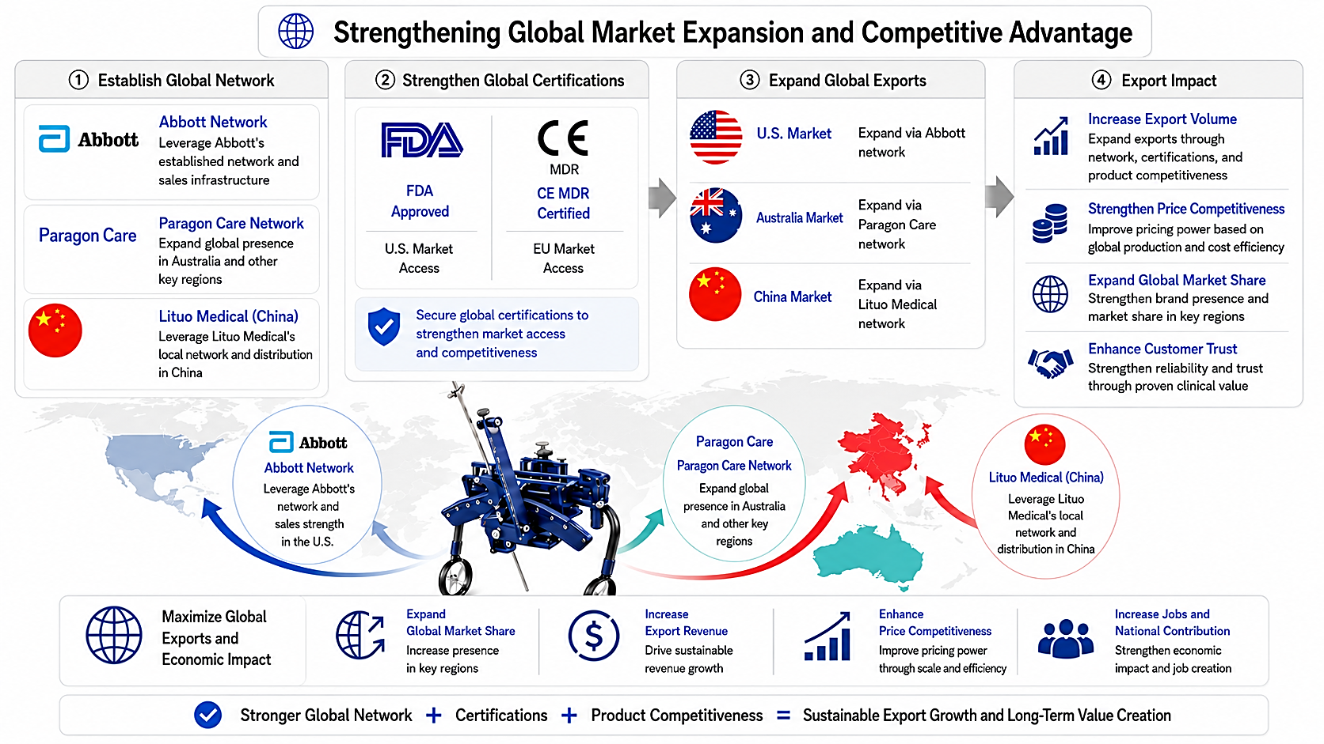





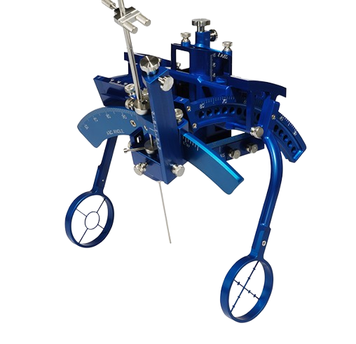



02 Global Expansion
Go-to-Market Strategy | Network · Certifications · Exports · Impact
Strengthening Global Market Expansion and Competitive Advantage
NaviNetics Asia
March 2026 Integration as
a Subsidiary(formerly CBH)
① Establish Global Network
② Strengthen Global Certifications
③ Expand Global Exports
④ Export Impact
Abbott Network
Increase Export Volume
U.S. Market
Expand via Abbott network
Manufacturing · R&D ·
Asia / Europe sales network
Leverage Abbott's established network and sales infrastructure
Expand exports through network, certifications, and product competitiveness
🇺🇸
FDA
FDA
FDA
Approved
MDR
CE MDR Certified
Paragon Care Network
Australia Market
Expand via Paragon Care network
Strengthen Price Competitiveness
Expand global presence in Australia and other key regions
U.S. Market
Access
EU Market
Access
Improve pricing power based on global production and cost efficiency
FDA Approved
FDA Approved
🇦🇺
Partner company
Lituo Medical (China)
Secure global certifications to strengthen market access and competitiveness
Expand via Lituo Medical network
Expand Global Market Share
China Market
Strengthen brand presence and market share in key regions
Leverage Lituo Medical's local network and distribution in China
U.S. Market Access
U.S. Market Access
Enhance Customer Trust
Strengthen reliability and trust through proven clinical value
Paragon Care Network
Abbott Network
Expand global presence in Australia and other key regions
Lituo Medical (China)
Leverage Abbott's network and sales strength
In the U.S.
Leverage Lituo Medical's local network and distribution in China
2026 U.S. Market Revenue Forecast
$2 Million
Maximize Global Exports and Economic Impact
Expand Global Market Share
Increase Export Revenue
Enhance Price Competitiveness
Increase Jobs and National Contribution
Increase presence in key regions
Drive sustainable revenue growth
Improve pricing power through scale and efficiency
Strengthen economic impact and job creation
Global Network + Certifications + Product Competitiveness = Sustainable Export Growth & Long-Term Value
Stronger Global Network + Certifications + Product Competitiveness = Sustainable Export Growth and Long-Term Value Creation

