Slide 1
BRITISH AIRWAYS
Airline Insights

Slide 2
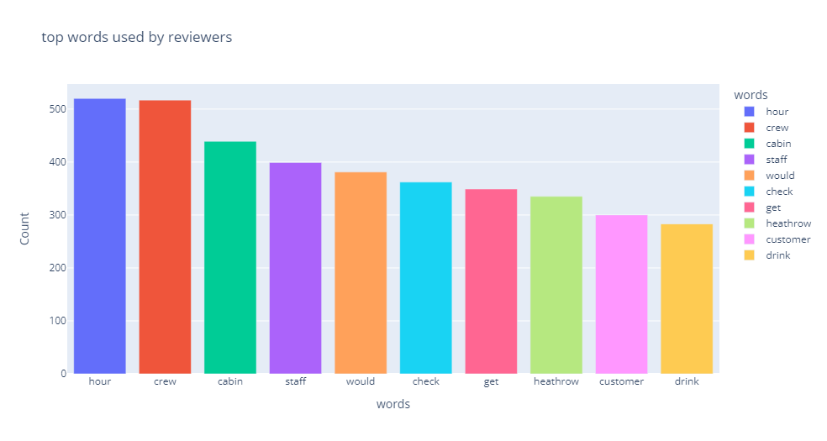
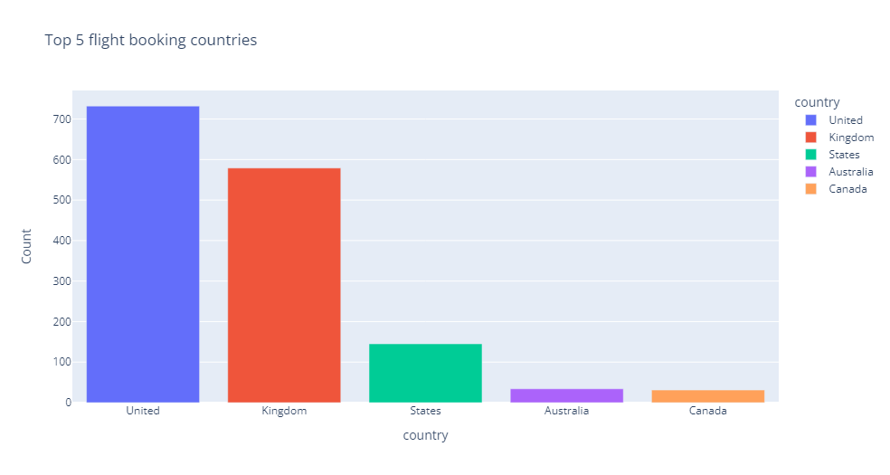
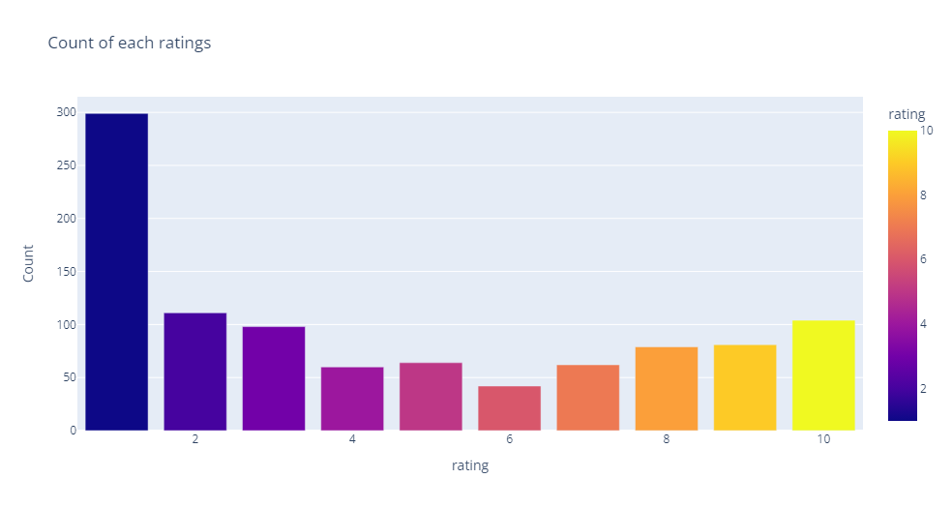
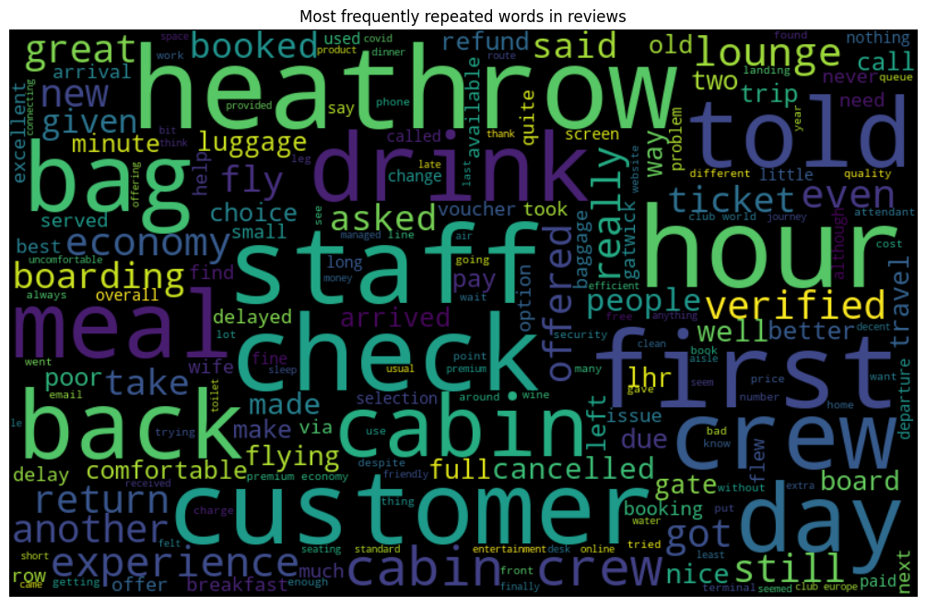
KEY METRICS
Avg Overall Rating
4.462/10
Total No of countries
52
Total records
1000
Most Used Words
Customer satisfaction feedbacks
7-10 ratings wrote about food quality, comfortable seats
1-3 wrote about dissatisfaction about seats ,screens, foods.
4-6 wrote about uncomfortability in seats, screens.
Key take aways :
Most of the customers liked cabin crew services, staffs, economy seats.
Many travelled in business class.

