Slide 1
Cafe Sales Data Analysis Project
Navitha . N

Slide 2
Introduction:
Data Cleaning is the process of identifying and correcting errors, missing values, duplicate records, and inconsistent data formats to improve data quality and make it ready for analysis.

Slide 3
Project Overview:
Objective:
Analyze coffee shop sales data to identify sales trends, customer purchasing patterns, and payment preferences.
Tools Used:
Python(Pandas)
Jupyter Notebook
PowerBI
Excel

Slide 4
Data Set:
Source : Loaded Dirty cafe sales csv file(10000 rows And 8 columns)
Key Fields:
Transaction ID
Item
Quantity
Price Per Unit
Total Spent
Location
Payment Method
Transaction Date

Slide 5
Problem Statement:
Missing values Present
Invalid Values(0,UNKNOWN ,ERROR)
Differernt data types
Need Meaningful business insights.

Slide 6
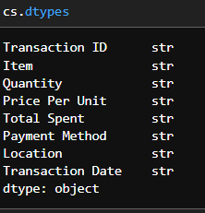
Data Cleaning:
1.Read a data set:
2.Checking Datatypes:

Slide 7
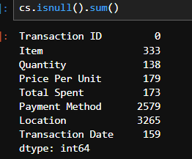
3.Checking Null Values:

Slide 8
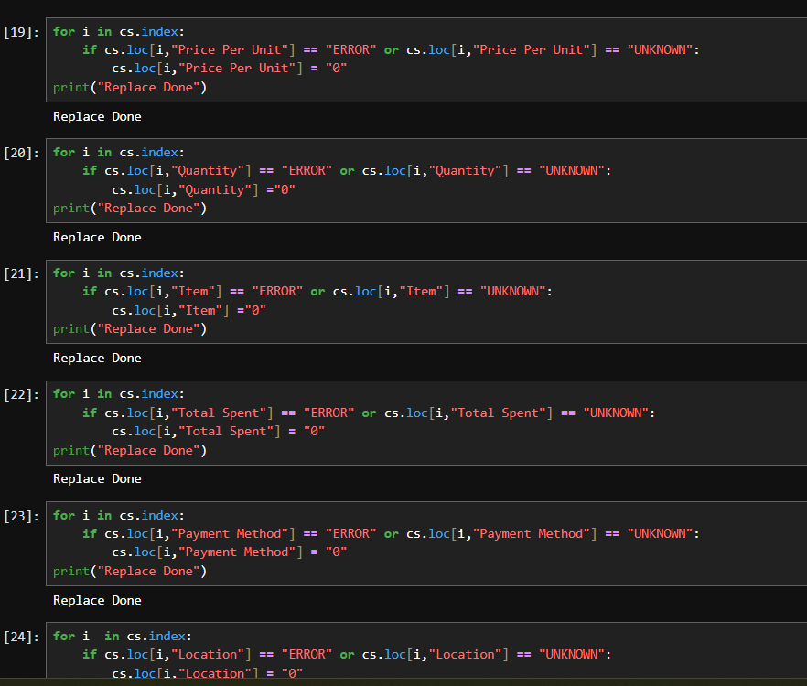
4. Replace Error And Unknown Values:

Slide 9
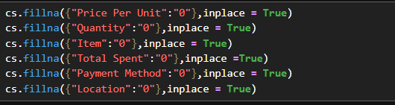
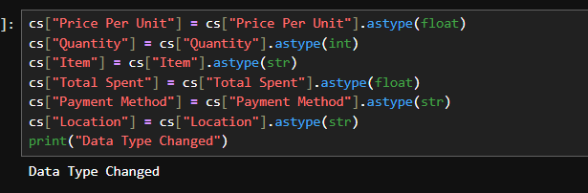
5. Replace Null Values:
6.Change Datatypes:

Slide 10
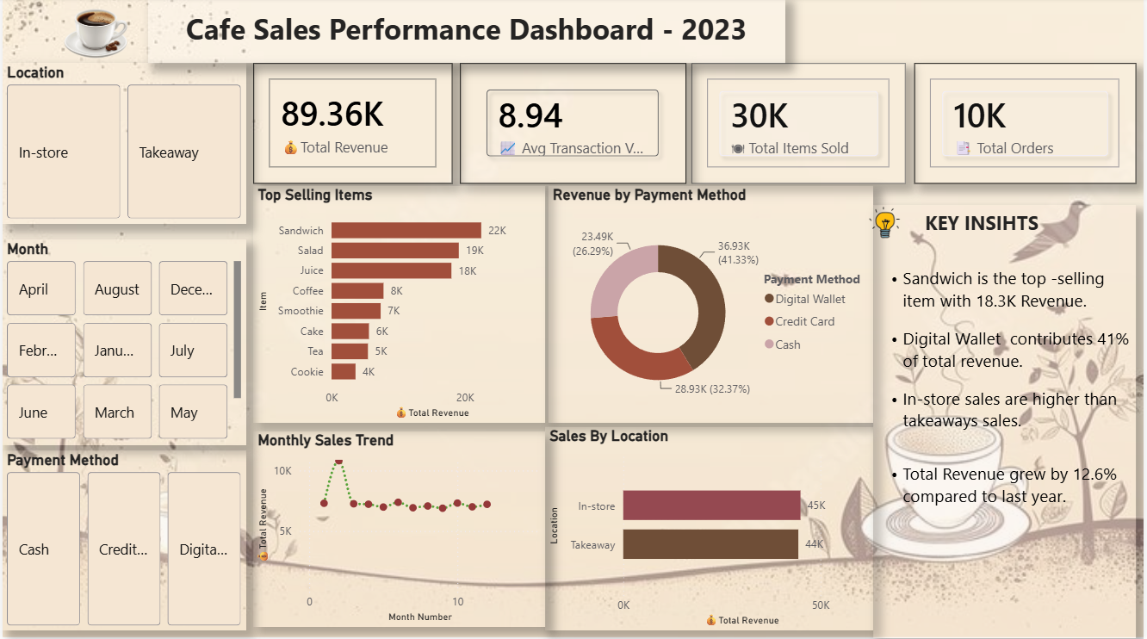
Dashboard:

Slide 11
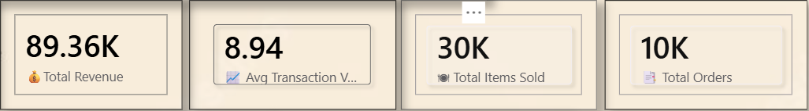
Key Performance Matrics
KPI Cards | Values | Insights
Total Revenue | 89.36K | Total Revenue reached 89.36k
Avg Transaction value | 8.94 | Customers Spent 8.94 on average per Transaction
Total Items Sold | 30k | More then 30K items were sold.
Total Orders | 10k | The cafe processed 10k orders succesfully.

Slide 12
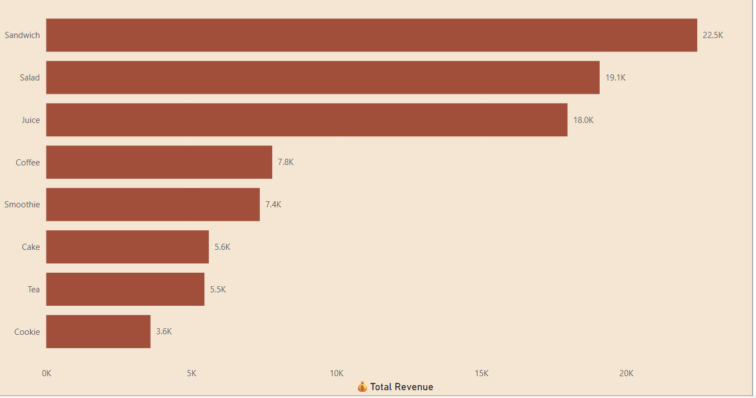
Top Selling Items:
Sandwich is the highest-selling item with 22k revenue.
Salad and Juice are the next base-performing products with 19k and 18k revenue.
Tea generates the lowest revenue among the top-selling items.

Slide 13
Business Recommendations:
Promote Top-selling Products:
Focus on Sandwich , Salad and Juice through combo offers and discounts.
Increase Digital Payments:
Encourage digital wallet usage with cashback and reward programs.
Boost Takeaway Sales:
Introduce special takeaway offers to increase customer orders.
Improve Low-Selling Items:
Review pricing and marketing strategies for Tea and Cake.
Seasonal Promotions:
Run special sampaigns during low-sales months to improve revenue.

Slide 14
Challenges Faced:
Handling missing and incorrect values in the dataset.
Cleaning and transforming data using Power Query.
Creating DAX measures for KPI calculations.
Selecting the righht visuals to represent business insights.
Designing an interactive and user-friendly dashboard.
Key Learnings:
Improved data cleaing and preprocessing skills.
Learned to create KPI cards and interactive slicers.
Gained hands-on experience with DAX calculations.
Understood how to convert raw data into meaningful insights.
Enhanced dashboard design and storytelling skills in Power BI

Slide 15
conclusion:
The Cafe Sales Dashboard helps track revenue,orders,products,payment methods and sales locations. The analysis shows that Sandwich is the best-selling item, Digital Wallet contributes the highest revenue , and In-store sales are slightly higher than Takeaway sales. This dashboard enables data_driven business decisions and supports sales growth.

