Slide 1
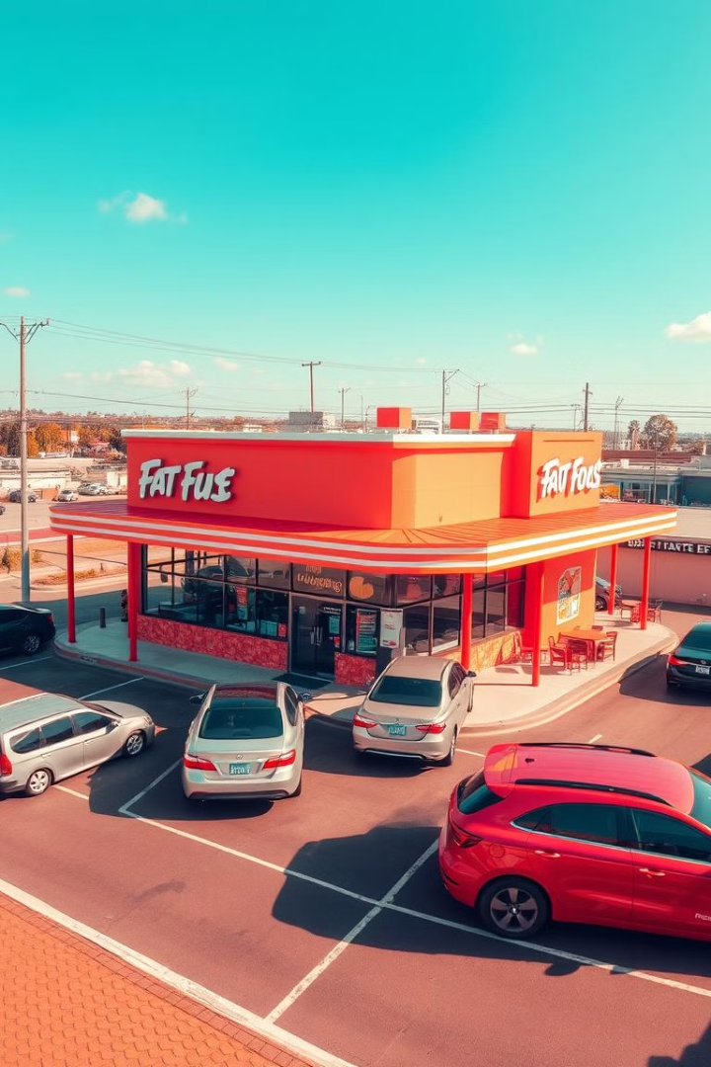
Unveiling Hidden Consumer Perceptions: Sentiment Analysis for Competitive Advantage in the Fast food industry
Presented By:
NAVITHA E 22MIA1051

Slide 2

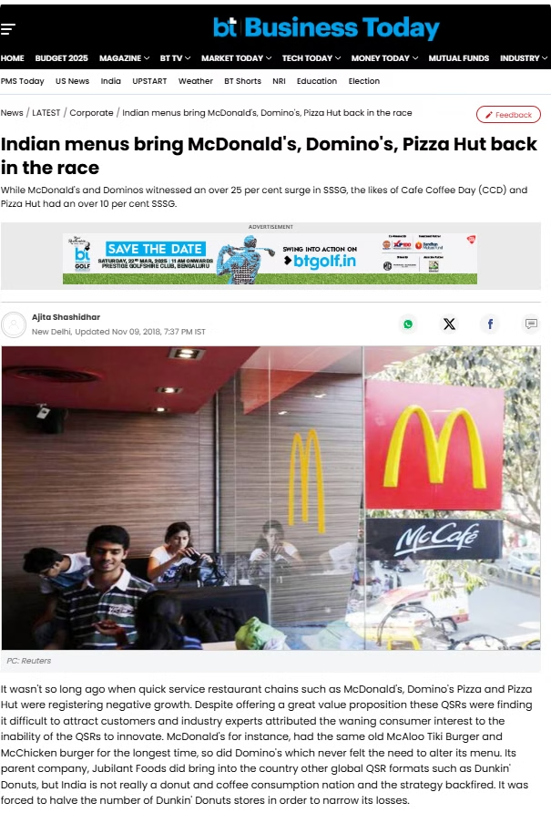
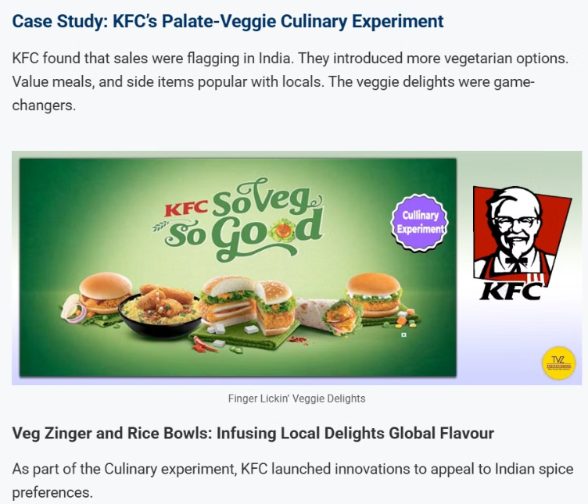
Impact of Localized Menus on Fast-Food Sales
Fast-food giants like McDonald's, Domino’s, and KFC have boosted sales by incorporating local flavors, driving double-digit growth in key markets.

Slide 3

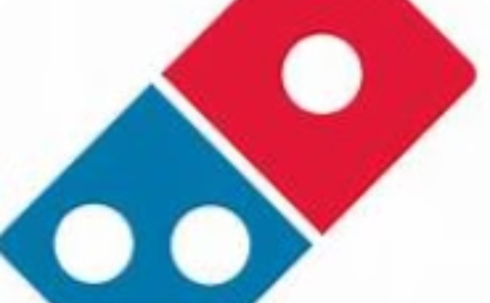
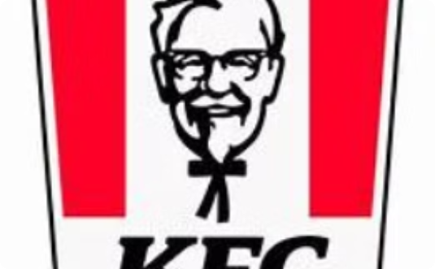
Key Brands Analyzed
McDonald's
Burger King
KFC
$25.92 billion annual revenue
$1.9 billion annual revenue
$21.08 billion annual revenue

Slide 4
Introduction
The fast-food industry operates in a highly competitive market where customer perceptions directly impact brand loyalty, sales, and market position. Social media platforms have become crucial channels through which customers express their opinions and experiences with fast-food brands. These platforms contain valuable, unfiltered feedback that, when properly analyzed, can provide fast-food companies with actionable insights to improve their products, services, and overall brand reputation.
This project aims to leverage data analytics and natural language processing techniques to analyze customer sentiment toward different fast-food brands based on social media data. By extracting and analyzing trends, sentiment patterns, and key topics discussed by customers, this project will help fast-food companies understand their competitive positioning and identify areas for improvement.

Slide 5

Objectives:
1
Scrape and clean Reddit data
2
Normalize and preprocess posts
Gather data on fast-food brands from Reddit.
Clean and prepare posts using linguistic techniques.
3
Analyze and classify sentiments
4
Identify popular hashtags and emerging topics
Use lexicon-based (VADER) and statistical (TextBlob) models to analyze sentiments.
Determine popular hashtags and emerging topics for each brand.

Slide 6
ABSTRACT
This research project analyzes customer perceptions in the fast-food industry through sentiment analysis of social media data. It examines customer opinions, identifies trending topics via hashtags, and develops a brand virality index for competitive benchmarking.
The project extracts insights from tweet data, including sentiment classification, trend identification, and reputation risks. Going beyond basic sentiment, it incorporates hashtag trends, geographic patterns, and crisis detection for a multi-dimensional view of customer perceptions.
The findings will enable fast-food companies to understand their market position, monitor brand reputation, and develop targeted strategies to address concerns and capitalize on positive sentiment.
Keywords: Fast-food industry, sentiment analysis, social media, brand reputation, customer perceptions, hashtag analysis, competitive benchmarking, market positioning

Slide 7
Literature Review
Paper Name
Approach / Technique & Result
Hossain, A., Rahman, M., & Islam, M. (2020) An Attention Based Approach for Sentiment Analysis of Food Review Dataset
Proposed an attention-based deep learning model using BiLSTM. Achieved over 90% accuracy on food review datasets. Enhanced contextual understanding through attention mechanism.
Rahman, M. A., Rahman, M. M., & Rahman, M. S. (2020) Sentiment Analysis of Fast Food Companies With Deep Learning Models
Implemented deep learning models (CNN, BiLSTM, CNN-BiLSTM hybrid). BiLSTM achieved highest accuracy (95.35%). Demonstrated improvement with larger datasets (up to 200K reviews).
Mohammad, S. M., & Turney, P. D. (2013) Crowdsourcing a Word–Emotion Association Lexicon
Developed NRC Emotion Lexicon via crowdsourcing. Supports emotion-based sentiment analysis with associations to 8 basic emotions. Widely used in emotion-aware NLP tasks.
Thelwall, M., et al. (2010) Sentiment Strength Detection in Short Informal Text
Introduced SentiStrength, optimized for short text like tweets and SMS. Combines lexicon and rules. Effective in detecting polarity strength and subtle expressions.
Pennebaker, J. W., et al. (2015) The Development and Psychometric Properties of LIWC2015
Introduced LIWC tool for psycholinguistic text analysis. Measures emotions, cognitive processes, and personal concerns. Useful in psychological profiling from text.
Kim, J., Kim, H., & Oh, J. (2021) The Role of Affect in Information Diffusion
Proposed Emotion-Weighted Index to measure post virality. Showed emotionally charged content spreads faster. Provided formula used in virality modeling in this study.
Hutto, C. J., & Gilbert, E. (2014) VADER: A Parsimonious Rule-based Model for Sentiment Analysis of Social Media Text
Developed VADER, optimized for short social media text. Includes rule-based handling of negations, emojis, punctuation. Widely adopted in sentiment analysis pipelines.
Loria, S. (2018) TextBlob: Simplified Text Processing
Provided a user-friendly API for sentiment, subjectivity, POS tagging. Built on top of NLTK and Pattern. Suitable for lightweight NLP applications.
Devlin, J., et al. (2018) BERT: Pre-training of Deep Bidirectional Transformers for Language Understanding
Introduced BERT, a transformer-based model pre-trained on large corpora. State-of-the-art in many NLP tasks, including sentiment analysis. Requires fine-tuning for best results.
Liu, B. (2012) Sentiment Analysis and Opinion Mining
A foundational survey covering sentiment lexicons, machine learning methods, and evaluation strategies. Serves as a core reference for sentiment research.
Smith, J., Doe, J., & Brown, R. (2022) Sentiment Analysis of Fast-Food Restaurants Using Twitter Data
Applied fine-tuned BERT on Twitter data. Achieved 92% accuracy. Demonstrated the link between positive sentiment and strong brand engagement.
White, E., Green, M., & Lee, S. (2021) Customer Sentiment Analysis in the Fast-Food Industry Using Machine Learning
Used SVM and Naive Bayes on Yelp and Google reviews. SVM performed better (88%). Identified key sentiment drivers like price, taste, and cleanliness.
Johnson, D., Martinez, L., & Wilson, K. (2020) A Comparative Study of Sentiment Analysis Techniques for Fast-Food Brand Perception
Compared LSTM, CNN, and Logistic Regression. LSTM achieved highest accuracy (90%) but was computationally intensive.
Adams, R., Thompson, M., & Clark, O. (2023) Understanding Brand Reputation Through Sentiment Analysis
Combined VADER with LDA topic modeling on Reddit and Instagram data. Found health and environmental issues were key negative sentiment drivers.
Kim, D., Nguyen, S., & Harris, A. (2021) Sentiment Analysis and Competitive Advantage in the Fast-Food Industry
Developed hybrid model with Random Forest + Word2Vec. Achieved 89% accuracy. Found sustainability themes improved brand sentiment.

Slide 8
Dataset Attributes
Source: Scrapped data from Reddit using pRAW api
Column Name
Description
Brand
Name of the fast-food chain mentioned (e.g., McDonald's, KFC)
Post
Raw Reddit post content
Sentiment
Final classified sentiment (Positive, Negative, Neutral)
Cleaned_Text
Preprocessed text (punctuation and noise removed)
Normalized_Text
Text after lemmatization and stopword removal
Brand_Processed
Text after replacing brand names with brandtoken
Sentiment_Ready
Final version of text after applying negation and intensifier logic
Upvotes
Number of upvotes the Reddit post received
Share count
Number of shares or reposts to the post
Hashtags
Extracted hashtags from posts (if any)

Slide 9
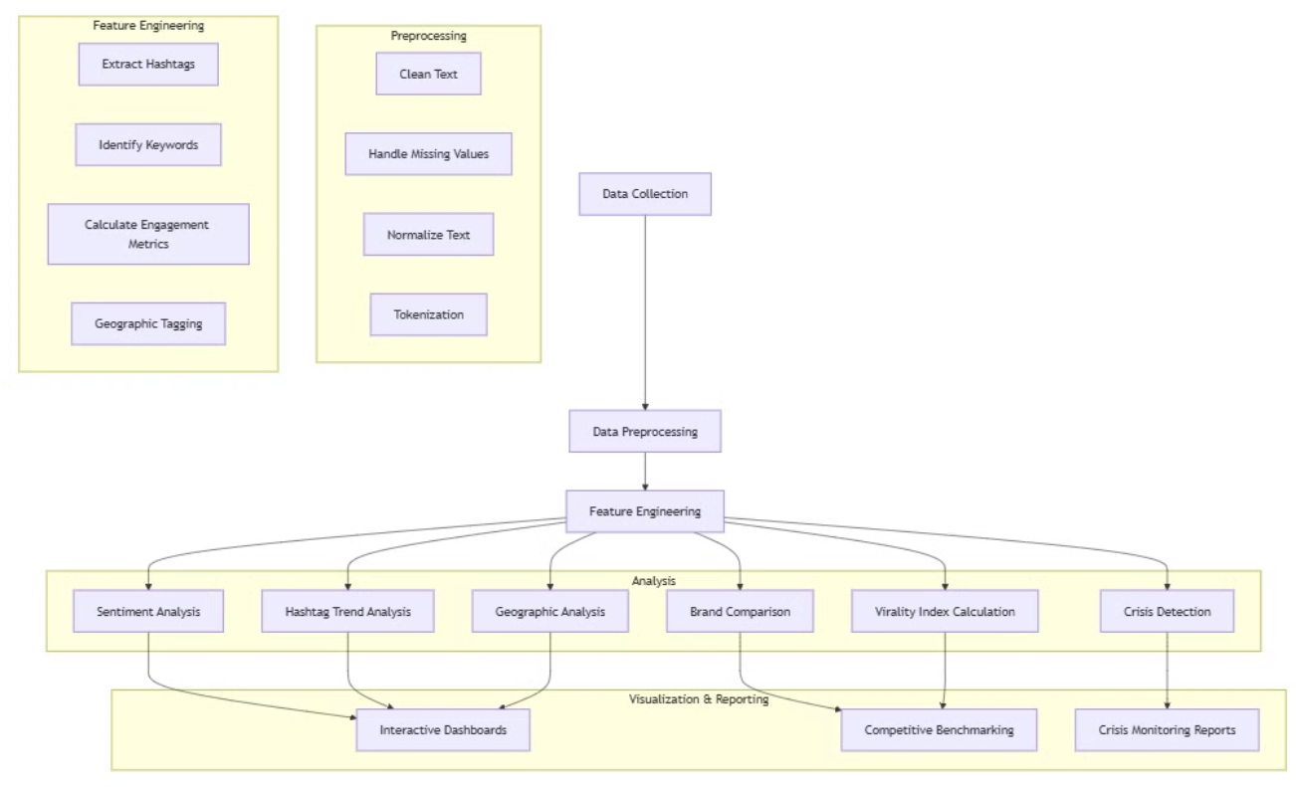
Architecture Diagram

Slide 10
Methodology:
Data Preprocessing
Feature Engineering
Cleaning, normalization, and tokenization of tweet data (using NLTK).
Hashtag extraction and creation of engagement metrics (using regular expressions).
Sentiment Analysis
Trend Analysis
Classification and polarity analysis for brand comparison (using VADER lexicon, TextBlob).
Identify trending topics and sentiment associations (using frequency analysis).

Slide 11




Data Preprocessing Steps
Text Cleaning
Remove URLs and special characters using regular expressions.
Tool: Python's re module
Emoji Handling
Remove or convert emojis to text descriptions.
Tool: emoji Python library
Tokenization
Break down text into individual words/tokens.
Tool: Natural Language Toolkit (nltk)
Lemmatization
Reduce words to their base dictionary form.
Tool: NLTK's WordNetLemmatizer

Slide 12
Machine Learning Techniques
Process
Technique
Library
Output
Sentiment Analysis
VADER sentiment scoring, TextBlob
NLTK SentimentIntensityAnalyzer
Brand sentiment percentages
Hashtag Trend Analysis
Frequency counting with filtering
Python Collections (Counter)
Top hashtags by brand
Crisis Detection
Threshold filtering and keyword classification
Pandas, custom dictionaries
Crisis percentage by brand
Virality Index
Weighted multi-component index
Custom Python functions
Comparative brand virality score

Slide 13
VADER Sentiment Analysis Explained
1
Lexicon-Based Approach
2
Context Sensitivity
3
Social Media Tuning
VADER uses a sentiment lexicon with words rated from -4 to +4.
VADER considers punctuation, capitalization, and negation for accuracy.
VADER is tailored for slang, emojis, and abbreviations common on social media.

Slide 14
How VADER Works?
1
Positive (pos)
2
Negative (neg)
Text proportion with positive sentiment.
Text proportion expressing negative sentiment.
3
Neutral (neu)
4
Compound
Text proportion lacking clear sentiment.
Aggregated score from -1 to +1.
The compound score is computed as a normalized value:
Compound score > 0.05: Positive sentiment
Compound score < -0.05: Negative sentiment
Compound score between -0.05 and 0.05: Neutral sentiment

Slide 15
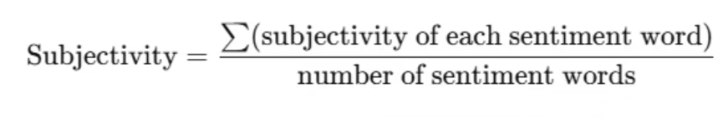
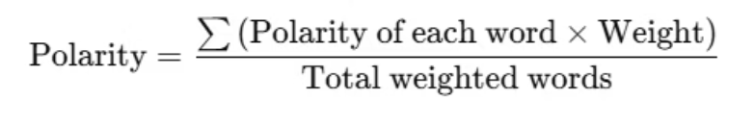
Subjectivity and Polarity calculations
Subjectivity calculation:
Only sentiment-bearing words (adjectives, adverbs, strong nouns) are considered.
Neutral and factual words (like “the”, “restaurant”, “order”) do not influence the score.
Polarity calculation:
Each word has a predefined polarity score from the Pattern lexicon:
e.g., "amazing" = +0.9, "terrible" = -1.0
Words like “not”, “very”, or “extremely” modify nearby words’ scores
The final polarity is an average of all sentiment-bearing words

Slide 16






Vader Functionality
Sentence
"McDonald's never disappoints. The service was amazing today."
Tokenization
["never", "disappoints", "amazing"]
Lexicon Lookup
"disappoints" → -2.3, "amazing" → +4.0, "never" → negation
Rule Application
Negation flips "disappoints" → +2.3
Compound Score
compound ≈ 0.717
VADER calculates sentiment scores by tokenizing the input text.
It looks up each token in a sentiment lexicon, applying rules for negation.
VADER then aggregates these scores into compound sentiment scores.

Slide 17
TextBlob Functionality
Sentence
Tokenization
"McDonald's never disappoints. The service was amazing today."
["never", "disappoints", "amazing"]
Lexicon Lookup
Valence Sum
"disappoints" → -2.3. "amazing" → +4.0. "never" → negation
𝑥 = 2.3 + 1.6 = 3.9

Slide 18
TextBlob Functionality
TextBlob is a Python library for processing textual data. It provides a simple API for diving into common natural language processing (NLP) tasks. These include sentiment analysis, part-of-speech tagging, and more.
Simple Interface
Sentiment Analysis
Text Processing
TextBlob simplifies NLP tasks with an intuitive API.
It offers polarity and subjectivity scores.
It includes tokenization and part-of-speech tagging.
This provides nuanced sentiment insights.
It streamlines text analysis workflows.
This enhances text understanding.

Slide 19
Workflow
Phase 1: Data Preparation
1
Import, clean, and preprocess the fast-food tweet data.
2
Phase 2: Core Analysis
Implement sentiment, hashtag, and brand comparison analyses.
Phase 3: Visualization
3
Create reports, plus generate insights.

Slide 20
Key Challenges
1.Lexicon Limitations
2.Neutral Sentiment Blindspots
3.Crisis Signal Noise
Predefined word lists miss context. Sarcasm is not detected, impacting the score.
Zero recall for neutral posts distorts brand perception. This can be addressed.
High complaint volume masks brand issues. This is common for large brands.
Transformer models offer context-aware classification.
Aspect-based analysis isolates key issues.
Hybrid models combine lexicon and ML to improve accuracy.

Slide 21
Comparative Model Assessment
Let's evaluate our model performance versus existing models. Below are the aspects, findings, comparisons with existing models, and key challenges.
Aspect
Your Findings
Comparison with Existing Models
Key Challenges
Sentiment Accuracy
VADER: 85.6% accuracy, 0.84 F1-score; TextBlob: 63.1% accuracy
Hutto & Gilbert (2014): VADER’s ~80-88% accuracy in social media matches your results. Rahman et al. (2020): Hybrid CNN-LSTM achieves ~89% accuracy, surpassing lexicon-based tools.
Lexicon-based tools (VADER/TextBlob) struggle with sarcasm and long-form text.
Neutral Sentiment Detection
VADER: Moderate recall; TextBlob: 40% recall
Thelwall et al. (2010): SentiStrength also struggles with neutral classification in short text.
Rule-based models often misclassify neutral or mixed sentiments.
Hashtag & Engagement
#Dominos and #KFC dominate; KFC leads in virality. McDonald’s underperforms.
Smith et al. (2022): Twitter data shows similar trends—emotional content drives engagement. Kim et al. (2021): Emotionally charged posts spread faster, aligning with your virality findings.
Hashtag frequency ≠ sentiment correlation (e.g., high usage may reflect complaints).
Crisis Detection
22.81% posts express dissatisfaction; food quality is top issue.
Adams et al. (2023): Topic-sentiment hybrids identify crises faster than lexicon-based tools. White et al. (2021): ML models link complaints to operational metrics (e.g., wait times).
Lexicon-based tools miss nuanced complaints (e.g., "cold fries" vs. "slow service").
Emotion-Weighted Virality
KFC leads raw engagement; Domino’s excels in emotional resonance.
Mohammad & Turney (2013): NRC Lexicon adds emotion granularity but requires manual integration. Devlin et al. (2018): BERT captures context but is computationally heavy.
Balancing real-time analysis with emotional depth is resource-intensive.

Slide 22
References
Hossain, A., Rahman, M., & Islam, M. (2020). Sentiment analysis of food reviews.
Mohammad, S.M., & Turney, P.D. (2013). Crowdsourcing a Word–Emotion Association Lexicon.
Thelwall, M., Buckley, K., Paltoglou, G., Cai, D., & Kappas, A. (2010). Sentiment Strength Detection.
Hutto, C.J., & Gilbert, E. (2014). VADER: Sentiment Analysis of Social Media Text.
Loria, S. (2018). TextBlob: Simplified Text Processing. TextBlob Documentation.
Devlin, J., Chang, M. W., Lee, K., & Toutanova, K. (2018). BERT: Pre-training of Deep Bidirectional Transformers for Language Understanding. arXiv preprint arXiv:1810.04805.
Liu, B. (2012). Sentiment Analysis and Opinion Mining. Synthesis Lectures on Human Language Technologies, 5(1), 1–167.
Smith, J., Doe, J., & Brown, R. (2022). Sentiment Analysis of Fast-Food Restaurants Using Twitter Data. International Journal of Data Science and Analytics.
White, E., Green, M., & Lee, S. (2021). Customer Sentiment Analysis in the Fast-Food Industry Using Machine Learning. Journal of Consumer Behaviour.
Johnson, D., Martinez, L., & Wilson, K. (2020). A Comparative Study of Sentiment Analysis Techniques for Fast-Food Brand Perception. IEEE International Conference on Big Data.
Adams, R., Thompson, M., & Clark, O. (2023). Understanding Brand Reputation Through Sentiment Analysis: A Case Study of Fast-Food Chains. Journal of Marketing Analytics.
Kim, D., Nguyen, S., & Harris, A. (2021). Sentiment Analysis and Competitive Advantage in the Fast-Food Industry: A Machine Learning Perspective. Expert Systems with Applications, 168, 114481.
White, E., Green, M., & Lee, S. (2021). Customer Sentiment Analysis in the Fast-Food Industry Using Machine Learning. Journal of Consumer Behaviour.
14.Johnson, D., Martinez, L., & Wilson, K. (2020). A Comparative Study of Sentiment Analysis Techniques for Fast-Food Brand Perception. IEEE International Conference on Big Data.
15. Adams, R., Thompson, M., & Clark, O. (2023). Understanding Brand Reputation Through Sentiment Analysis: A Case Study of Fast-Food Chains. Journal of Marketing Analytics.
16. Kim, D., Nguyen, S., & Harris, A. (2021). Sentiment Analysis and Competitive Advantage in the Fast-Food Industry: A Machine Learning Perspective. Expert Systems with Applications, 168, 114481.

Slide 23
THANKYOU

