Slide 1
SQL – DML
Lecture 7 - Part 2

Slide 2
In this lecture you will learn
How to use SQL as a DML -
Query data in a database using SELECT command
Insert new data using INSERT command
Modify existing data using UPDATE command
Remove unwanted/expired data using DELETE command

Slide 3
SQL ‘SELECT’
SQL has one basic statement for retrieving information from a database called the SELECT clause
SELECT clause has many options

Slide 4
SQL – ‘SELECT’…
SELECT <attribute-list>
FROM <table-list>
[WHERE <condition>]
[GROUP BY <group attribute(s)>]
[HAVING <group condition>]
[ORDER BY <attribute list>];
<attribute-list> is a list of column names
<table-list> is a list of tables which the query accesses
<condition> is the condition that the output rows must satisfy

Slide 5
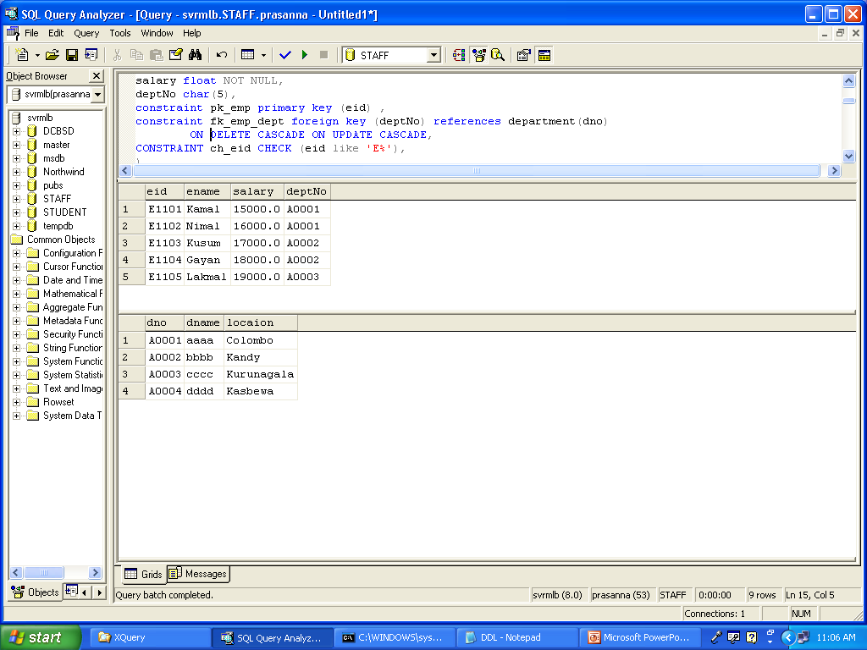
Employee(eid, ename, salary, deptNo) Department(dno, dname, location)
Example

Slide 6
Structured Query Language
Use of Asterisk (*)
* means all columns
Ex: Select details about all employees
SELECT *
FROM Employee
Selecting specific columns
Ex: Select names of all employees
SELET ename
FROM Employee

Slide 7
Structured Query Language
Duplicates are maintained in SQL tables. Also, SQL queries allow duplicates
ALL (by default) – allows duplicates
DISTINCT – disallow duplicates
For example…
SELECT ALL deptno
FROM Employee
SELECT DISTINCT deptno
FROM Employee

Slide 8
Structured Query Language
Select names of employees working in the dept A0001
SELECT ename
FROM Employee
WHERE deptno = ‘A0001’
List all the department names which are located in ‘Colombo’
SELECT dname
FROM Department
WHERE location = ‘Colombo’

Slide 9
Structured Query Language
List all the department names which are in Colombo OR Kandy
SELECT DISTINCT dname
FROM Department
WHERE location = ‘Colombo’ OR location = ‘Kandy’
List all the employee names who are in department A0001 and salary grater than 10000
SELECT ename
FROM Employee
WHERE deptno = ‘A0001’ AND salary > 100000

Slide 10
Structured Query Language
String operations…
LIKE comparison operator can be used with
% : replaces an arbitrary number of characters
_ : replaces a single character

Slide 11
Structured Query Language
“List the employee name’s starting with A”
SELECT Name
FROM Emp
WHERE Name LIKE ‘A%’
List the names of employee starting with ‘Kama’ and ending with another one letter.
SELECT Name
FROM Emp
WHERE Name LIKE ‘Kama_’

Slide 12
Structured Query Language
Ordering of results
Using ORDER BY clause &
ASC (default) and DESC clauses
Example:
“List the ID and name of employees working for department “Admin”. Prepare the output according to the ascending order of the salary”
SELECT ID, Name
FROM Emp
WHERE dept = ‘Admin’
ORDER BY salary ASC

Slide 13
Structured Query Language
Ordering multiple columns…
Example…
“List the employee ID, department and salary, display the result in ascending order of department and descending order of salary
SELECT ID, name, salary
FROM Emp
ORDER BY dept ASC, salary DESC

Slide 14
Structured Query Language
IS NULL
In SQL, NULLs are considered to be distinct from every other null.
Example…
“List the names of employees who are not assigned to a department yet”
SELECT name
FROM Emp
WHERE manager IS NULL

Slide 15
Structured Query Language
IS NOT NULL…
“List the names of employees who are assigned to departments”
SELECT name
FROM Emp
WHERE manager IS NOT NULL

Slide 16
Structured Query Language
JOINS
List the employee information with their department details who are working in departments
Employee(eid, ename, salary, deptNo) Department(dno, dname, location)

Slide 17
Structured Query Language
SELECT *
FROM Employee, Department
WHERE deptno = dno

Slide 18
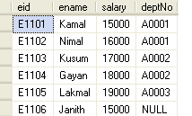
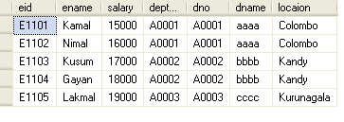
Structured Query Language

Slide 19
Structured Query Language
Example…
Print the names of employees and the names of their working departments
SELECT ename, dname
FROM Employee, Department
WHERE deptno = dno

Slide 20
Structured Query Language
Renaming & Aliasing…
Sometimes the same attribute name appears in multiple tables of the FROM clause. Then we need to use the table name with attribute name to identify attributes separately.
Sometime need to change the field name of display. Then rename the it.

Slide 21
Structured Query Language
For example …
SELECT employee.ename, department.dname
FROM employee, department
WHERE employee.deptno = department.dno
SELECT e.ename AS EmployeeName, d.dname AS Department Name
FROM employee e, department d
WHERE e.deptno = d.dno

Slide 22
Aggregate Functions & Grouping
SUM, MIN, MAX, COUNT, AVG, etc…
Example…
“Find the average, minimum, maximum salary of employees”

Slide 23
Structured Query Language (contd.)
SELECT MIN(Salary)
FROM Emp
SELECT MAX(Salary)
FROM Emp
SELECT AVG(Salary)
FROM Emp
SELECT MIN(Salary), MAX(Salary), AVG(Salary)
FROM Emp

Slide 24
Structured Query Language (contd.)
COUNT(*) – Number of rows
Example…
Count the number of employees in the company
SELECT COUNT(*)
FROM Emp
COUNT(*) returns the number of rows in the result of the query including NULL rows.

Slide 25
Structured Query Language (contd.)
DISTINCT – Find the distinct values…
Example…
“List the different salary values of employees”
SELECT DISTINCT Salary
FROM EMP

Slide 26
Structured Query Language (contd.)
COUNT(DISTINCT …) – Count the distinct values
“How many different salary grades are there in the company?”
SELECT COUNT(DISTINCT salary)
FROM EMP

Slide 27
Structured Query Language (contd.)
If it is known that for a particular month an employee will be given a fixed allowance of Rs.10,000 what is the Net salary of each employee for that month.
SELECT ename, (salary + 10000) AS [Net Salary]
FROM Employee

Slide 28
SAMPLE QUESTION - 2
Purchase(product, date, price, quantity)
Example : find total sales for the entire database
SELECT Sum(price * quantity)
FROM Purchase
Example : find total sales of ‘Banana’
SELECT Sum(price * quantity)
FROM Purchase
WHERE product = ‘Banana’

Slide 29
Structured Query Language (contd.)
Grouping:
Usually, we want aggregations on certain parts of the relation.
Example:
Find the number of employees in each department.
SELECT COUNT(eid) AS [Number of employees]
FROM Employee
GROUP BY deptNo

Slide 30
Structured Query Language (contd.)
HAVING Clause:
HAVING clause contains conditions on aggregates.
List the department number and the number of employees for each department only if the number of employees is greater than 5.
SELECT COUNT(eid) AS [Number of employees]
FROM Employee
GROUP BY deptNo
HAVING COUNT(eid) > 5

Slide 31
Structured Query Language (contd.)
Typical execution order
Compute the FROM and WHERE clauses
2. Group by the attributes in the GROUP BY
3. Produce one tuple for every group by applying aggregation
4. Check for the conditions given in the HAVING clause for each group

Slide 32
SAMPLE QUESTION - 3
Purchase(product, date, price, quantity)
Example: Find total sales for each product

Slide 33
SAMPLE QUESTION - 3

Slide 34
SAMPLE QUESTION - 3
Product
TotalSales
Apple
1300
255.50
Banana
SELECT product, Sum(price*quantity) AS TotalSales
FROM Purchase
GROUP BY product

Slide 35
SAMPLE QUESTION - 3
Consider same query and modify, products that has been sold at least 30 items after 9/1.
SELECT product, Sum(price * quantity)
FROM Purchase
WHERE date > “9/1”
GROUP BY product
HAVING Sum(quantity) > 30

Slide 36
SAMPLE QUESTION - 4
Find all authors who wrote at least 10 documents
Author(login,name)
Wrote(login,url)
Document(url, title)

Slide 37
SAMPLE QUESTION - 4
SELECT a.name
FROM Author a, Wrote w
WHERE a.login=w.login
GROUP BY a.login, a.name
HAVING count(w.url) >= 10

Slide 38
SQL – ‘INSERT’
We can modify data using the following three commands: INSERT, DELETE and UPDATE
INSERT statement:
Inserting a single row
*The order of values must be the same as in the CREATE TABLE statement
INSERT INTO Dept VALUES (1, 'Sales', 'BoC Merchant Tower')

Slide 39
SQL – ‘INSERT’…
Inserting to user-specified columns
* Only the columns are specified are filled with values. Unspecified columns are filled with NULL if there is no default values.
INSERT INTO Employee (NIC, name, works_in)
VALUES ('781111111V', 'Ajith Perera', 1)

Slide 40
SQL – ‘INSERT’…
Inserting multiple rows…
INSERT INTO Employees
<Select statement>*
*we’ll learn the select statement in detail later

Slide 41
SQL – ‘DELETE’
Deleting tuples from tables…
Deleting all records
Deleting only specified records
DELETE FROM <table>
WHERE <selection-condition>
DELETE FROM Dept
DELETE FROM Dept WHERE dno = 2

Slide 42
SQL – ‘UPDATE’
Updating tuples in a table
UPDATE <table>
SET <column> = <expression>
WHERE <selection condition>

Slide 43
SQL – ‘UPDATE’…
Updating all tuples
Updating selected tuples
UPDATE Employee
SET works_in = 2
WHERE NIC = ‘781111111V’
UPDATE Employee SET works_in = 1

