Slide 1
Database Design and Data Modelling
Lecture 2 –Part 1

Slide 2
Objectives
Phases of Database design
Data Modelling using a Data Model

Slide 3
Database Design
Why is Database Design important?
Without careful planning you may create a database that…
contains unnecessary data which occupies the storage space
omits data required to create critical reports
takes a considerable time to respond to user questions
produces results that are incorrect or inconsistent
is unable to accommodate changes in the user's requirements
A poorly designed database will require more time in the long-term…!

Slide 4
Database Design process
1.Requirements Analysis
What does the user want?
2.Conceptual Database Design
Model Data requirements using a Conceptual Data Model --> ER model
3.Logical Database Design
Model Data requirements using a Logical Data Model → Relational Data Model
4.Schema Refinement
Fine tune the result
5.Physical Database Design
Implementation of the design using a Database Management System
6.Security Design
Implement Controls to ensure security and integrity

Slide 5
Data Modeling
What is a Data Model?
A data model focuses on what data should be stored in the DB and how it should be organized
Without representing the data as a database would see it, a data model represents the data as the user sees it in the ‘real world’
A data model can be considered similar to an architect's building plan
The goal of the data model is to make sure that all data objects required by the database are completely and accurately represented

Slide 6
Types and Examples of Data Models
1) High Level Conceptual Data Models
Provide concepts for presenting data in ways that are close to the way people perceive data.
Ex: Entity Relationship Model/Diagram

Slide 7
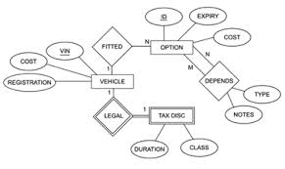
Entity Relationship (ER) Model
Represents data as ‘real world’ Objects (Entities)

Slide 8
Types and Examples of Data Models …
2) Record-based Logical Data Models
Provide concepts users can understand but are not too far from the way data is stored in the computer
Ex: Hierarchical Model,
Network Model,
Relational Model,
Object Oriented Model, etc…

Slide 9
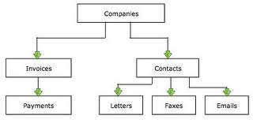
Hierarchical Model
Represents data as a hierarchical tree structure. Each branch of the hierarchy represents a number of related records.

Slide 10
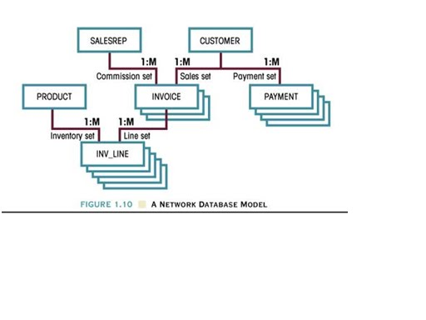
Network Model
Represents data as record types

Slide 11
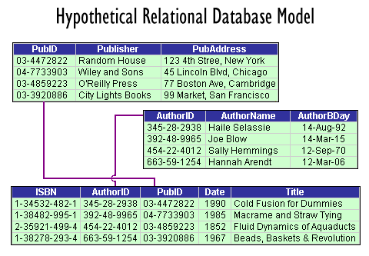
Relational Model
Represents data as relations/tables

Slide 12
Properties of a good Data Model
Completely and accurately represents the data requirements of the end users/application
Uses simple notations and natural language so it can be easily understood by the end user
Detailed enough to be used by a database designer to build the database.
Eliminates redundant data
Independent of any hardware and software constraints
Adapts to changing requirements with minimum of effort

Slide 13
Database Design process (Revisited)
1.Requirements Analysis
What does the user want?
2.Conceptual Database Design *
Model Data requirements using a Conceptual Data Model --> ER model
3.Logical Database Design *
Model Data requirements using a Logical Data Model → Relational Data Model
4.Schema Refinement
Fine tune the result
5.Physical Database Design
Implementation of the design using a Database Management System
6.Security Design
Implement Controls to ensure security and integrity
* Will be discussed in this module

Slide 14
Step 1: Requirements Analysis
The goals of the requirements analysis are:
to determine the data requirements of the database in terms of objects
to identify and describe the information about these objects
to identify the relationships among these objects
to identify different transactions that will be performed on the database
to identify performance, integrity, security or administrative constraints to be imposed on the database
to identify design and implementation constraints if any (ex: specific technologies, hardware and software, programming languages, policies, standards, etc…)

Slide 15
Step 1: Requirements Analysis…
Information needed for the requirements analysis can be gathered in several ways:
Review of existing documents –
Can become familiar with the organization/ activity you need to model by reviewing the existing documentation. Ex: existing forms and reports, written guidelines, job descriptions, personal narratives, etc…
Interviews with end users –
Can organize individual/group meetings with the end users. Can use a blackboard, flip chart, or overhead transparencies to record information gathered from the interviews.
Review of existing automated systems –
Can review the system design specifications and documentation, if the organization already has an automated system

Slide 16
Step 2: Conceptual Database Design
The information gathered in the requirements analysis phase is used to create a:
high-level description of the data in a conceptual data model or Semantic Data Model.
Eg. ER Model

Slide 17
Step 3: Logical Database Design
In this step, we determine the DBMS to implement the database & also the data model.
We utilize the conceptual schema created in the previous step and convert it into a schema of a particular data model* (e.g. Relational Data Model )
*we will cover this in the next two lectures.

Slide 18
Step 4: Schema Refinement
The schema created by the logical database design phase is further refined for potential problems such as redundancies.

Slide 19
Step 5: Physical Database Design
In this step, performance criteria are taken into consideration and further enhancements to the schema & creation of indexes are considered.

Slide 20
Step 6: Security Design
Different user groups and their roles are identified.
Appropriate levels of access are then provided to the data ensuring that users have access to only the necessary data.
Eg. Bank
Customer – read access
Teller – read/update (limited)
Manager – read/update

