Slide 1
Introduction to Database and DBMS
Lecture 1

Slide 2
Objectives
Identify a DB and a DBMS
Characteristics and problems of data storage mechanisms
The advantages and disadvantages of the DB approach
The major components of a DBMS
Levels of abstraction in a DBMS

Slide 3
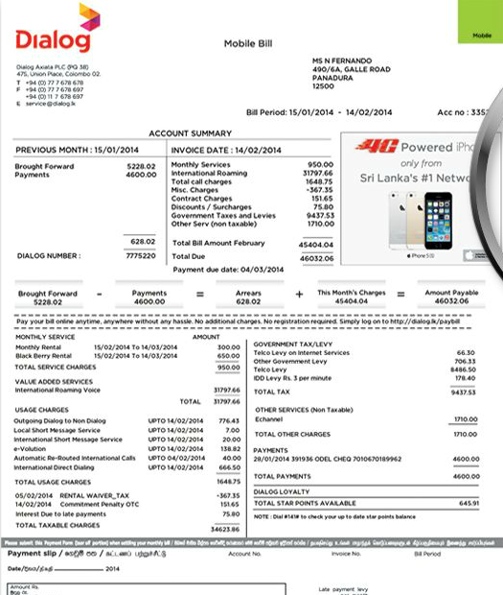
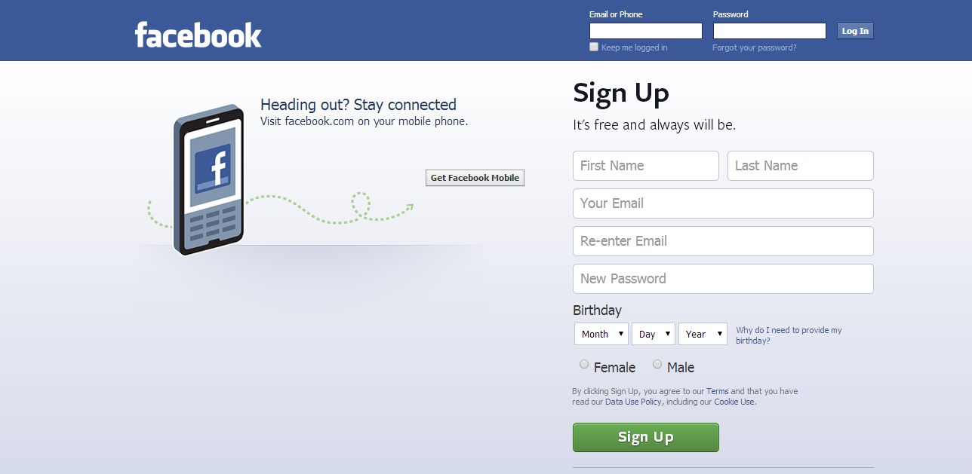
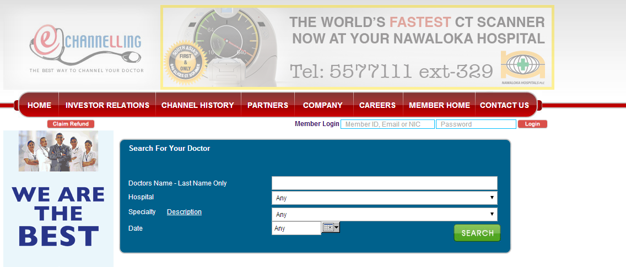
How do you produce these information?

Slide 4
Database
What is a database?
Database is a collection of related data
(examples???)

Slide 5
Places Where databases are used
Banks: ATM
Airlines: reservations, schedules
Universities: registration, grades
Sales: customers, products, purchases
Manufacturing: production, inventory, orders, supply chain
Human resource Management Systems: employee records, salaries, tax deductions
Databases touch all aspects of our lives…

Slide 6


Types of Databases
Numeric and Textual Databases
Banks
Multimedia Databases
Amazon. Com
Geographic Information Systems (GIS)

Slide 7
DBMS
What is a DBMS (Database Management System)
Set of programs to access the data
Is a software package designed to create and maintain databases

Slide 8
DBMS (contd…)
The DBMS is a general-purpose software system
Defining
Specifying the data types, structures, and constraints for the data to be stored in the database.
Constructing
The process of storing the data itself on some storage medium that is controlled by the DBMS.
Manipulating
Manipulating a database includes such functions as querying the database to retrieve specific data, updating the database to reflect changes, and generating reports from the data.

Slide 9
DBMS examples
DBMS | Vendor | Type | Primary Market
Access | Microsoft | Relational | Desktop
SQL Server | Microsoft | Relational | Enterprise
SQLBase | Centura Software | Relational | Mobile/Embedded
Teradata | NCR | Relational | VLDB (Data Warehousing)
DB2 | IBM | Object Relational | Enterprise/VLDB
Informix Dynamic Server 2000 | Informix | Object Relational | Enterprise
Oracle 8I | Oracle | Object Relational | Enterprise
Oracle Lite | Oracle | Object Relational | Mobile
MySQL | Freeware | Relational | Open Source
PostgreSQL | Freeware | Object Relational | Open Source
Etc…

Slide 10

Data Storage & Retrieval Options
Manual Processing
Time Consuming
Does not support large volume of data
File based Processing
Traditional Computer Files
Inadequate
Database Processing

Slide 11
File Based Processing
ID 001
Name Anne
Address Perth
TelNo 747374
Marks 75
Data Entry & Reports | File Handling Routines
 | File Definitions
Student System Files
ID 001
Name Anne
Address Perth
TelNo 747374
Books-Loan 5
Data Entry & Reports | File Handling Routines
 | File Definitions
Data Duplication
Library System Files

Slide 12
File Based Processing
ID 001
Name Anne
Address Perth
TelNo 747374
Marks 75
Data Entry & Reports | File Handling Routines
 | File Definitions
Student System Files
ID 001
Name Anne
Address Perth
TelNo 747374
Books-Loan 5
Data Entry & Reports | File Handling Routines
 | File Definitions
Library System Files

Slide 13
File Based Processing
ID 001
Name Anne
Address Sydney
TelNo 624875
Marks 75
Change request
Data Entry & Reports | File Handling Routines
 | File Definitions
Student System Files
ID 001
Name Anne
Address Perth
TelNo 747374
Books-Loan 5
Data Entry & Reports | File Handling Routines
 | File Definitions
Inconsistent Data
Library System Files

Slide 14
Limitations of File Based Systems
Data Inconsistency
Duplication of Data
Security – Only password security
How do we resolve these problems?

Slide 15
Database Processing
Change Request
stno Name address
001 Jay Perth …………….
Data Entry &
Reports
Students
Application
Programs
DBMS
Data Entry &
Reports
Database
Library
App. Programs

Slide 16
Database Processing
Change Request
stno Name address
001 Jay Sydney …………….
Data Entry &
Reports
Students
Application
Programs
DBMS
Data Entry &
Reports
Database
Library
App. Programs

Slide 17
Advantages of using a DBMS
Data independence
Efficient data access
Data integrity and security
Data administration
Concurrent access, recovery from crashes
Reduced application development time

Slide 18

Data independence
Application programs are independent from data representation and storage details.
The structure of data files is stored in the DBMS catalog separately from the access programs.
E.g. a file access program may be written in such a way that it can access only STUDENT records of the structure.

Slide 19
Program-data dependence
Three file processing systems at Some Company
File descriptions are stored within each application program that
accesses a given file. Any change to a file structure requires changes
to the file descriptions for all programs that access the file.

Slide 20
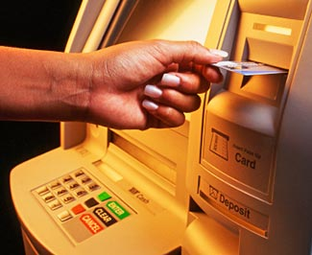
Efficient Data access
DBMS utilises sophisticated techniques to store and retrieve data efficiently, including support for very large files, index structures and query optimisation.
Storage methods can be improved without changing the application programs.

Slide 21
Data integrity and security
DBMS can enforce integrity constraints on the data.
e.g., checking account balance against withdrawal.
checking the withdrawal amount against the daily ATM withdrawal limit.
Access controls govern what data is visible to different class of users.

Slide 22
Data administration
Centralising administration of data shared among many users.
data managed by professionals
Organise data to,
meet user needs
minimise redundancy
Fine tuning of storage for efficient retrieval.

Slide 23

Concurrent access and Crash recovery
Concurrent accesses are scheduled by DBMS.
users can think of the data as being accessed by one user at a time.
DBMS protects users from the effects of system failure.

Slide 24
Reduced application development time
DBMS supports many functions common to applications that access the database
High-level interfaces to data also facilitate quick development of applications
These applications are likely to be more robust than applications developed from scratch because many important tasks are handled by DBMS instead of being implemented by the application

Slide 25
When NOT to use a DBMS
High initial investment (DBMS is an expensive software package)
Applications use small amounts of data
Lack of resources (disk space, memory, etc.) to support a database
Single-user applications
Overhead for flexible querying, security, concurrent access & crash recovery is not required

Slide 26
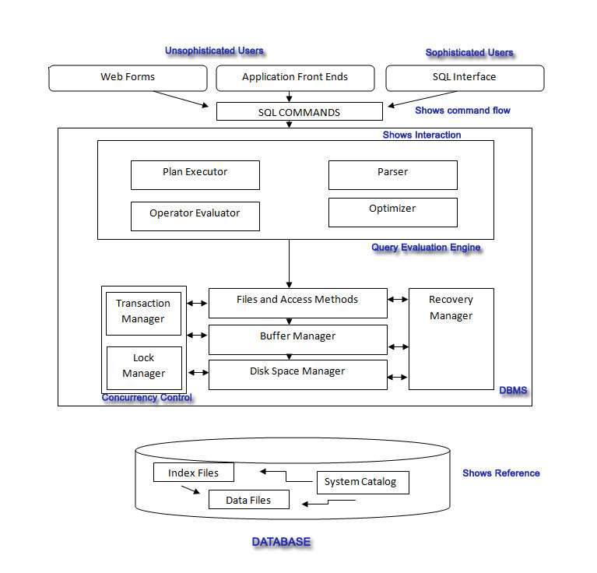
COMPONENTS of a DBMS

Slide 27
Levels of Abstraction in a DBMS
DBMS is described at three levels of abstraction:
External Schema
many views describe how
users see the data
Conceptual Schema
defines logical structure
Physical Schema
describes the files and indexes used
Note:
Information about the schemas is stored
in the system catalog
View 1
View 2
View 3
Conceptual Schema
Physical Schema
DISK

Slide 28
Levels of Abstraction in a DBMS(contd)
Conceptual schema
describes the stored data in terms of the data model of the DBMS
in a relational DBMS, the conceptual schema describes all relations that are stored in the database

Slide 29
Levels of Abstraction in a DBMS(contd)
Physical schema
describe storage details
summarizes how the relations described in the conceptual schema are actually stored on secondary storage devices such as disks and tapes
decide what file organizations used to store the relations
create indexes to speed up data retrieval operations

Slide 30
Levels of Abstraction in a DBMS(contd)
External schemas
allow data access to be customized (and authorized) at the level of individual users or groups of users
any given database has exactly one conceptual schema and one physical schema because it has just one set of stored relations, but it may have several external schemas

Slide 31
Levels of Abstraction in a DBMS
Proposed to support:
Program-data independence
Support of multiple views of the data

Slide 32
Data Independence
One of the main advantages of DBMS.
The three-schema architecture provides the concept of data independence, upper-levels are unaffected by changes to lower-levels.
Two types:
Logical data independence
Physical data independence

Slide 33
Logical Data Independence
The ability to modify the conceptual schema without having alteration in external schemas or application programs.
Eg. addition or deletion of fresh entities, attributes or relationships should be possible without having alteration to existing external schemas or having to rewrite application programs.

Slide 34
Physical Data Independence
The ability to modify the inner schema without having alteration to the conceptual schemas.
Eg. Using new storage devices. Switching from one access method to another. Modifying indexes.
should be possible without having to change the conceptual schema.

Slide 35
Example: University Database
Conceptual schema:
Students(sid: string, name: string, login: string,
age: integer, gpa:real)
Courses(cid: string, cname:string, credits:integer)
Enrolled(sid:string, cid:string, grade:string)
Physical schema:
Relations stored as unordered files.
Index on first column of Students.
External Schema (View):
Course_info(cid:string,enrollment:integer)
Notes:
7

