Slide 1
Final Project Presentation
Group-3

Slide 2
ABOUT OUR TEAM
Team Manager – Harshita Goyal
Team Data Analyst– Harpreet Kaur
Team Developer – Navjot Kaur
Team Business Analyst – Pravalika Kiriyanthan

Slide 3
Project Summary :
We scraped data from a weather API (https://www.weatherapi.com/) and used Python to acquire and store it in a database to show the acquisition of a data source from a remote source. Our cloud database was MongoDb, and we utilized Python to perform a pseudo-batch process that runs every 24 hours. We used the Flask web application framework to display our results on a website. To present a dashboard visualization of the data using charts and graphs, we used Python on the server side and JavaScript on the client side.

Slide 4
BUSINESS PROPOSAL
London is known for its unpredictable weather due to sudden gusts of winds, and short periods of heavy rain throughout the year.
Due to the nature of these weather conditions, analyzing them at a microscopic level is a huge task.
Our team in London has successfully recorded this data and analyzed it to draw various conclusions.
While the winds and rains records on paper do not suggest harsh weather, they are the main reasons behind the sudden temperature drop, wind chills and pollution levels causing exposure to harmful ozone gases.
Our clients aspire to build a dedicated weather app that can help people know the exact temperature down to the minutes on a real-time basis.

Slide 5
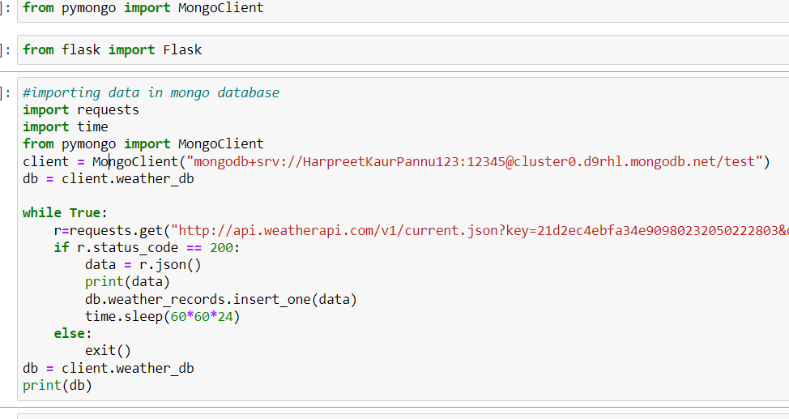
Importing data from the weather API to MongoDB database every 24 hours

Slide 6
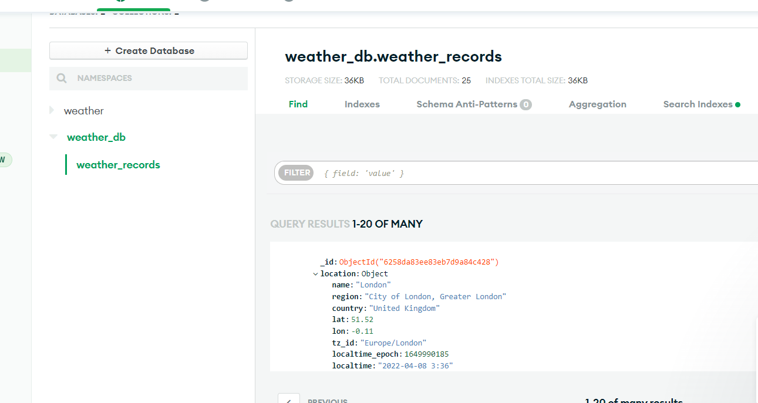
MongoBD Database

Slide 7
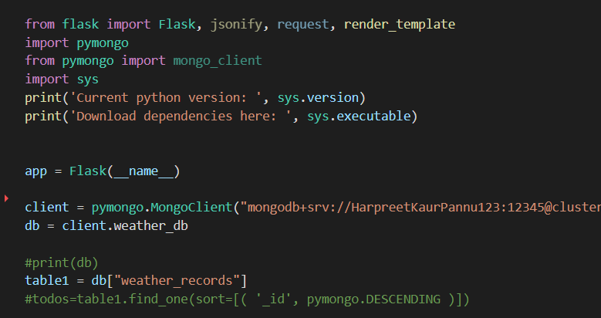
Using Flask to create a Web Application Framework

Slide 8
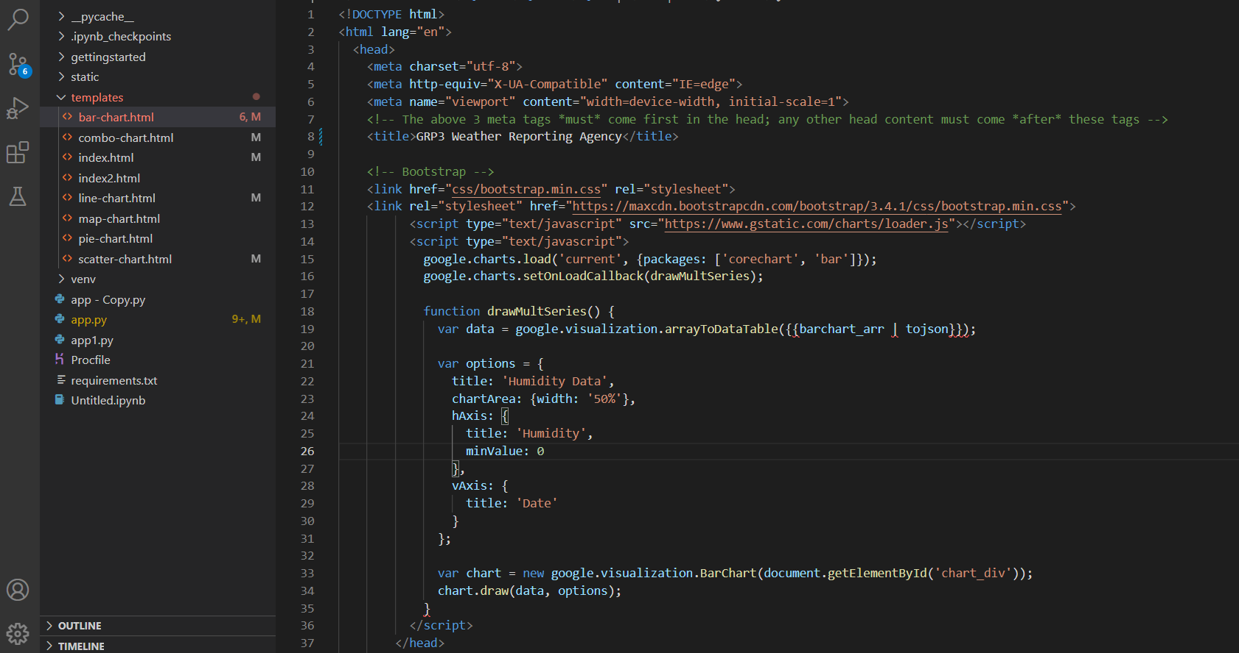
Using Google charts to create visualizations

Slide 9
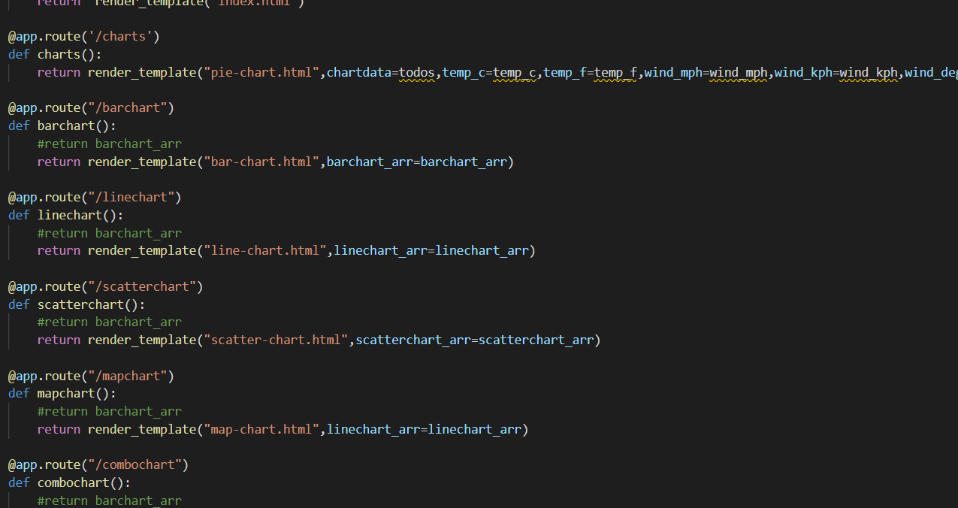
App.py Code

Slide 10
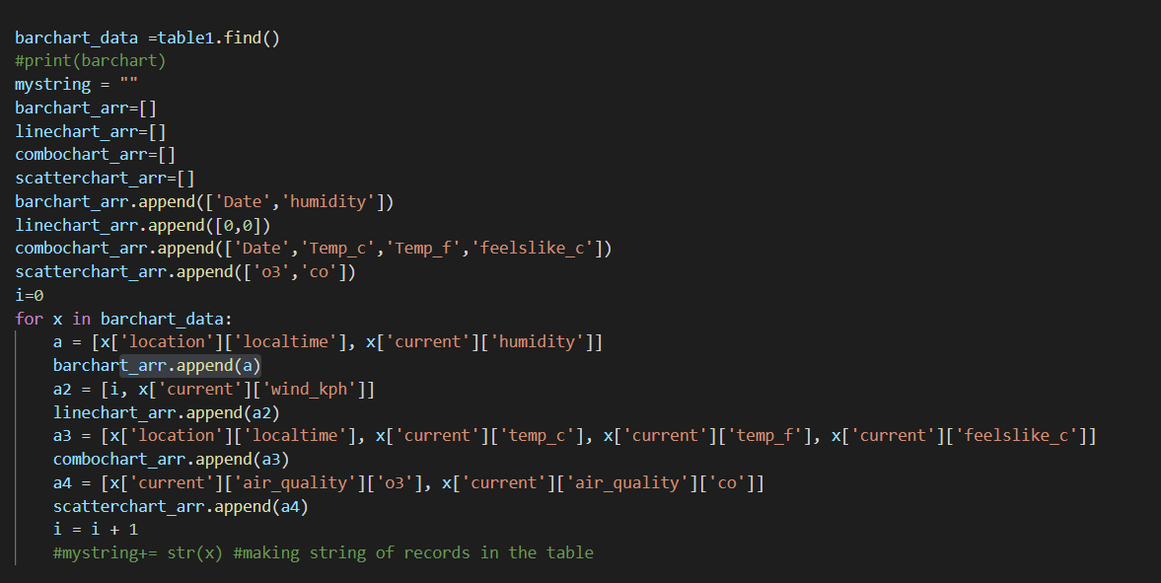
App.py Code

Slide 11
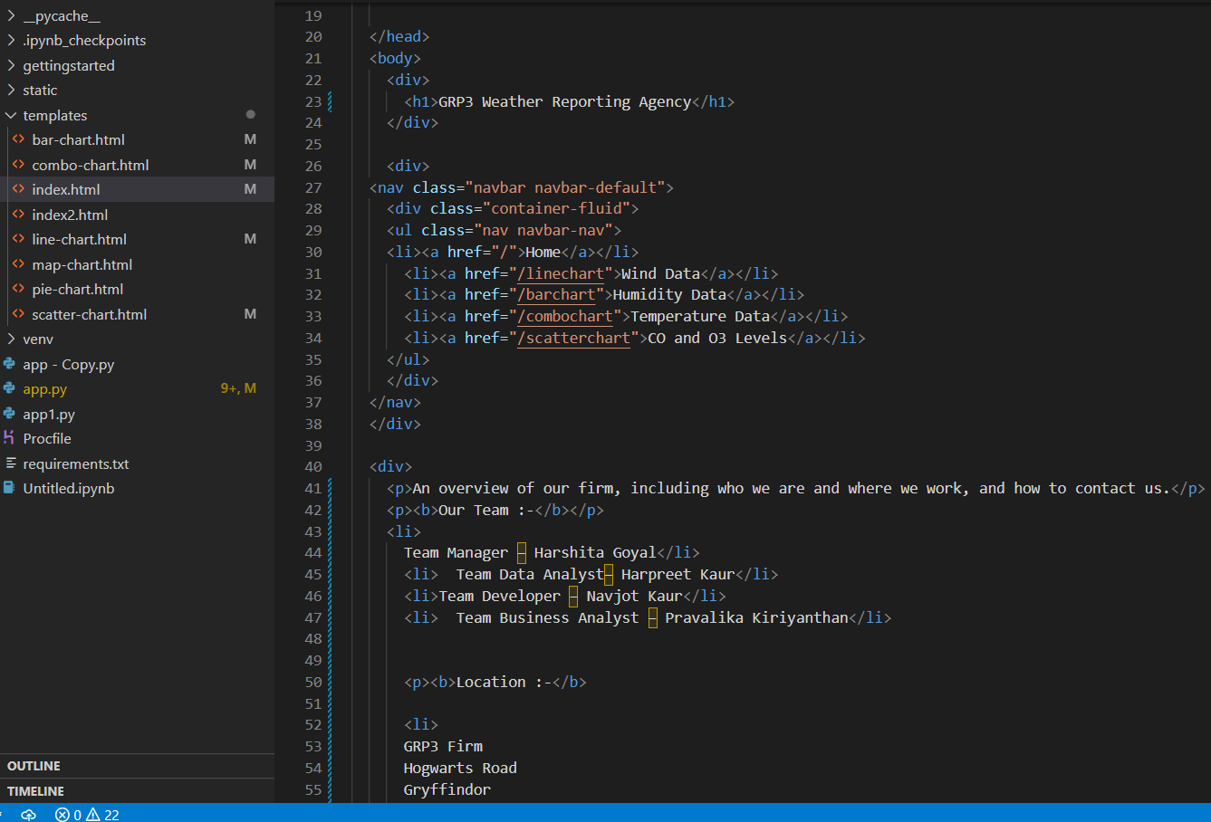
Homepage Code

Slide 12
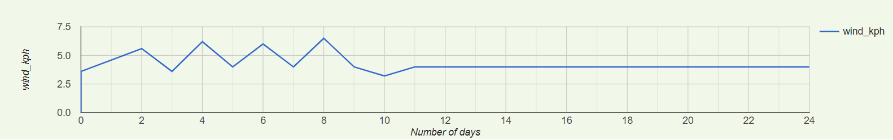
A LINE GRAPH BETWEEN TIME AND WIND
In this graph, we have recorded the wind speed fluctuations over a period of days
The wind is measured in kilometers per hour.
This data is recorded but is averaged out before it is transmitted to the users.
By gathering information such as location, landmasses, time and other variables from various places, we can further develop a model that can predict the weather with high accuracy.

Slide 13
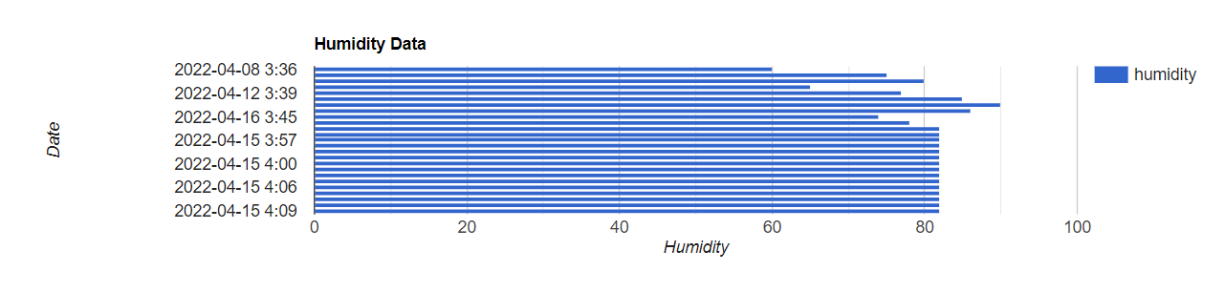
A BAR GRAPH BETWEEN HUMIDITY AND TIME
In this chart, we have recorded the humidity in the air at different times on different days.
The observations were made in the early hours of the evening.
As the temperature starts decreasing, the cold winds cannot carry as much moisture causing raise in the humidity levels.
While this does not impact the general public, certain industries and factories have to be very cautious regarding these humidity levels.

Slide 14
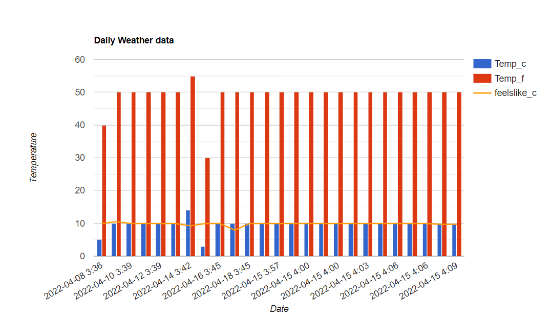
COMBO CHART- TIME AND TEMPERATURE IN A BAR GRAPH AND TIME AND FEELS LIKE TEMPERATURE IN LINE GRAPH
We've combined two graphs in this chart: one is a bar graph of Time and temperature, and the other is a line graph of Time and feels like temperature, which functions as a trendline.
The temperature was taken at different times on different days.
Feels like temperatures is an attempt to comprehend and measure the human response to temperature, which is complicated by several factors.

Slide 15
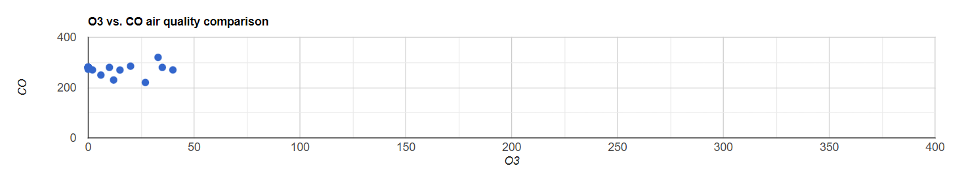
A SCATTER PLOT BETWEEN O3 LEVELS AND CO LEVELS
In this graph, we have recorded tropospheric ozone (O3) and carbon monoxide (CO) levels.
This graph talks about the CO levels at different O3 levels.
Tracking this information would help us in understanding the air quality of the area so we can take preventive measure to control it.

Slide 16

Demonstration Link :https://winddata.herokuapp.com/

Slide 17

Any Questions?

