Slide 1

SYST24444
Mobile Web-Based Application Development
Prepared for: School of Applied Computing
Summer 2017 – Week3

Slide 2
Outline…
DOM traversal methods
jQuery Visibility methods
Show/Hide methods
Event handler methods
Fade/Slide methods
Basic Animation methods

Slide 3
To recap…
Different selectors
Basic selectors (tag-name, id, class)
Hierarchy selectors (position in the DOM)
Different filters
Basic filters (based on the index or subscript of the result-set)
Attribute filters (having a specific attribute, etc.)
Combo filters (child, visibility, content)

Slide 4
DOM Traversal
it is quite possible that we might be interested in identifying and working with elements that are related to a current element.
Here is a list for some of jQuery functions for this purpose:
children(): Retrieves all the child elements of the matched elements, except text nodes
prev(), next(), parent(): used to traverse the family relationships of an element
find(): search within a given element to find elements that match a selector expression
each(): loops over a set of matched elements and calls a function for each one

Slide 5
DOM Traversal example
Open page DOMTraversal.html from Exercises folder located in week3.zip

Slide 6
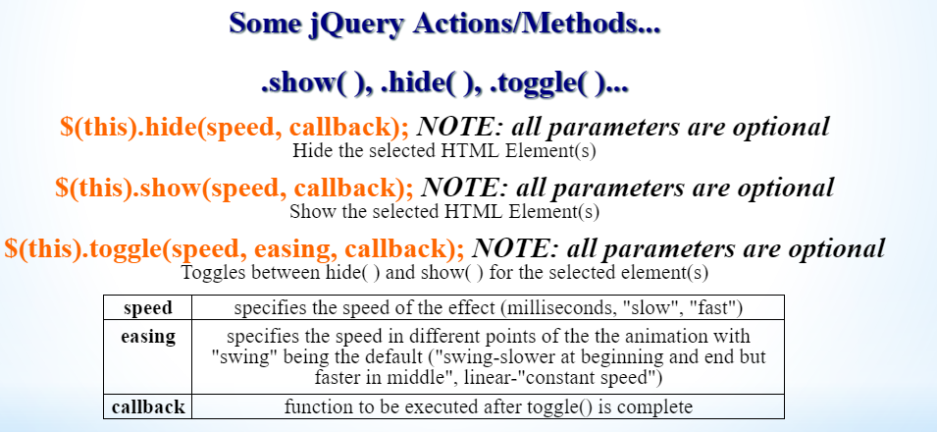

Slide 7
Actions example
Open page ShowHide.html from Exercises folder located in week3.zip

Slide 8
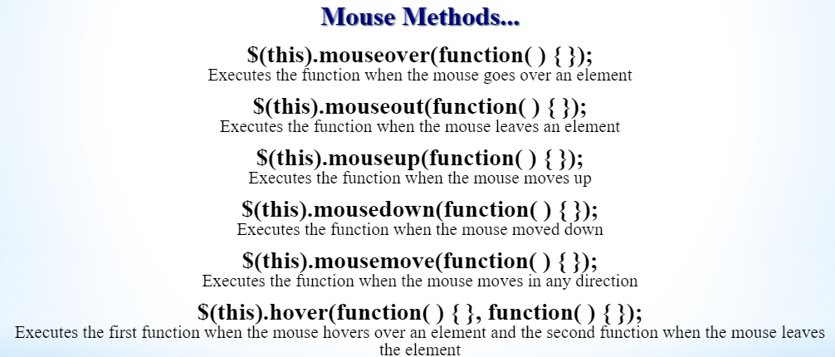

Slide 9
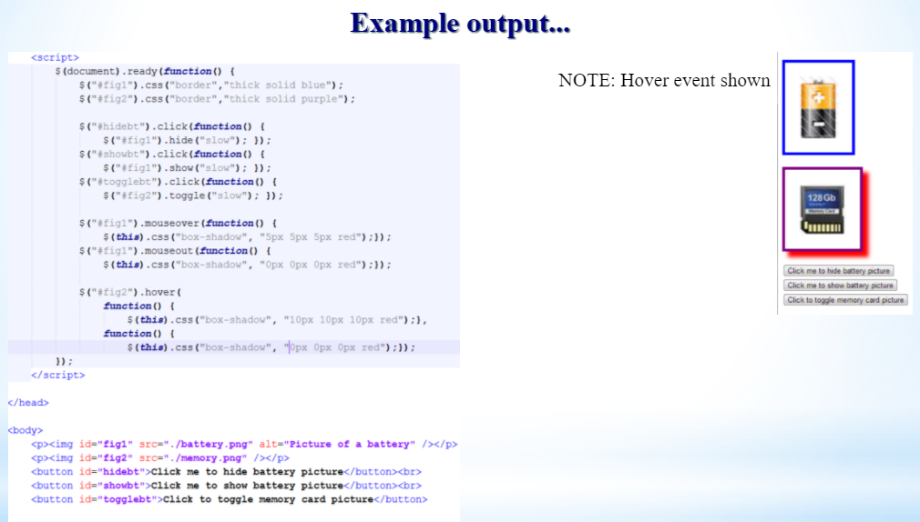

Slide 10
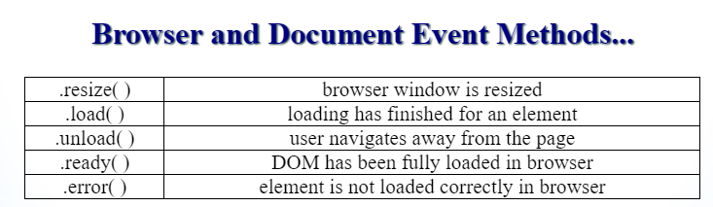

Slide 11
Mouse events example
Open page events.html from Exercises folder located in week3.zip

Slide 12
Fade/slide effects
Open page FadeSlide.html from Exercises folder located in week3.zip

Slide 13
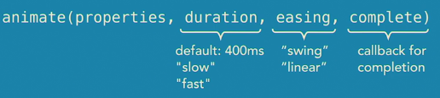
Basic animations

Slide 14
Animation example
Open page Animation.html from Exercises folder located in week3.zip

Slide 15
Class Exercise (self checked ☺)
Open page DOM_climb.html from Exercises folder located in week3.zip

