Slide 1

SYST24444
Mobile Web-Based Application Development
Prepared for: School of Applied Computing
Summer 2017 – Week2

Slide 2
Outline
Introduction to jQuery
DOM
jQuery Selectors and Filters
Exercise1

Slide 3
What’s jQuery
Free Open-source JavaScript Library
Lightweight and contains all the common DOM, event, etc. functions
Simplifies common web development tasks- highly interactive and responsive
AJAX
Contents manipulation
Animations
Smooths over cross-browser development issues
Concise and easy-to-read syntax that reduces verbose code

Slide 4
jQuery at a glance
Uses CSS syntax for common operations (e.g., find and select page contents)
Designed to work on sets of elements
Concise code via statement chaining
Highly extensible with plugins
Distributed as a single script file that has to be referenced in your HTML page

Slide 5
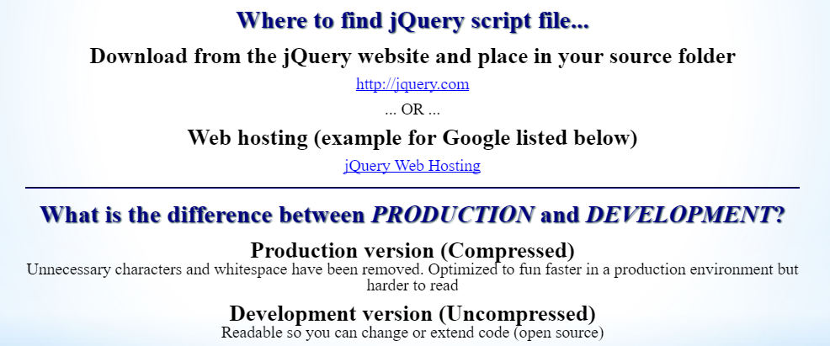

Slide 6
jQuery vs JavaScript
Open compare_js_jquery.html from exercises folder

Slide 7
Welcome to jQuery
First jQuery enabled page!
Open exercises folder -> welcome.html

Slide 8
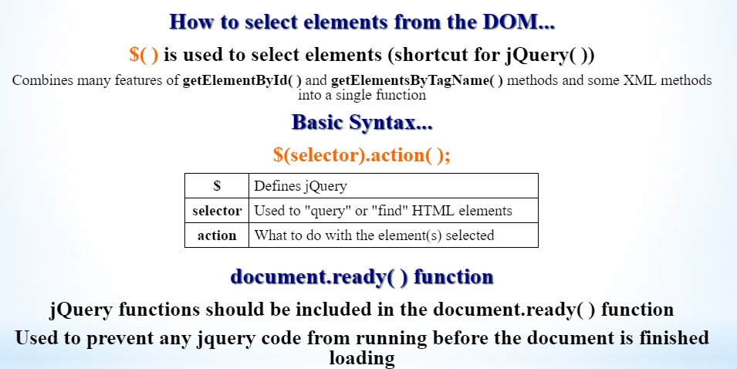
Selectors and filters in jQuery

Slide 9
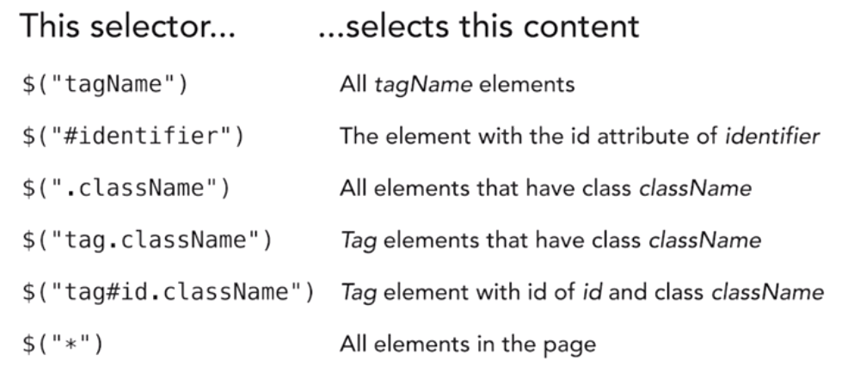
Basic jQuery selectors

Slide 10
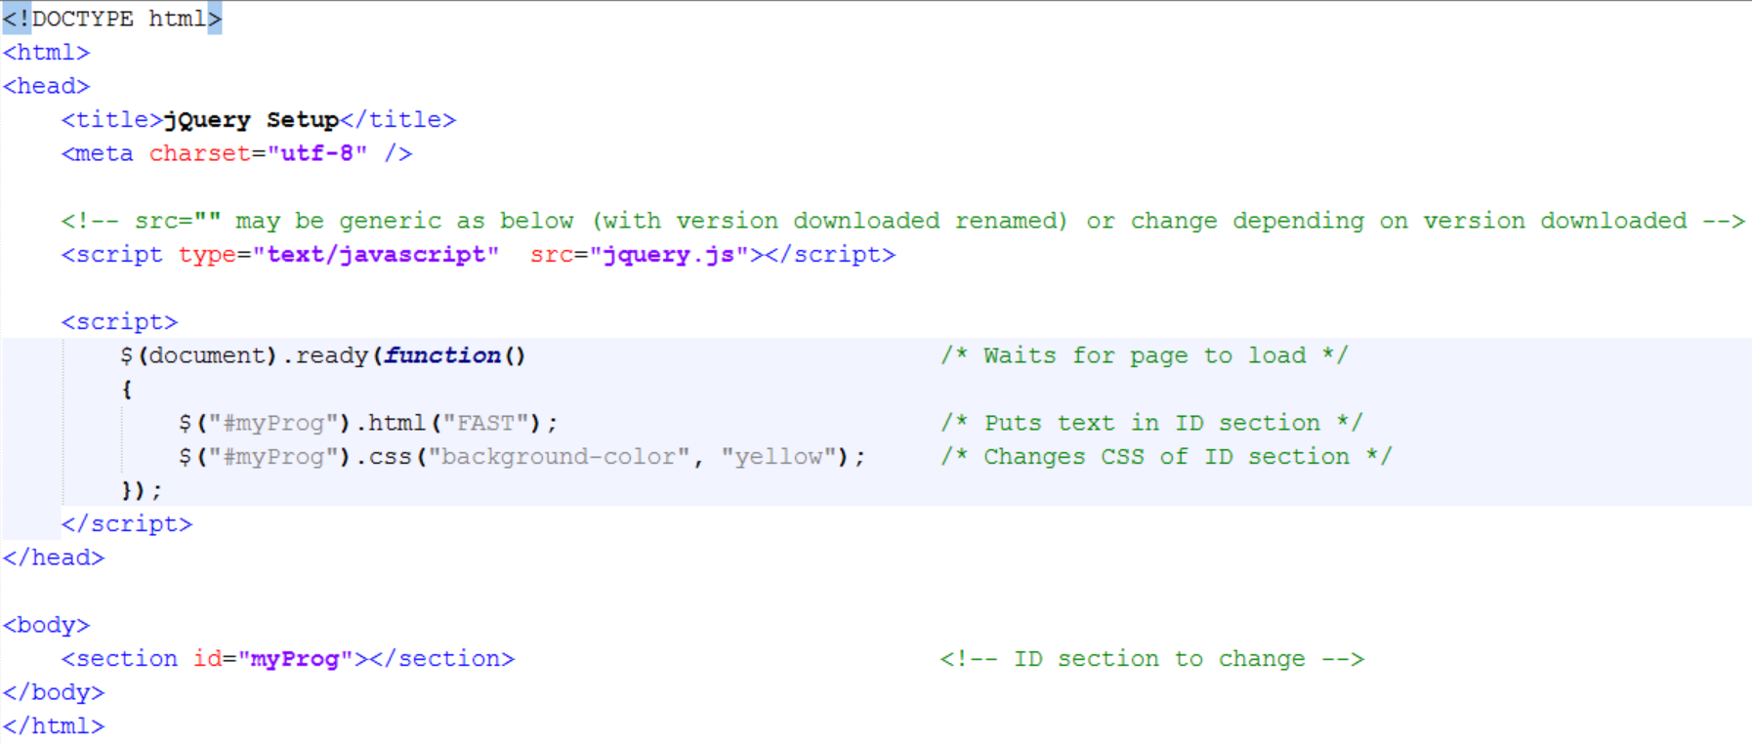
A Simple jQuery Page...

Slide 11
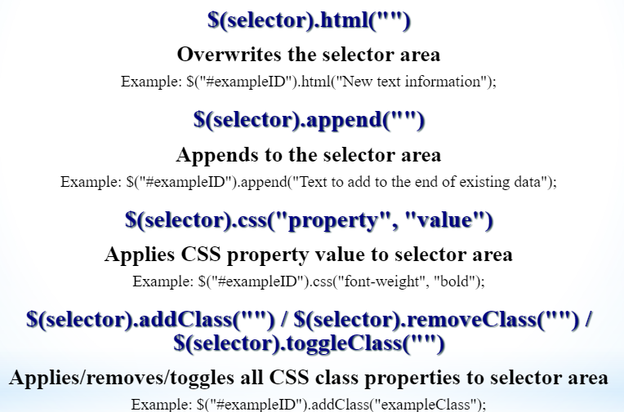

Slide 12
DOM - Document Object Model
Organized structure of objects
Systematic organization makes every object in a document accessible to jQuery
Objects are organized into a document tree
Object collections ... same type of objects are organized into arrays:
Ex. $("img"), $("a"), $("form"), etc.
Load array ... $("img") ... creates an array of <img> elements
Can reference individually by order in array...
$("h1:nth(0)").css("font-size", "24px"); // changes 1st <h1> in document to 24px size
$("h1:first").html("First h1 element"); // also changes 1st <h1> to new text
$("#lastImg").append(($("img:last").attr("src"))); // places the src attribute of the last image into the ID element
DOM Tree Exercise Example

Slide 13
Selectors example
Open BasicSelectors.htm from exercises

Slide 14
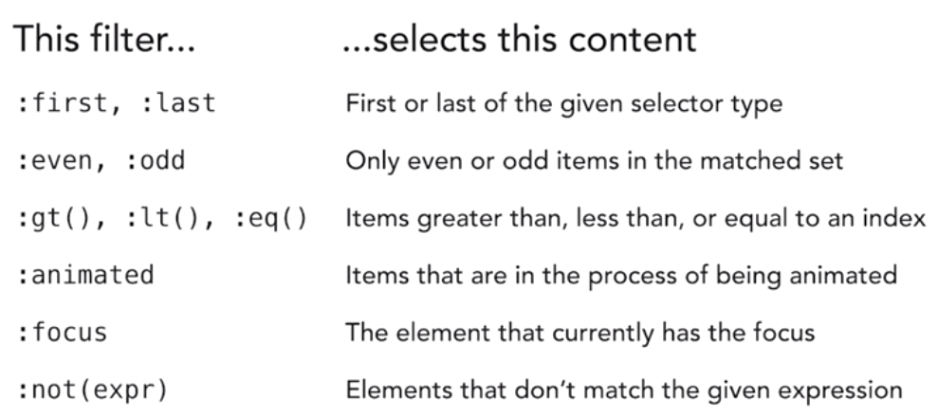
jQuery Basic Filters

Slide 15
Filters example
Open BasicFilters.htm from exercises

Slide 16
jQuery Hierarchy selectors
To select elements based on their position in the document tree, use the Hierarchy Selectors.
The Hierarchy Selectors work by examining the position of target elements relative to other elements:
$("parent > child"): selects "child" elements that are immediate descendants of the "parent“
$("ancestor descendant"): selects "descendant" elements as long as they have an "ancestor" element somewhere above them
$("prev + next"): selects the "next" element if it is immediately preceded by a "prev" element
$("prev ~ siblings"): selects all "siblings" elements that come after a "prev" element

Slide 17
jQuery Hierarchy selectors
Open HiererchySelectors.html from exercises

Slide 18
jQuery Attribute Filters
Attribute filters are used to select elements in the Web page that have attribute values matching a given set of criteria.
Some examples include:
[attr]: element has an attribute named attr
[attr=val]: element has an attribute whose value is "val"
[attr^=val]: element has an attribute whose value starts with "val"

Slide 19
jQuery Attribute Filters
Open AttributeFilters.html from exercises

Slide 20
Child, Visibility, and Content Filters
These selectors are used to retrieve content that matches certain conditions, such as whether they contain certain content, whether they are visible/hidden, or whether they are in a certain position within their parent.
:contains('text'): select elements that contain specific text
:parent: select elements have at least one child node (element or text)
:has(selector): select elements that contain at least one element that matches the selector
:first-child: select elements that are the first child of their parents
:last-of-type: select elements that are the last of their type among siblings
:nth-child(): select elements that are the nth child of their parent

Slide 21
jQuery Attribute Filters
Open ChildVisCont.html from exercises

Slide 22
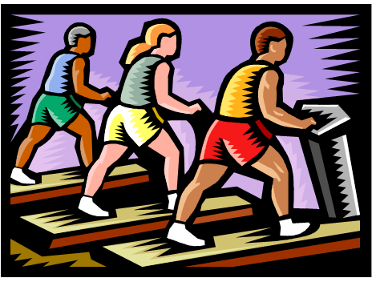
In-Class Exercise ☺

