Slide 1
twit-predict
Andrea Christians & NavkarAN Kumar

Slide 2
Outline
Introduction and value proposition
Political campaigns
New Brunswick Election
Team Structure and Workflow
Sprints 1-4
Predictions
Conclusions

Slide 3
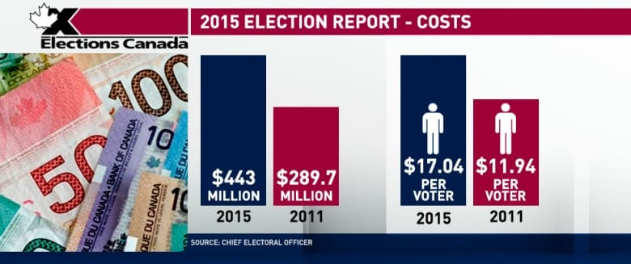
Political Campaigns
Money
Time
Resources
[4]
Notes:
Based on public opinion i.e.
News + Social Media
17,546,697

Slide 4
How do candidates win elections?
PUBLIC OPINION

Slide 5
Twit-Predict
Political predictions for a given party via Sentiment Analysis
Grouped by location
Customized results for each political party

Slide 6
Twit-predict
Benefits for citizens:
Encourage citizens to vote if they are unhappy with the current predictions
Benefits for political candidates:
Gauge public approval via sentiment analysis after events
Gauge public approval on a location basis -> know which areas to target
Results can help redirect the campaign to target these demographics saving time, money and resources

Slide 7
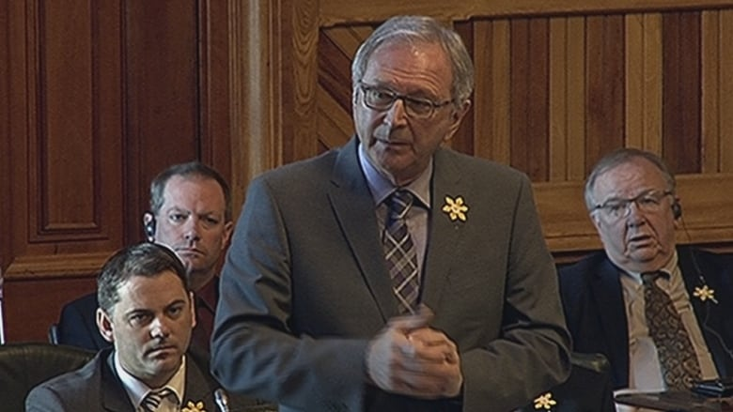
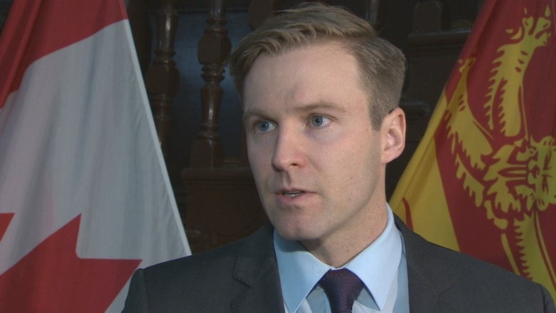
Conservative party - Blaine Higgs [1]
New Brunswick General Election - 24 September 2018
liberal party- Brian gallant [2]
Notes:
Canadian English (liberal party) currently
Sept 24 2018
Liberals in lead but won by very slight vote

Slide 8
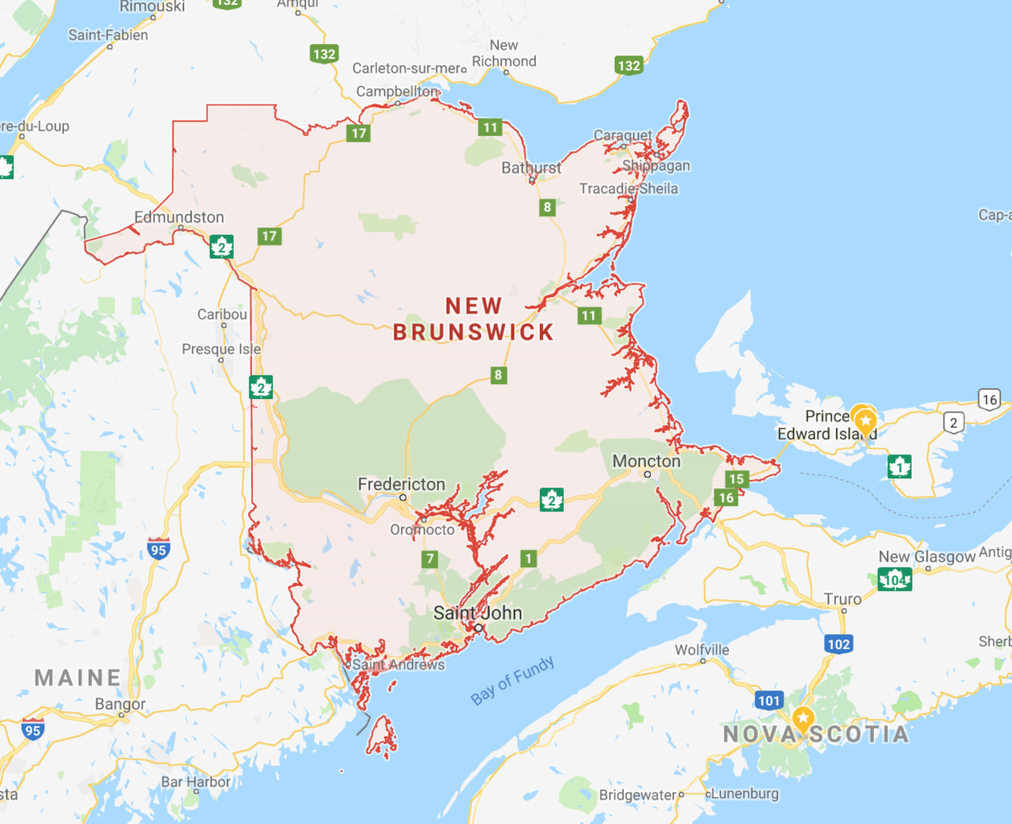
Team Roles and Workflow
Team Roles
Nav: Data Scientist
Andrea: Data Engineer
4 Sprints ~ 1 week each
External data: News API + Twitter
Tools:: Apache Spark, PowerBI, Python
Location: Moncton, Fredericton & Greater New Brunswick
Fredericton
Moncton
Notes:
localy

Slide 9
Workflow
TRAINING DATA
NewsAPI
Global Political Tweets
APACHE SPARK Streamer (Tweets)
Location: Fredericton and Moncton
Blaine Higgs
Conservative Party
Location: Fredericton and Moncton
Brian Gallant
Liberal Party
Importing Tweets
And Sentiment Analysis
Machine
Learning
APACHE SPARK Mlib (70%)
Stream Data
Data
Visualization
PowerBI
TESTING DATA
New Brunswick Political Tweets

Slide 10
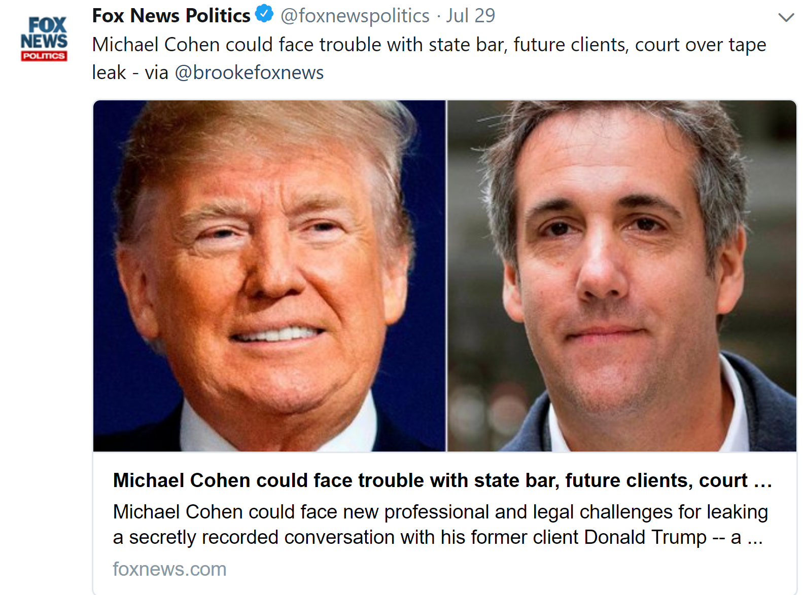
Sprint 1
Import Tweets/Training Data
Training data (global)
NewsAPI
#ABCPolitics
#FoxPolitics
Testing data (New Brunswick)
#nbpoli
Find a political lexicon
[5]

Slide 11
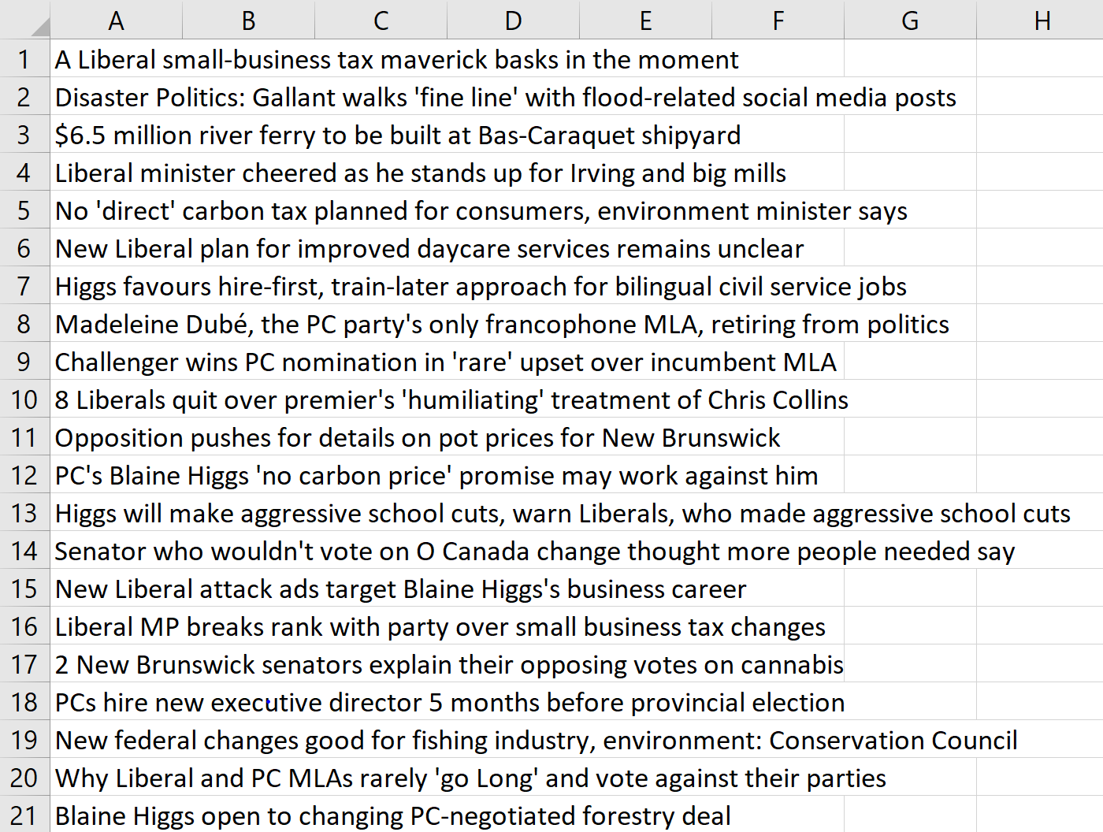
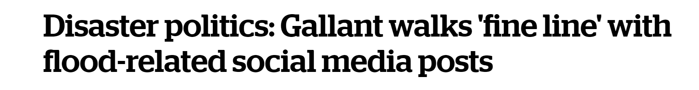
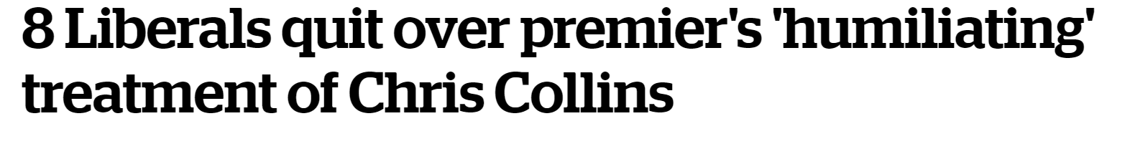
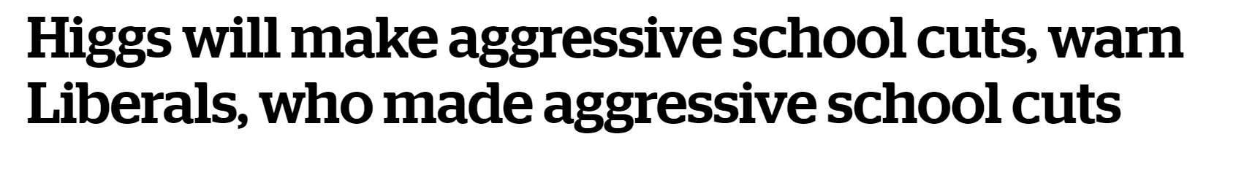
Sprint 1: Tweets and News Headlines
[3]
[1]
[2]

Slide 12
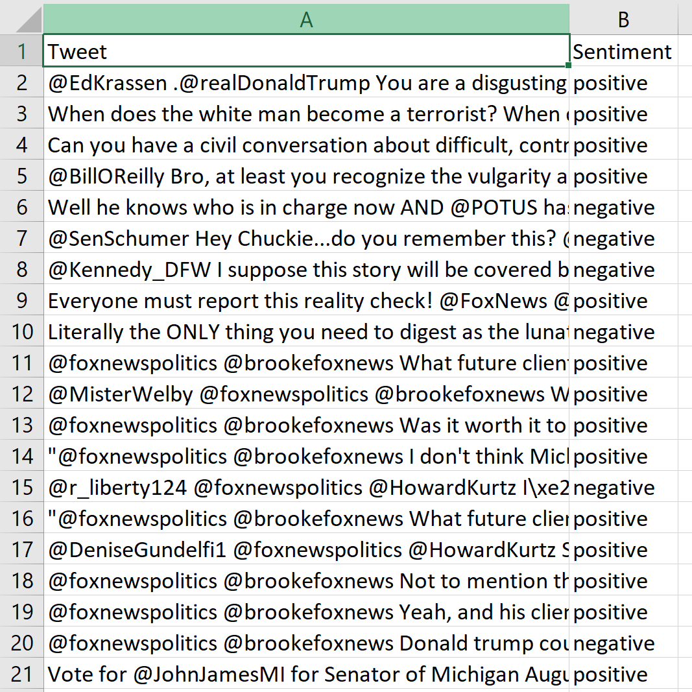
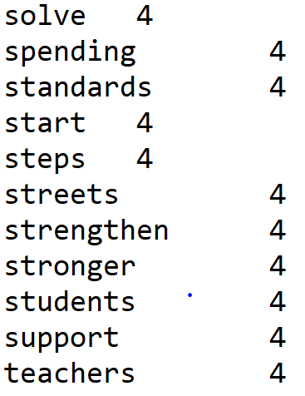
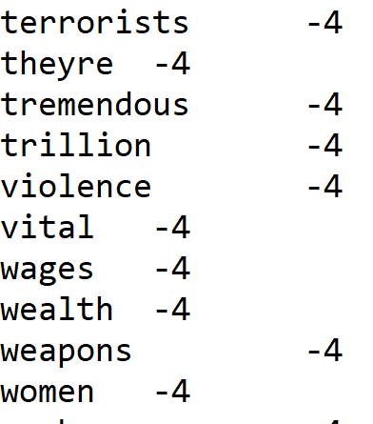
Sprint 2
Cleaning the data
Running sentiment analysis for training and test data
Train the model
Political lexicon
[6]
Sentiment Analysis on Training Data
Political Lexicon
Notes:
Positie and negative

Slide 13
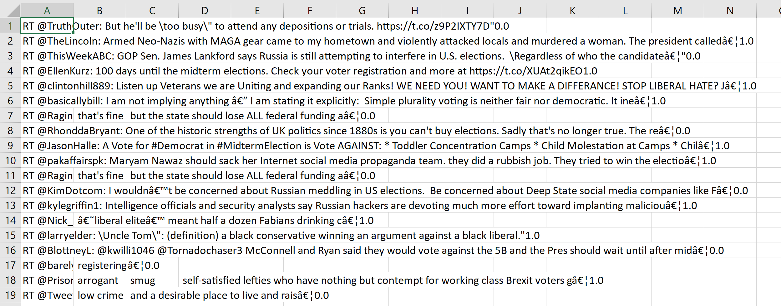
Sprint 3
Run model with tweets
Stream data from location
Import data into PowerBI

Slide 14
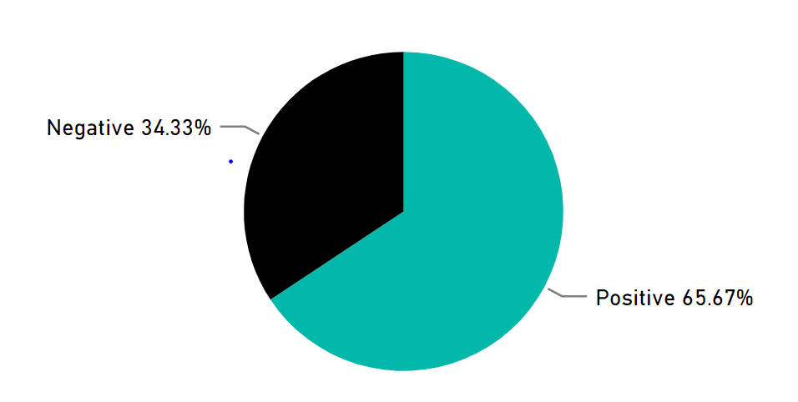
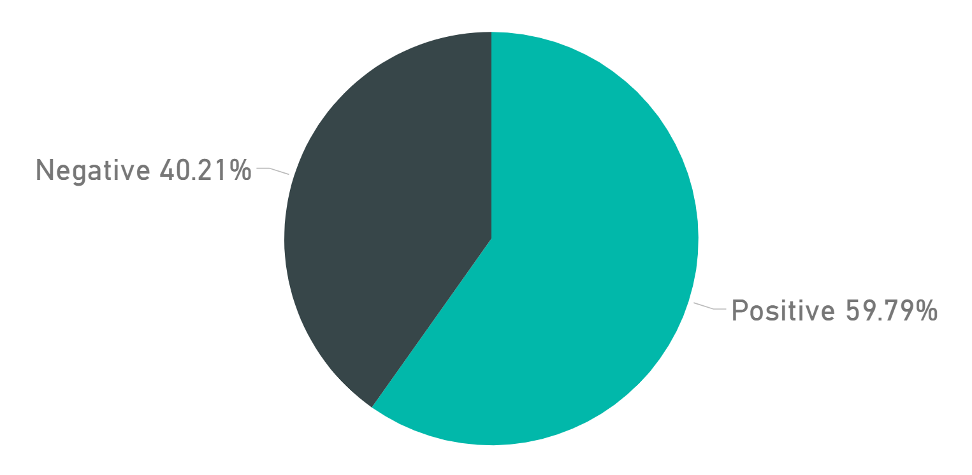
Sprint 4: VISUALIZATION
Current outlook for the Conservative Party in Moncton (Positive versus Negative)
Current outlook for the Liberal Party in Moncton (Positive versus Negative)

Slide 15
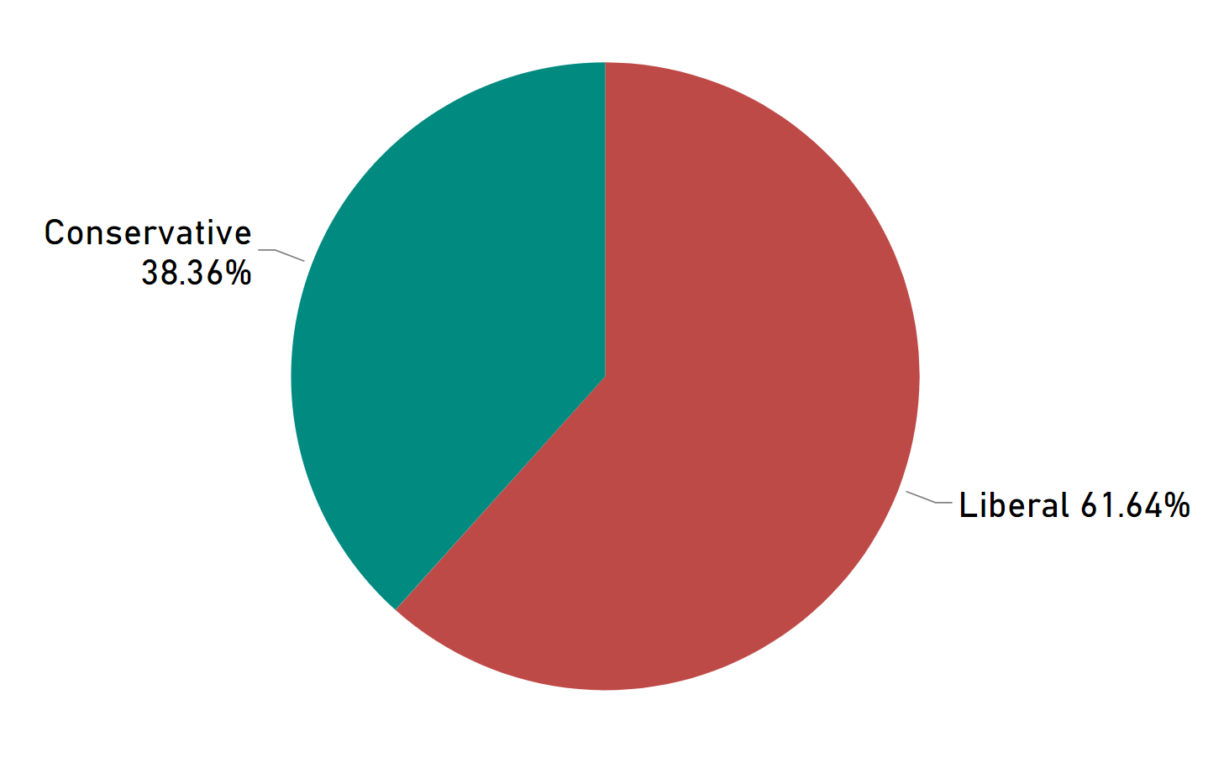
FINAL PREDICTION
(New Brunswick)

Slide 16
Conclusions
Created our own training and test data
Successfully streamed locational data for our prediction and gave outcomes for Moncton, Fredericton and greater New Brunswick
Liberal’s appear to have the majority vote
Notes:
Similarly to polls, The outcomes would encourage people to vote.

Slide 17
References
[1]"8 Liberals quit over premier's 'humiliating' treatment of Chris Collins | CBC News", CBC, 2018. [Online]. Available: https://www.cbc.ca/news/canada/new-brunswick/liberals-moncton-centre-resign-chris-collins-1.4675994. [Accessed: 29- Jul- 2018].
[2]"Higgs will make aggressive school cuts, warn Liberals, who made aggressive school cuts | CBC News", CBC, 2018. [Online]. Available: https://www.cbc.ca/news/canada/new-brunswick/higgs-liberals-education-cuts-school-closures-1.4719096. [Accessed: 29- Jul- 2018].
[3]"Disaster politics: Gallant walks 'fine line' with flood-related social media posts | CBC News", CBC, 2018. [Online]. Available: https://www.cbc.ca/news/canada/new-brunswick/flood-politics-social-media-gallant-higgs-1.4652658. [Accessed: 29- Jul- 2018].
[4]"Marathon 78-day election cost taxpayers $443 million says Elections Canada | CBC News", CBC, 2018. [Online]. Available: https://www.cbc.ca/news/politics/elections-canada-443-million-1.3436139. [Accessed: 31- Jul- 2018].
[5]"Fox News Politics (@foxnewspolitics) on Twitter", Twitter.com, 2018. [Online]. Available: https://twitter.com/foxnewspolitics?ref_src=twsrc%5Egoogle%7Ctwcamp%5Eserp%7Ctwgr%5Eauthor. [Accessed: 31- Jul- 2018].
[6]C. Vail, "MBA 676: Political Sentiment Lexicon", Rstudio-pubs-static.s3.amazonaws.com, 2018. [Online]. Available: https://rstudio-pubs-static.s3.amazonaws.com/338458_3478e1d95ccf49bf90b30abdb4e3bd40.html. [Accessed: 02- Aug- 2018].

Slide 18
Questions!
Congrats to everyone who survived this semester! :D

Slide 19
Errors in the Data and challenges (appended slide if asked about during questions)
Not all tweets were related to the topic that was queried
Limitations in our political lexicon
Limitations of tweets (count)
Spelling and Typos in tweets
Accuracy – 70%
Our challenges:
Time
Data gathering

