Slide 1
Tableau1
File created on: 01-07-2022 15:29:50

Slide 2
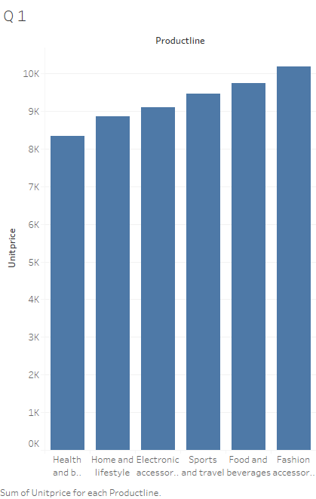

Slide 3
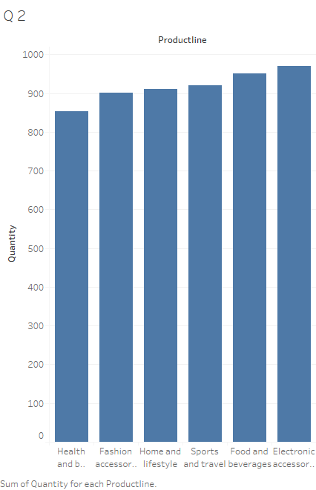

Slide 4


Slide 5


Slide 6


