Slide 1
MLOPS ASSIGNMENT DEMONSTRATION
Cats vs Dogs
MLOps Workflow
Git + DVC
MLflow
FastAPI
Docker + GHCR
GitHub Actions
Prometheus
From versioned code and data to a deployed model prediction
Navneet Kang
Notes:
I built an end-to-end Cats versus Dogs MLOps project. I will demonstrate how a tracked code change moves through testing, container delivery, deployment, prediction, monitoring and post-deployment evaluation.
[Sources]
- https://github.com/Navneet-Kang/cats-dogs-mlops-assignment

Slide 2
CATS VS DOGS MLOPS
One workflow connects every stage of the model lifecycle
1
2
3
4
5
6
Code + data
Prepare + train
Track + test
Build + publish
Deploy + verify
Predict + monitor
Git and DVC
Reproducible stages
MLflow and pytest
Docker and GHCR
Self-hosted runner
API and Prometheus
The assignment outcome is not only a trained model—it is a traceable path from change to live prediction.
Navneet Kang | MLOps assignment
2
Notes:
My workflow starts with versioned code and data. DVC defines preparation and training, MLflow records experiments, pytest protects the change, GitHub Actions builds the image, my Windows runner deploys it, and the live API is monitored and evaluated.
[Sources]
- https://github.com/Navneet-Kang/cats-dogs-mlops-assignment/blob/main/dvc.yaml
- https://github.com/Navneet-Kang/cats-dogs-mlops-assignment/blob/main/.github/workflows/ci-cd.yml

Slide 3
CATS VS DOGS MLOPS
Reproducibility is built into data, experiments and tests
01
02
03
Git + DVC
MLflow
Automated tests
Source code is tracked in Git. Raw image folders are referenced by DVC, while dvc.yaml defines prepare and train stages.
Training parameters, validation history, test metrics, plots and the serialized model are recorded together.
Tests validate preprocessing and the prediction response. CI runs pytest before publishing an image.
Evidence: dvc.yaml, data/raw.dvc
Evidence: src/catsdogs/train.py
Evidence: tests/ and ci-cd.yml
Before final submission: remove the unresolved conflict markers from dvc.lock and confirm dvc status succeeds.
Navneet Kang | MLOps assignment
3
Notes:
The project includes reproducibility controls at three levels: data and pipeline versioning, experiment tracking, and automated tests. I also want to be transparent that the current dvc.lock still requires conflict-marker cleanup before I claim the repository is fully clean.
[Sources]
- https://github.com/Navneet-Kang/cats-dogs-mlops-assignment/blob/main/dvc.yaml
- https://github.com/Navneet-Kang/cats-dogs-mlops-assignment/blob/main/src/catsdogs/train.py
- https://github.com/Navneet-Kang/cats-dogs-mlops-assignment/tree/main/tests

Slide 4
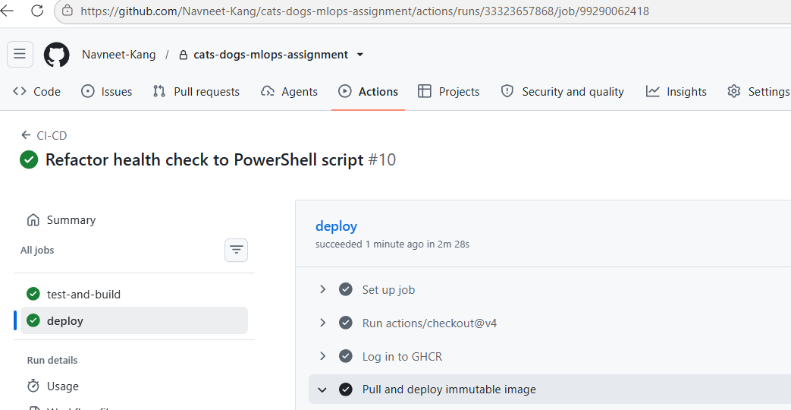
CATS VS DOGS MLOPS
Every main-branch change is tested, packaged and deployed
Automation gates
•
pytest runs with coverage before image publication
•
Docker images are pushed to GHCR as latest and commit SHA
•
Deployment waits for /health and runs a prediction smoke test
Result: test-and-build ✓ deploy ✓
Evidence: green CI/CD job status
Navneet Kang | MLOps assignment
4
Notes:
This is my CI/CD proof. The test-and-build job completed first, then the deploy job succeeded. The workflow installs dependencies, runs tests, publishes the image and deploys only after the earlier job passes.
[Sources]
- https://github.com/Navneet-Kang/cats-dogs-mlops-assignment/actions
- https://github.com/Navneet-Kang/cats-dogs-mlops-assignment/blob/main/.github/workflows/ci-cd.yml
- User-provided screenshot: 6924dfdf-f74a-4417-9d3b-f4be844f1019.png

Slide 5
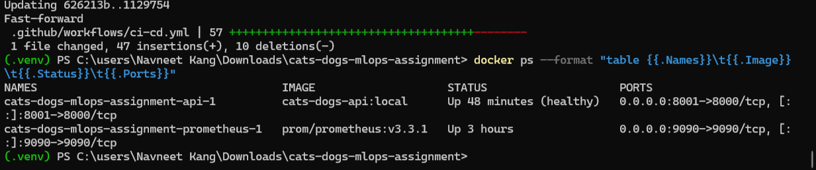
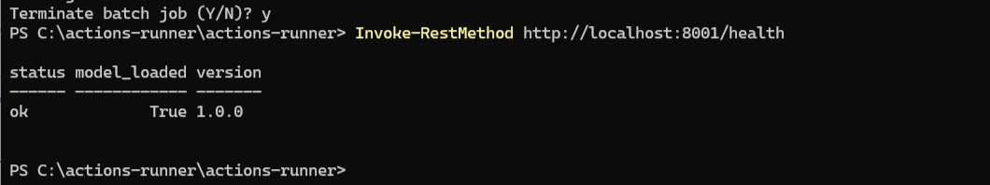
CATS VS DOGS MLOPS
The running API and monitoring stack are healthy
Docker Compose runs two services
API
FastAPI container
host port 8001 → container 8000
health status: healthy
MONITORING
Prometheus container
host port 9090
collects request count and latency
Evidence: healthy containers and /health response
Navneet Kang | MLOps assignment
5
Notes:
The deployed stack contains the FastAPI model service and Prometheus. Docker reports the API as healthy on port 8001, and the health endpoint confirms status OK, model loaded true and application version 1.0.0.
[Sources]
- https://github.com/Navneet-Kang/cats-dogs-mlops-assignment/blob/main/docker-compose.yml
- https://github.com/Navneet-Kang/cats-dogs-mlops-assignment/blob/main/app/main.py
- User-provided screenshots: e5aecb39-7ae1-476a-b4b1-c7f1e7b6c2d0.png and fa8839f1-803f-4b5f-8a41-f80aed1280c9.png

Slide 6
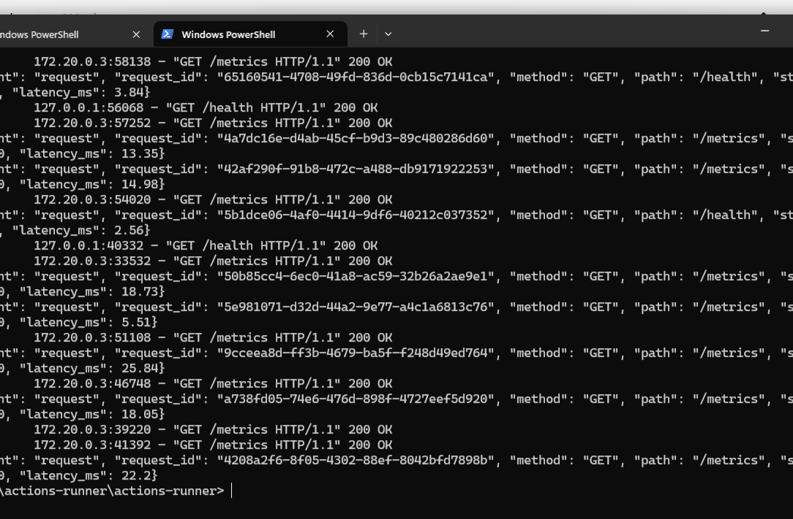
CATS VS DOGS MLOPS
The live service predicts, reports health and exposes metrics
/health
Confirms that the API is ready and the model is loaded
/predict
Validates an image and returns a class with probabilities
/metrics
Exposes prediction volume and latency for Prometheus
Structured JSON logs include request ID, method, path, status and latency—without logging image bytes or filenames.
Evidence: successful /health and /metrics requests
Navneet Kang | MLOps assignment
6
Notes:
The API exposes health, prediction and metrics endpoints. The screenshot shows successful health and metrics requests. My structured logs support traceability while excluding image content and filenames.
[Sources]
- https://github.com/Navneet-Kang/cats-dogs-mlops-assignment/blob/main/app/main.py
- https://github.com/Navneet-Kang/cats-dogs-mlops-assignment/blob/main/prometheus.yml
- User-provided screenshot: dae7a1ed-c17a-4aeb-8d3b-9202c06bd3f7.png

Slide 7
CATS VS DOGS MLOPS
The pipeline works, but the baseline model is not production-ready
50.3%
offline test accuracy
3.87%
offline dog-class F1
Interpretation: accuracy is near chance and the dog class is recognized poorly. The engineering workflow is successful; model quality needs improvement.
Navneet Kang | MLOps assignment
7
Notes:
The baseline result is intentionally reported without exaggeration. Offline test accuracy is 50.3 percent and dog-class F1 is about 3.87 percent. Post-deployment accuracy is 50 percent and dog-class F1 is zero. These results show that the pipeline is measurable and functioning, but the model is not production-ready.
[Sources]
- https://github.com/Navneet-Kang/cats-dogs-mlops-assignment/blob/main/artifacts/test_metrics.json
- https://github.com/Navneet-Kang/cats-dogs-mlops-assignment/pull/1
- User-provided post-deployment evaluation screenshot: a9bdbdec-7446-4851-9f7a-26a9047a8d20.png

Slide 8
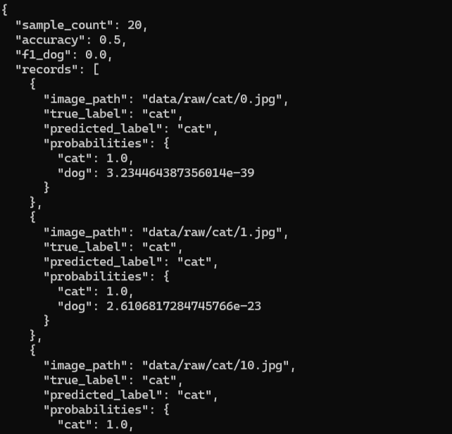
CATS VS DOGS MLOPS
Post-deployment evaluation tests the live prediction path
Unlike offline evaluation, this test sends labeled images through the deployed API—including upload handling, preprocessing, model inference and response parsing.
20
50%
0%
labeled images
accuracy
dog-class F1
Evidence note: the evaluator exists in GitHub, but artifacts/post_deploy_metrics.json should still be committed to main.
Evidence: deployed endpoint evaluation output
Navneet Kang | MLOps assignment
8
Notes:
This is step eight of the assignment. I sent 20 labeled images through the deployed HTTP endpoint. The resulting accuracy was 50 percent and dog-class F1 was zero. This exposes the same model-quality weakness seen offline. The evaluator is committed, but I should also commit the generated JSON artifact before final submission.
[Sources]
- https://github.com/Navneet-Kang/cats-dogs-mlops-assignment/blob/main/scripts/post_deploy_evaluate.py
- https://github.com/Navneet-Kang/cats-dogs-mlops-assignment/pull/1
- User-provided screenshot: a9bdbdec-7446-4851-9f7a-26a9047a8d20.png

Slide 9
CATS VS DOGS MLOPS
The complete workflow is ready to demonstrate
What I will demonstrate
Next improvements
✓
Green CI and deployment jobs
✓
Commit SHA matches the running image tag
•
Replace the linear baseline with transfer learning or a CNN
•
Increase API and failure-path test coverage
✓
Healthy API with the model loaded
•
Use a larger labeled production evaluation set
✓
Live image prediction through /predict
•
Clean dvc.lock and commit the post-deployment JSON artifact
✓
Prometheus metrics and post-deployment evaluation
Conclusion
The MLOps engineering workflow is complete and measurable; model quality is the next priority.
Navneet Kang | MLOps assignment
9
Notes:
I will finish by showing the green workflow, matching commit and image tag, healthy endpoint, live prediction, metrics and post-deployment evaluation. The project successfully demonstrates the engineering lifecycle. My next priority is improving the model and completing the two remaining evidence-cleanup tasks.
[Sources]
- https://github.com/Navneet-Kang/cats-dogs-mlops-assignment
- https://github.com/Navneet-Kang/cats-dogs-mlops-assignment/actions

