Slide 1
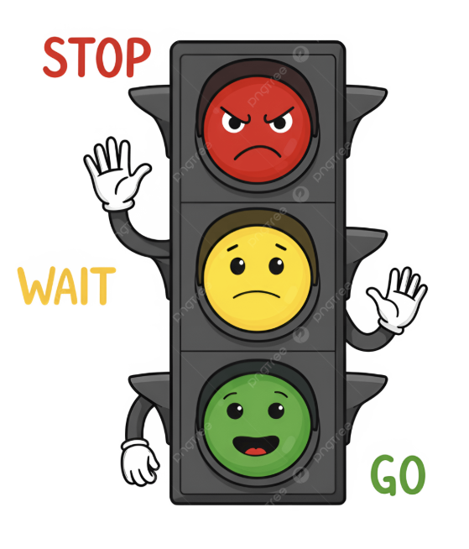

.
Project title: Automated Traffic Management System
Introduction
• Urban intersections often experience congestion due to static traffic signal scheduling. • Vehicles entering the intersection without exit space can cause gridlock (deadlock) situations.
Motivation
• Real-time traffic analysis using computer vision can estimate lane density and intersection occupancy. • An AI based adaptive signal system can dynamically manage traffic flow and prevent deadlocks.
Existing Work
• Fixed-time traffic signals widely used in urban intersections. • Manual traffic control by traffic police during peak congestion. • Engineer-configured signal timers based on historical traffic data.
Gaps
• Fixed timers cannot adapt to real-time traffic density variations. • Manual control is resource intensive and expensive. • Current systems rarely handle intersection deadlocks or signal coordination.
Name: NAVNEET
Roll No: 2301135
Supervisor: Dr Ferdous A Barbhuiya

Slide 2



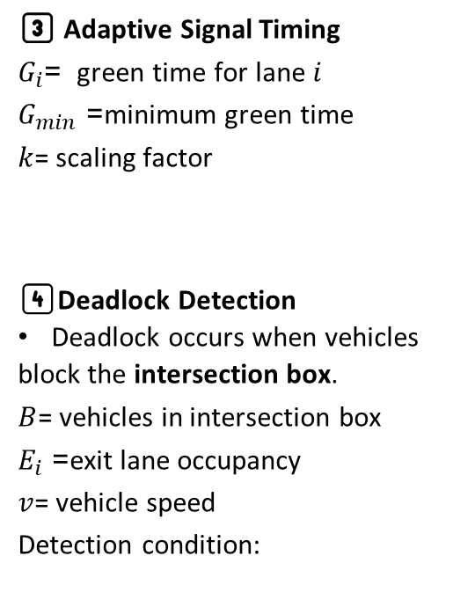
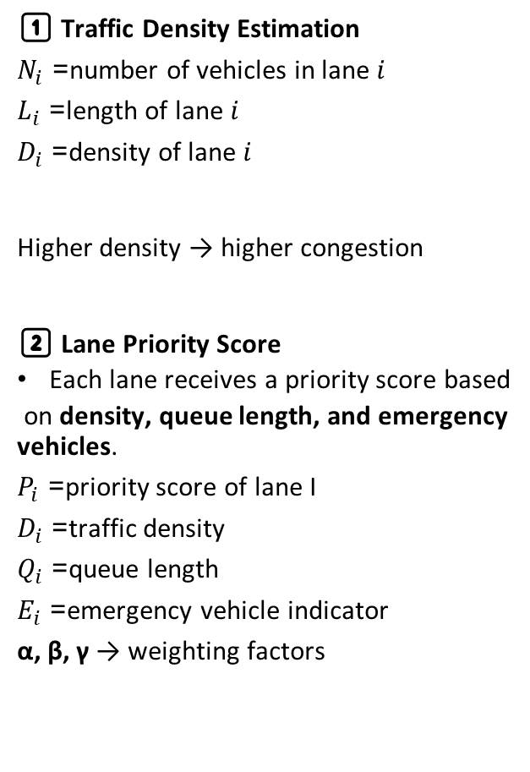
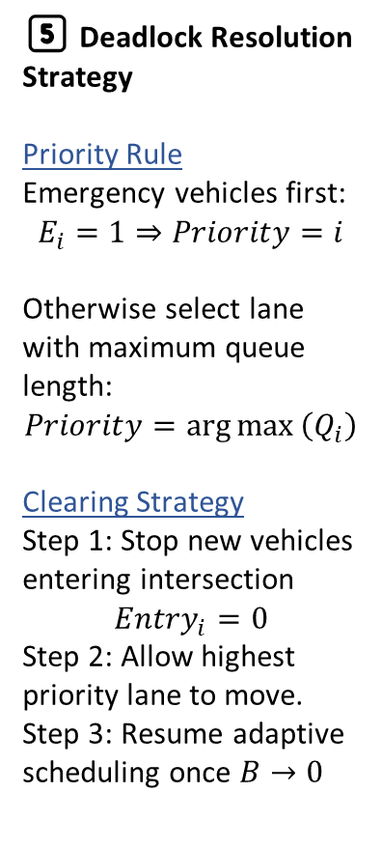
.
Details of proposed work/solutions:
1️⃣ Traffic Density Estimation
$N_{i}$= number of vehicles in lane $i$
$L_{i}$= length of lane $i$
$D_{i}$= density of lane $i$
Higher density → higher congestion
2️⃣ Lane Priority Score
Each lane receives a priority score based
on density, queue length, and emergency vehicles.
$P_{i}$= priority score of lane I
$D_{i}$= traffic density
$Q_{i}$= queue length
$E_{i}$= emergency vehicle indicator
α, β, γ → weighting factors
3️⃣ Adaptive Signal Timing
$G_{i}$= green time for lane $i$
$G_{min}$= minimum green time
$k$= scaling factor
4️⃣Deadlock Detection
Deadlock occurs when vehicles
block the intersection box.
$B$= vehicles in intersection box
$E_{i}$= exit lane occupancy
$v$= vehicle speed
Detection condition:
5️⃣ Deadlock Resolution Strategy
Priority Rule
Emergency vehicles first:
$$E_{i}=1⇒Priority=i$$
Otherwise select lane with maximum queue length:
$$Priority=\arg{max}⁡\left(Q_{i}\right)$$
Clearing Strategy
Step 1: Stop new vehicles entering intersection
$$Entry_{i}=0$$
Step 2: Allow highest priority lane to move.
Step 3: Resume adaptive scheduling once $B→0$
Visual Workflow :
Traffic Cameras
↓
Vehicle Detection (YOLO)
↓
Lane Mapping & Vehicle Count
↓
Traffic Density Calculation
(Dᵢ = Nᵢ / Lᵢ)
↓
Priority Calculation
(Pᵢ = αDᵢ + βQᵢ + γEᵢ)
↓
Deadlock Detection
↓
Signal Decision Engine
↓
Traffic Signal Control
Dᵢ = Nᵢ / Lᵢ
Gi​= $G_{min}$​+ k *Di​
$$Deadlock=\left(B>B_{th}\right)∧\left(E_{i}>E_{th}\right)∧\left(v≈0\right)$$
Pᵢ = αDᵢ + βQᵢ + γEᵢ , $γ≫α,β$
Name: NAVNEET
Roll No: 2301135
Project Title: Automated Traffic Management System

Slide 3
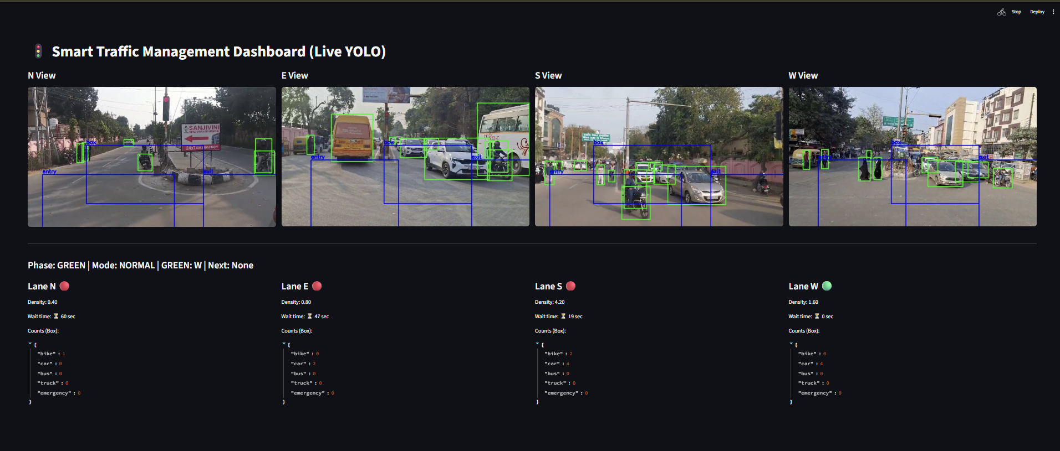
Work Done till date:
Detection Result:
1️⃣ Vehicle Detection Result
YOLO bounding boxes
vehicle labels (car, bike, truck)
2️⃣ Multi-Lane Traffic Monitoring
North / South / East / West vehicle counts
3️⃣ Traffic Dashboard
lane vehicle counts
signal timers
deadlock alerts
Result Achieved:
Prototype Development
• AI-based traffic monitoring system implemented using YOLO object detection • Multi-lane vehicle detection and traffic density estimation
System Capabilities
• Real-time vehicle detection and classification • Lane density calculation and priority scoring
Name: NAVNEET
Roll No: 2301135
Project Title: Automated Traffic Management System

