Slide 1




Animated picture effects for PowerPoint slides
Reproduction instructions
1
Printing instructions
2
Removing instructions
3
For your reference, the steps required to reproduce each of these slides have been included in the Slide Notes.
To print the reproduction instructions in this file:
Select the slide that you want to reproduce.
Place your cursor in the Slide Notes.
Press CTRL + A, and then Copy the text.
Open a new document in Microsoft Word.
Then Paste the text into the Word document.
Print the Word document.
If you notice delays in slide effects or a decrease in performance, you may want to remove the reproduction instructions in the Slide Notes. To remove the instructions from a particular slide:
Place your cursor in the Slide Notes.
Press CTRL + A, and then press DELETE.
Notes:
For reproduction steps for this slide, refer to the PowerPoint template titled “Combined picture and text effects for PowerPoint slides” (ANI_TEXT.potx), slide number 8.

Slide 2

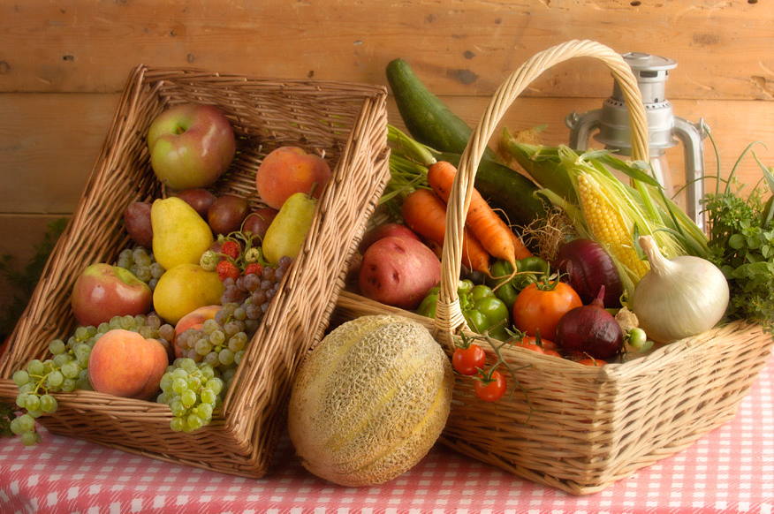
Notes:
Custom animation effects: Grayscale picture fades to full color
(Basic)
To reproduce the grayscale picture effects on this slide, do the following:
On the Home tab, in the Slides group, click Layout, and then click Blank.
On the Insert tab, in the Illustrations group, click Picture. In the Insert Picture dialog box, select a color picture and then click Insert.
On the slide, select the picture. Under Picture Tools, on the Format tab, in the bottom right corner of the Size group, click the Size and Position dialog box launcher. In the Size and Position dialog box, on the Size tab, resize or crop the picture as needed so that under Size and rotate, the Height box is set to 4.15” and the Width box is set to 6.25”. Resize the picture under Size and rotate by entering values into the Height and Width boxes. Crop the picture under Crop from by entering values into the Left, Right, Top, and Bottom boxes.
Under Picture Tools, on the Format tab, in the Adjust group, click Recolor, and then under Color Modes click Grayscale (first option from the left).
Right-click the grayscale picture, and then click Format Picture. In the Format Picture dialog box, in the left pane, click Shadow. In the Shadow pane, click the button next to Presets, and then under Outer click Offset Diagonal Top Right (third row, first option on the left).
On the Home tab, in the Drawing group, click Arrange, point to Align, and then do the following:
Click Align to Slide.
Click Align Middle.
Click Align Center.
To reproduce the full-color picture effects on this slide, do the following:
Select the grayscale picture. On the Home tab, in the Clipboard group, click the arrow under Paste, and then click Duplicate.
Select the duplicate picture. Under Picture Tools, on the Format tab, in the Adjust group, click Recolor, and then under No Recolor click No Recolor.
On the Home tab, in the Drawing group, click Arrange, point to Align, and then do the following:
Click Align to Slide.
Click Align Middle.
Click Align Center.
To reproduce the animation effects on this slide, do the following:
On the Animations tab, in the Animations group, click Custom Animation.
On the slide, select the full-color picture, and then do the following in the Custom Animation task pane:
Click Add Effect, point to Entrance, and then click More Effects. In the Add Entrance Effect dialog box, under Subtle, click Fade, and then click OK.
Under Modify: Fade, in the Start list, select With Previous.
Under Modify: Fade, in the Speed list, select Slow.
Click Add Effect, point to Entrance, and then click More Effects. In the Add Entrance Effect dialog box, under Subtle, click Expand, and then click OK.
Under Modify: Expand, in the Start list, select With Previous.
Under Modify: Expand, in the Speed list, select Fast.
To reproduce the background effects on this slide, do the following:
On the Design tab, in the Background group, click Background Styles, and then click Style 8 (second row, fourth option from the left). (Note: If this action is taken in a PowerPoint presentation containing more than one slide, the background style will be applied to all of the slides.)

