Slide 1
Evolutionary algorithms

Slide 2
Introduction, motivations

Slide 3
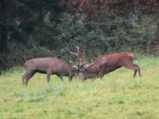
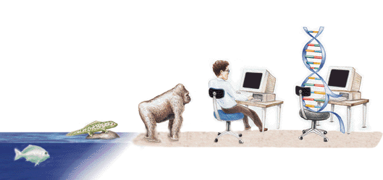
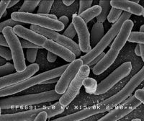
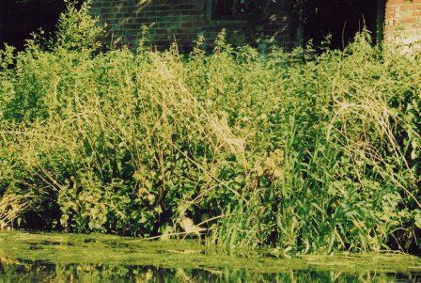
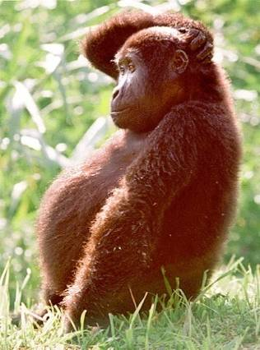
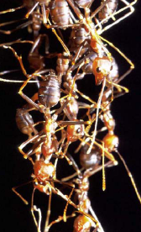
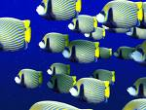
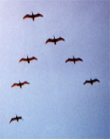

Elements of intelligence in biological systems
Competition
Evolution
Reproduction
Learning
Swarming
Communication

Slide 4
Learning, evolution, adaptation
Learning:
Changes will be made after the evaluations
Learning is the purpose of change
Evolution:
Evaluations happen after the changes
Evolution is the result of change
Adaptation:
Changes occur after evaluations or as a result of adaptation to environmental conditions

Slide 5
General optimization algorithms
Deterministic
Calculus based
Hill climbing
…
Stochastic
Random search
Simulated annealing
…
Evolutionary algorithms: Stochastic search methods, computationally simulate the natural evolutionary process using the idea of survival of the fittest

Slide 6
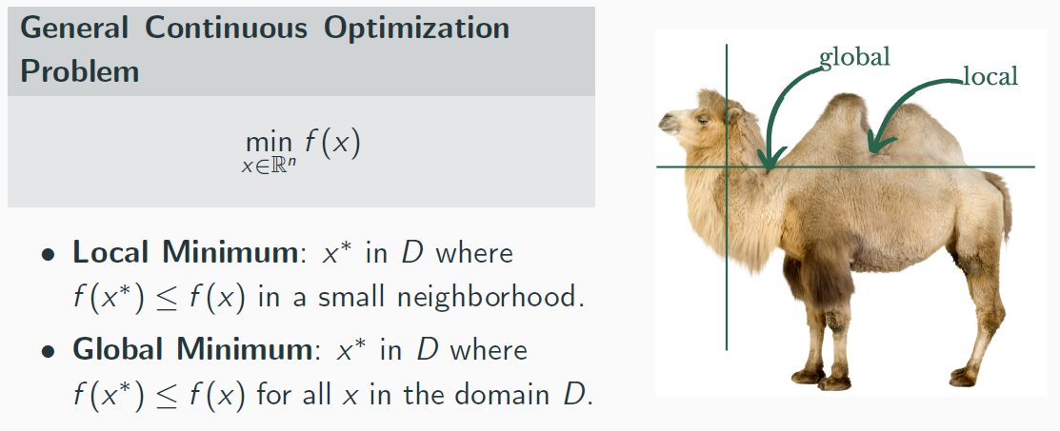
Continuous optimization problem

Slide 7
Evolutionary algorithms
Their basic principle is the search on the population of solutions guided by laws known from biology
The individuals in the population are the solutions of the given problem
The population is evolving, we obtain better and better individuals

Slide 8
Evolutionary computation - history
The idea of using simulated evolution to solve engineering and design problems have been around since the 1950’s
However, it wasn’t until the early 1960’s that we began to see three influential forms of EA emerge:
Evolutionary programming (Lawrence Fogel, 1962)
Genetic algorithms (Holland, 1975)
Evolution strategies (Rechenberg, 1965 & Schwefel, 1968)
The designers of each of the EA techniques saw that their particular problems could be solved via simulated evolution
Fogel was concerned with solving prediction problems
Rechenberg & Schwefel were concerned with solving parameter optimization problems
Holland was concerned with developing robust adaptive systems

Slide 9
Terminology
Gene: functional entity that encodes a specific feature of the individual (e.g. hair color)
Allele: value of gene (e.g. blonde)
Genotype: the specific combination of alleles carried by an individual
Phenotype: the physical makeup of an organism
Locus: position of the gene within the chromosome
Individual: chromosome, represents a candidate solution for the problem
Population: collection of individuals currently alive

Slide 10
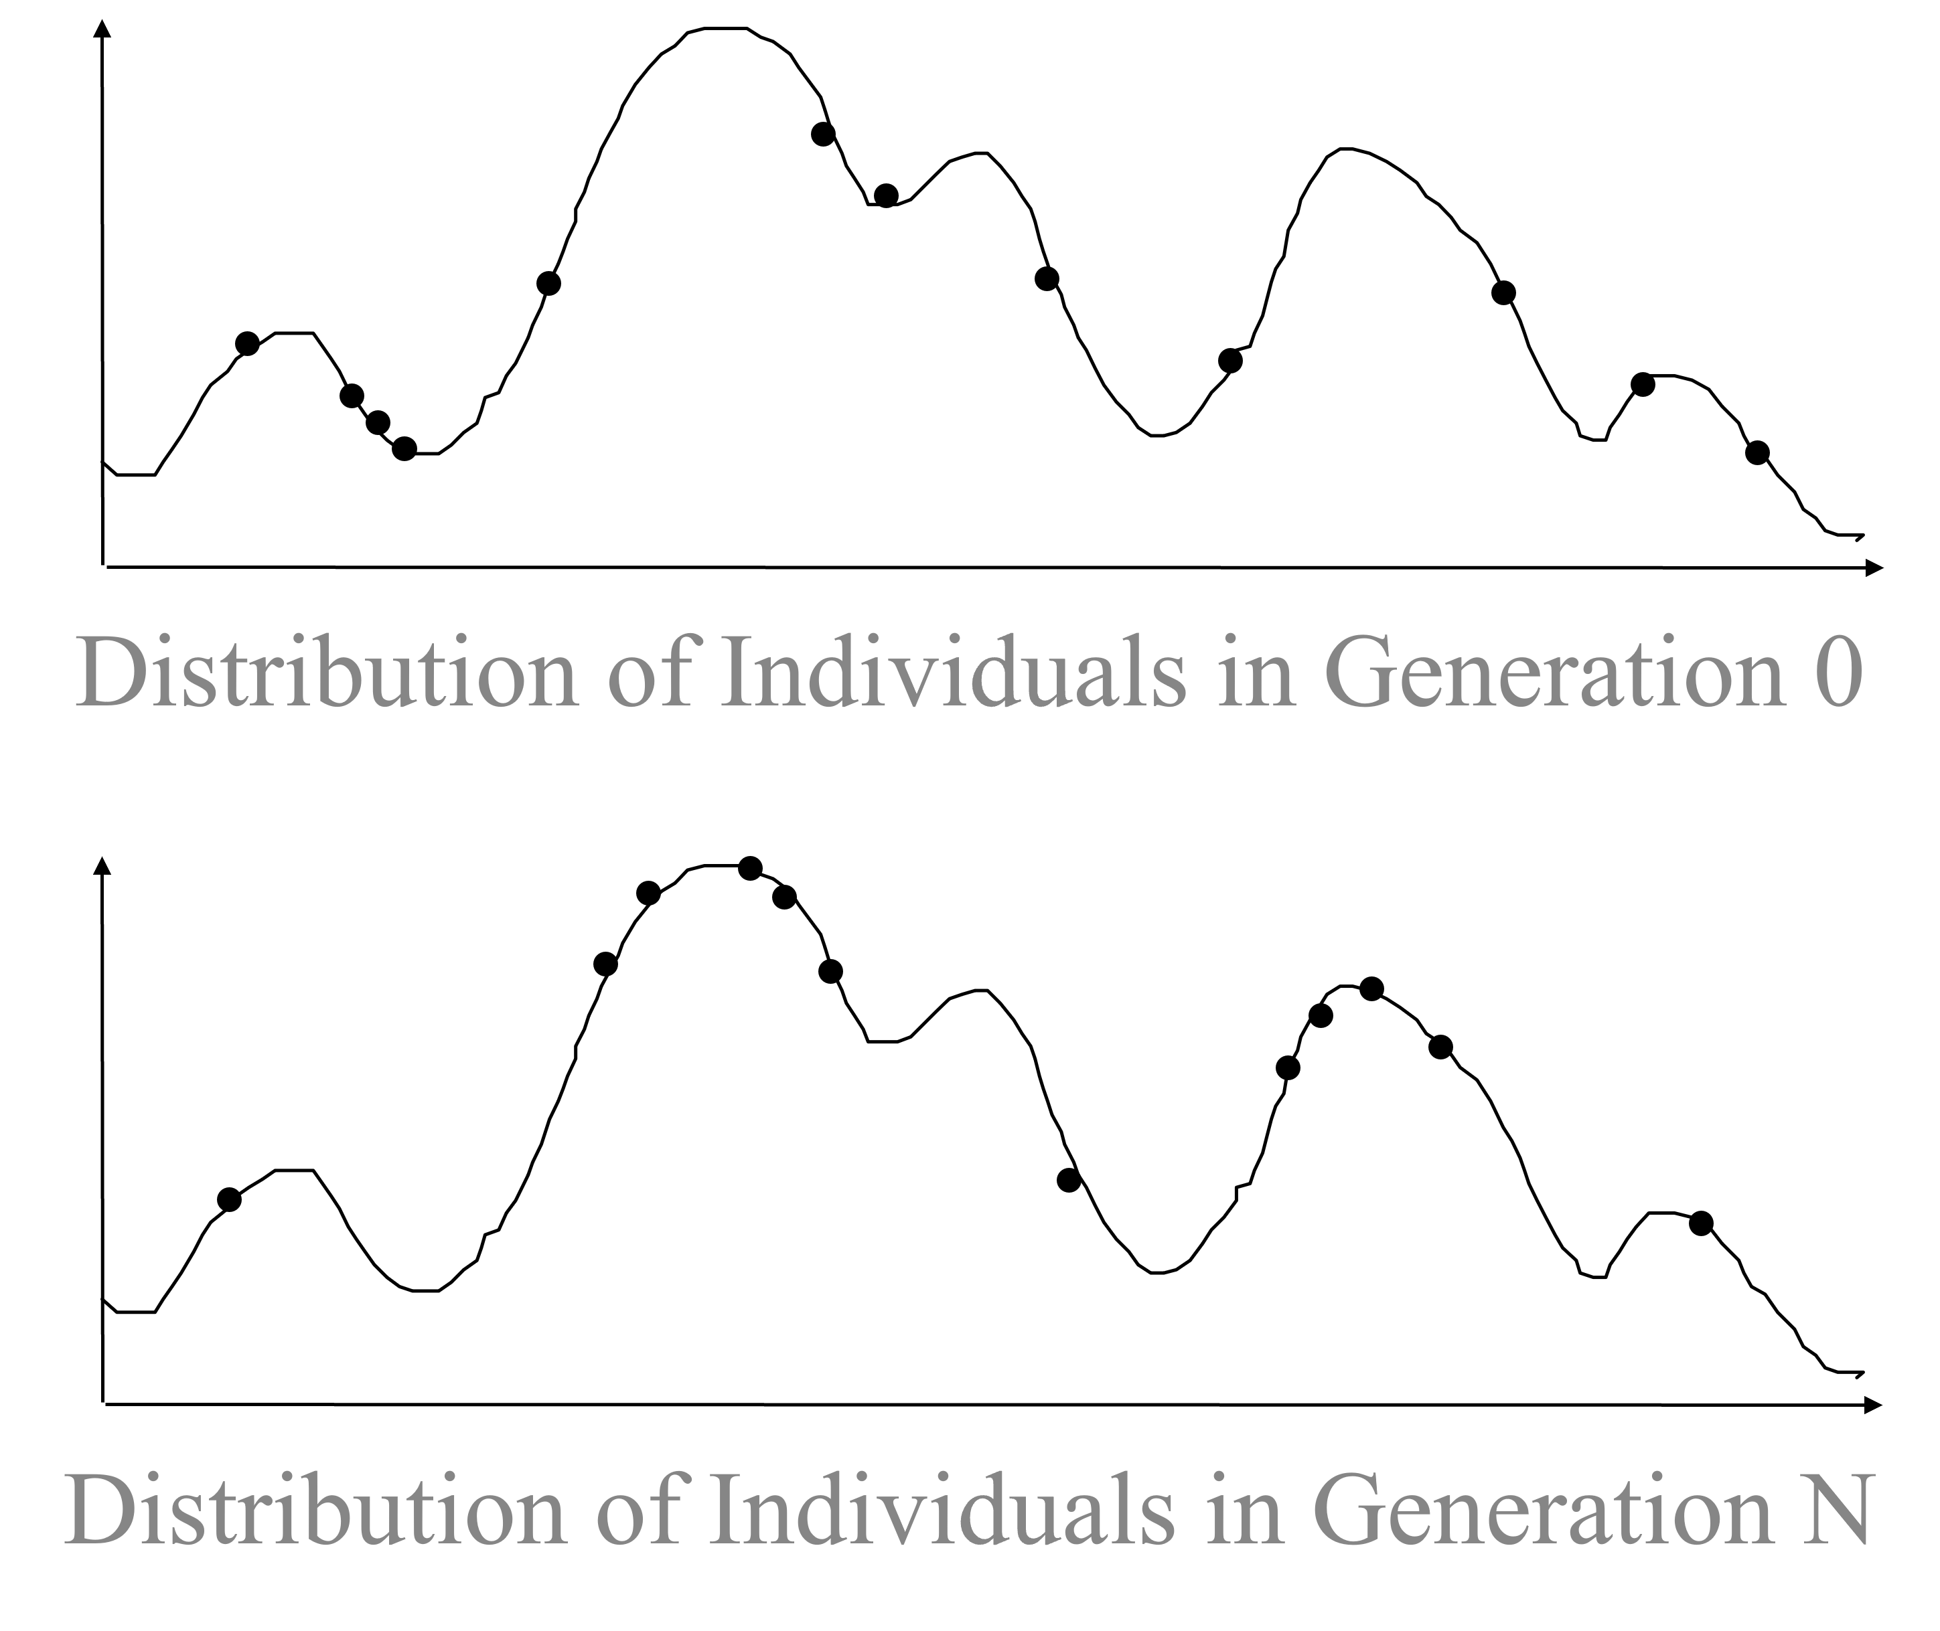
Evolution of the population

Slide 11
Genetic algorithms

Slide 12
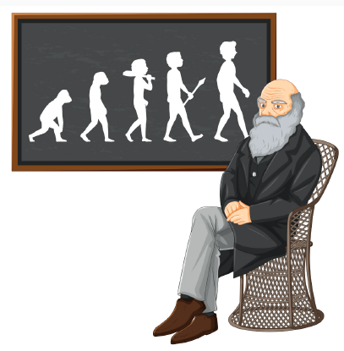
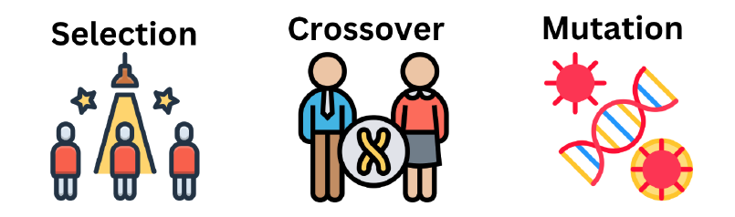
Genetic algorithm
Population-based optimization method
Inspired by Darwinian theory of evolution
Stochastic in nature
Utilizes 3 bio-inspired operators

Slide 13
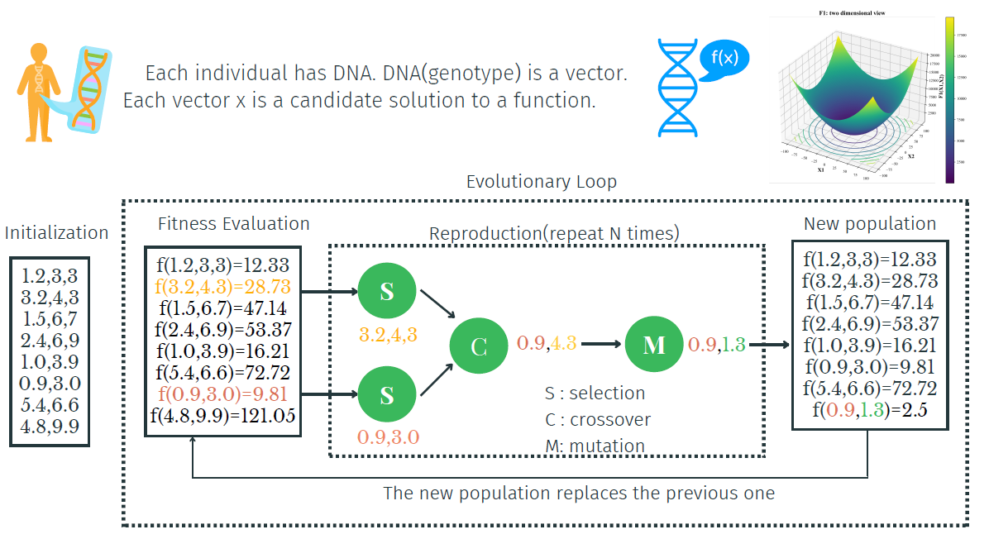
Genetic algorithms

Slide 14
The individual
The individual is a solution candidate to the problem
A possible solution to the problem is encoded into the individual in some form
e.g. binary, or real
Fitness value: the individuals are evaluated according to some criterion how good solution they can provide to the given problem
Better individuals have a higher fitness value, thus they have a higher chance to survive

Slide 15
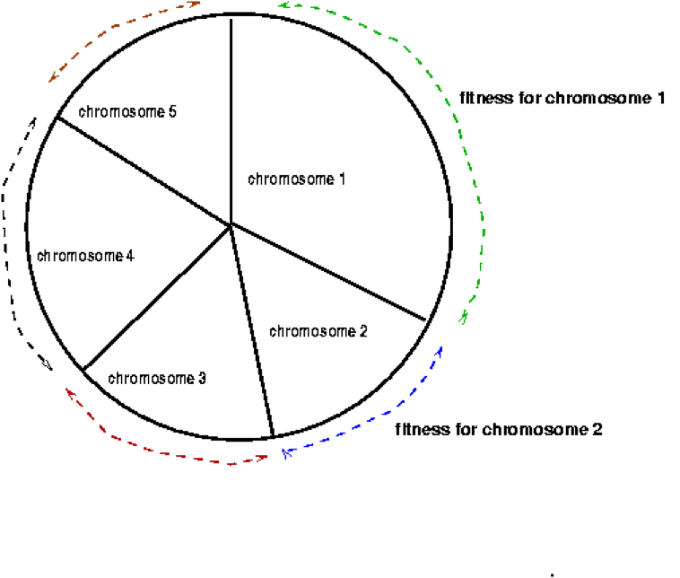
Selection methods
There are many ways to select chromosomes to survive to the next generation
Roulette wheel selection: the better the chromosome, the more chance for selection it possesses; imagine a roulette wheel where every chromosome is represented in proportion to its fitness function
Then a ‘roulette’ ball is thrown and selects chromosomes – chromosomes with larger fitness will be selected with a higher probability

Slide 16
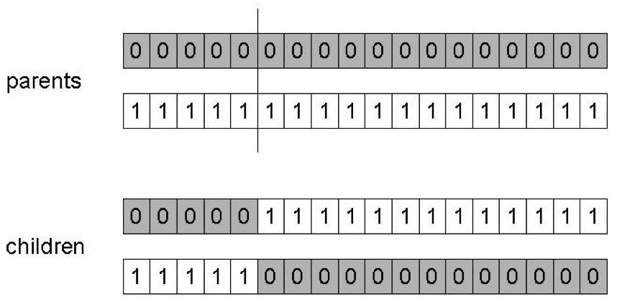
Crossover
Choose a random point on the two parents
Split parents at this crossover point
Create children by exchanging tails

Slide 17
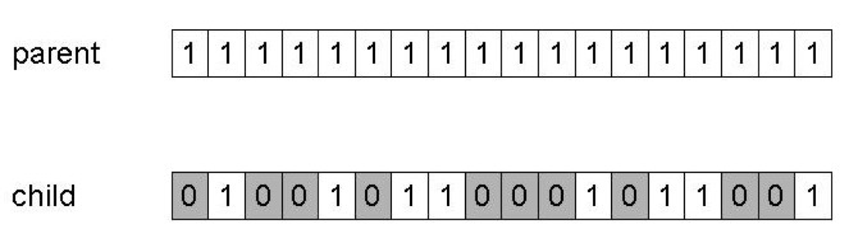
Mutation
Alter each gene independently with a probability p_{m} (mutation rate)

Slide 18
An example (Goldberg)
Simple problem: max x² over {0,1,…,31}
Genetic algorithm approach:
Representation: binary code, e.g. 01101 13
Population size: 4
Crossover, mutation
Roulette wheel selection
Random initialization

Slide 19
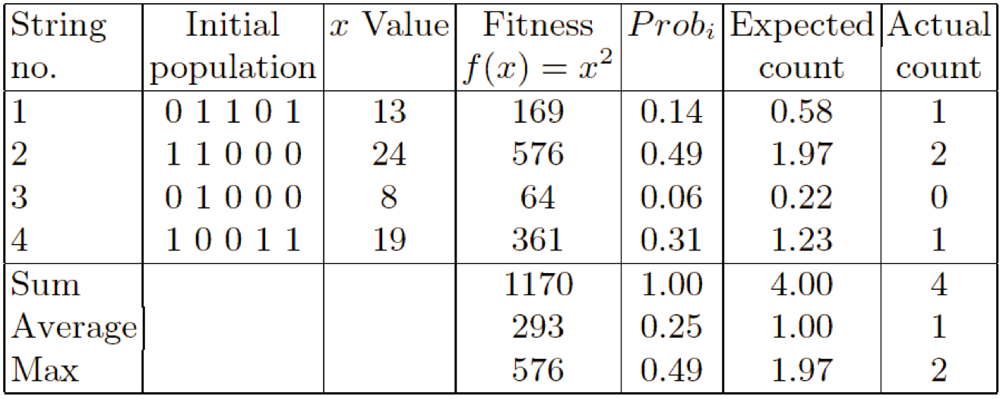
An example: selection

Slide 20
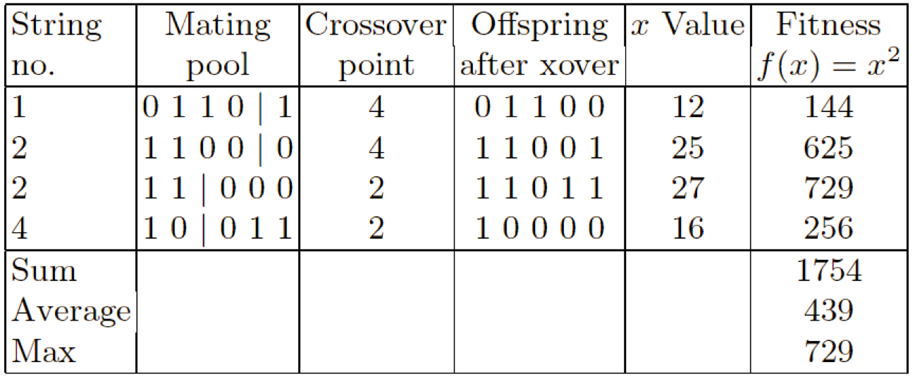
An example: crossover

Slide 21
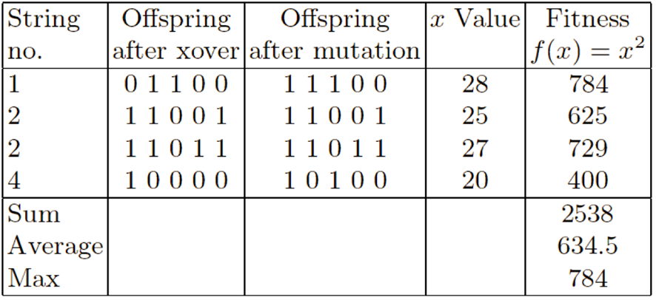
An example: mutation

Slide 22
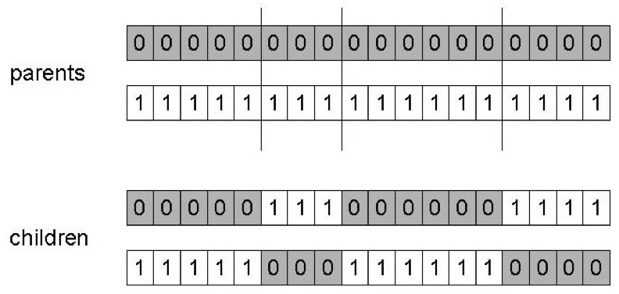
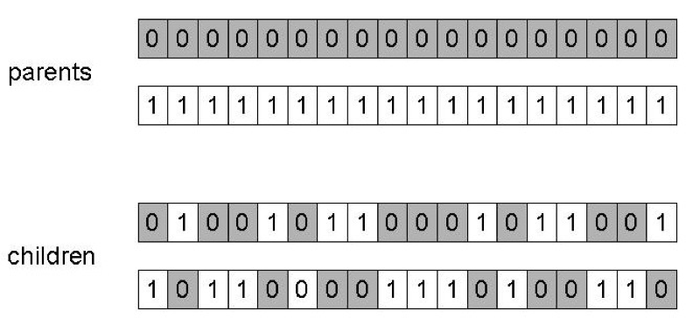
Alternative crossover operators
n-point:
uniform:

Slide 23
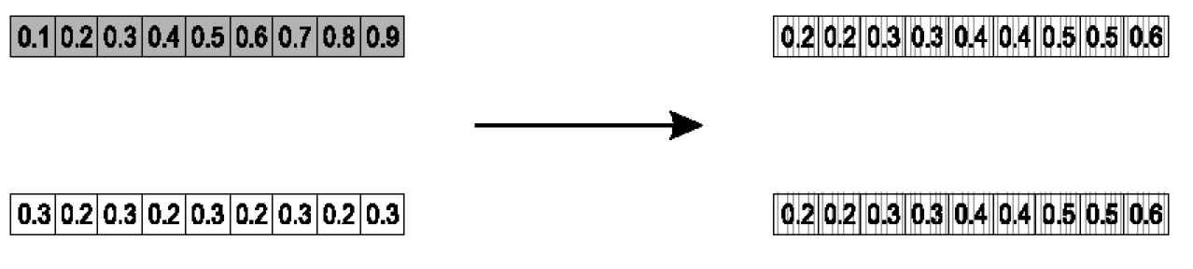
Real-coded GA
Crossover for example:
parents: ⟨x1,…,xn⟩ and ⟨y1,…,yn⟩
offspring1: αx+(1-α)y
swapped for the other offspring
e.g.: (α = 0.5)
Mutation: x= ⟨x1,…,xn⟩ x’= ⟨x’1,…,x’n⟩ xi,x’i ∈[LBi,UBi]

Slide 24
Genetic programming

Slide 25
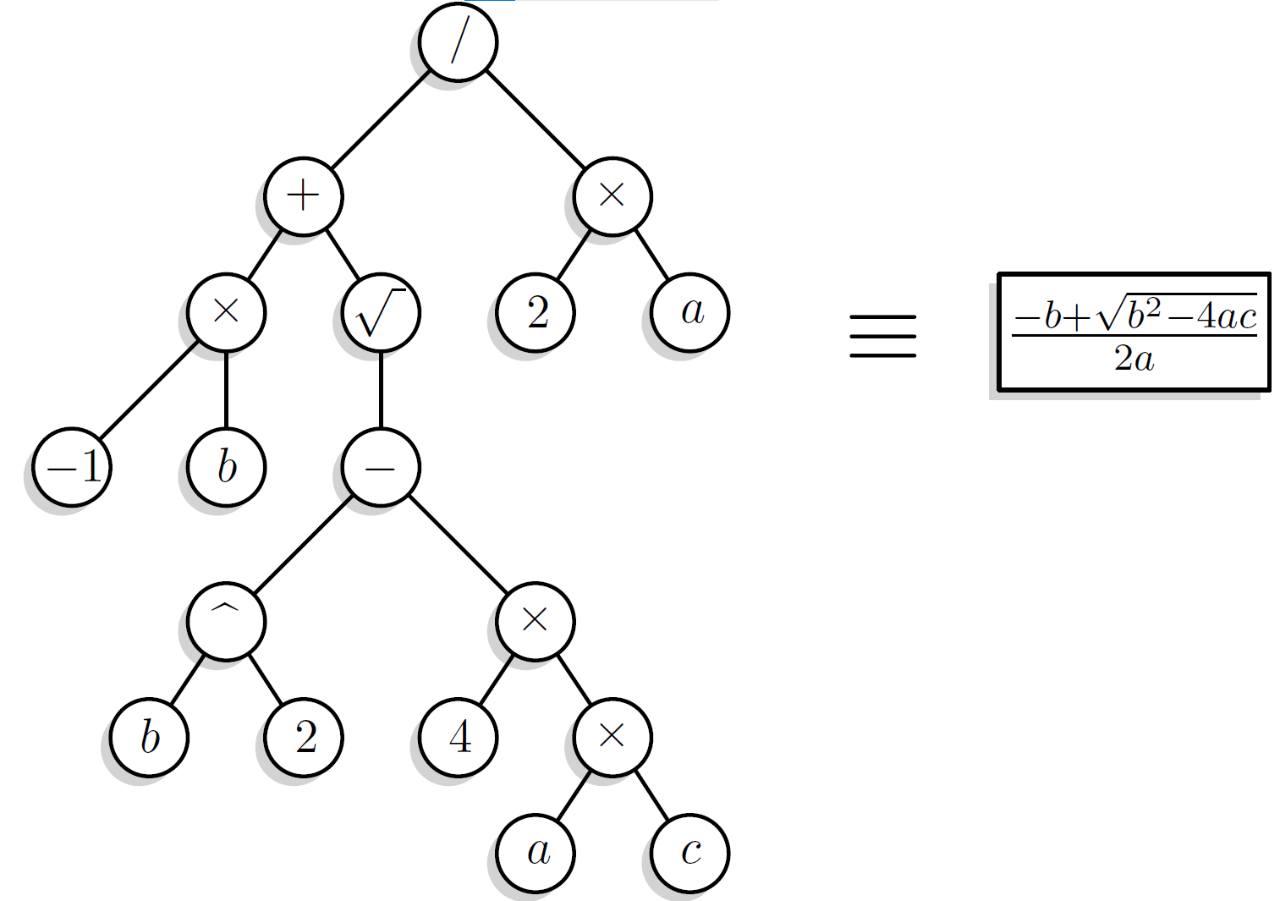
Genetic programming
John Koza (~1990)
Genetic programming applies the approach of genetic algorithm to the space of possible computer programs
A wide variety of seemingly different problems from many different fields can be reformulated as a search for a computer program to solve the problem
Individuals are described by an expression tree

Slide 26
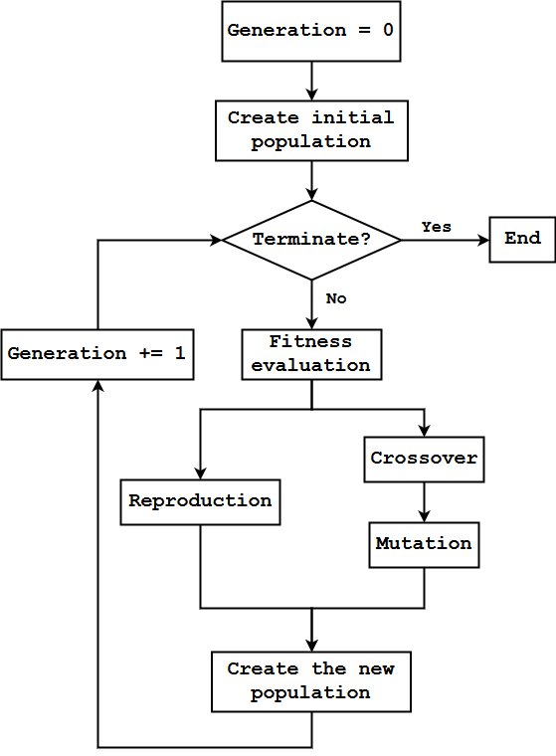
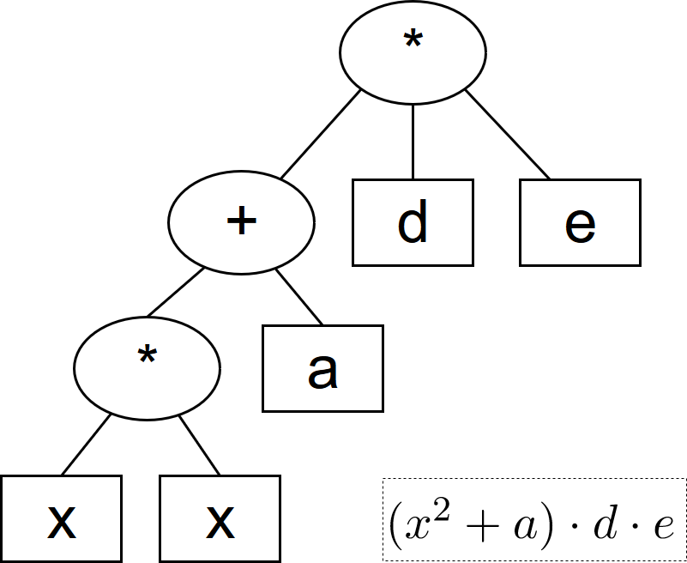
Genetic programming
The individual is a tree-based structure
Evolutionary operators
Reproduction
Crossover
Mutation
Generation = 0
Creation of initial population
Stop?
Yes
End
No
Generation += 1
Fitness evaluation
Crossover
Reproduction
Mutation
Creation of the new population

Slide 27
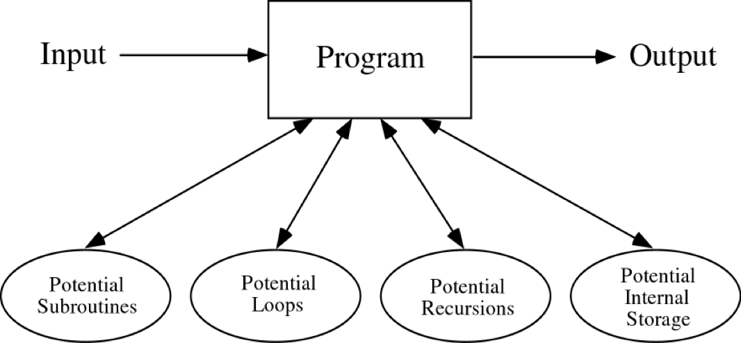
A computer program

Slide 28
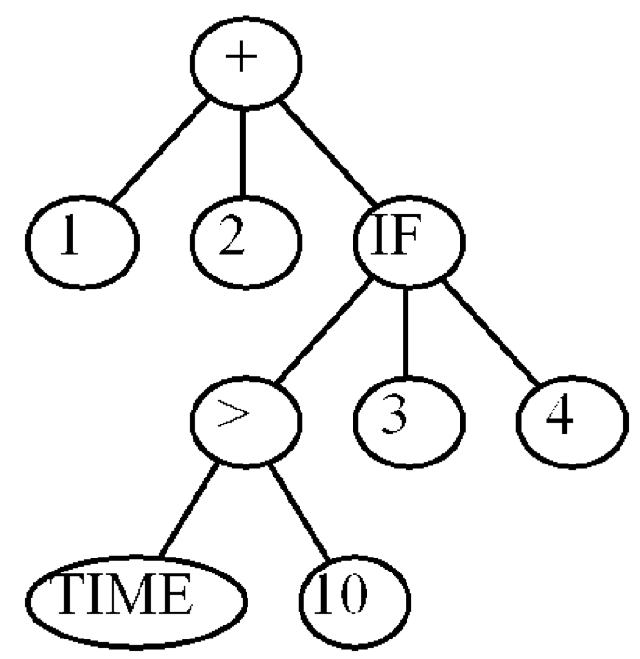
A computer program in C and its tree representation
int foo (int time)
{
int temp1, temp2;
if (time > 10)
temp1 = 3;
else
temp1 = 4;
temp2 = temp1 + 1 + 2;
return (temp2);
}
(+ 1 2 (IF (> TIME 10) 3 4))

Slide 29
Creating random programs
Available functions:
e.g. F = {+, -, *, %, IF}
Available terminals:
e.g. T = {X, Y, constants}
The random programs are:
syntactically valid
executable
The trees may have different sizes and shapes

Slide 30
Genetic operators in GP
Reproduction
Mutation
Crossover
Reproduction:
select parent based on fitness
copy it (unchanged) into the next generation of the population

Slide 31
Mutation
Select 1 parent (based on fitness)
Pick a point in the tree
Delete subtree at the picked point
Grow new subtree at the mutation point in same way as generated trees for initial random population
The result is a syntactically valid executable program
Put the offspring into the next generation of the population

Slide 32
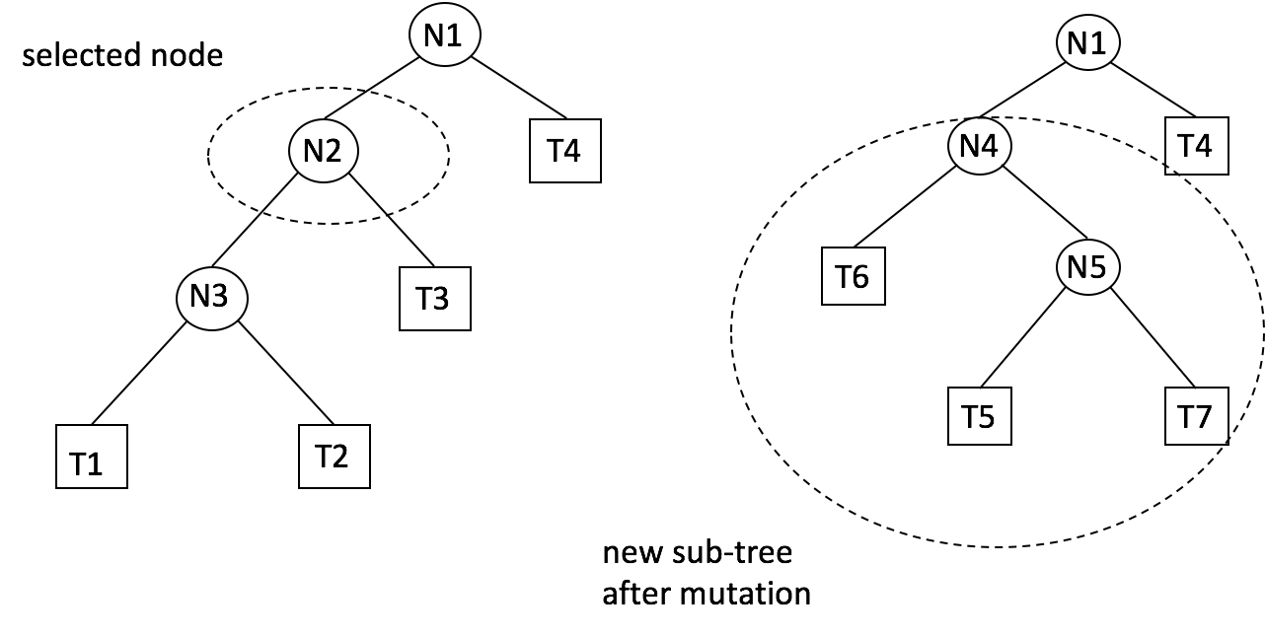
Subtree mutation

Slide 33
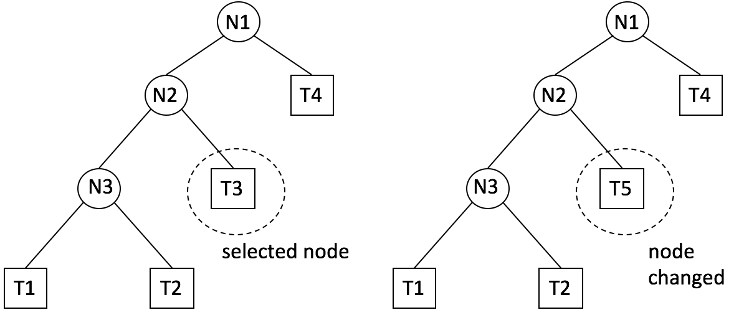
Node mutation

Slide 34
Crossover
Select 2 parents (based on fitness)
Randomly pick a node in the tree for first parent
Independently randomly pick a node for second parent
Exchange the subtrees at the two picked points
The result is a syntactically valid executable program
Put the offspring into the next generation of the population

Slide 35
Crossover
IF (X<10) THEN 8 ELSE A*B
IF
÷
15
A+B
<
8
*
15
+
X
10
A
B
A
B
IF
÷
A*B
A+B
<
8
15
*
+
IF (X<10) THEN 8 ELSE 15
X
10
A
B
A
B

Slide 36
Preparatory steps
Determining the set of terminals
Determining the set of functions
Determining the fitness measure
Determining the parameters for the run
Determining the criterion for terminating a run

