Slide 1


Reinforcment Learning
Introduction to Machine Learning – Lecture 6. Balázs Nagy, PhD

Slide 2
References
MIT course
© Alexander Amini and Ava Amini
MIT 6.S191: Introduction to Deep Learning
http://introtodeeplearning.com/
Georgia Tech – Machine Learning course
https://www.youtube.com/watch?v=Jk2V9yA82YU

Slide 3
What is general intelligence? How can it be defined?
A very general mental capability that, among other things, involves the ability to reason, plan, solve problems, think abstractly, comprehend complex ideas, learn quickly and learn from experience. It is not merely book learning, a narrow academic skill, or test-taking smarts. Rather, it reflects a broader and deeper capability for comprehending our surroundings—“catching on,” “making sense” of things, or “figuring out” what to do.
/Wall Street Journal, 1994/

Slide 4
Intelligence in the context of machines – Artificial Intelligence (AI)
Goal:
The theory and development of computer systems able to perform tasks normally requiring human intelligence, such as visual perception, speech recognition, decision-making, and translation between languages.
Study the theory and design of algorithms that help machines (agents) gain the capability to perform tasks by interacting with the environment and continually learning from its successes, failures, and rewards

Slide 5
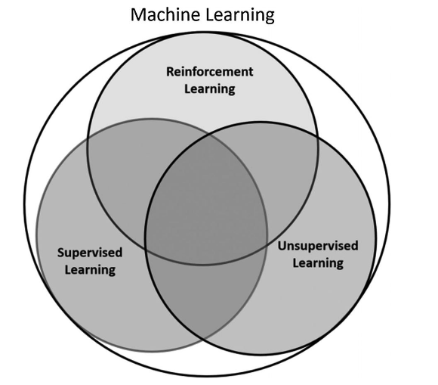
Artificial Intelligence
Any technique that enables computers to mimic human intelligence.
Machine Learning
A subset of AI that includes abstruse statistical techniques that enable machines to improve at tasks with experience.
Deep Learning
The subset of machine learning composed of algorithms that permit software to train itself to perform tasks by exposing multilayered neural networks to vast amount of data.

Slide 6
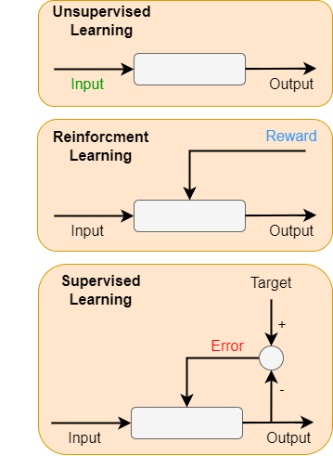
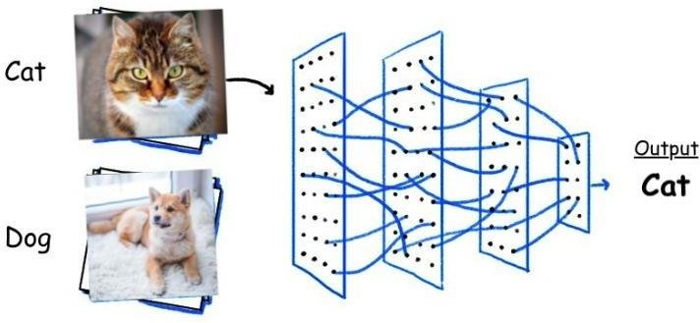
Learning methods
Supervised Learning
system is presented with the labeled data
the objective is to generalize the knowledge so that new unlabeled data can be labeled

Slide 7
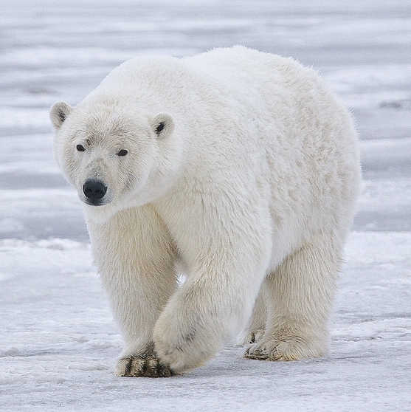
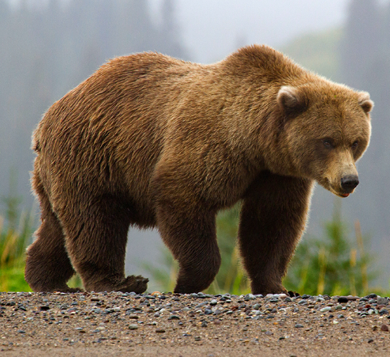
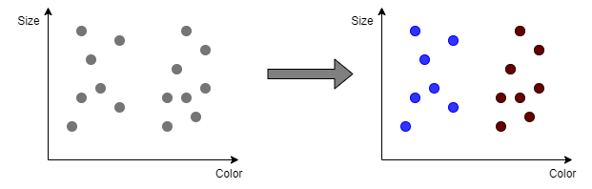
Learning methods
Unsupervised Learning
No labels, only has the inputs
The system uses this data to learn the hidden structure of the data so that it can cluster/categorize the data into some broad categories.
Often used for feature extraction

Slide 8
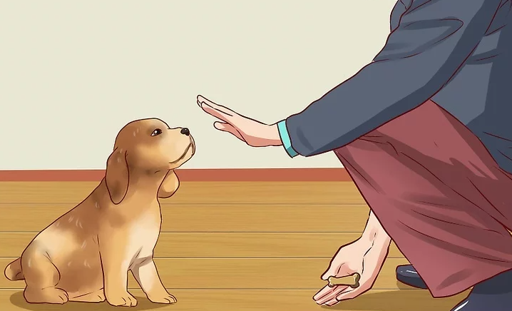
Learning methods
Reinforcment Learning
The agent does not have prior knowledge of the system
It gathers feedback and uses that feedback to plan/learn actions to maximize a specific objective.
As it does not have enough information about the environment initially, it must explore to gather insights.
Once it gathers “enough” knowledge, it needs to exploit that knowledge to start adjusting its behavior to maximize the objective it is chasing.

Slide 9
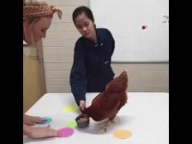
Learning methods

Slide 10
Reinforcement Learning (RL) – Key concept

Slide 11
Reinforcement Learning (RL) – Key concept
Agent
Agent: takes actions

Slide 12
Reinforcement Learning (RL) – Key concept
Agent
Environment
Environment: the world in wich the agent exists and operates

Slide 13

Reinforcement Learning (RL) – Key concept
Action
Agent
Environment
Action: a movement the agent can make in the environment
Action space A: the set of possible actions an agent can make in the environment

Slide 14


Reinforcement Learning (RL) – Key concept
Action
Agent
Environment
Observation
Reward: feedback that measures the success or failure of the agent’s action

Slide 15
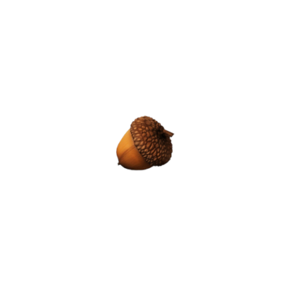

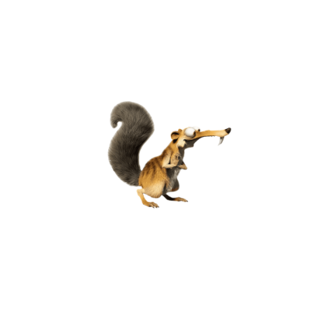
Grid world example
0
0
0
10
Environment
Model: rules of the game, the physics of the world
Policy: A policy is a strategy that an agent uses in pursuit of goals.
1
Agent
2
3
4
0
0
0
0
State
Action
5
6
7
8
0
0
0
0
Reward
9
10
11
12
0
0
0
0
13
14
15
16

Slide 16
Grid world example
0
0
0
10
Environment
1
Agent
2
3
4
}
0
0
0
0
State
Action
Trajectory
5
6
7
8
0
0
0
0
Reward
9
10
11
12
0
0
0
0
13
14
15
16

Slide 17
Markov Decision Process

Slide 18
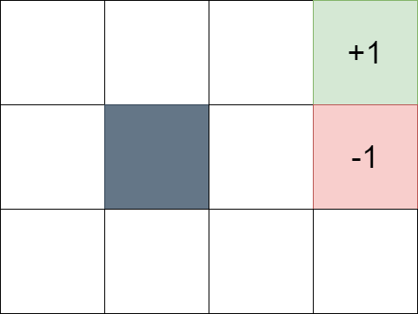
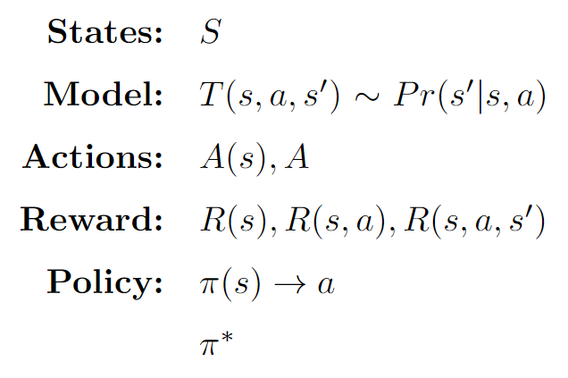

Markov Decision Process
=[1,2,3,4,5,6,7,8,9,10,11,12]
9
10
11
12
=[up, down, left, right]
5
6
7
8
START
1
2
3
4

Slide 19
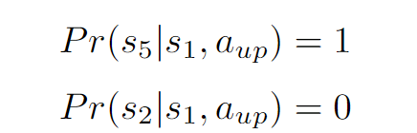
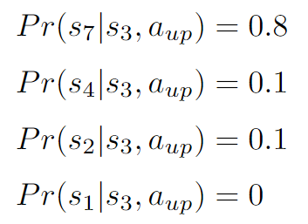
Markov Decision Process
Deterministic:
Non-deterministic or Stochastic:
}
9
10
11
12
Sum = 1
5
6
7
8
}
1
2
3
4
Sum = 1

Slide 20
Markov Decision Process
Markovian property: - Only present matters
- Stationary (rules do not change)
9
10
11
12
MDP
5
6
7
8
Problem definition
1
2
3
4
Solution
Optimal policy: maximises the long term expected reward

Slide 21
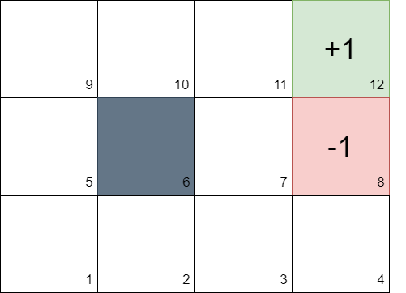
Markov Decision Process
+1
-1
s, a, r
Temporal Credit Assigment
Delayed reward
Minor changes matters
Notes:
Chess example
We play a long game.
I win.
How do you know which action was good?

Slide 22



Markov Decision Process
Action Space:
Rules:
Stochastic
Rewards given

Slide 23
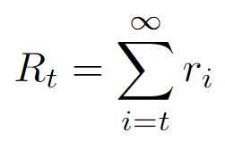
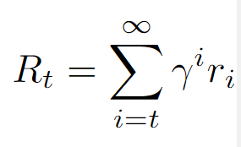
Reinforcement Learning (RL) – Key concept
Action
Agent
Environment
Observation
Total Reward
Discounted Total Reward

Slide 24
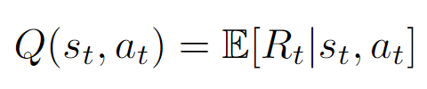
Defining the Q-function
Total reward, R_{t}, is the discounted sum of all rewards obtained from time t
The Q-function captures the expected total future reward an agent in state, s, can receive by executing a certain action, a

Slide 25
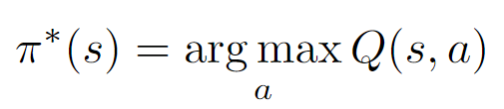
How to take actions given a Q-function?
Ultimately, the agent needs a policy π(s), to infer the best action to take at its state, s
Strategy: the policy should choose an action that maximizes future reward

Slide 26
Deep Reinforcment Learning Algorithms
Value Learning
Find Q(s,a)
a = argmax Q(s,a)
ª
Policy Learning
Find π(s)
Sample a ̴ π(s)

Slide 27
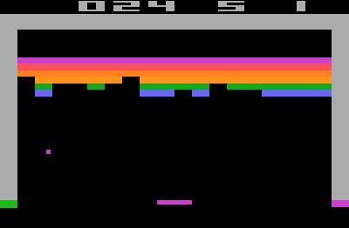


Q function intuition
It can be very difficult for humans to accurately estimate Q-values
A
B
Which (s, a) pair has a
higher Q-value?
Atari game - Breakout

Slide 28
Deep Q Networks (DQN): Training
How can we use deep neural networks to model Q-functions?
Action + State Expected return
State Expected Return for Each Action
Q(s,a₁)
Deep NN
Deep NN
Q(s,a₂)
state, s
Q(s,a)
„move right”
state, s
Q(s,a_{n})
action, a
Input
Agent
Output
Input
Agent
Output
Notes:
Firs case: you need to run your network multiple times
Second: more efficient

Slide 29
Deep Q Networks Summary
Use NN to learn Q-function and then use to infer the optimal policy, π(s)
Q(s,a₁)
=20
Deep NN
Q(s,a₂)
=3
π(s)= argmax Q(s,a)
ª
= a₁
state, s
Q(s,a₃)
=0
Notes:
Policy is the end to end answer

Slide 30
Deep Q Networks Summary
Use NN to learn Q-function and then use to infer the optimal policy, π(s)
Q(s,a₁)
=20
Deep NN
Q(s,a₂)
=3
π(s)= argmax Q(s,a)
ª
= a₁
state, s
Q(s,a₃)
=0
Send action back to the environment and receive next state
Notes:
Policy is the end to end answer

Slide 31
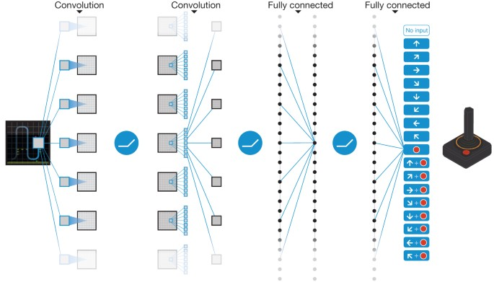
DQN Atari playing Network
Mnih, V., Kavukcuoglu, K., Silver, D. et al. Human-level control through deep reinforcement learning. Nature 518, 529–533 (2015). https://doi.org/10.1038/nature14236

Slide 32
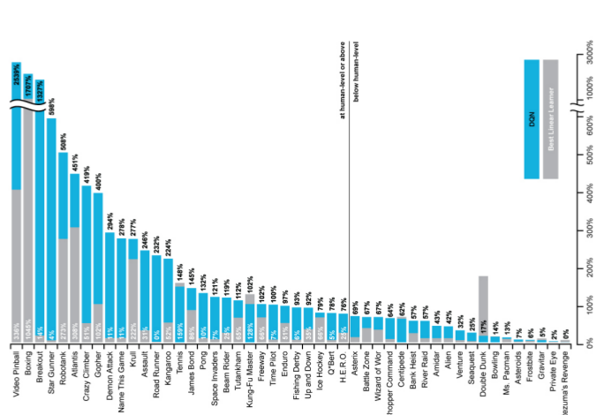
DQN Atari Results
Above Human level
Below Human level
https://github.com/Neo-47/Atari-DQN

Slide 33
Downsides of Q-learning
Complexity:
Can model scenarios where the action space is discrete and small
Cannot handle continuous action spaces
Flexibility:
Policy is deterministically computed from the Q function by maximizing the reward → cannot learn stochastic policies
To address these, consider a new class of RL training algorithms:
Policy gradient methods

Slide 34
Deep Reinforcement Learning Algorithms
Value Learning
Find Q(s,a)
a = argmax Q(s,a)
ª
Policy Learning
Find π(s)
Sample a ̴ π(s)

Slide 35
Deep Q Networks Summary
DQN: Approximate Q function and use to infer the optimal policy, π(s)
Q(s,a₁)
=20
Deep NN
Q(s,a₂)
=3
π(s)= argmax Q(s,a)
ª
= a₁
state, s
Q(s,a₃)
=0
Notes:
Policy is the end to end answer

Slide 36
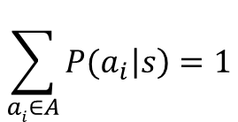
Policy Gradient (PG): Key Idea
DQN: Approximate Q function and use to infer the optimal policy, π(s)
Policy Gradient: Directly optimize the policy π(s)
$$\sum_{ai∈A}{{P(a}_{i}\left|s\right)=1}$$
P(a₁|s)
=0.9
Deep NN
P(a₂|s)
=0.1
π(s) ̴ P(a,s)
= a₁
state, s
P(a₃|s)
=0
Notes:
Not interested in the exact numerical value
Rather than
Intrested in the likelihood that choosing that action will result in the best scenario
Probability distribution

Slide 37
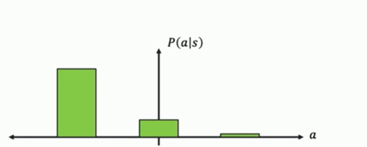

Discrete vs Continous Action Spaces
Discrete action space: which direction should I move?

Slide 38
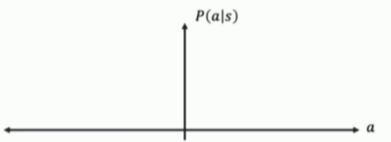
Discrete vs Continous Action Spaces
Discrete action space: which direction should I move?
Continous action space: how fast should I move?
7 m/s
Faster Left
Faster Right

Slide 39
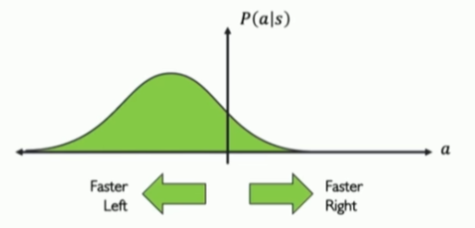
Discrete vs Continous Action Spaces
Discrete action space: which direction should I move?
Continous action space: how fast should I move?
7 m/s
Parametrization
Faster Left
Faster Right

Slide 40
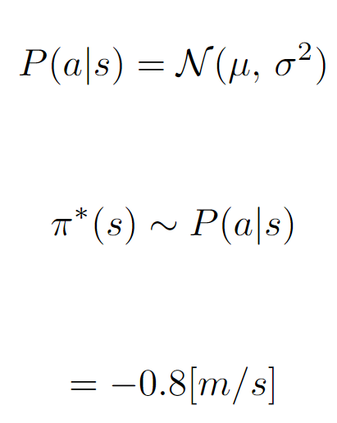

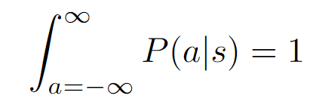
Policy Gradient (PG): Key Idea
Policy Gradient: Enables modeling of continous action space
Mean, μ
=-1
Deep NN
Variance, σ²
=-0.5
state, s
Faster Left
Faster Right
Notes:
Parametrisize the gaussian distribution

Slide 41

Trainig Policy Gradients
Training Algorithm
1. Initialize the agent
2. Run a policy until termination
3. Record all states, actions, rewards
4. Decrease probability of actions that resulted in low reward
5. Increase probability of actions that resulted in high reward
(s₄,a₄,r₄)
(s₃,a₃,r₃)
(s₂,a₂,r₂)
(s₁,a₁,r₁)
RUN AGAIN
(s₀,a₀,r₀)

Slide 42
Trainig Policy Gradients
Training Algorithm
1. Initialize the agent
2. Run a policy until termination
3. Record all states, actions, rewards
4. Decrease probability of actions that resulted in low reward
5. Increase probability of actions that resulted in high reward
Log-likelihood of action
loss = -logP(a_{t}|s_{t})R_{t}
reward
Gradient descent update
w’ = w - loss
w’ = w + logP(a_{t}|s_{t})R_{t}
Policy gradinet

Slide 43

Reinforcment learning in real life
SIMULATION
Training Algorithm
1. Initialize the agent
2. Run a policy until termination
3. Record all states, actions, rewards
4. Decrease probability of actions that resulted in low reward
5. Increase probability of actions that resulted in high reward

Slide 44

VISTA – An open source simulator for self-driving cars

Slide 45
Thank you for your attention!

