Slide 1

Supervised Learning
Introduction to Machine Learning – Lecture 4 Computer Science BSc Course, ELTE Faculty of Informatics
János Botzheim
Associate Professor Department of Artificial Intelligence botzheim@inf.elte.hu

Slide 2





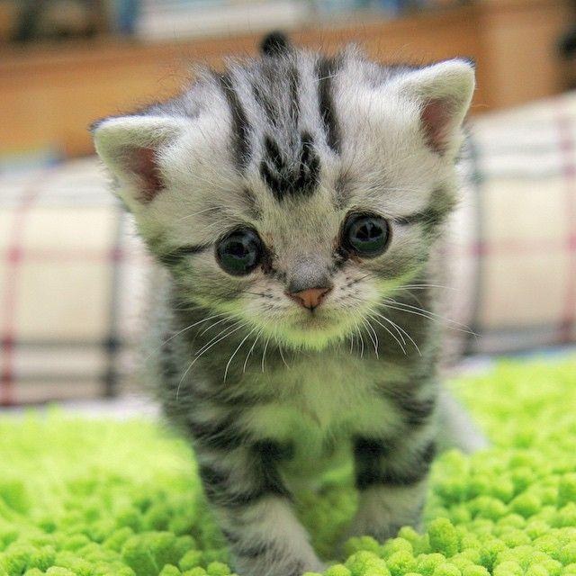

Unsupervised learning

Slide 3
Supervised learning
label
dog
cat
bird

Slide 4
Learning - Programming
Traditional computer programming:
Supervised learning:
Unsupervised learning:
Input
Computer
Output
Program
Input
Computer
Program
Output
Computer
Program
Input
Output

Slide 5
Types of learning
Learning
Agent can improve its performance based on observations
Machine Learning
Subset of artificial intelligence, computer system learns by patterns in observation data
Learning tasks
Classification: output is one of a finite set of values
Regression: output is a numeric prediction
Learning Feedback
Supervised Learning – learn a function that maps inputs to outputs by observing input-output pairs
Unsupervised Learning – learn patterns in data without explicit feedback (e.g. clustering)
Reinforcement Learning – learn beneficial actions based on rewards and punishments

Slide 6
Supervised learning
given: input-output training patterns (x1^{(p)}, x2^{(p)},…, xn^{(p)}, d^{(p)})
p: number of patterns, n-dimensional input, scalar output
x
d
system
+
+
error
y
-
model

Slide 7
Supervised learning
Representation:
rule based system
fuzzy system
decision tree
neural network
support vector machine
etc.
Evaluation:
error
accuracy
cost
entropy
etc.
Optimization:
gradient based algorithm
evolutionary algorithm
etc.

Slide 8
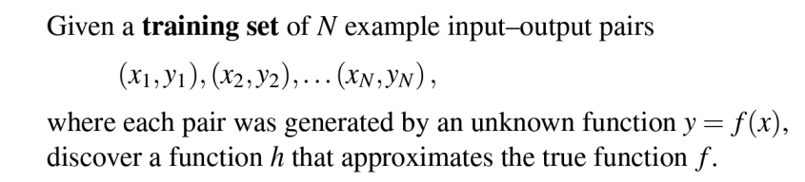
Supervised Learning
More formally
The function h is called a hypothesis or a model of the data

Slide 9
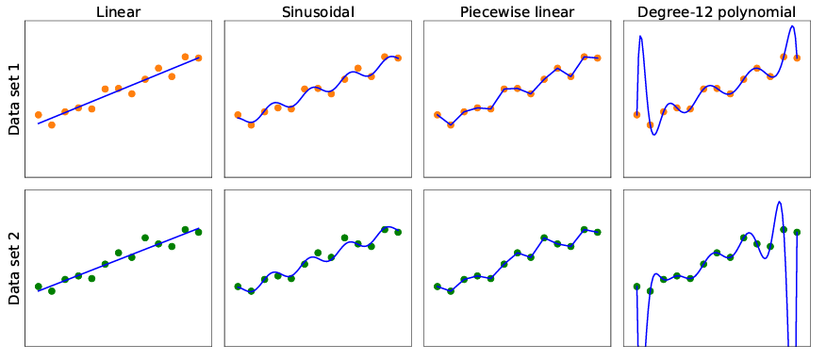
Supervised Learning

Slide 10
Supervised Learning - Generalization
Performance measures
Performance on the training set
Performance on test set
Generalization
h generalizes well if it accurately predicts the outputs of the test set

Slide 11
Supervised Learning - Bias & Variance
One way to analyze hypothesis spaces is by the bias they impose (regardless of the training data set) and the variance they produce (from one training set to another).
Bias
The tendency of a predictive hypothesis to deviate from the expected value when averaged over different training sets
Variance
The amount of change in the hypothesis due to fluctuation in the training data
Bias–variance tradeoff
more complex, low-bias hypotheses that fit the training data well
simpler, low-variance hypotheses that may generalize better

Slide 12
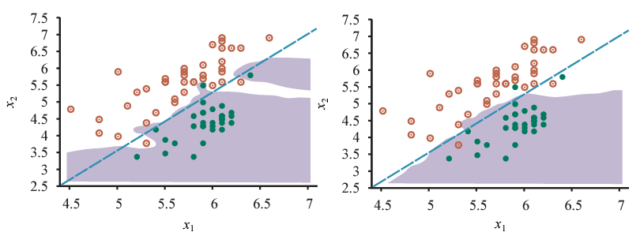
Supervised Learning - Underfitting & Overfitting
Underfitting
The algorithm fails to find a pattern in the data
Model is too simple
Overfitting
Fits too much to the particular data set it is trained on
Performs poorly on unseen data (train-test accuracy)
Model is too complex
Amount of data is not enough
Data is not diverse enough

Slide 13


Decision Trees
Maps a vector of attribute values to a single output “decision”
Sequence of tests
Start from root
Explore branches
Until a leaf is reached
Node = test of input attribute value
Input and output values can be discrete or continuous
Simple example: Boolean decision tree
A Boolean decision tree is equivalent to a logical statement of the form:
Where are attribute-value tests corresponding to a path from the root to a true leaf

Slide 14
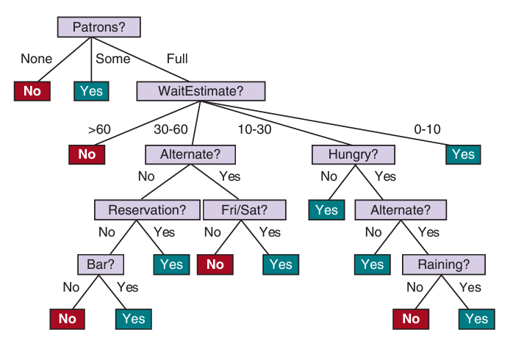
Decision Trees
Example: Waiting in restaurant

Slide 15
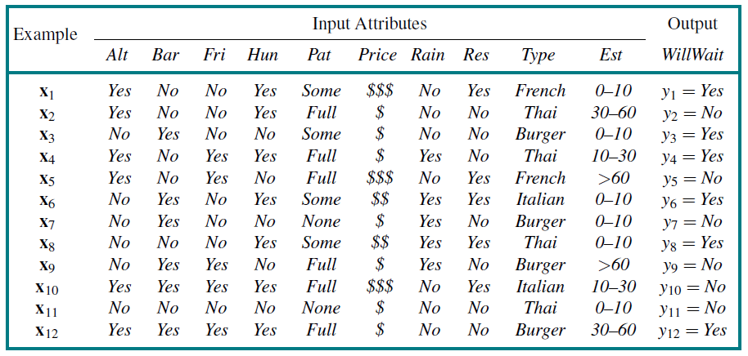
Decision Trees
Training dataset

Slide 16
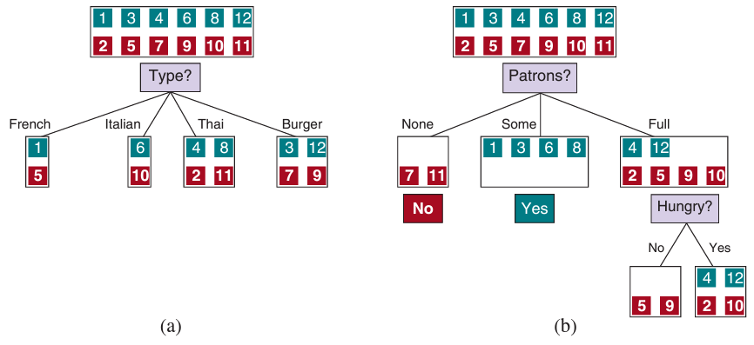
Decision Trees
Find most important features and solve sub-problems sequentially

Slide 17
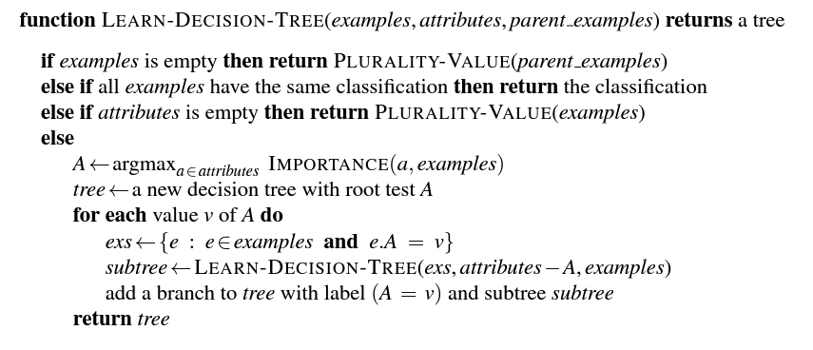
Decision Trees

Slide 18
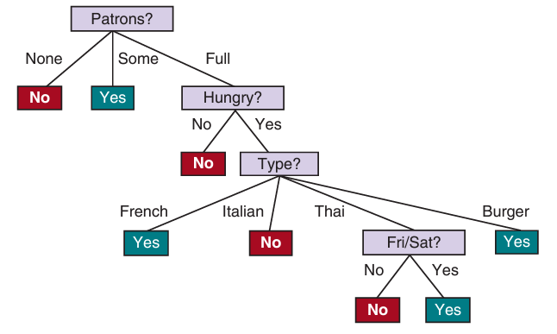
Decision Trees
Final decision tree has short paths
Simpler than the original tree
Fitted to the training set
BUT The learning algorithm looks at the examples, not at the correct function
Selecting most important attributes based on information gain defined by expected reduction in entropy of the output variable

Slide 19
Decision Trees
Generalization
If we increase the number of attributes, overfitting is more likely
If we increase the number of training samples, overfitting is less likely
Pruning: improving generalization for decision trees
Eliminate nodes that are not clearly relevant
Look at a test node that has only leaf nodes as descendants
If the test appears to be irrelevant - eliminate and replace it with a leaf node
Use significance test to measure low information gain threshold

Slide 20
Decision Trees
Pros
Ease of understanding
Scalability to large data sets
Versatility in handling discrete and continuous inputs
Performing classification and regression
Cons
Suboptimal accuracy (largely due to the greedy search)
If trees are very deep, then getting a prediction for a new example can be expensive
Decision trees are unstable – adding just one new example can change the entire tree

Slide 21


Linear Regression and Classification
Univariate Linear Regression = “fitting a straight line” fit model on (x, y) training examples so that y = w₁x + w₀ where w₀ and w₁ are learned weights
The learned linear function
The task of finding this linear function based on training data is called linear regression
Find values of w₀, w₁ that minimizes the empirical loss (e.g. L2 loss)

Slide 22

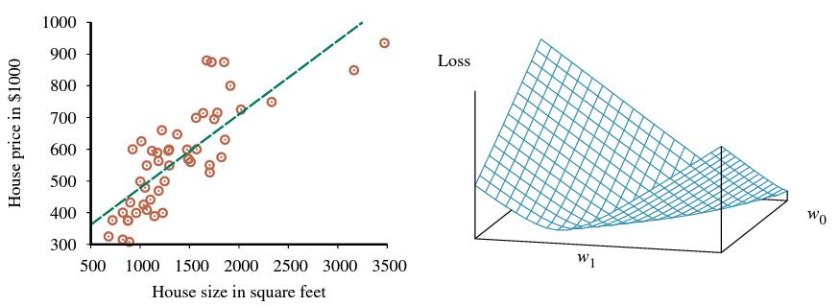
Linear Regression and Classification
We can find the function that minimizes the loss using partial derivatives

Slide 23
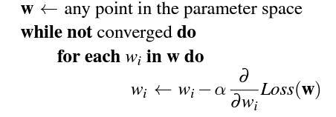
Linear Regression and Classification
For more complex cases we need to introduce gradient descent
Algorithm for finding a point in the weight space that minimizes the loss
Similar to the hill climbing but here we are minimizing the loss, not maximizing the gain
Gradient Descent
Select random starting point in weight space
Compute an estimate of the gradient
Move a small amount in the steepest downhill direction
Repeat until we converge on a point with minimum loss
Parameters
Learning rate (α) – determines the step size for the descent

Slide 24
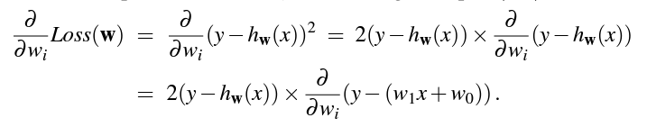
Linear Regression and Classification
For the univariate case the loss was quadratic - the partial derivative is linear
We apply the chain rule
Create the update function with the selected learning rate
Single example
Batch

