Slide 1
+
MediSync
Doctor-Patient Appointment and Healthcare Management System
A full-stack Android healthcare platform connecting patients and doctors through appointment booking, secure records, chat, video consultation, AI assistance, and clinic location services.
Team Members
Name | USN
Navneet Kumar Dubey | 1BF24CS194
Babu Ld | 1BM25CS423
MediSync | Software Engineering Presentation
1

Slide 2
Project Overview
What MediSync does
MediSync is designed as a single healthcare workspace where patients can find doctors, book consultations, keep reports, chat with doctors, and use AI guidance, while doctors can manage schedules, clinic location, appointments, and patient communication.
+
Patient Side
+
Doctor Side
Doctor search, appointment booking, AI health chat, medical record storage, appointment history, chat and video consultation.
Profile management, clinic location on map, weekly and custom slot management, appointment dashboard, patient chats and video calls.
+
Communication Layer
+
Storage and Records
Real-time chat, WebSocket events, Firebase notifications, and WebRTC-based video consultation support doctor-patient interaction.
PostgreSQL stores structured records, MinIO stores files/photos, and local app caching supports offline viewing of downloaded records.
MediSync | Software Engineering Presentation
2

Slide 3
Problem Statement
Why this system is needed
• Patients often need separate tools for finding doctors, booking appointments, storing reports, and communicating after consultation.
• Manual or semi-manual appointment handling can create confusion about available slots, consultation mode, fees, and clinic location.
• Medical reports are frequently scattered across devices or chats, making follow-up care slower and less organized.
• Doctors need a simple workflow to manage clinic location, online/offline slots, appointments, patient chats, and reminders.
• A reliable healthcare app must support secure authentication, real-time updates, notifications, and access to important data even during network issues.
MediSync | Software Engineering Presentation
3

Slide 4
Objectives
Core goals of MediSync
+
Secure Access
+
Doctor Discovery
OTP login and JWT-based protected API access for patient and doctor roles.
Search and filter doctors by name, speciality, and consultation mode.
+
Appointment Booking
+
Connected Care
Book slots with real-time status updates and prevent duplicate booking.
Enable chat, file sharing, notifications, and video calls between patient and doctor.
+
Medical Records
+
AI Guidance
Store and retrieve medical reports with local cache support.
Provide an AI assistant for basic health questions and report/image support.
MediSync | Software Engineering Presentation
4

Slide 5
Project Scope
Boundaries of the system
In Scope
Out of Scope
• Patient and doctor registration and profile management
• Doctor search, slot display, and appointment booking
• Doctor schedule, custom slot, and clinic location management
• Medical records upload, listing, caching, and filtering
• Real-time chat, notifications, and video consultation
• AI health assistant for guidance and report/image support
• Emergency medical decision-making or ambulance dispatch
• Replacing professional diagnosis or treatment advice
• Payment gateway integration in the current version
• Hospital-wide ERP modules such as pharmacy inventory or billing
• Advanced clinical decision support beyond general AI guidance
MediSync | Software Engineering Presentation
5

Slide 6
Technology Stack
Tools and platforms used
+
Android App
+
Backend API
Kotlin, Jetpack Compose, MVVM, Repository Pattern, Room/SQLite cache
Node.js, Express.js, TypeScript, JWT middleware, REST API routes
+
Database
+
Real-Time
PostgreSQL for users, profiles, appointments, chat, records, ratings
WebSockets for chat/video signalling and Redis for pub-sub/session support
+
Storage
+
External Services
MinIO object storage for profile photos, chat files, and medical reports
Firebase Cloud Messaging, Google Maps, Gemini AI, WebRTC
MediSync | Software Engineering Presentation
6

Slide 7
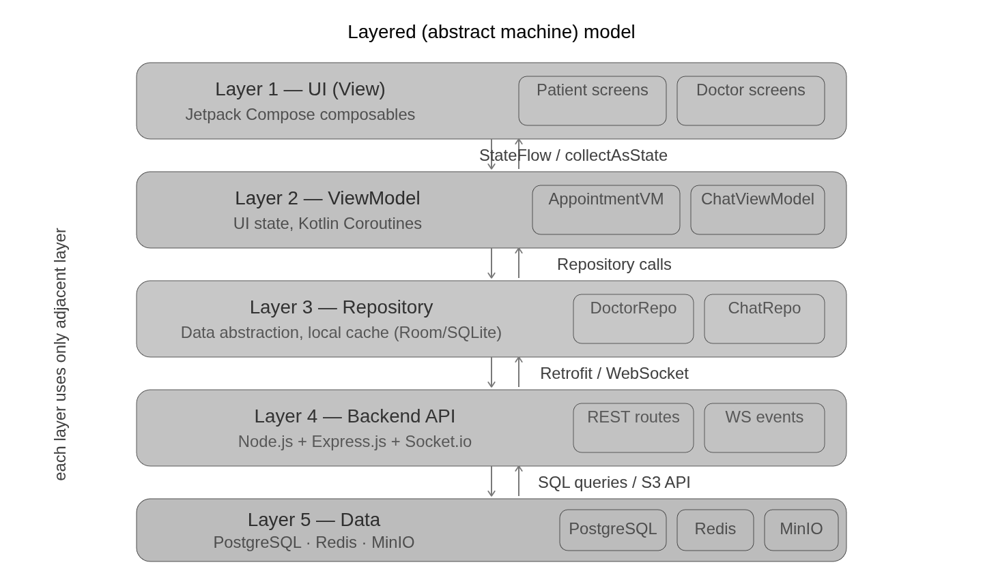
Software Engineering Approach
Iterative development aligned with Agile principles
Development was handled in iterative increments: first authentication and profile flows, then appointment booking, then records and chat, followed by video calling, AI assistant, offline caching, and UI refinement.
1. Requirement analysis from patient and doctor workflows
2. Modular design for authentication, appointment, chat, records, and doctor scheduling
3. Implementation using Android MVVM and backend REST/WebSocket services
4. Scenario-based testing for success, failure, offline, and edge cases
5. Deployment and refinement after real device testing
MediSync | Software Engineering Presentation
7

Slide 8
Functional Requirements
Module-wise system functions
Patient Module
Doctor Module
System Module
• Login/register as patient
• Search doctors by speciality
• Book online/offline slots
• View appointment details
• Upload and view records
• Create professional profile
• Set clinic map location
• Manage weekly/custom slots
• View dashboard and appointments
• Chat or video call patients
• Generate JWT sessions
• Prevent duplicate slot booking
• Send FCM notifications
• Store files in MinIO
• Cache records locally
MediSync | Software Engineering Presentation
8

Slide 9
Non-Functional Requirements
Quality attributes expected from the system
+
Security
+
Reliability
JWT-protected APIs, OTP login, role-based access, and controlled file access through object storage.
Appointment slot status is updated transactionally to avoid double booking and inconsistent data.
+
Performance
+
Usability
REST APIs, indexed tables, Redis pub-sub, and local caching reduce repeated loading and improve response time.
Clean doctor/patient dashboards, search filters, bottom navigation, and direct actions improve learnability.
+
Maintainability
+
Availability
Separate routes, controllers, repositories, view models, and composables keep modules easier to modify.
PM2 process management, deployed backend, Dockerized services, and cached records support practical usage.
MediSync | Software Engineering Presentation
9

Slide 10
Major Functional Modules
High-level breakdown of MediSync
+
Authentication & Profile
+
Doctor Discovery
OTP login, role selection, patient/doctor profile forms, profile photo support
Speciality categories, search results, doctor detail screen, ratings, location preview
+
Appointment Engine
+
Doctor Scheduling
Slot picker, booking validation, appointment list/detail, status and consultation type
Weekly templates, custom slots, fees, duration, online/offline mode
+
Communication
+
Records & AI
Chat rooms, text/file/image sharing, read status, notifications, video calls
Medical reports, local cache, PDF/image access, Gemini-powered AI assistant
MediSync | Software Engineering Presentation
10

Slide 11
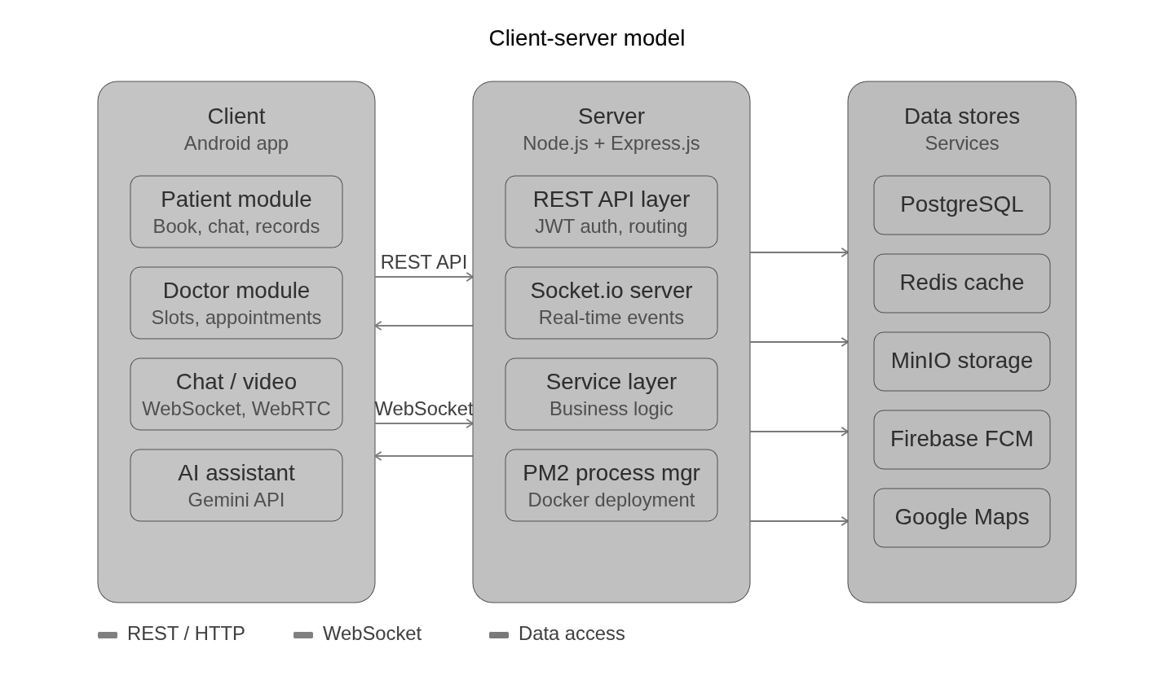
System Architecture
Client-server architecture of MediSync
MediSync | Software Engineering Presentation
11

Slide 12
Layered Architecture Model
Abstract machine view from the report
• Presentation layer: Jetpack Compose screens and reusable UI components.
• ViewModel layer: screen state, validation, loading, and navigation events.
• Repository layer: coordinates API, cache, and local data access.
• Backend service layer: controllers, routes, middleware, WebSocket handlers.
• Data layer: PostgreSQL, MinIO, Redis, and Firebase/AI integrations.
MediSync | Software Engineering Presentation
12

Slide 13
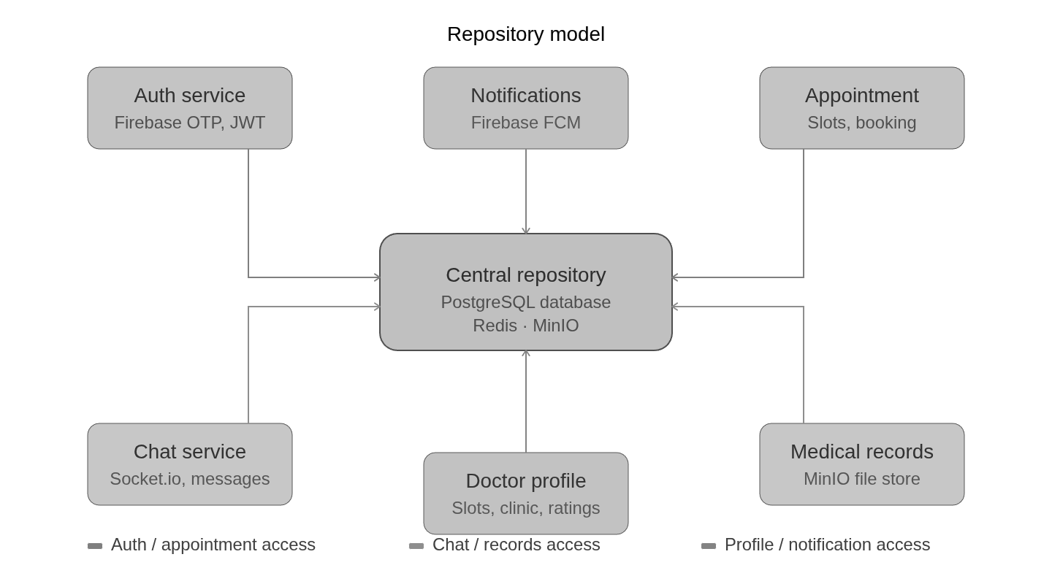
Repository and Data Access Model
How app data is organized
The repository pattern keeps UI code independent from network and local data sources. ViewModels request data from repositories, repositories decide whether to use cached local data or backend APIs, and the UI observes clean state updates.
• Cleaner separation of concerns
• Better testability of app logic
• Offline-friendly medical record access
• Reusable data operations across screens
MediSync | Software Engineering Presentation
13

Slide 14
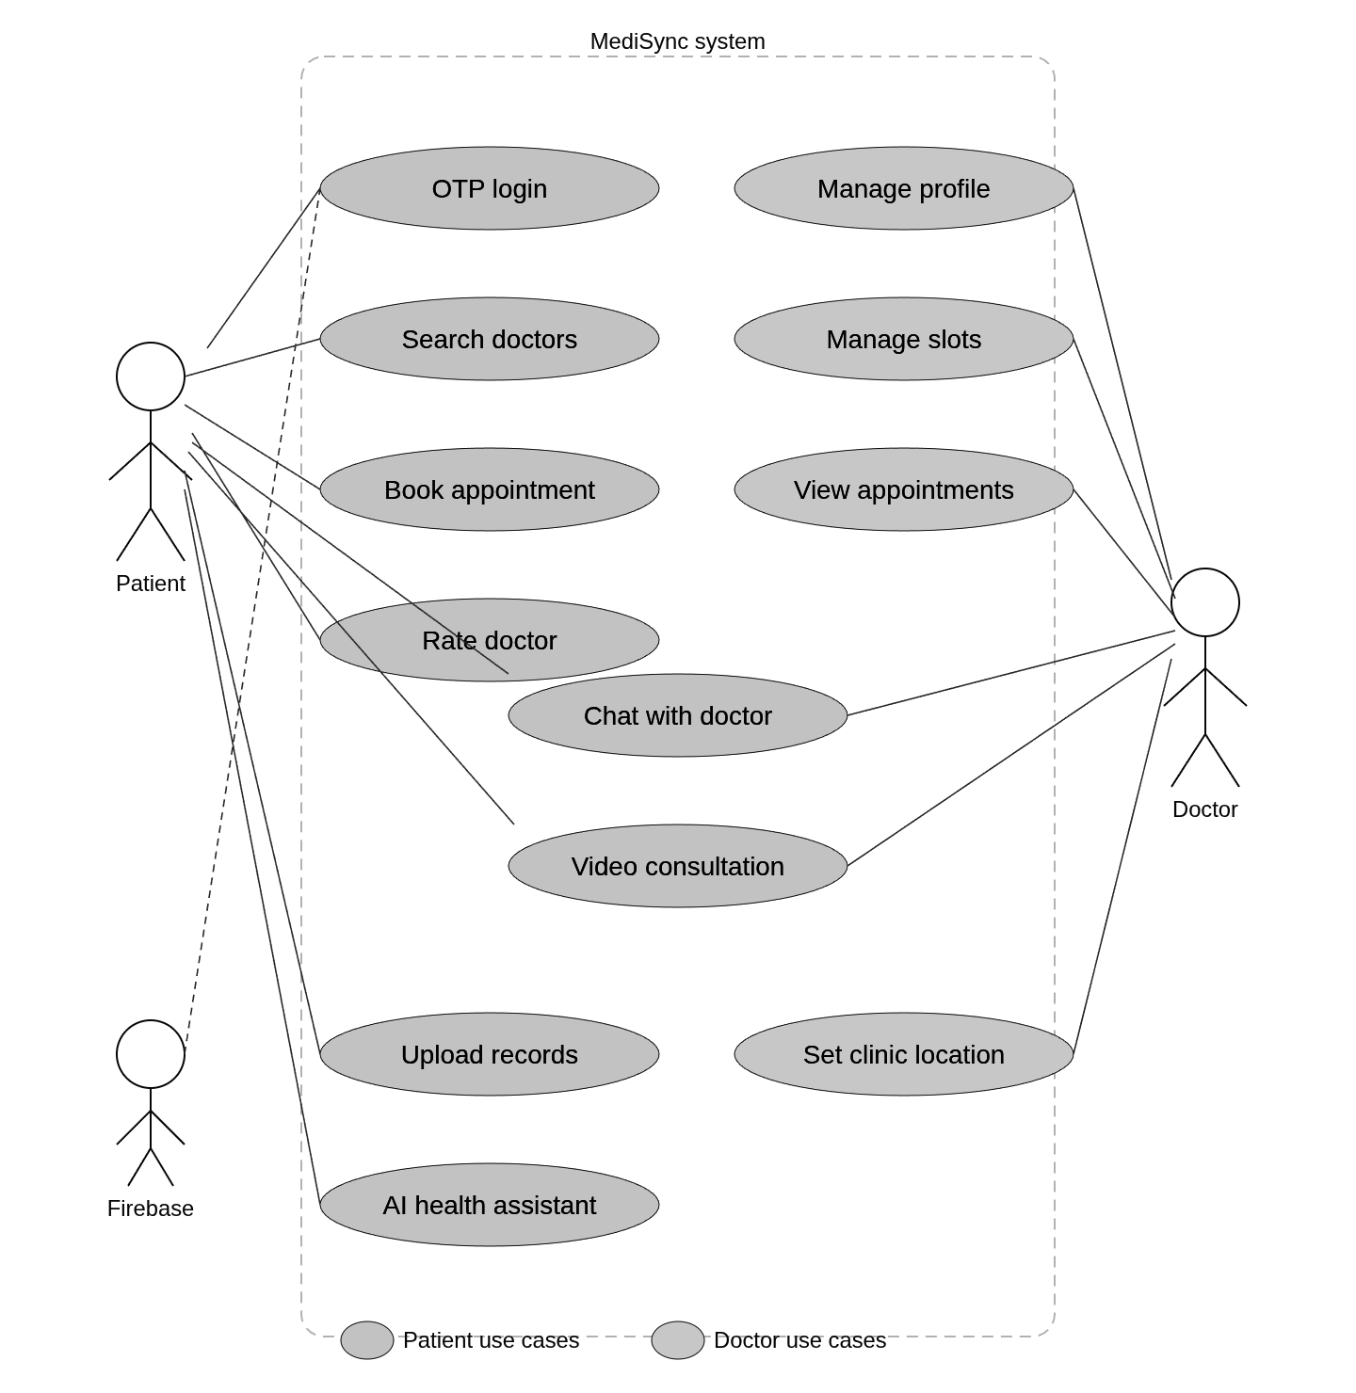
Use Case Diagram
Major actors and system interactions
MediSync | Software Engineering Presentation
14

Slide 15
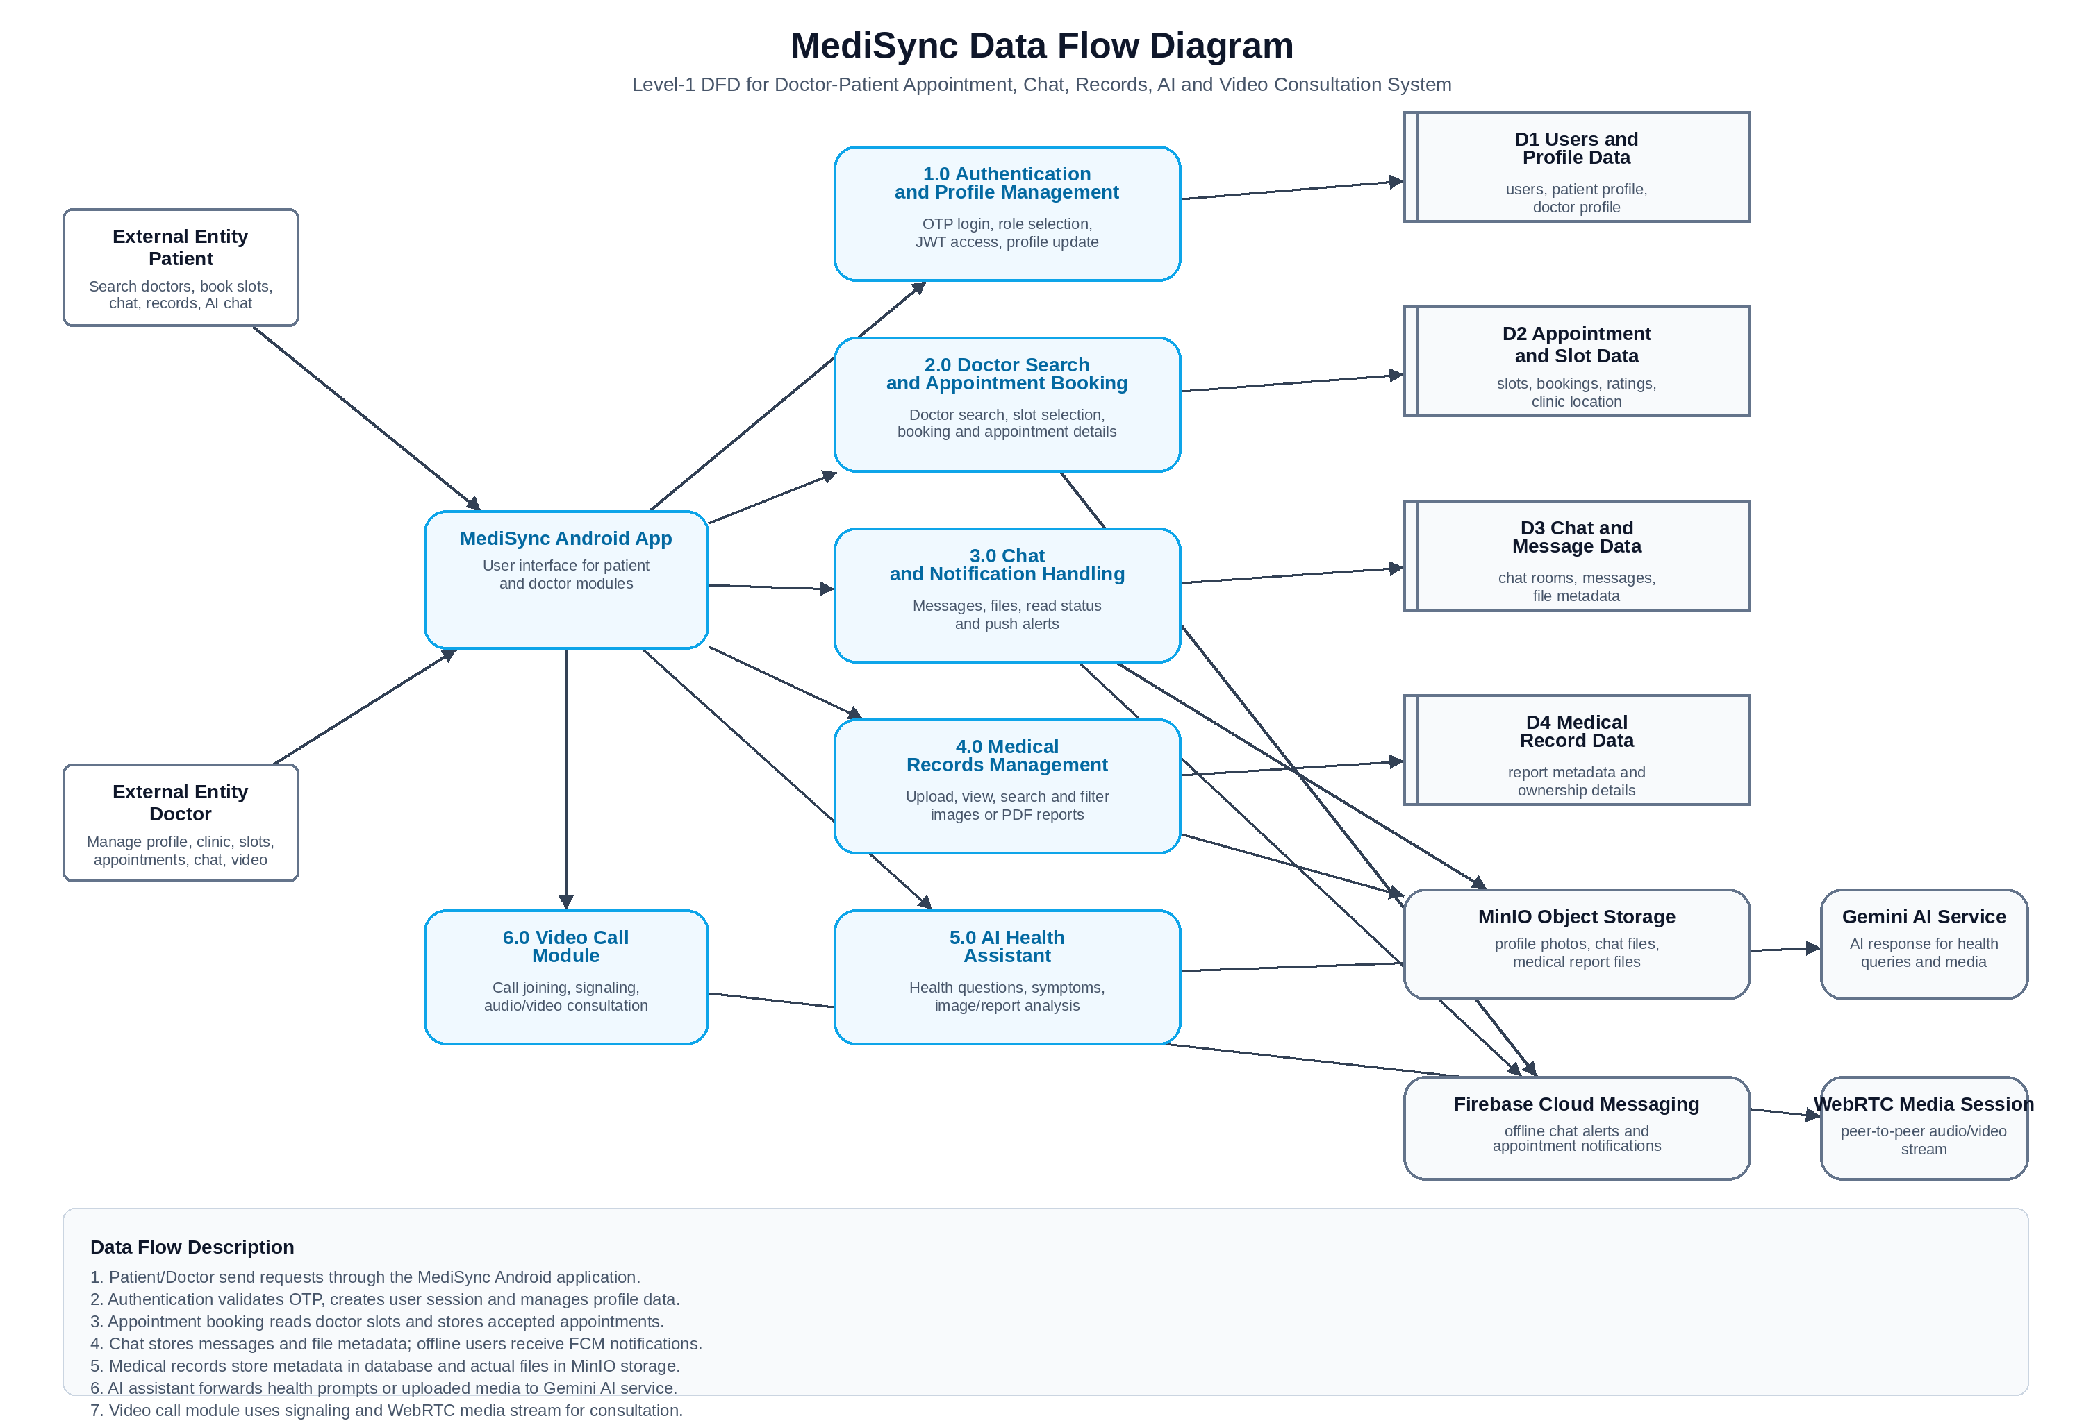
Data Flow Diagram
Flow of data between actors, app, backend, and storage
MediSync | Software Engineering Presentation
15

Slide 16
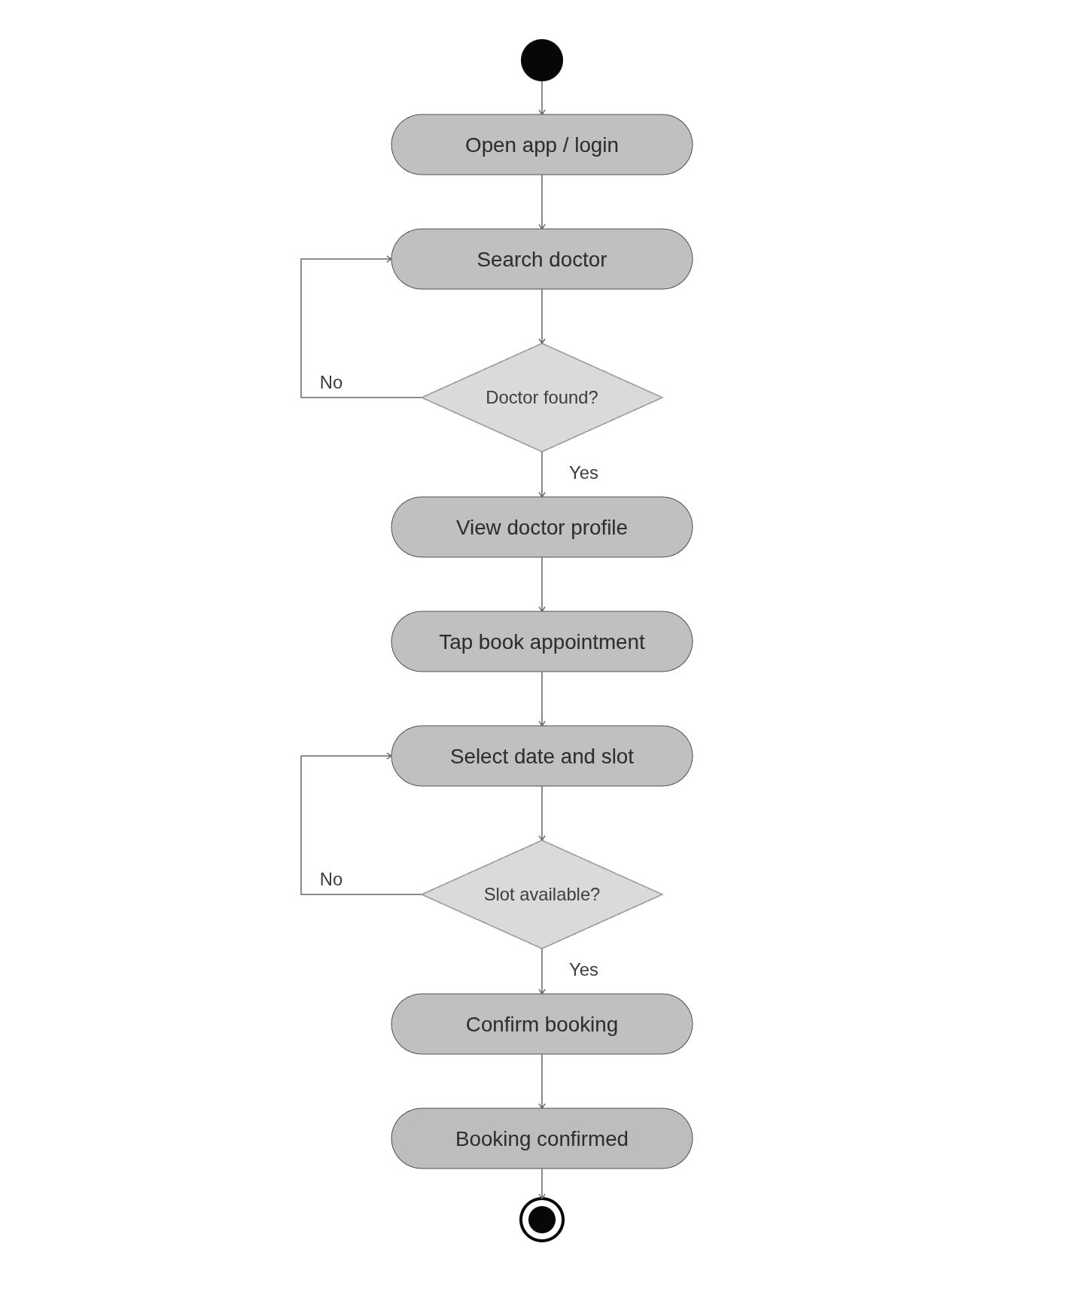
State / Activity Model
Main booking and consultation states
• User authenticates and enters role-specific workspace.
• Patient searches doctor and selects available slot.
• Slot moves from available to booked after transaction succeeds.
• Appointment details, chat, records, and video call become accessible.
• Consultation can end with completed status, rating, and follow-up record sharing.
MediSync | Software Engineering Presentation
16

Slide 17
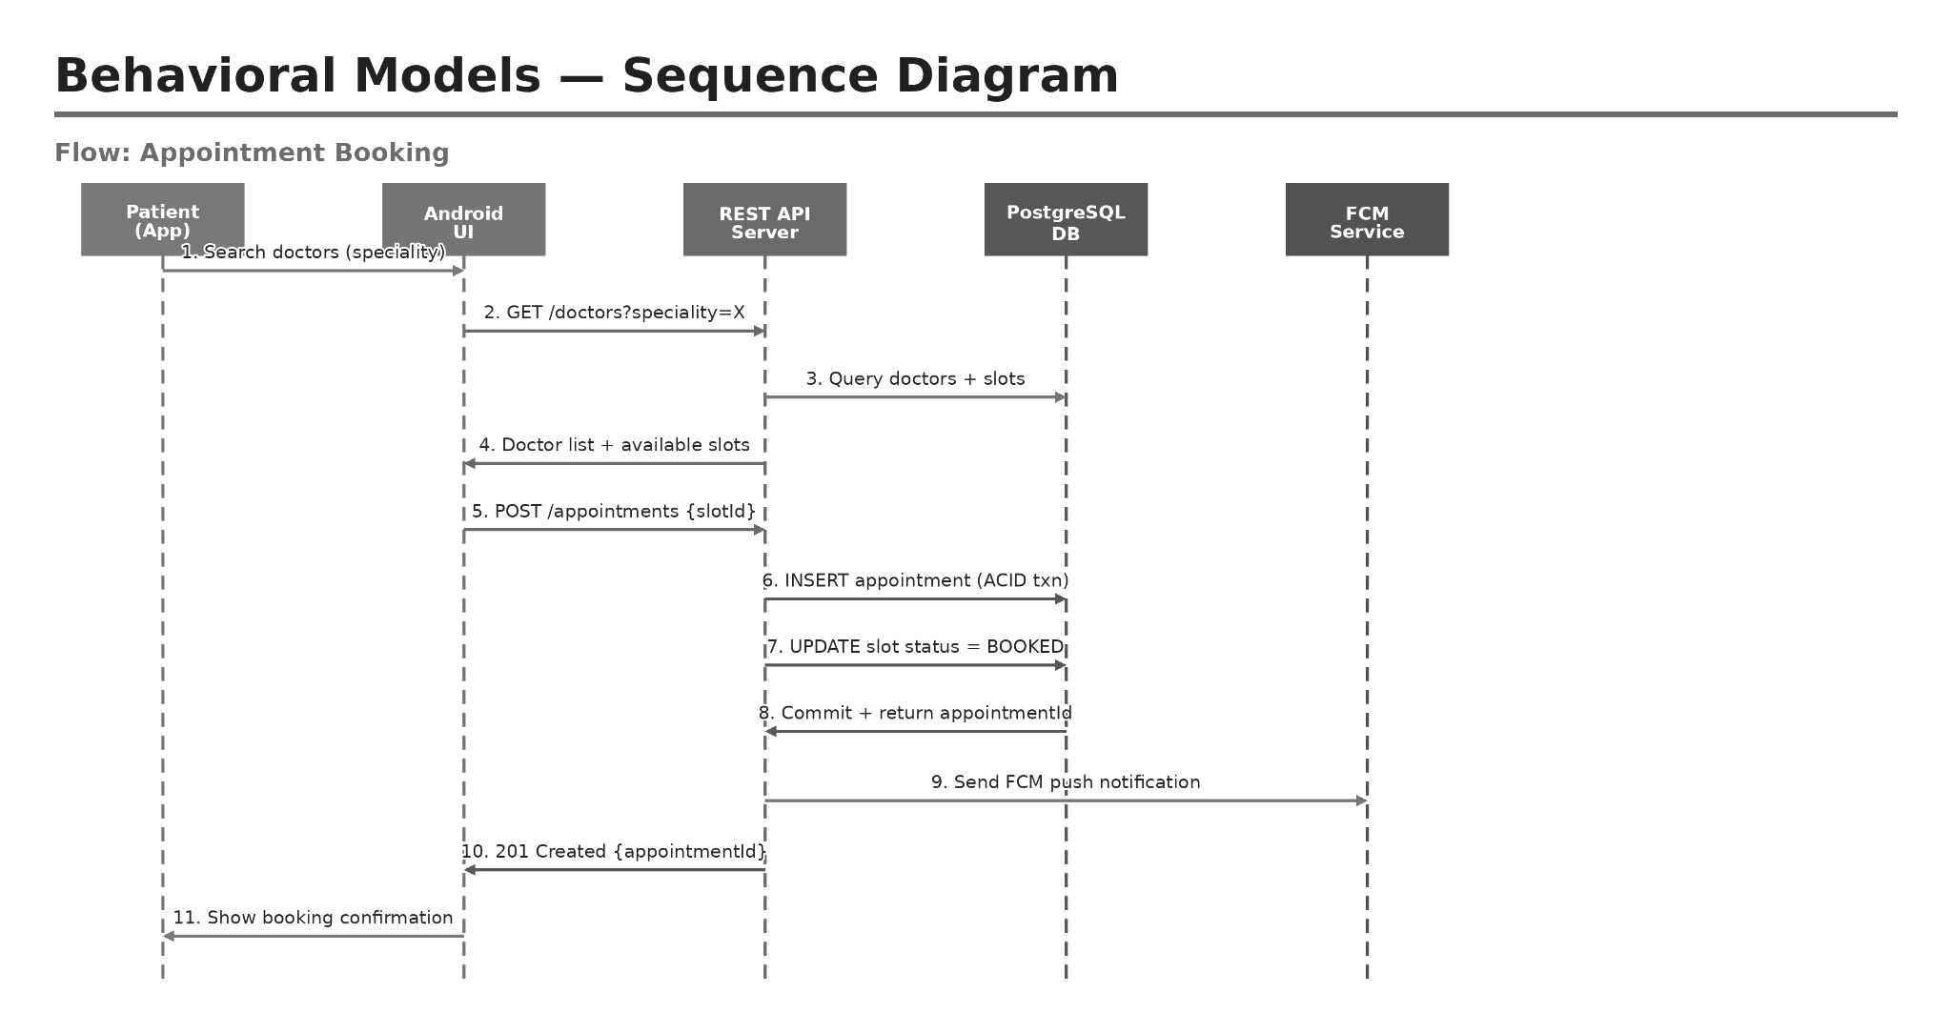
Sequence Diagram
Typical interaction flow
MediSync | Software Engineering Presentation
17

Slide 18
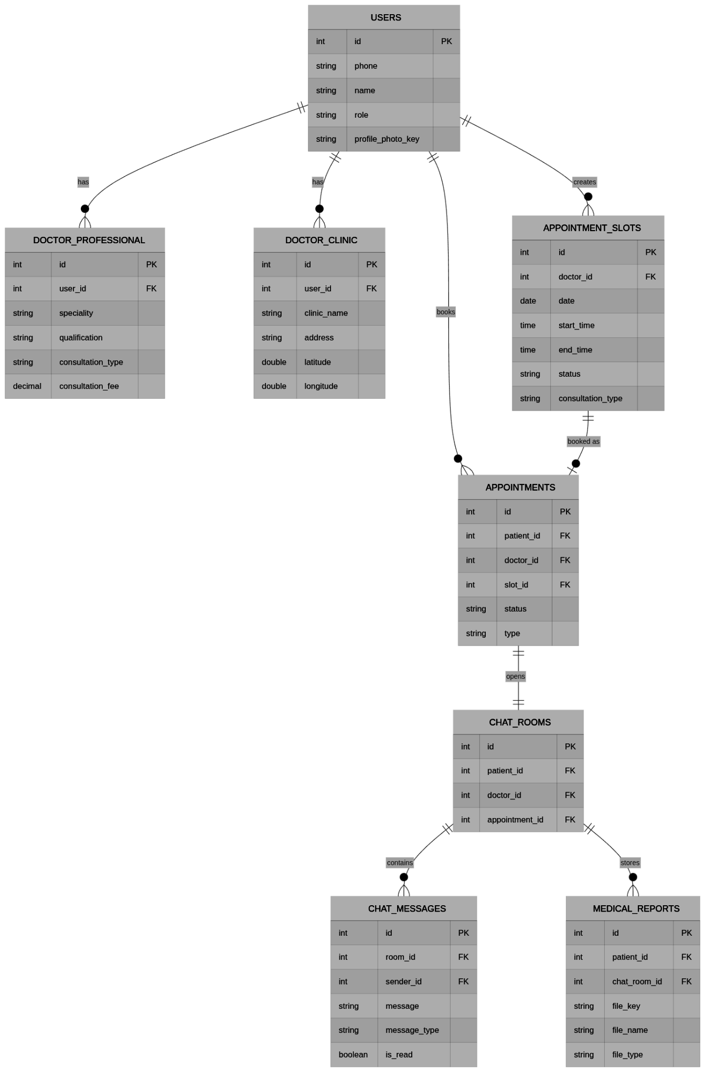
ER / Structural Model
Database structure used in MediSync
• users is the central entity for patient and doctor roles.
• Profile tables extend user data separately for patient and doctor details.
• appointment_slots and appointments manage booking lifecycle.
• chat_rooms and chat_messages support doctor-patient communication.
• medical_reports and doctor_ratings store reports and feedback.
MediSync | Software Engineering Presentation
18

Slide 19
Detailed Design: API and Services
Backend responsibilities
Authentication
Doctor & Patient
• POST /auth/send-otp
• POST /auth/verify-otp
• JWT middleware for protected routes
• Profile fetch/update APIs
• Doctor search and details
• Clinic location update
Appointments
Communication
• Get available dates/slots
• Book appointment
• Patient/doctor appointment lists
• Chat rooms/messages
• File view URLs
• Video WebSocket signalling
• FCM notifications
MediSync | Software Engineering Presentation
19

Slide 20
Database and Storage Design
Structured data, files, and real-time support
PostgreSQL
MinIO
Redis & FCM
• Users and roles
• Profiles
• Slots and appointments
• Chat metadata
• Reports and ratings
• Profile photos
• Medical report files
• Chat image/PDF files
• Object keys stored in DB
• Public/private bucket policies
• WebSocket coordination
• Pub-sub support
• Offline notifications
• Device token table
• Doctor/patient alerts
MediSync | Software Engineering Presentation
20

Slide 21
Testing Strategy
How the application was validated
Testing focused on scenario-based validation because MediSync has many user-driven workflows such as login, booking, chat, record upload, map selection, and video call handling.
+
Functional Testing
+
Integration Testing
Validated every major feature against expected user flows.
Checked Android app, backend APIs, PostgreSQL, MinIO, Redis, and FCM together.
+
Negative Testing
+
UI Testing
Tested invalid OTP, no network, booked slots, missing profile fields, and offline cases.
Checked layout consistency, navigation, filters, lists, and screen responsiveness.
MediSync | Software Engineering Presentation
21

Slide 22
Sample Scenario-Based Test Cases
Representative test coverage
TC ID | Module | Scenario | Expected Result | Status
TC-01 | Auth | Login with valid phone number and OTP. | User reaches correct role-based home screen. | Pass
TC-02 | Booking | Select available slot and confirm booking. | Appointment created and slot becomes booked. | Pass
TC-03 | Booking | Try booking an already booked slot. | Slot remains unavailable and duplicate booking is prevented. | Pass
TC-04 | Chat | Send message/file while receiver is offline. | Message stored and notification is sent when token exists. | Pass
TC-05 | Records | Open medical records without network after cache exists. | Previously cached record list remains visible. | Pass
TC-06 | Video | Start video call from chat and join same room. | Local/remote video streams appear and controls work. | Pass
MediSync | Software Engineering Presentation
22

Slide 23
LOC Estimation
Lines of Code estimation using SE course formula
Formula: S = (Sopt + 4 × Sm + Spess) / 6
Module | Component | Optimistic | Most Likely | Pessimistic | Estimated LOC
Android App | Auth + Onboarding | 600 | 800 | 1100 | 817
Android App | Patient Module | 900 | 1300 | 1700 | 1300
Android App | Doctor Module | 700 | 1000 | 1400 | 1017
Android App | Chat + Video UI | 800 | 1200 | 1600 | 1200
Android App | AI Chat + Records UI | 600 | 900 | 1200 | 900
Android App | Shared Components | 500 | 700 | 1000 | 717
Server | Auth + Middleware | 300 | 450 | 600 | 458
Server | Doctor/Patient/Slot APIs | 500 | 750 | 1000 | 758
Server | Appointments Logic | 400 | 600 | 800 | 600
Server | Chat WS + Video Signaling | 350 | 500 | 700 | 508
Server | Records, AI, Ratings | 300 | 450 | 600 | 458
Server | Cron + Config + Utils | 200 | 300 | 400 | 300
Android App: ~5,951 LOC
Server: ~3,082 LOC
Total: ~9,833 LOC
MediSync | Software Engineering Presentation
23

Slide 24
Cost Estimation — COCOMO Model
Using LOC method and Basic COCOMO Organic Mode
LOC Method
Basic COCOMO - Organic Mode
• Total LOC: S = (7500 + 4×10000 + 13000) / 6 ≈ 10,083 LOC ≈ 10 KLOC
• Cost per LOC = Labour rate / OAP = ₹80,000 / 620 LOC/month ≈ ₹129 per LOC
• Total project cost = 10,000 × ₹129 = ₹12,90,000 (~$15,500)
• Estimated effort = 10,000 / 620 ≈ 16.1 person-months
• Infrastructure cost ≈ ₹1,000/month using VPS-hosted PostgreSQL, Redis and MinIO
Parameter | Formula / Value | MediSync Result
Size | S = 10 KLOC | ~9,833 LOC
Effort | E = 2.4 × KLOC^1.05 | ≈ 27.2 PM
Dev. Time | T = 2.5 × E^0.38 | ≈ 8.1 months
Team Size | N = E / T | ≈ 3–4 developers
Reference: Pressman SE, Chapter 26 Empirical Estimation Models, as covered in Unit 4 SE course notes.
MediSync | Software Engineering Presentation
24

Slide 25
Project Scheduling — Gantt Chart
17-week implementation timeline
Task
W1
W2
W3
W4
W5
W6
W7
W8
W9
W10
W11
W12
W13
W14
W15
W16
W17
Requirements Elicitation
System Design & Architecture
Sprint 1: Auth + DB Schema
Sprint 2: Booking + Slots + FCM
Sprint 3: Chat + Video + AI
Sprint 4: Records + Ratings
Testing & Bug Fixes
Deployment & Documentation
M1: Design Complete
M2: MVP Release
M3: Feature Complete
M4: Final Deployment
MediSync | Software Engineering Presentation
25

Slide 26
Risk Analysis
Important risks and mitigations
+
Network Failure
+
Double Booking
Cache records and keep UI from clearing existing data when refresh fails.
Use database transactions and slot status checks before appointment creation.
+
File Access Issues
+
Notification Failure
Use MinIO bucket policies and backend-generated view URLs correctly.
Store FCM tokens and handle missing/expired tokens without crashing.
+
Video Call Instability
+
Data Privacy
Use WebRTC signalling and controlled room joining behaviour.
Protect APIs with JWT and keep only required medical/file metadata in the database.
MediSync | Software Engineering Presentation
24

Slide 27
Results and Achievements
What the project delivers
• A working Android healthcare application with separate patient and doctor workflows.
• End-to-end appointment booking from doctor slot creation to patient appointment details.
• Real-time chat, file sharing, medical records, and notification support.
• Clinic location selection and map display for offline consultations.
• AI assistant screen for health questions and report/image analysis support.
• Backend deployment with PostgreSQL, Redis, MinIO, WebSockets, and PM2 process management.
MediSync | Software Engineering Presentation
25

Slide 28
Conclusion and Future Scope
Final summary and possible improvements
Conclusion
Future Scope
MediSync successfully demonstrates how a mobile healthcare platform can combine appointment management, doctor-patient communication, medical record storage, and AI assistance in a single workflow. The project applies software engineering principles through modular design, layered architecture, scenario-based testing, and deployment-ready backend services.
• Payment gateway integration
• E-prescription support
• Advanced analytics for doctors
• Improved video call PiP behaviour
• Hospital/clinic admin dashboard
• More secure AI workflow through backend proxy
MediSync | Software Engineering Presentation
26

Slide 29
LOC Estimation
Lines of Code estimation using SE course formula
Formula: S = (Sopt + 4 × Sm + Spess) / 6
Module | Component | Optimistic | Most Likely | Pessimistic | Estimated LOC
Android App | Auth + Onboarding | 600 | 800 | 1100 | 817
Android App | Patient Module | 900 | 1300 | 1700 | 1300
Android App | Doctor Module | 700 | 1000 | 1400 | 1017
Android App | Chat + Video UI | 800 | 1200 | 1600 | 1200
Android App | AI Chat + Records UI | 600 | 900 | 1200 | 900
Android App | Shared Components | 500 | 700 | 1000 | 717
Server | Auth + Middleware | 300 | 450 | 600 | 458
Server | Doctor/Patient/Slot APIs | 500 | 750 | 1000 | 758
Server | Appointments Logic | 400 | 600 | 800 | 600
Server | Chat WS + Video Signaling | 350 | 500 | 700 | 508
Server | Records, AI, Ratings | 300 | 450 | 600 | 458
Server | Cron + Config + Utils | 200 | 300 | 400 | 300
Android App: ~5,951 LOC
Server: ~3,082 LOC
Total: ~9,833 LOC
MediSync | Software Engineering Presentation
23

