Slide 1
+
MediSync
Doctor-Patient Appointment and Healthcare Management System
A full-stack Android healthcare platform for patient appointment booking, doctor slot management, real-time chat, video consultation, medical record storage and AI-based health assistance.
Team Members
Name | USN
Navneet Kumar Dubey | 1BF24CS194
Babu Ld | 1BM25CS423
MediSync | Software Engineering Presentation
1

Slide 2
Project Overview & Technology Stack
What the app does and the major technologies used
Layer | Technology | Purpose
Mobile | Kotlin + Jetpack Compose | Android UI
Backend | Node.js + Express + TypeScript | REST APIs and logic
Database | PostgreSQL | Structured data
Realtime | WebSocket | Chat and signaling
Video | WebRTC | Audio/video call
Storage | MinIO | Files and photos
Notify/AI | FCM + Gemini | Push + AI assistant
Project Overview
Patients can search doctors, view profiles, book online/offline appointments and access appointment details.
Doctors can manage profile details, clinic location, weekly templates, custom schedules and appointment workflow.
Both users can chat in real time, share files, receive notifications and join video consultations.
Medical records are stored and searchable, while AI Chat provides general health guidance and report/image discussion.
MediSync | Software Engineering Presentation
2

Slide 3
Problem Statement
Why MediSync is needed
Fragmented booking
Weak follow-up communication
Patients often do not know doctor availability before visiting, causing waiting time and repeated calls.
After appointment booking, doctor-patient communication is usually scattered across phone calls or messaging apps.
Unorganized medical records
Manual doctor scheduling
Reports and prescriptions are commonly stored as physical papers or separate files without searchable access.
Doctors need a reliable way to manage recurring and custom slots without double booking.
MediSync | Software Engineering Presentation
3

Slide 4
Objectives and Scope
Clear project boundaries for implementation
Objectives
In Scope
Build a doctor-patient appointment system with online and offline consultation support.
Provide secure OTP login and role-based patient/doctor workflows.
Enable real-time chat, file sharing, medical records and video consultation.
Support doctor slot management through weekly templates and custom schedules.
Integrate AI assistant for general health guidance and report/image discussion.
Authentication, profiles, doctor search, booking, chat, records, AI chat, maps, ratings, notifications and video call.
Out of Scope
Payment gateway, e-pharmacy, insurance claims, laboratory ordering, iOS app and full hospital ERP management.
MediSync | Software Engineering Presentation
4

Slide 5
Software Development Life Cycle
Agile iterative development model
Requirements
Design
Implementation
Testing
Deployment
Feedback
Why Agile?
Sprint Focus
Features such as booking, chat, records, video call and AI were developed in iterations.
Each iteration allowed testing with real app screens and improving UI/UX based on feedback.
Sprint 1: authentication and profiles
Sprint 2: doctor search, slots and booking
Sprint 3: chat, records and notifications
Sprint 4: AI, video call, testing and deployment
MediSync | Software Engineering Presentation
5

Slide 6
Functional Requirements
Main system services expected by users
Patient Requirements
Doctor Requirements
System Requirements
OTP login and profile creation
Search doctors by name/speciality/mode
View doctor profile and clinic map
Book appointment from available slots
Chat with doctor and share records
Use AI assistant for health guidance
Maintain personal/professional profile
Set clinic location using map
Create weekly and custom slots
View appointments and next patient
Chat with patients and receive alerts
Join video consultation
JWT-protected APIs
Prevent duplicate booking
Store files in MinIO
Save structured data in PostgreSQL
Send FCM notifications
Support WebSocket realtime events
MediSync | Software Engineering Presentation
6

Slide 7
Non-Functional Requirements
Quality attributes considered during design
Security
Reliability
JWT authentication for protected routes
Role-based access for patient and doctor data
Controlled object access through MinIO policies
Graceful handling of network failure
Cached records visible offline
Booking validation avoids duplicate allocation
Performance
Usability
Files stored outside database
Fast search and filter UI
Lightweight API responses for mobile screens
Clean mobile-first interface
Simple navigation through bottom bar/sidebar
Readable cards, maps and appointment details
MediSync | Software Engineering Presentation
7

Slide 8
Major System Modules
How the system is divided
Auth & Profile
Doctor Search
Appointments
Doctor Slots
OTP login, JWT, role and personal profile
Speciality filters, doctor profile and ratings
Slot picker, booking and appointment detail
Weekly templates and custom schedules
Chat & FCM
Medical Records
AI Chat
Video Call
Realtime messages and offline notifications
Upload, search, image/PDF filters and cache
Health query and report/image analysis
WebRTC consultation and signaling
MediSync | Software Engineering Presentation
8

Slide 9
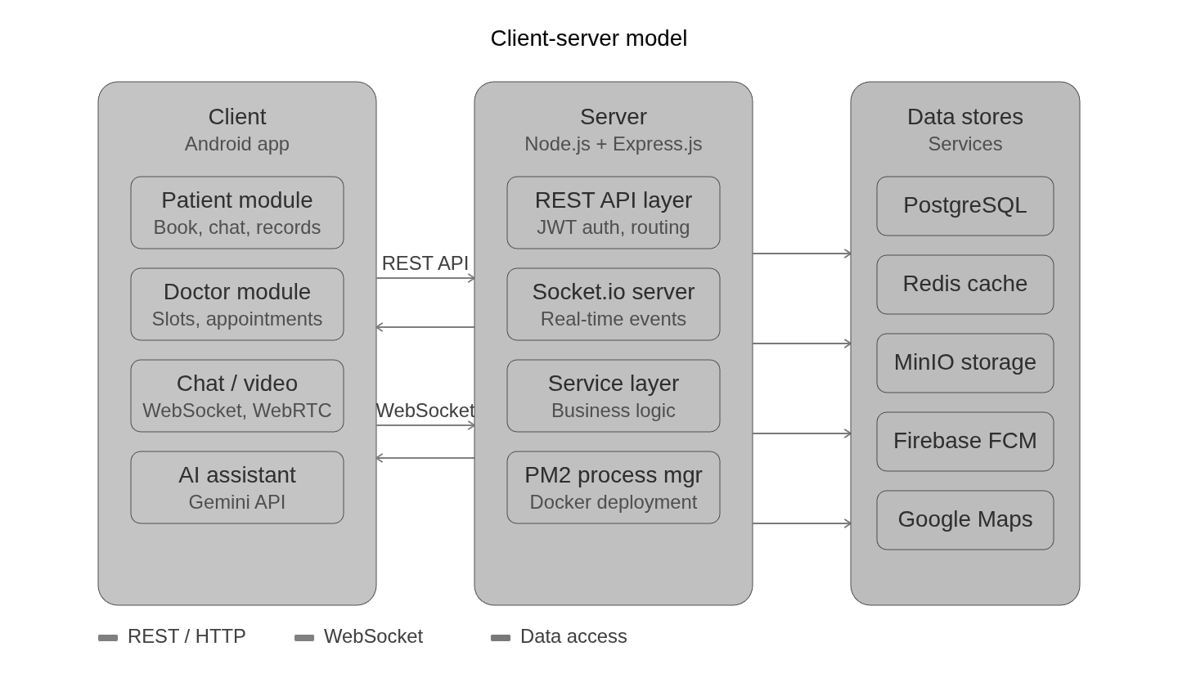
System Architecture
Client-server architecture with external services
MediSync | Software Engineering Presentation
9

Slide 10
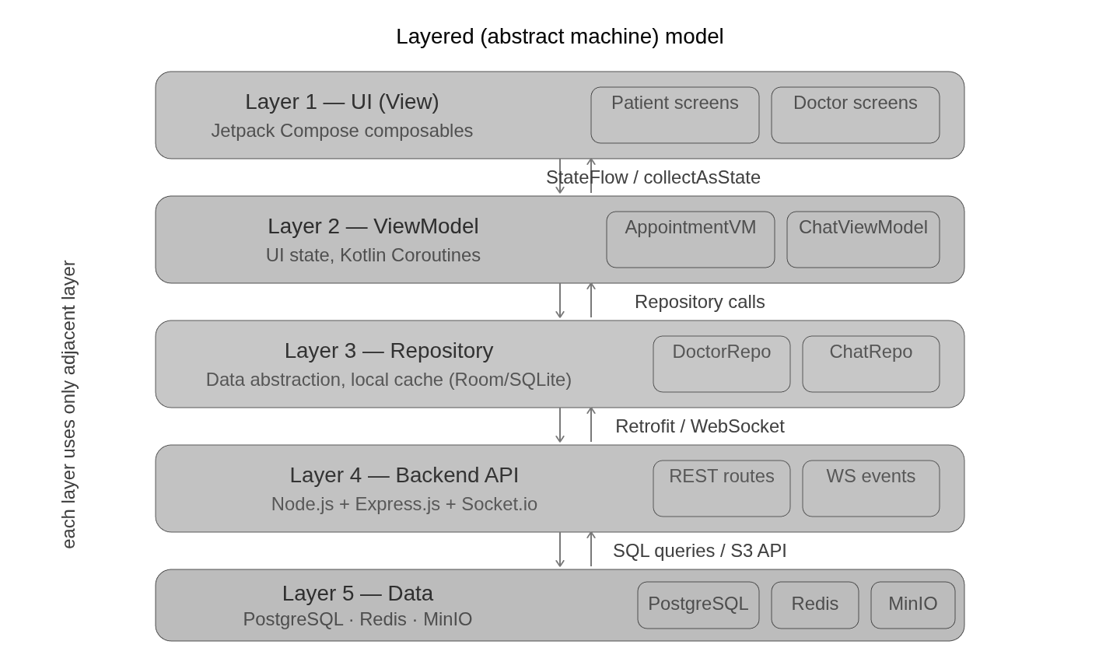
Architectural Model
Layered model used for clean separation of responsibilities
Layer Responsibilities
UI layer handles Compose screens and navigation.
ViewModel layer maintains screen state and triggers repository calls.
Repository layer coordinates API, local cache and domain data.
Backend layer handles REST, WebSocket and business logic.
Data layer contains PostgreSQL, Redis and MinIO storage.
MediSync | Software Engineering Presentation
10

Slide 11
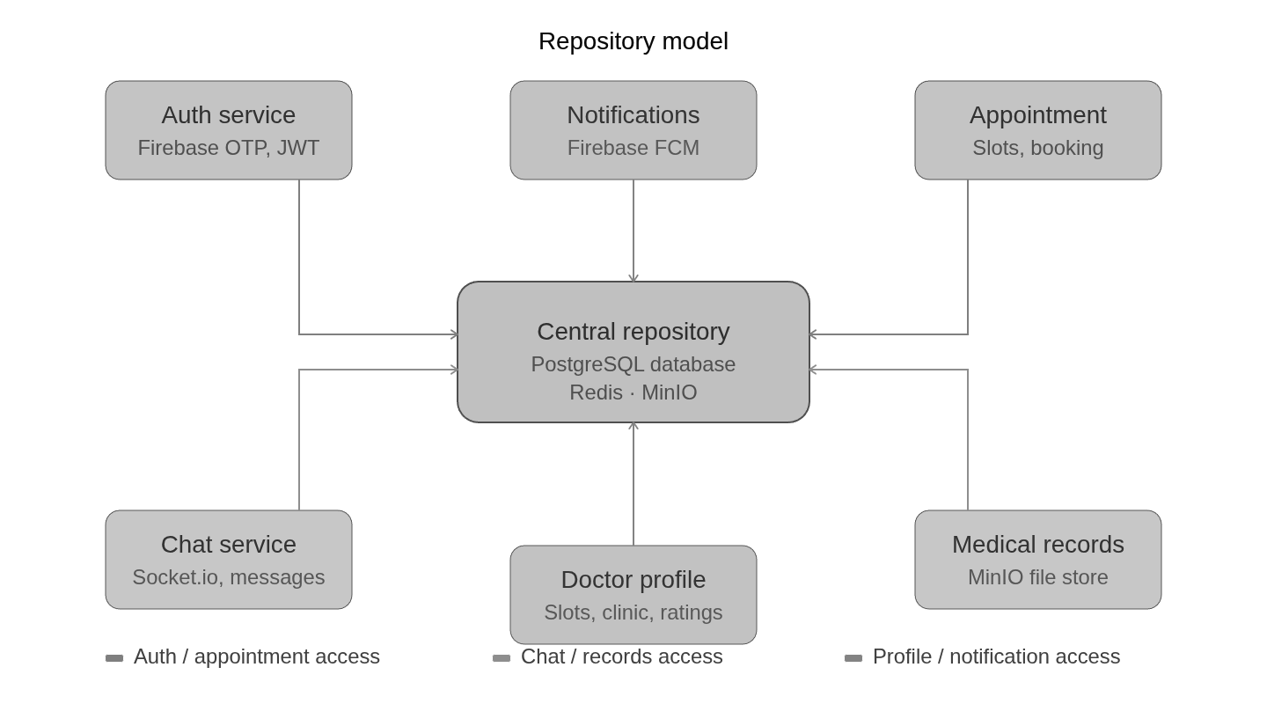
Repository Model
How data access is organized
Why Repository Pattern?
Keeps ViewModels independent from direct API/database details.
Allows offline cache and remote API data to be handled in one place.
Makes features such as records, chat, appointments and profiles easier to test and maintain.
MediSync | Software Engineering Presentation
11

Slide 12
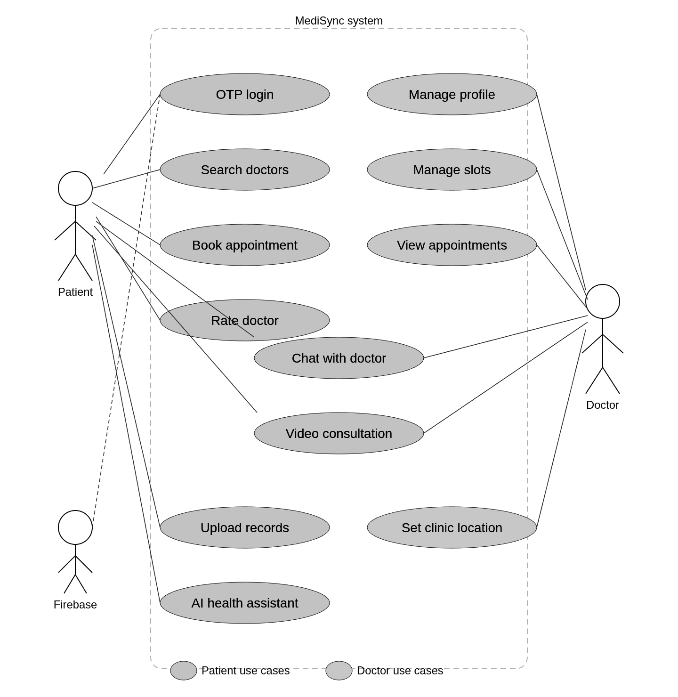
Use Case Diagram
Main interactions of Patient, Doctor and System
MediSync | Software Engineering Presentation
12

Slide 13
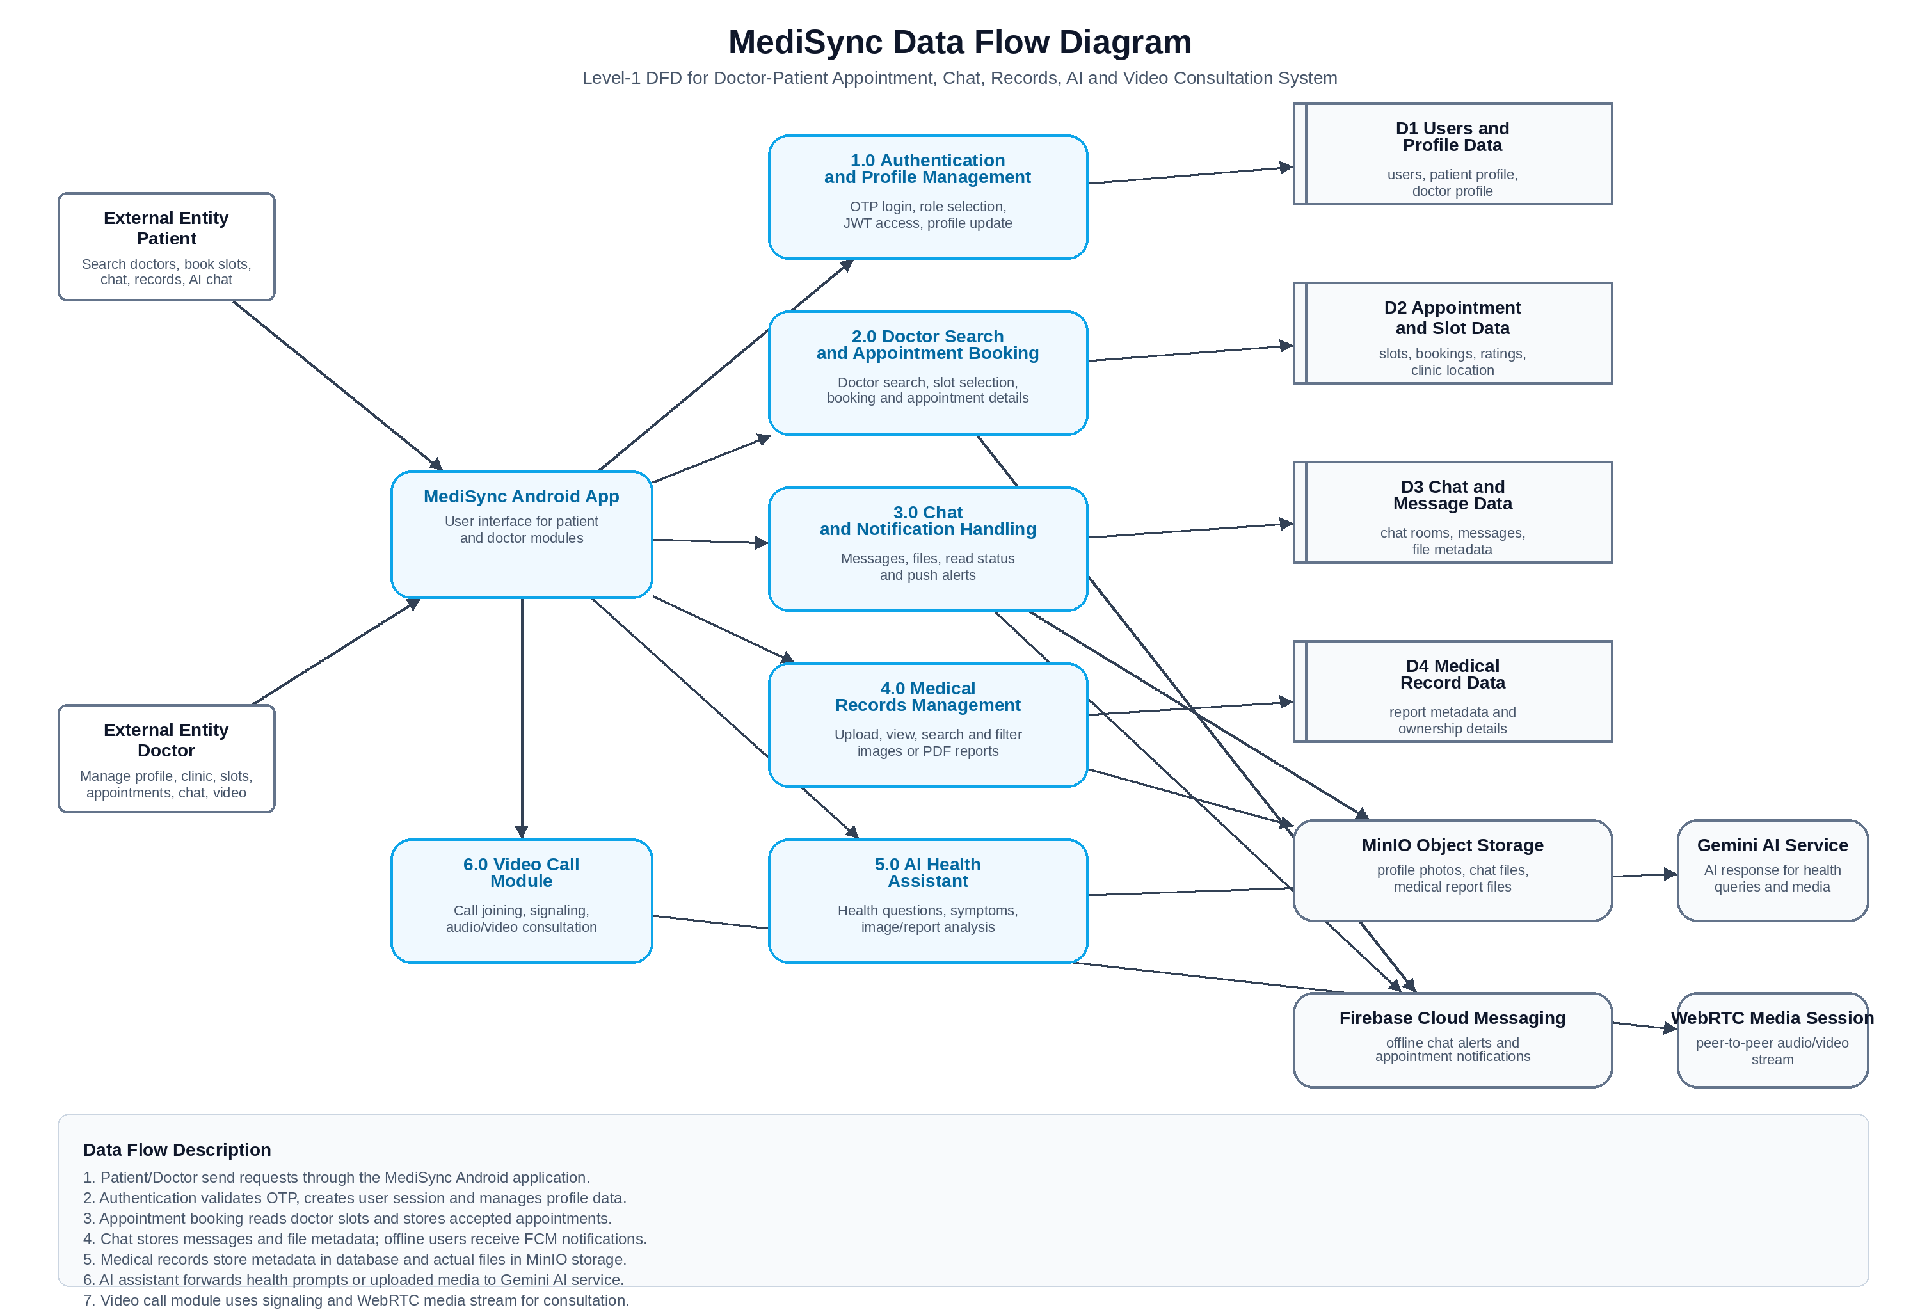
Data Flow Diagram
Data movement between users, app, backend, stores and services
MediSync | Software Engineering Presentation
13

Slide 14
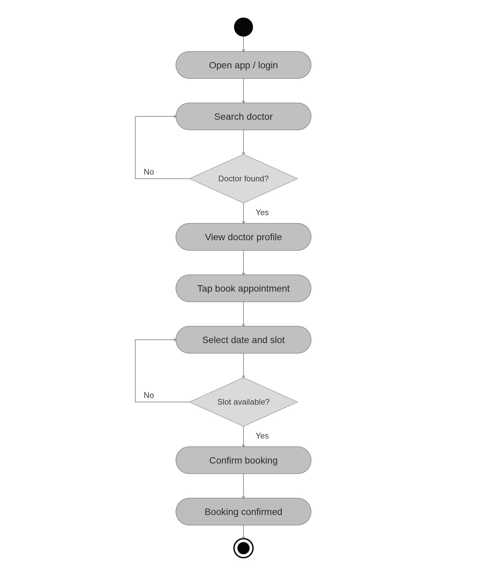
State Model
Appointment booking and consultation state transitions
State Flow Explanation
User searches doctor and selects an available slot.
System validates slot availability before creating appointment.
Booked appointment becomes accepted and can lead to chat or video consultation.
After consultation, the appointment can be completed and rated.
Invalid or unavailable slot selection returns to slot selection state.
MediSync | Software Engineering Presentation
14

Slide 15
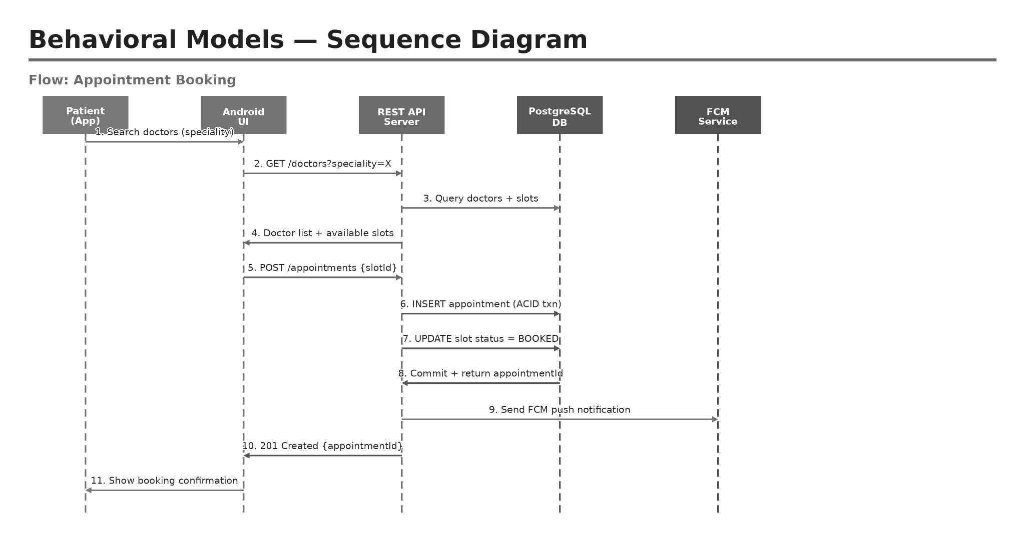
Sequence Diagram
Appointment booking request-response flow
MediSync | Software Engineering Presentation
15

Slide 16
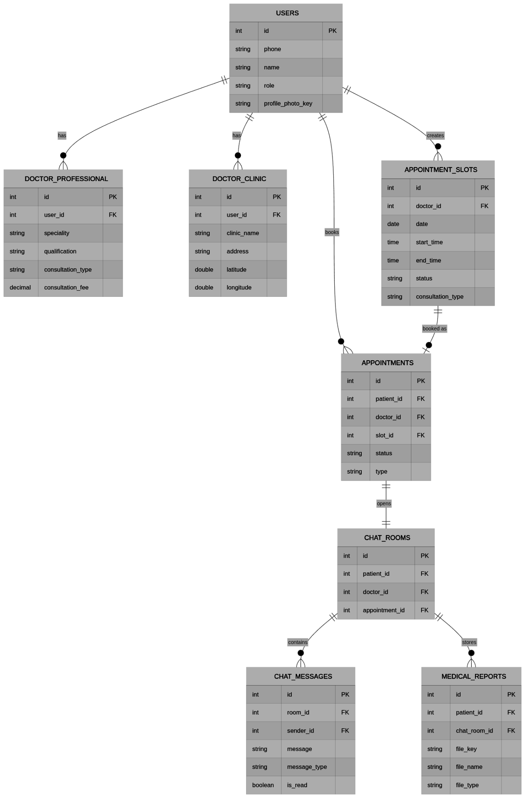
Structural Design
Database entities and class-level relationships
Core Entities
users stores shared account details for patient and doctor roles.
doctor_professional and doctor_clinic extend doctor-specific information.
appointment_slots and appointments manage the booking lifecycle.
chat_rooms and chat_messages store real-time conversation metadata.
medical_reports stores uploaded report metadata; file bytes are kept in MinIO.
MediSync | Software Engineering Presentation
16

Slide 17
Implementation Highlights
Important development decisions
Backend API
Realtime Layer
Express routes grouped by auth, doctor, patient, appointments, chat, records and ratings
Middleware verifies JWT and protects role-based resources
WebSocket handles chat room joining and message delivery
Video WebSocket handles call signaling events
Storage Layer
Mobile Layer
PostgreSQL stores structured data
MinIO stores profile photos, chat files and medical reports
Jetpack Compose screens with ViewModel state
SQLite/Room cache used for offline-friendly records and profile data
MediSync | Software Engineering Presentation
17

Slide 18
Security and Reliability Design
How the system avoids common failures
Security
Reliability
OTP based mobile authentication reduces fake user creation.
JWT token is required for protected API routes.
Patient and doctor data is separated through role-aware APIs.
MinIO bucket policy and object keys control file visibility.
Firebase service account is used by backend for push notifications.
Appointment booking uses backend validation to avoid double booking.
Records and chat files are cached locally after download.
If refresh fails due to network issue, old cached records remain visible.
Notifications are attempted only when recipient is offline or not connected.
PM2 keeps backend process running on deployed server.
MediSync | Software Engineering Presentation
18

Slide 19
Testing Strategy
Verification performed module-wise
Unit Testing
Integration Testing
Scenario Testing
ViewModel logic
Repository methods
API controller logic
Utility functions
Auth with database
Appointment booking with slots
Chat WebSocket flow
Records upload and MinIO URLs
Network failure handling
Already booked slot selection
Offline notification flow
Video call join/leave conditions
MediSync | Software Engineering Presentation
19

Slide 20
Scenario-Based Test Cases
Important scenarios tested
Authentication
Patient Module
Valid OTP, invalid OTP, resend OTP, new user role selection
Doctor search by name/speciality, doctor profile, appointment booking
Appointment Module
Chat & Notification
Available slot booking, already booked slot, online/offline filter, details screen
Text message, file share, read status, offline FCM notification
Records & AI
Doctor Module
Upload image/PDF, search/filter records, ask health question, image/report analysis
Weekly/custom slot creation, clinic map save, dashboard appointment list
Video Call
General
Join call, mute/unmute, remote user wait state, call end behavior
Missing profile data, network failure, app navigation and cache fallback
MediSync | Software Engineering Presentation
20

Slide 21
Estimation: LOC and COCOMO
Software Engineering estimation from course model
LOC Estimation
COCOMO Basic Model
Formula used: S = (Sopt + 4Sm + Spess) / 6.
Estimated size: approximately 10 KLOC.
Used to calculate productivity, effort and approximate project cost.
Useful for understanding development effort across mobile, backend and database modules.
Project considered under organic mode for academic-level team development.
Effort and duration are estimated using KLOC-based empirical formula.
Cost estimation is presented as an engineering approximation, not actual commercial billing.
Supports planning, scheduling and resource justification.
MediSync | Software Engineering Presentation
21

Slide 22
Schedule and Risk Analysis
Planning and RMMM considerations
Project Schedule
Key Risks and Mitigation
Week 1: requirement gathering and UI planning.
Week 2: authentication, profile and search modules.
Week 3: appointment slots, booking and doctor workflow.
Week 4: chat, records, notifications and storage.
Week 5: AI chat, video call, testing and deployment.
Network failure: local cache and error-safe UI.
Double booking: backend slot validation.
File access issue: MinIO bucket policy and public/view URL handling.
Notification token mismatch: token refresh and cleanup.
Video call instability: WebSocket signaling and WebRTC state checks.
MediSync | Software Engineering Presentation
22

Slide 23
Project Results
Implemented and demonstrated features
Patient Experience
Doctor Experience
Search doctor, book appointments, chat, records, AI support and video consultation.
Manage slots, clinic location, appointments and patient communication.
Backend Services
Report Artifacts
REST APIs, WebSocket events, PostgreSQL, Redis, MinIO, FCM and deployment with PM2.
Use case, DFD, state model, sequence diagram, ER/class design, test cases and estimation.
MediSync | Software Engineering Presentation
23

Slide 24
Conclusion and Future Scope
Final outcome and possible extensions
Conclusion
Future Enhancements
MediSync successfully integrates patient booking, doctor slot management, medical records, chat, notifications, AI assistance and video consultation in one Android system.
The project applies software engineering concepts such as requirement analysis, modular design, architectural modelling, DFD, state model, testing, estimation and risk analysis.
Online payment and invoice generation.
E-prescription and medicine recommendation workflow.
Lab report booking and hospital admin dashboard.
Multi-language support and iOS/cross-platform version.
Advanced analytics for doctors and appointment trends.
MediSync | Software Engineering Presentation
24

Slide 25
References
Sources used for SE models and technical implementation
R. S. Pressman, Software Engineering: A Practitioner’s Approach, 7th ed., McGraw-Hill.
I. Sommerville, Software Engineering, 9th ed., Pearson.
College Unit 2 notes: Requirements Engineering Process.
College Unit 3 notes: Architectural Design and Design Models.
College Unit 4 notes: Estimation, Scheduling and Risk Management.
Official documentation: Android Jetpack Compose, Node.js, PostgreSQL, MinIO, Firebase, WebRTC and Gemini API.
MediSync | Software Engineering Presentation
25

